Slide 1
Shielding Experiments at High Energy Accelerators of Fermilab (I)
Dose rate around high intensity muon beam
ISORD5 July15-17,2009 Kitakyushu, Japan
T.Sanami, on behalf of JASMIN collaboration
JASMIN collaboration
H.Nakashima¹, N.Mokhov³, D.Boehnlein³, M.Hagiwara², H.Hirayama², Y.Iwamoto¹, H.Iwase², V.Kamran³, Y.Kasugai¹, H.S.Lee⁸, A.Leveling³, F.Masukawa¹, N.Matsuda¹, H.Matsumura², T.Nakamura⁶, Y.Nakane¹, K.Oishi, Y.Sakamoto¹, T.Sanami², N.Shigyo⁴, H.Yashima⁵
¹JAEA, ²KEK, ³FNAL, ⁴Kyushu-U, ⁵Kyoto-U, ⁶Tohoku-U, ⁷Shimizu Corp, ⁸PAL

Slide 2
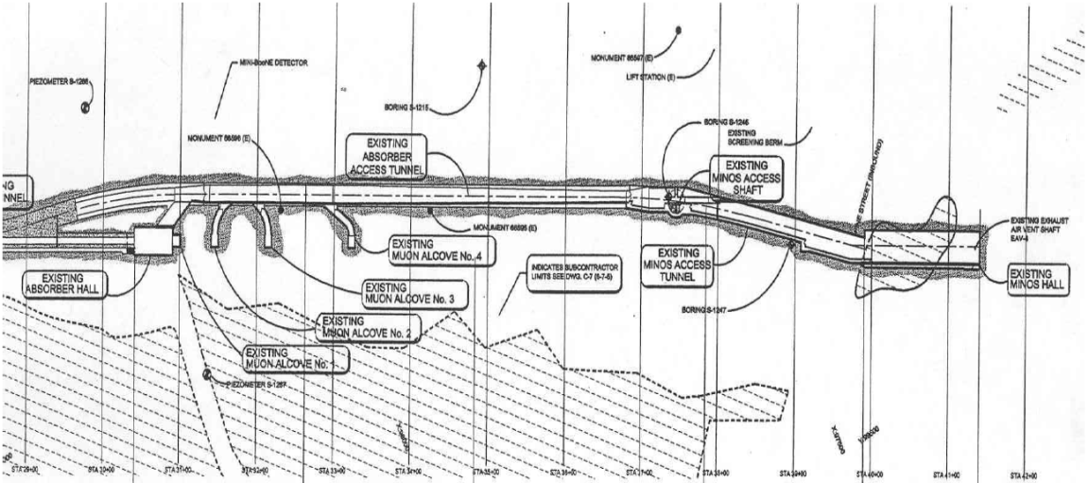
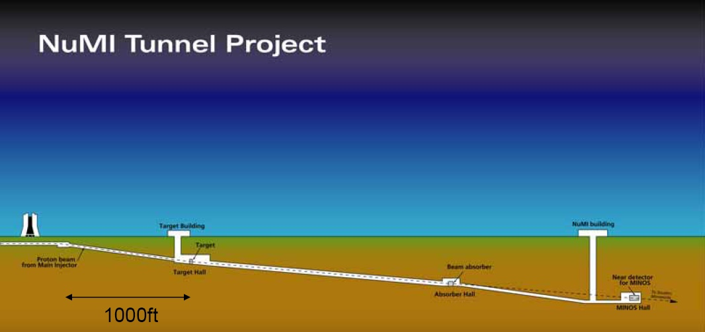
Experimental facilities - NuMI
NuMI – Neutrino from Main-Injector
Induced activities by muons
Muon transport
Muon interaction
Muon alcoves Bypass tunnel
Muon, ν beam
Target
120GeV p
Hadron absorber
Spatial distribution of muons
Decay pipe
π→μ
  Dose rate distribution around intense Muon beam (= This presentation)

Slide 3
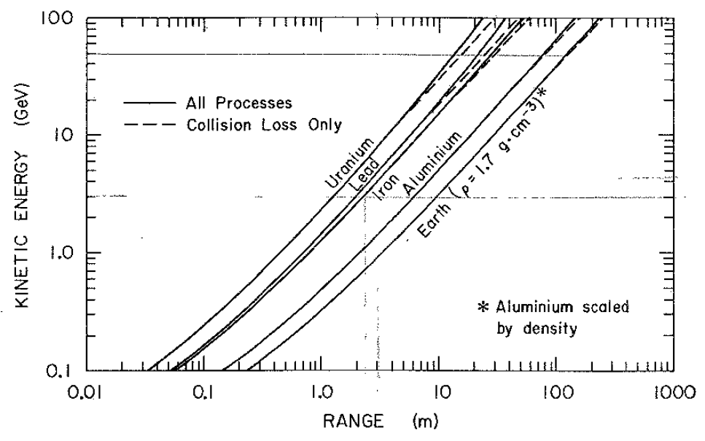
Introduction
Muon
  T1/2=2.19×10⁻⁶, mass 105.658 MeV, charged
  Cosmic –ray, Accelerators
  Application
    Non-destructive inspection
    Muon storage ring and collider
Penetrability and directionality of muons
→ more than 10 GeV accelerator, muon is important for radiation safety design
Purpose:
Distribution of muons from experiment and calculation
(1) dose rate, (2) source of dose

Slide 4
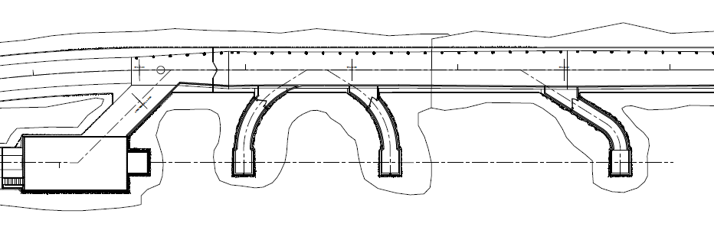
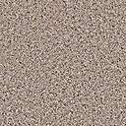
Dosimeters in NuMI Alcoves and Bypass tunnel
Muons from 120 GeV, 260 kW proton beam
  800 m long decay volume, Thick hadron absorber
  Up to 60 m thick rock
Bypass tunnel
Fermilab rock
12m
18m
30m
Alcove1
Alcove2
Alcove3
Alcove4
Hadron
Absorber
OSL/CR39/CR39(B)
TLD
IC
Muons
Other hadrons

Slide 5
Dosimeters
Various detectors, various responses
 | OSL | CR39 | CR39(B) | TLD | TLD(n) | IC
Muon | ☺ | ☻ | ☻ | ☺ | ☻ | ☺
Photon | ☺ | ☻ | ☻ | ☺ | ☻ | ☺
Thermal neutron | ☻ | ☻ | ☺ | ☻ | ☺ | ☻
Fast Neutron | ☻ | ☺ | ☻ | ☻ | ☻ | ☻
HighE neutron | ☻ | ☻ | ☻ | ☻ | ☻ | ☻

Slide 6
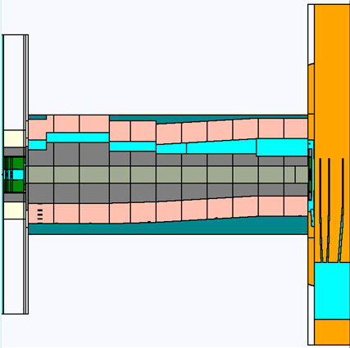
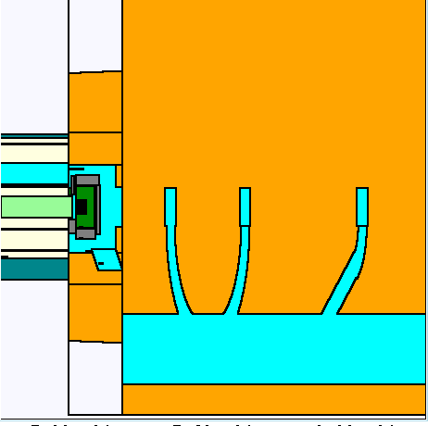
Theoretical calclulation
Target (Graphite)
120 GeV -256kW typical
Decay pipe (670m long – 2m diam.)
MARS code
Simulate interaction and transport of 120 GeV proton and secondary particles
Fermilab rock
Ca : O : C : Mg : H = 0.09 : 0.56 : 0.17 : 0.08 : 0.10
ρ=2.85 g/cm³
Absorber hall and muon alcoves

Slide 7
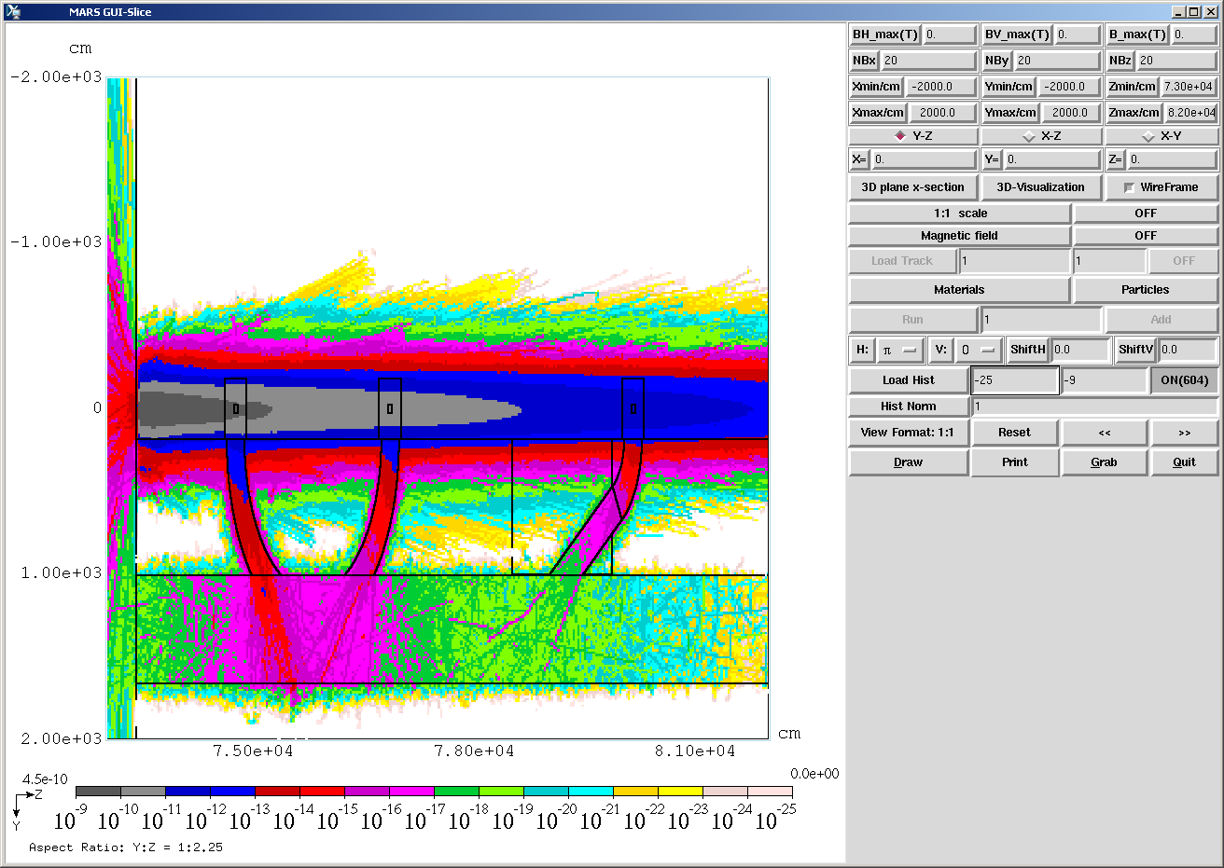
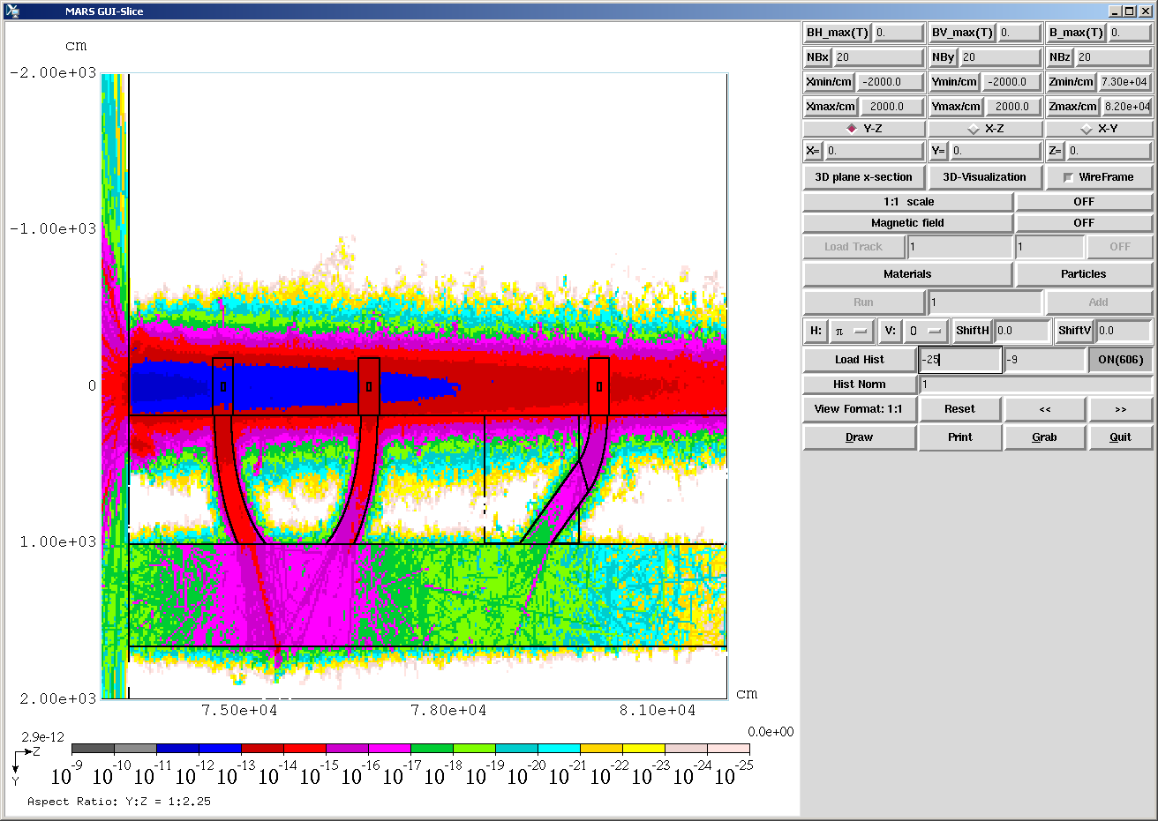
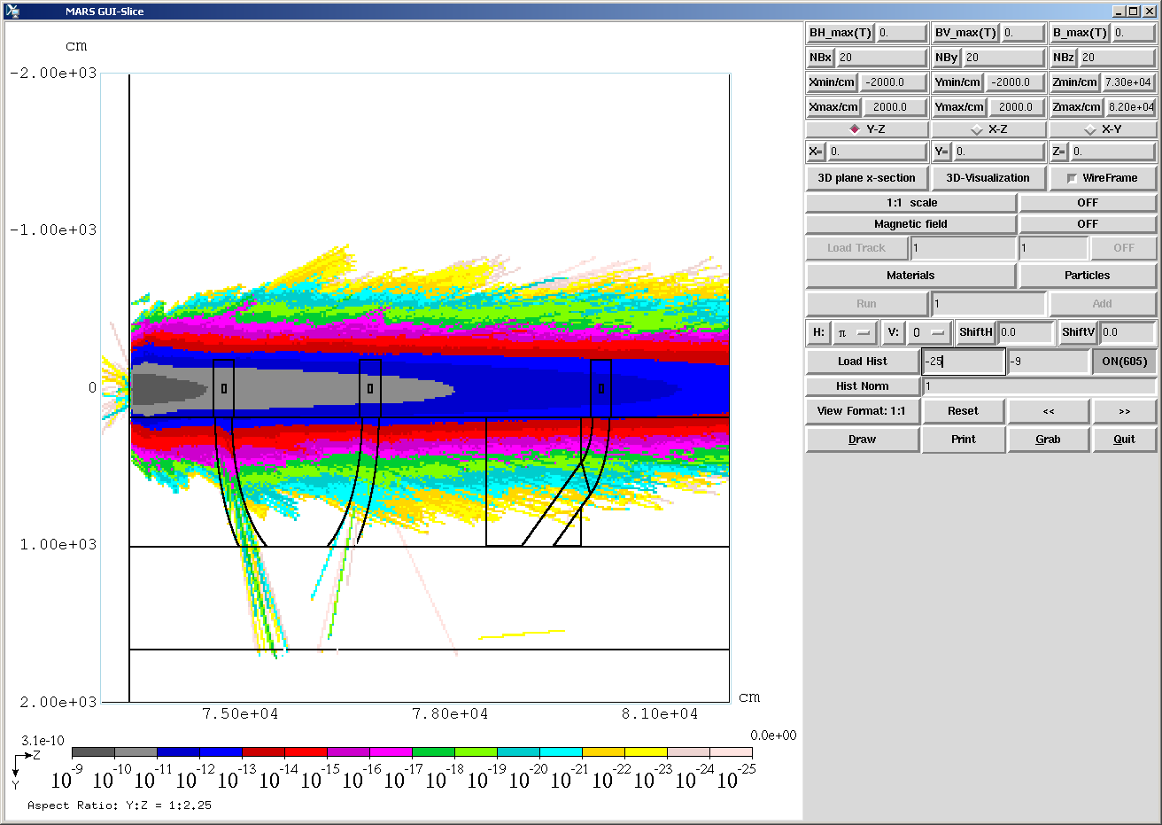
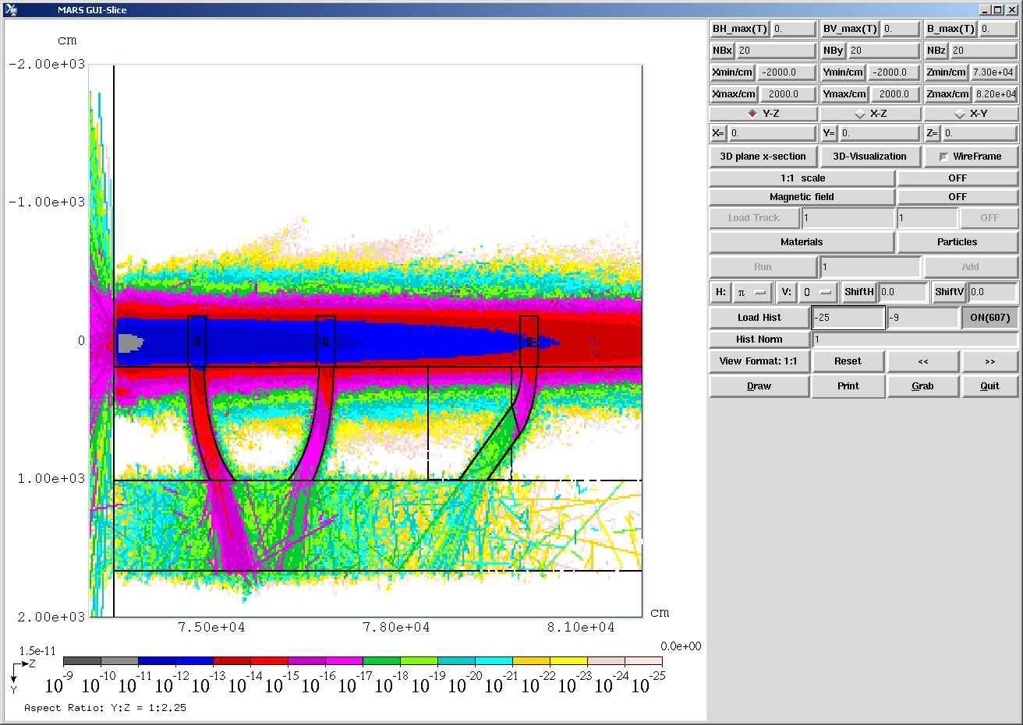
Dose distribution
Total dose
Neutron dose
Muon dose
Photon dose
mSv/hr/pps

Slide 8
Dose distribution perpendicular to beam axis
Muon dose
Alcove2
Neutron dose
DET: Total dose DEG: Photon dose
DEM:Muon dose DEN:Neutron dose

Slide 9
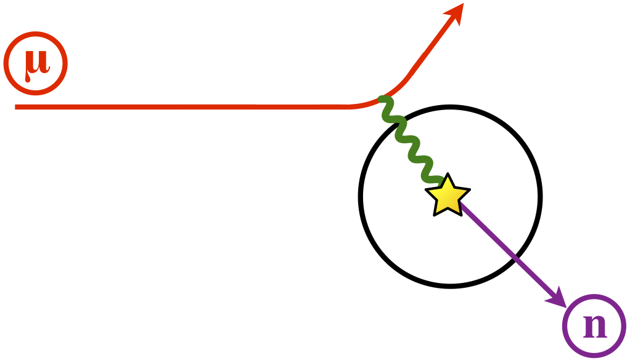
Source of electron, photon and neutron
Electro-magnetic cascade
Bremsstrahlung
Pair production
γ
e⁻
e⁺
Photo nuclear reaction

Slide 10
Dose distribution perpendicular to beam axis
Alcove3
Alcove4
Dose from muon is dominant around the beam line
Dose from electron, photon and neutron are 28%, 3% and 0.1% of total
Dose at more than 5 m from the center is from electron, neutron and photon
The calculation well describes experimental data

Slide 11
Attenuation along the beam axis
Total dose
Secondary particles (e, γ,n) are generated in the rock
  → Muon beam initiate electro-magnetic cascade
Ratio to total dose are
μ:e:γ:n = 0.68:0.28:0.03:0.01
MARS simulates muon attenuation very well

Slide 12
Conclusion
Dose rates around intense muon beam
  2D map of muon attenuation and dose distribution of secondary particles using various dosimeters
  20μSv/1e12proton at the beam line in the alcove2
  Muon initiates electro-magnetic cascade
  Ratio to total dose are μ:e:γ:n = 0.7:0.3:0.03:0.01
  Contribution from secondary particle is dominant at 5 m from the beam line
  muon attenuation and dose are simulated very well

