Slide 1
The JASMIN Collaboration
Study of nuclear reactions
induced by fast muons at NuMI
Speaker: Hiroshi MATSUMURA
(KEK, JAPAN)
MOTIVATION
Understanding of nuclear reactions induced by fast muons is important for some applications.
But, the reactions are not still known well.
We are interested in muon nuclear reactions from both science and applications.
2/16/2012

Slide 2
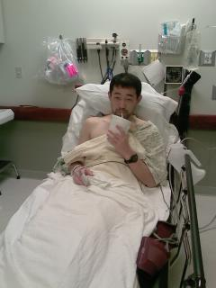

Many thanks!
One year ago, I got hernia here. Many people helped me and I escaped death. The operation went very well.
at Hospital on 12/12/2010

Slide 3
The JASMIN Collaboration
Study of nuclear reactions
induced by fast muons at NuMI
Speaker: Hiroshi MATSUMURA
(KEK, JAPAN)
MOTIVATION
Understanding of nuclear reactions induced by fast muons is important for some applications.
But, the reactions are not still known well.
We are interested in muon nuclear reactions from both science and applications.
2/16/2012

Slide 4
Long attenuation length of fast muons
Muon exposure in high intensity and high energy accelerator facilities
Production of radionuclides in environment
Study of reactions by fast muons
for Radiation management
for Application for Geosciences

Slide 5
Initial interactions in nuclear reactions
Initial interaction
in nuclear reaction
induced by a hadron
Initial interaction
in nuclear reaction
induced by a fast muon
well known
μ
not known well
Nucleon
γ
Hadron
Nucleon
Virtual photon
Nucleus
μ
Nucleus
We are interested in the effect from the difference between the initial interactions.

Slide 6
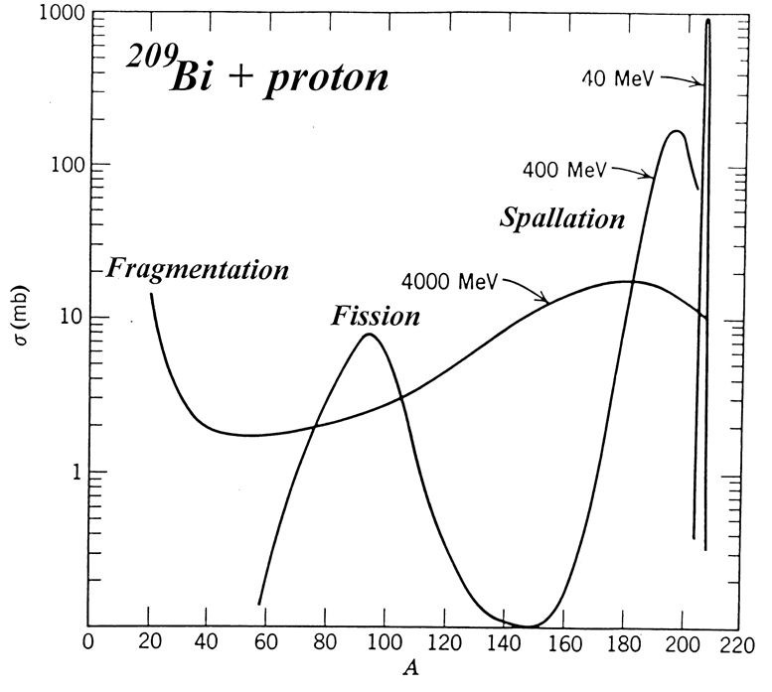
Spallation by proton bombardment
spallation
How about
muon reaction?
Cross sections (mb)
Bombardment
Cascade
Equilibrium
Product mass number
FIG. Mass distribution produced
by protons in Bi target.
Evaporation
Miller and Hudis, Ann. Rev. Nucl. Sci. 9, 159 (1959)
In this study, we experimentally investigated
nuclear reactions induced by fast muons.

Slide 7

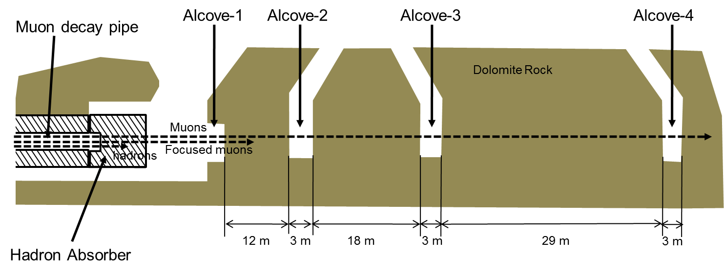
Muon beam at NuMI in fermilab
For this study, we need high intensity source of muons.
0 64 128 256 meters
NuMI in fermilab
Beam Absorber
Alcoves
Main Injector
Target Hall
π⁺ μ⁺ + ν_{μ}
MINOS Hall
Decay pipe
MINOS Detector

Slide 8
Muon beam at NuMI in fermilab
(1) High energy muons
(2) High muon flux
(3) 4 irradiation rooms
(4) Monitoring of muons
Great sensitivity for activation measurements.
Two energy-type muons are available.
Attenuation in rock is good for geosciences.
FIG. Muon energy spectra
at the alcoves calculated by MARS15.

Slide 9
Experimental procedures
Gamma-ray spectrometry
Ge detector
ex. Cu plate
99.994%
8cmΦx1cmT
We obtained yields of
radionuclides in various target materials.
Yields of spallation products
in Cu and Au targets at alcove-2
We will discuss
muon reactions!

Slide 10
RESULTS

Slide 11
Rudstam's formula for spallation
Rudstam's empirical formula for spallation yields
(G. Rudstam,
Z. Naturforsch. 26a, 1027 (1966))
σPR^{2/3}exp[PA-R|Z-SA+TA²|^{3/2}]
1.79{exp(PA_{t})-1}
Cu + muons
at NuMI alcove-2
Yield(Z,A) =
σ ̂ : Total inelastic cross section
P : Slope of the mass distribution
R : Width of the charge distribution.
S and T : Location of the charge distribution
Experimental
σ ̂
P
R
S and T
FIG. Example of isotopic yield distributions by Rudstam's empirical formula for Cu spallation
FIG. Charge distribution of spallation products on Cu at Alcove-2.
The yields of the radionuclides by fast muons from Cu could be fitted to Rudstam’s empirical formula for the spallation yields

Slide 12
Product mass distribution
Rudstam's empirical formula for spallation
Parameter P expresses energy transfer to a target nucleus.
σPR^{2/3}exp[PA-R|Z-SA+TA²|^{3/2}]
1.79{exp(PA_{t})-1}
Yield(Z,A) =
Large energy transfer
Cu + muons
1/P = large
Is energy transfer large or small?
compared with other reactions
Small energy transfer
FIG. Mass distribution of spallation products
in Cu target at alcove-2.
1/P = small
Slope parameter, P = 0.221, was
obtained for Cu target at alcove-2.

Slide 13
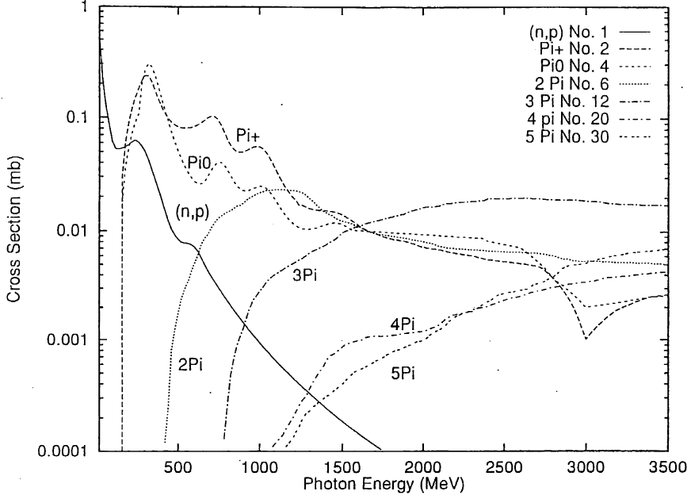
Comparison among incident particles
μ
Answer
smaller than hadron reaction
similar to photon reaction
nucleus
nucleon
nucleon
Cu target
γ
hadron
virtual photon
γ
Energy transfer to a target nucleus.
μ
real photon
fast muon
photon
(bremsstrahlung)
Excitation function of γN
FIG. Energy dependences of 1/P
in nuclear reactions on Cu.
Energy transfer to target nucleus
from fast muons is similar to photoreaction.

Slide 14
Product mass distribution in Au target
μ
nucleus
nucleon
nucleon
γ
virtual photon
γ
μ
real photon
Excitation function of γN
FIG. Comparison of mass distributions of spallation products in Au target
between by muon and photon.
The second component of the mass yield curve in Au target might indicate contribution of high energy deposition by virtual photons.

Slide 15
Comparison with theoretical calculation
Recently, a muon-nucleus interaction was included in the MARS15 code.
We compared Cu spallation between experiment and calculation.
Cu + muon
EXCELLENT!
μ
nucleus
Experiment
nucleon
γ
Calculation
(MARS15)
virtual photon
μ
FIG. Comparison of the mass distribution of spallation products
in Cu target at alcove-2 between experiment and
theoretical calculation by MARS15.
Theoretical mass yields from Cu at Alcove-2 calculated by MARS15 approximately agreed with the experimental mass yields.

Slide 16
Summary
We found characteristics of nuclear reactions induced by fast muons as following.
(1) The yields of the radionuclides from Cu could be fitted to Rudstam’s empirical formula for the spallation yields.
(2) The energy transfer to a target nucleus by a fast muon is smaller than by hadrons and similar to by a photon.
(3) In the mass yields in Au target, we found an unexpected contribution of high energy deposition by virtual photons.
(4) Theoretical mass yields from Cu at alcove-2 calculated by MARS15 approximately agreed with the experimental mass yields.

Slide 17
FURTHER STUDIES
More details of muon reactions
We can use higher flux muons at Absorber Hall
Application for geosciences
We need depth profile of muon-induced production of cosmic nuclides in rock
I will talk the possibility in later session
with preliminary results.

Slide 18
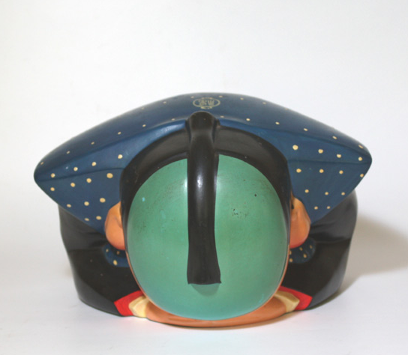

Thank you very much
for your valuable supports
for our experiments.

