Slide 1
Mtest experiment (activation)
Feb. 16, 2012
Activation group
Hiroshi Yashima

Slide 2
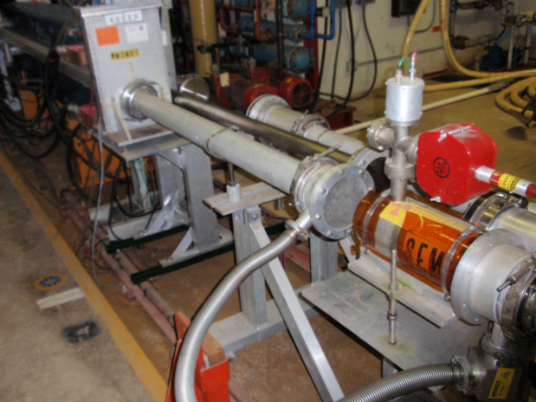
Mtest Experiment(activation)
To obtain experimental data(activation cross section, mass yield distribution)
for E_{p}>120 GeV)
NE213 neutron detector at several angles
120GeV
2e11 pps
Activation samples in M01
3e5 particle per spill
TOF
MI
Trigger detector
Cu Target 60cm L

Slide 3
Experimental procedure (2010Feb. Dec.)
Before irradiation experiment,
beam spot check by using GAFCHROMIC Film
One M01 control access for setting up film
irradiation (1 hour, 1.0e9 p/sec)
One M01 control access for pick up film
irradiation experiment
1 sample per day ×5 samples (see next slide) = 5 days
In each day,
  One M01 control access for setting up samples
  after beam time(18:00-)
  One beam operation ( 4:00- >4hours, 1.0e9 p/sec)
  depends on the schedule of radiation safety staff
  who bring samples to HIL for beam stop
  3. One M01 control access for pick up samples to HIL after irradiation
Activities induced in samples were measured by HPGe detector

Slide 4
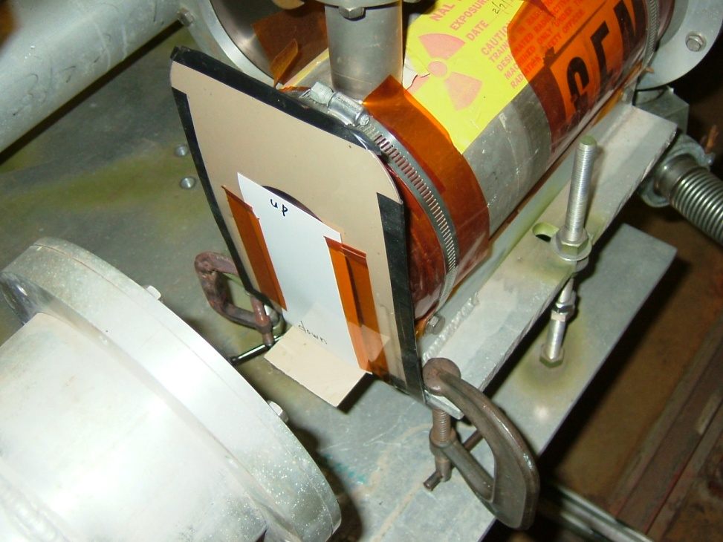
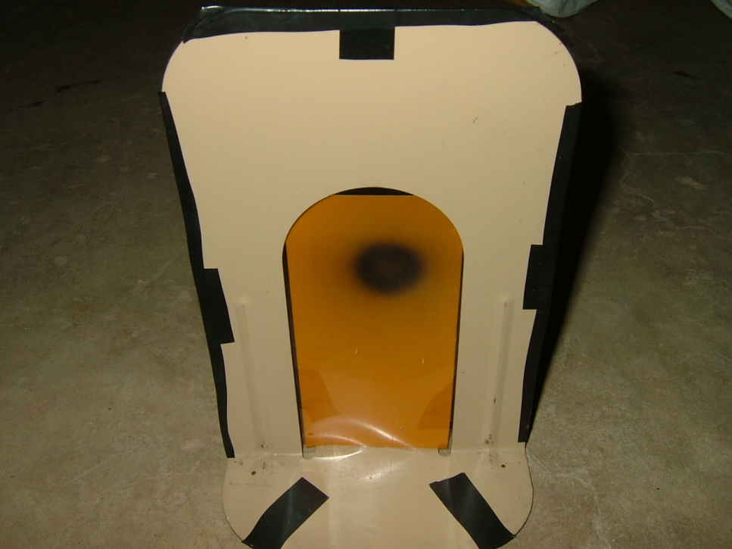
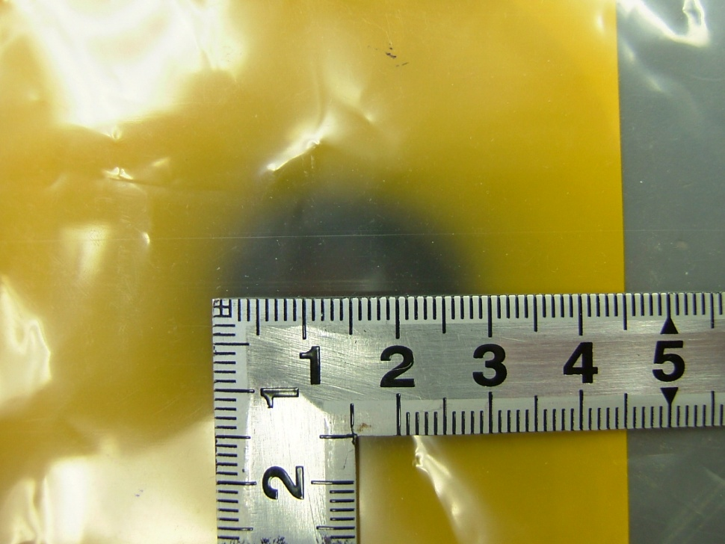
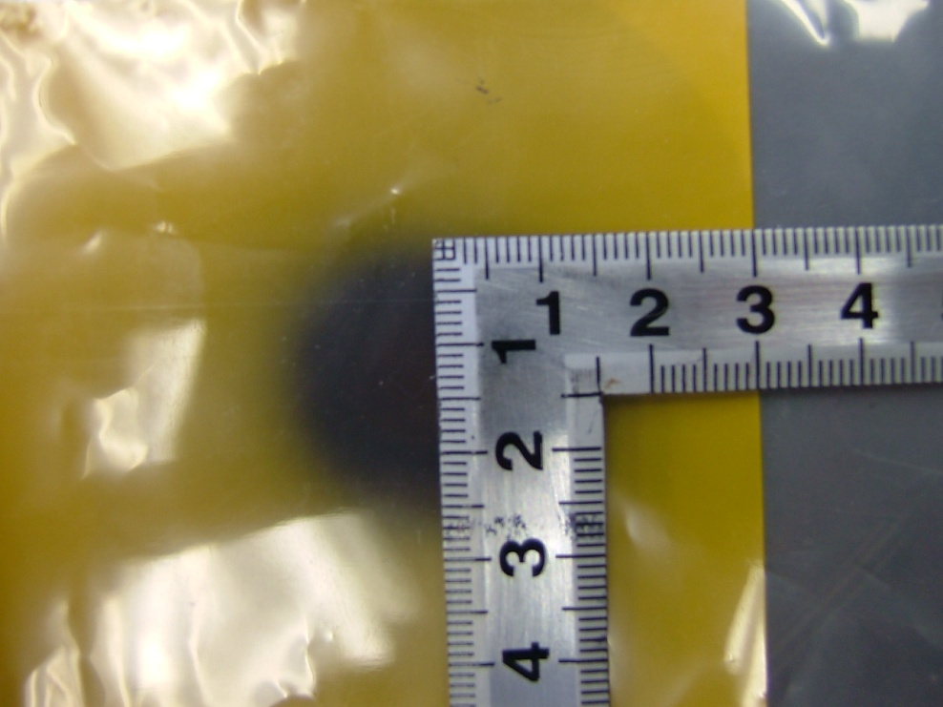
Beam spot check
GAFCHROMIC Film

Slide 5
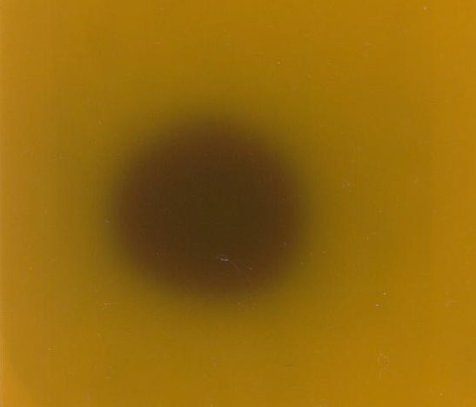
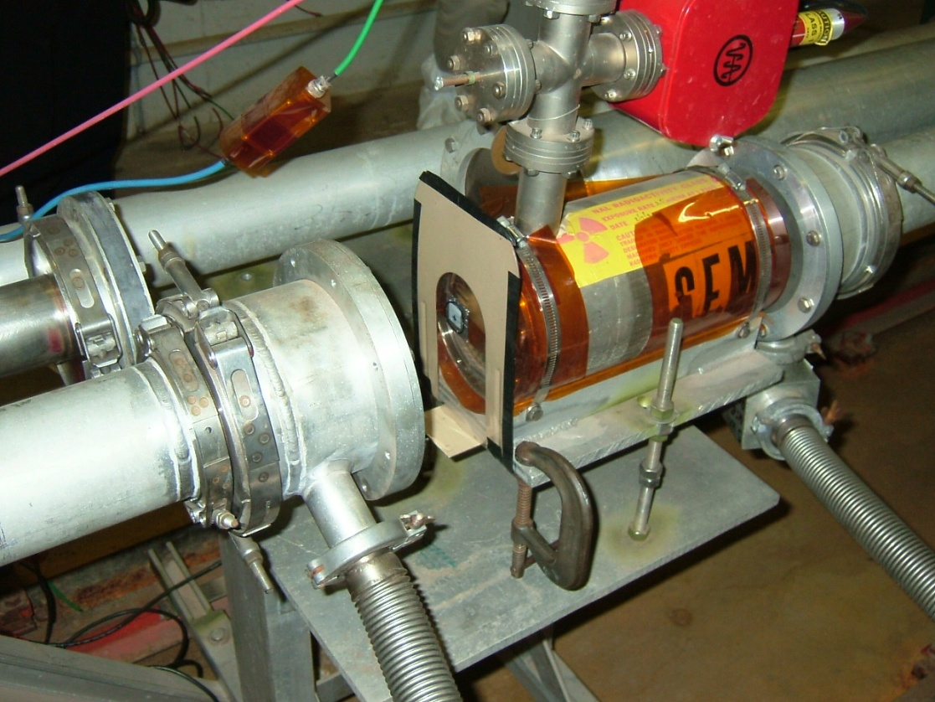
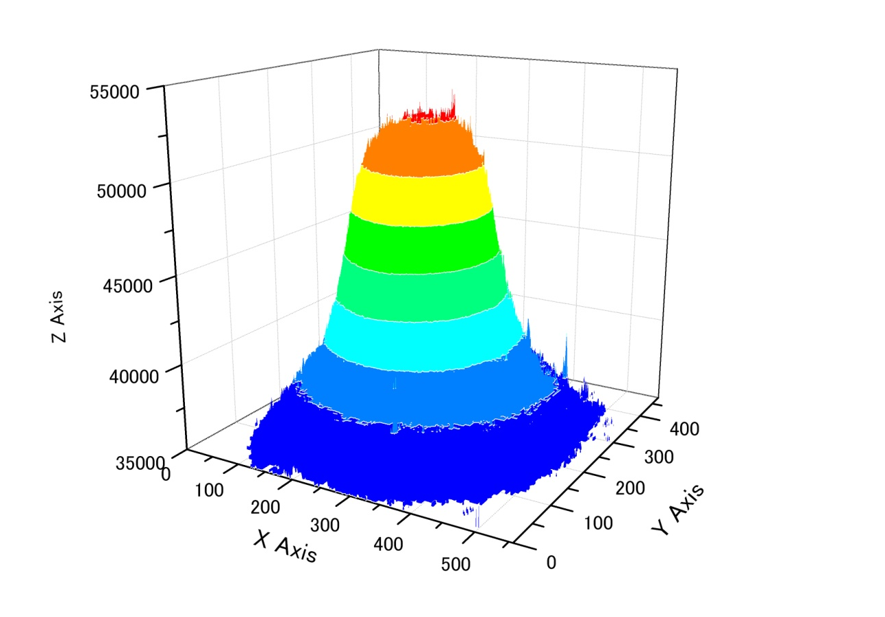
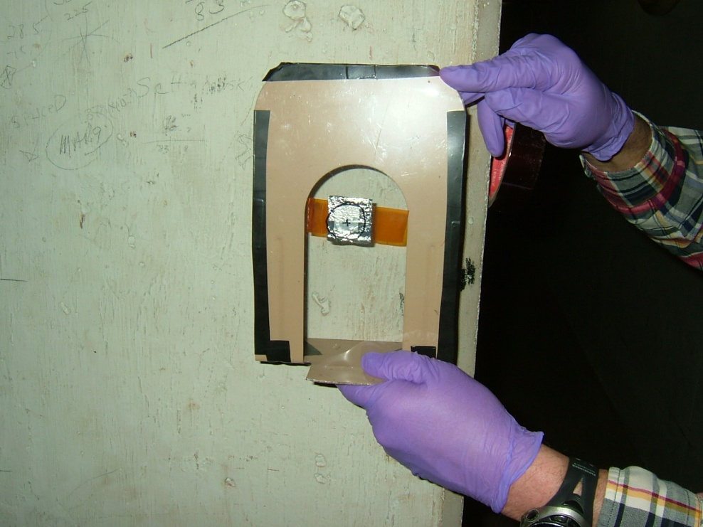
Beam profile
Sample position
Scan
sample

Slide 6
1st experiment(Feb. 2010)
monitor: Al 3cm× 3cm×0.01cm×3foils
sample: Cu 3cm× 3cm×0.02cm×3foils
monitor: Al 3cm× 3cm×0.01cm×3foils
sample: Co 3cm× 3cm×0.02cm×3foils
monitor: Al 3cm× 3cm×0.01cm×3foils
sample: Ni 3cm× 3cm×0.02cm×3foils
monitor: Al 3cm× 3cm×0.01cm×3foils
sample: Al 3cm× 3cm×0.05cm×3foils
monitor: Al 2.5cm× 2.5cm×0.01cm×3foils
sample: Y 2.5cm× 2.5cm×0.01cm×3foils
monitor: Al 3cm× 3cm×0.01cm×3foils
sample: Au 3cm× 3cm×0.02cm×3foils

Slide 7
proton flux by ²⁷Al(p,3pn)²⁴Na reaction
proton flux were estimated by using cross section 8.04 mb
For Ni, Al, Au, current(Al monitor) > current(SEM)
→For thick sample irradiation, there are some
influence of secondary particle?
2nd experiment

Slide 8
2nd experiment(Dec. 2010)
sample: Al 0.025mm ×3
sample: Cu 0.025mm ×3
sample: Ni 0.2mm ×3
To calibrate SEM
To check secodary
particles by using
thinner sample
Try again by using
thicker sample
sample: Au 0.03mm ×3
sample: Au 0.2mm ×3
To check secodary
particles by using
thinner sample
Try again by using
thicker sample

Slide 9
SEM calibration by ²⁷Al(p,3pn)²⁴Na reaction
proton flux were estimated by using cross section 8.04 mb
result of Al monitor foil agree well with result of SEM.
^{nat}Cu(p,x)²⁴Na reaction
result of this work agree well with result of S.I.Baker et al.
proton flux determined by SEM were used for analysis

Slide 10
Results
Product mass
small
large

Slide 11
Cu
Ni
Co
Asano et al.,
Physical Review C 28,1718(1983)
Projectile:12GeV proton

Slide 12
Summary
Activation cross section data for Cu, Ni, Co
by 120 GeV proton beam
σ(Cu) ≒ σ(Co) ≠ σ(Ni)
Future works
・Measurement and analysis for long half-life products
・Activation cross section data for Au and Y
・Mass yield distribution, charge distribution
・Simulation(Nuclear reaction, secondary effect)

