Slide 1
Measurement of thick target neutron energy spectra bombarded with 120-GeV protons
Y. Iwamoto¹, T. Sanami², T. Kajimoto³, N. Shigyo³, M. Hagiwara², H.S. Lee⁴,
D. Boehnlein⁵, R. Coleman⁵, D. Jensen⁵, A. Leveling⁵, N.V. Mokhov⁵, E.Ramberg⁵, A. Soha⁵, K.Vaziri⁵, Y. Sakamoto¹, H. Nakashima¹
1 Japan Atomic Energy Agency, 2 KEK, 3 Kyushu University,
4 Pohang Accelerator Laboratory, 5 Fermi National Accelerator Laboratory

Slide 2
Introduction
Validation of high-energy particle transportation codes for “neutron production on source”
 | Beam | Sample | Detector | Comment
Agosteo et al CERN | 40GeV/c Mixed beam proton/pion+ 158GeV/c Pb | Cu,Ag,Pb 5 x 2.5φ cm | Bonner Ext. E Bonner Unfolding | Protons are subtracted by calc.
Present FNAL | 120GeV proton | C 50cm Al 50cm Cu 20,40,60cm W 10cm | NE213 TOF at 15,30,60,90,120,150º Wendi at 60,90,170º | Direct Mes. Shadow bar Close by dump
Experimental neutron data for 100 GeV proton incident reaction are scarce.
Purpose: Measurement of neutron energy spectra at 15º and 90º from 120 GeV proton induced reaction using TOF method.

Slide 3
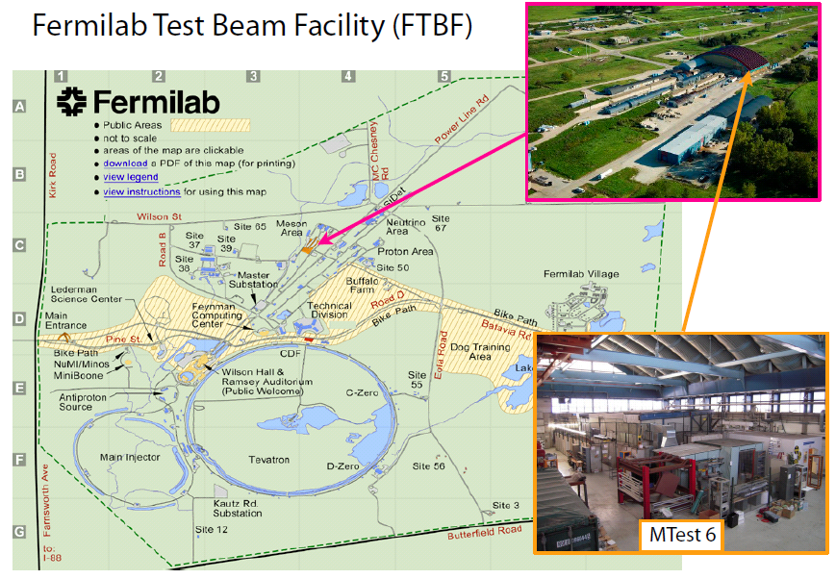
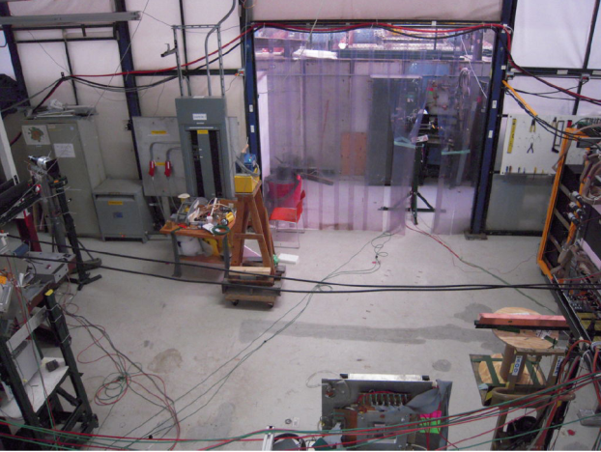
Measurement
Fermilab Test Beam Facility (FTBF)
MT6SEC2

Slide 4
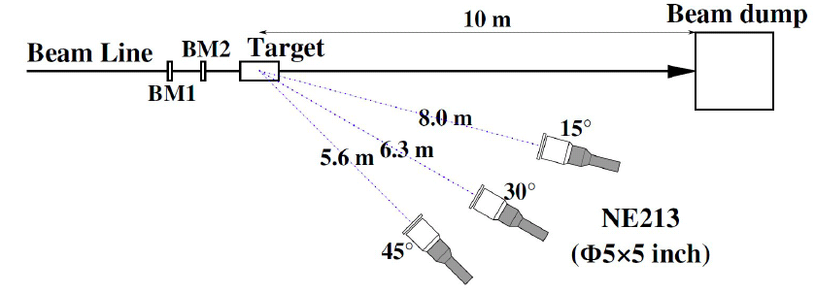
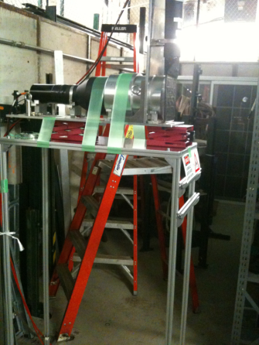
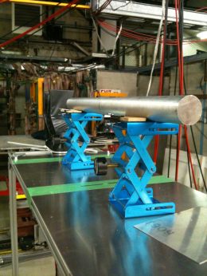
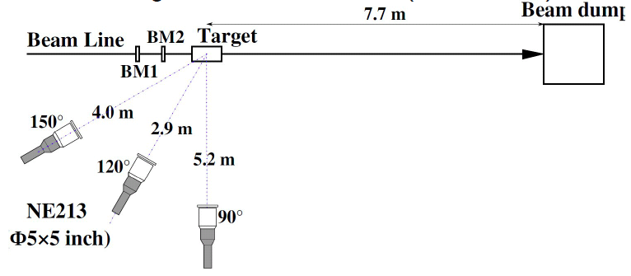
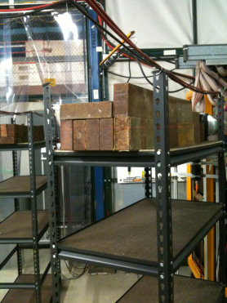
Experiments
Detector: Liquid organic scintillator NE213
Time-of-Flight (TOF) method:
beam pulse – detector signal
Forward angle
Target:
50cm thick x 7 φ cm Al,
10cm thick x 3 φ cm W,
20, 40cm thick x 5 x 5 cm Cu
Backward angle
Target | Size (cm) | Energy loss (GeV)
Al | φ3.5 x 50 | 0.29
Cu | 5 x 5 x 20 | 0.36
Cu | 5 x 5 x 40 | 0.71
W | φ3 x 10 | 0.33
1m thick iron shadowbar for measurement of room-scattered neutrons.

Slide 5
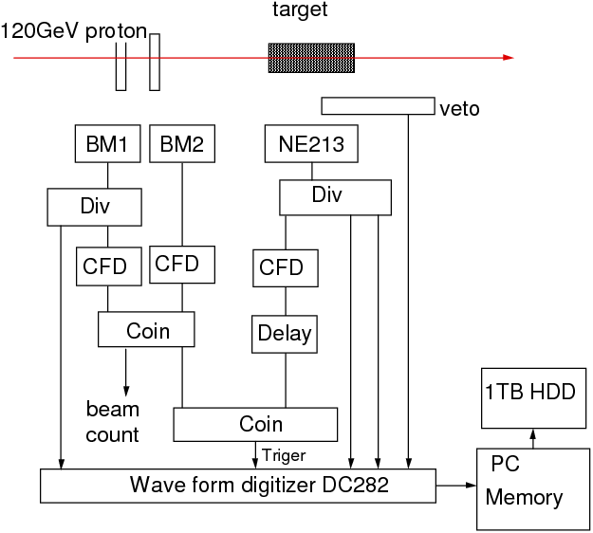
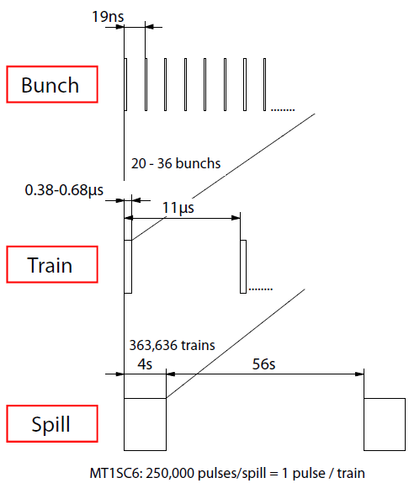
Beam structure
Electronics
19ns
20-36
bunches
11us
Wave Form (WF) data taking
Neutron trigger
2GHz sampling
2-coin. beam monitor
2-gain record for PSD
CFD trigger for low threshold
Beam – NE coin for BG reduction
Recording beam monitor WFs

Slide 6
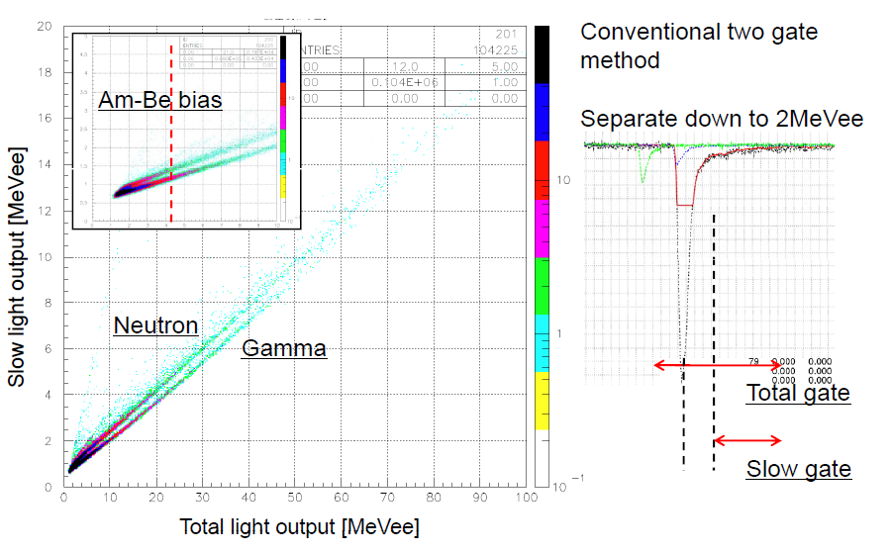
Neutron and Gamma-ray separation by WF

Slide 7
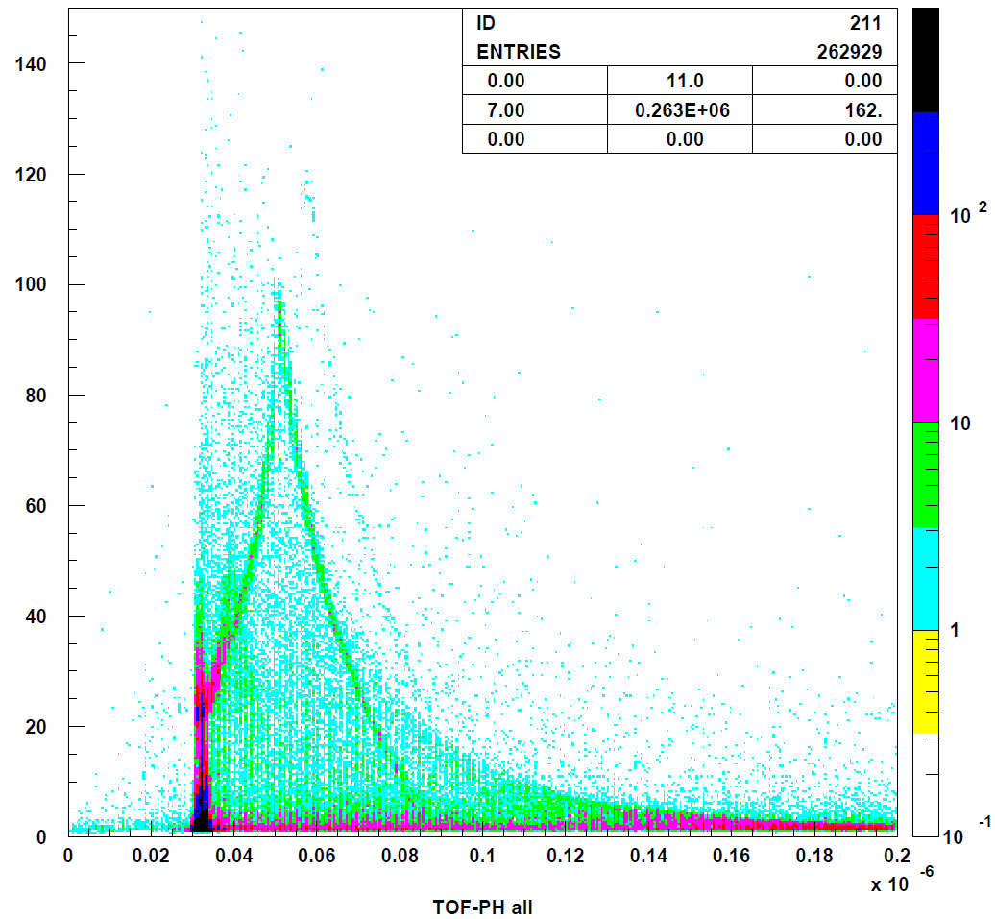
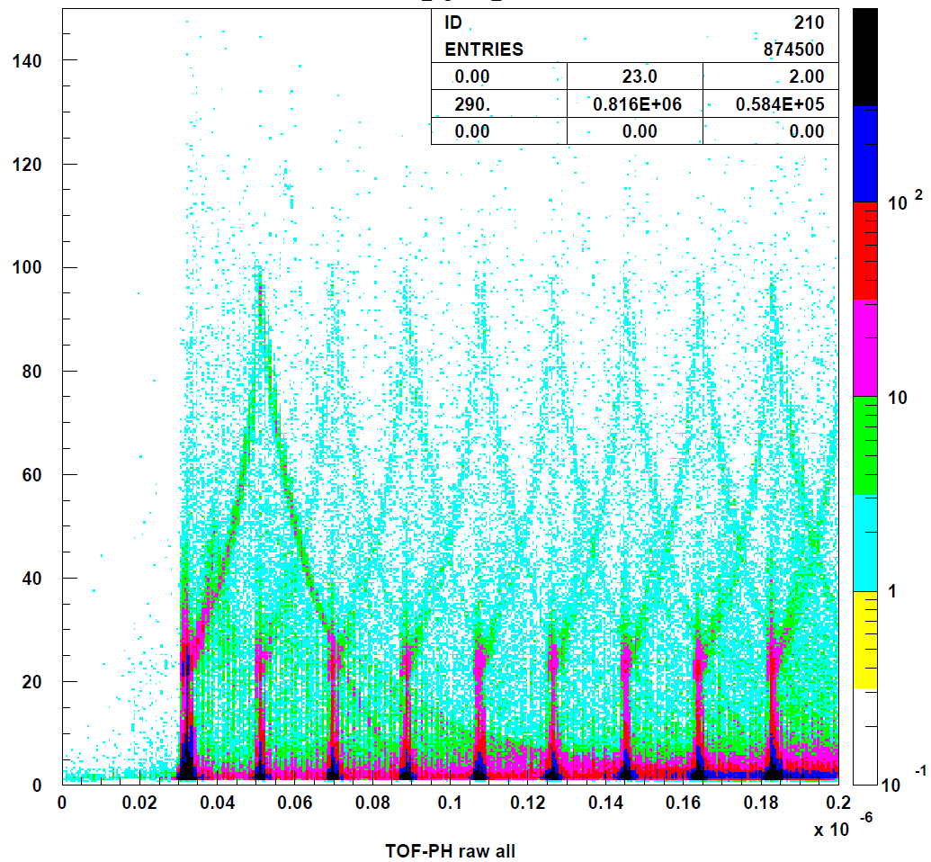
TOF vs Light output
Single proton events
All events
proton
pion
neutron
photon
19ns
Energy resolution : ~30% at 1 GeV neutron
for 20 cm thick Cu at 15º and 8.0m
Count‐loss due to multi proton event: ~10%
Detection Eff.(ScinfulQMD): ~15% for high energy

Slide 8
Benchmark calculation
Characteristics of inelastic hadron-nucleus interactions
Code | High-energy (> -5GeV/c) | Low-energy (< ~5GeV/c)
PHITS | Hadronic cascade model JAM | Intra nuclear-cascade model Bertini
FLUKA | Glauber-Gribov multiple scattering | Preequilibrium-cascade model PEANUT
MARS | Los Alamos Quak-Gluon String Model | Cascade-exciton model CEM

Slide 9
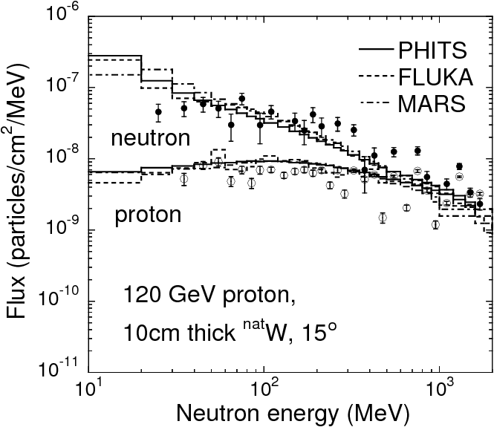
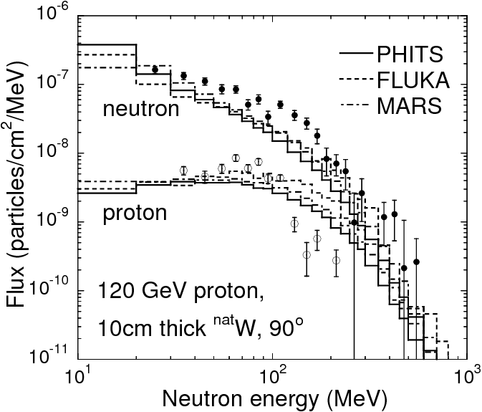
10cm thick tungsten
The difference between PHITS, FLUKA and MRAS results is almost negligible.
At 15º, the calculated results agree well with experimental data.
At 90º, calculated results underestimate the experimental data.
This may be resulted from the strong forward emission of particles in the high-energy physics model.

Slide 10
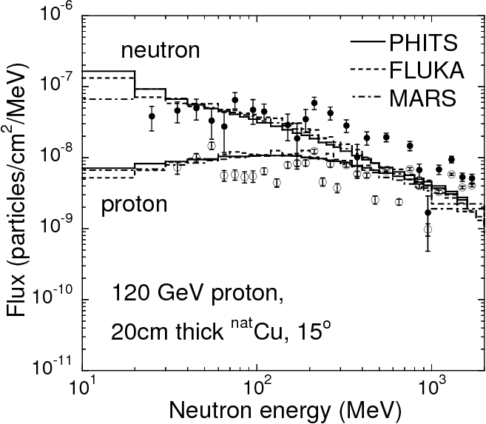
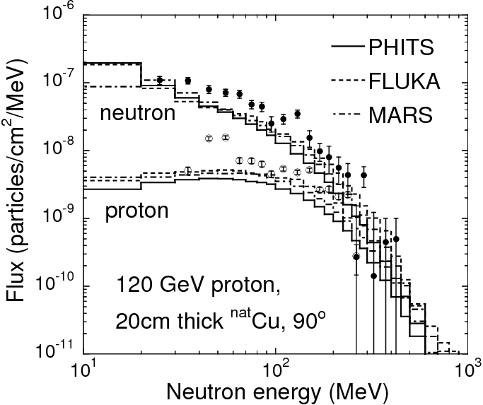
20cm thick copper
The tendency of the relation between calculated and experimental results is almost same with that for a 10-cm-thick tungsten target.

Slide 11
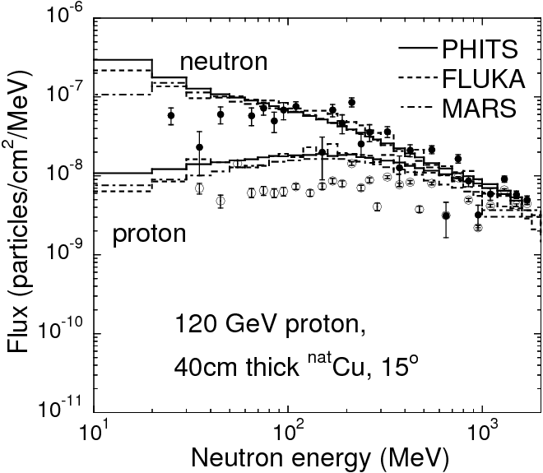
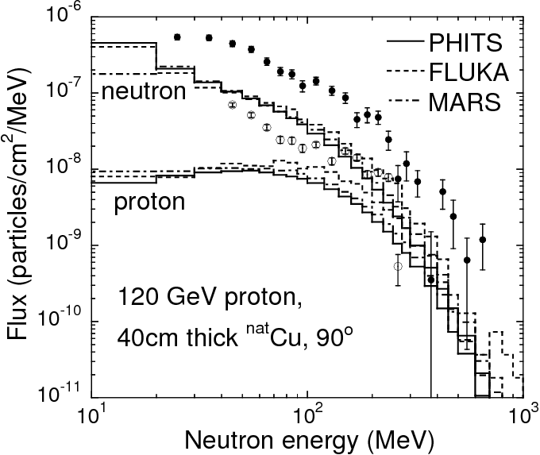
40cm thick copper
At 15º, the calculated results agree well with experimental data.
At 90º, the difference between calculated results and experimental data is larger than that for 20-cm-thick copper target.
It seems that a thicker target enhances the disagreement at 90º due to the strong emission to the forward angle in physics model.

Slide 12
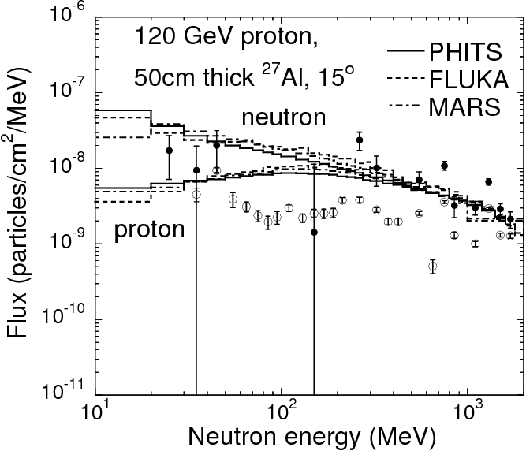
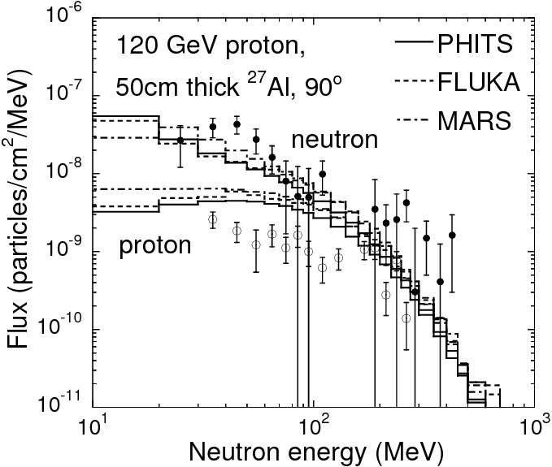
50cm thick aluminum
The statistics of experimental data was not enough.
In general, calculated results give agreement with experimental data.

Slide 13
Summary
Neutron energy spectra at 15º and 90º produced from 10 cm thick tungsten, 20 and 40 cm thick copper, and 50cm aluminum targets bombarded with 120-GeV protons were measured at FTBF.
The neutron time-of-flight measurements were performed using an NE213 organic liquid scintillator at 8.0 m for 15º and 5.2 m for 90º.
The waveforms were recorded using the 10 bit digitizer.
To compare the experimental results, Monte Carlo calculations with the PHITS, FLUKA and MARS codes were performed.
All calculated results at 15º gives good agreement with the data, while these calculated results at 90º underestimate the experimental results due to the strong forward emission of particles in the models.

