Slide 1
9 O’Clock Meeting
Kelli Rubrecht
MCR Crew Chief
Monday, February 7, 2022

Slide 2
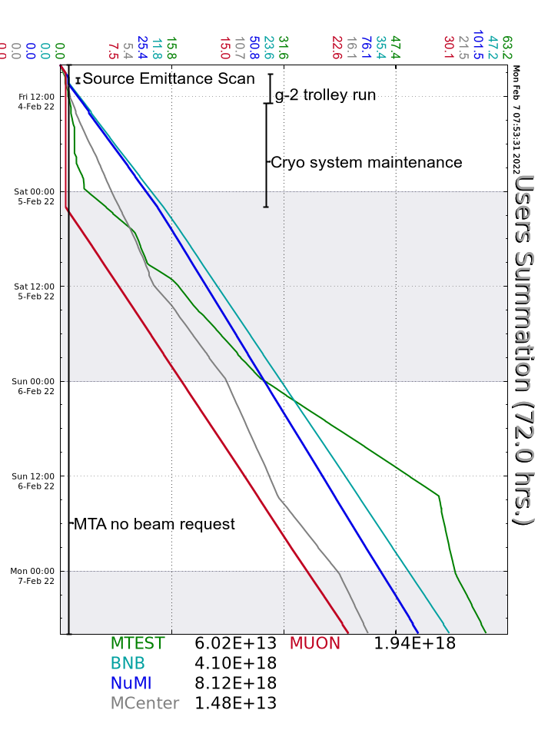
Since Friday…
Walkthroughs on the off-shifts
Beam to users as requested
g-2 trolley run and cryo maintenance kept Muon off until early Saturday
Good uptime!
Beam to NuMI, BNB, Muon, MCenter, MTest

