Slide 1
9 O’Clock Meeting
Gilberto Perez
MCR Crew Chief
Wednesday, February 9, 2022

Slide 2
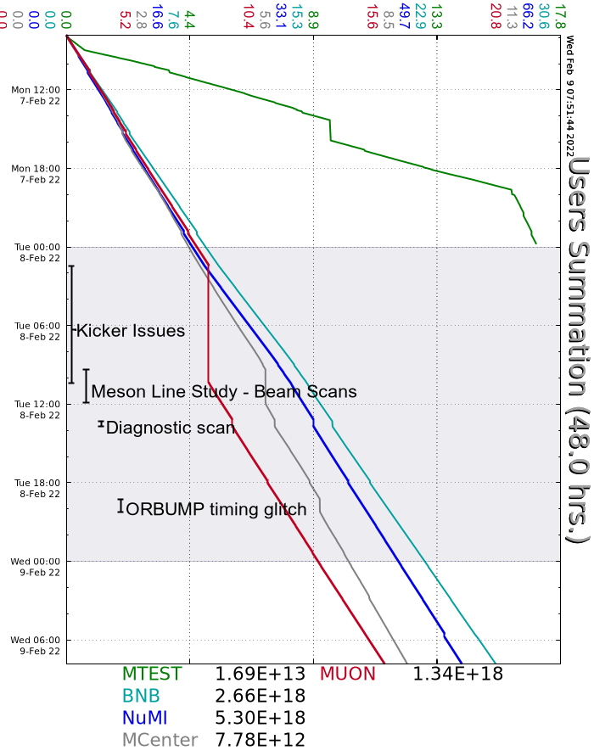
Since Monday…
Monday
Source A boiler heater PS tripped off.
MIRF Center Anode Supply tripped off
Booster West Anode Supply tripped off
Tuesday
g-2 experienced problems with their kicker early on the owl shift. Resumed beam around 10:30am.
Source A boiler heater PS tripped off.
MIRF Center Anode Supply tripped off.
Experienced problems with SWD beam in Booster. Traced the problem to a bad ORBUMP trigger.
Wednesday
ORBUMP trigger on the $13 changed again.

