Slide 1
Study of Target Shapes for g-2 with Yields Expected at End of the First 4 Quads in the M2 Beamline

Slide 2
Overview
This study investigates enhancements in pion yield in the g-2 targetry due to:
  smaller proton beam spot size
  proton beam on edge of slab shaped inconel targets of varying lengths, widths, and orientations (thin vertically or horizontally).
It is carried out using particle tracking simulations (using MARS and g4beamline) to the end of the 4th quad in M2 line, where downstream acceptance cuts are then applied to arrive at an estimate for the pion and proton yields.

Slide 3
Proton Beam Properties
100 million Protons on Target (POT)
KE = 8 GeV
Proton spot sizes used:
Small:
  σx = σy = 0.15 mm, ε = 0.3 mm-mrad
  σx’ = σy’ = 0.6366 mrad
  Used on all target shapes studied.
  From Sergei’s (1/10/12) presentation
Default: scaled from pbar operation
  σx = 0.055 mm σy = 1.1066 mm
  σx’ = σy’ = 0.38 mrad
  Used only on existing pbar target to extract improvment due to smaller spot size.

Slide 4
Target, Li Lens, & PMAG Properties
Target material is the nominal inconel that was used for pbar production.
Distance from center of target to center of Li lens is 25.16 cm (the old nominal). Dean Still has a different distance, but did not bother to change this for this study.
Lens is 16 cm long and 1 cm radius.
Gradient in lens is 256.25 T/m
PMAG is reverted back to that in Nikolai’s original MARS file which scaled B from 8 GeV protons to 3.1095 GeV/c pions:
B = 0.542219 T.
  Choice is based on making P(pi+) distribution at start of M2 to peak near 3.1 GeV/c rather than forcing reference to follow 3○ bend.
One configuration that is simulated uses old B = 5.12346 T (3 ○ bend) to quantify performance gap between old and current configurations using existing pbar target.

Slide 5
Target Shapes and Dimensions Studied
Target Shape | Target Length (mm) | Target Width / Diameter (mm)
Cylinder | 74 | 0.75
Horizontal Slab | 59, 74, 89, 118*, 148* | 0.60, 0.75, 1.00**, 1.25**
Vertical Slab | 59, 74, 89 | 0.60, 0.75, 0.90
Default Pbar Target*** | chord ~75 | -
Pmagic = 3.094 GeV/c
P(pi+ & protons) = 3.15588 GeV/c +/- 2% (1.02 x Pmagic +/- 0.02 x Pmagic)
P(mu+) = 3.094 GeV/c +/- 0.15%
* See next slide arguing longer targets.
** See two slides ahead showing weak dependence on target width, so from practicality standpoint, favor thicker targets.
*** Default Pbar target is simulated with small and default proton beam spot sizes.

Slide 6
Sergei Striganov’s 1/10/12 Target Team Meeting
At β≈3.5cm, longer targets get higher yields.
+8.7%
β = 3.5 cm?

Slide 7
Sergei Striganov’s 1/10/12 Target Team Meeting

Slide 8
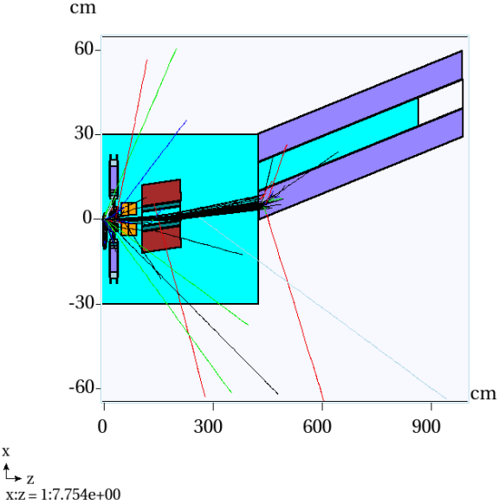
Top View of Targetry Layout
(material sliced in y=0 plane)
1/16” SS316
Fe
Various targets used
Virtual detector at entry of 1st quad in M2 line. R = (3.28/2)”=4.17cm.
Particles are translated and rotated by 3○ in horizontal plane before being propagated in the M2 line using g4beamline. (Even small x-z position correlation is preserved. )
100 protons on target

Slide 9
Horizontal Slab Length = 14.8cm Width = 0.125 cm
side view zoomed
side view greater zoom
top view

Slide 10
Top view of 2 pi+’s at horizontal radial edge at start of AP2 enclosure
Quad Number | d(Quad1 US to Quad Center) (m) | dB/dr(T/m)
1 | 0.3505 | 10.6T/0.701m*(3.1095/8.889) =5.2896 (F)
2 | 1.6710 | 9.0T/0.701m*(3.1095/8.889) = 4.4912 (D)
3 | 3.8910 | 9.0T/0.701m*(3.1095/8.889) = 4.4912 (D)
4 | 5.2010 | 10.4T/0.701m(3.1095/8.889) = 5.1898 (F)
All quads have an effective magnetic field length = 0.701 m.

Slide 11
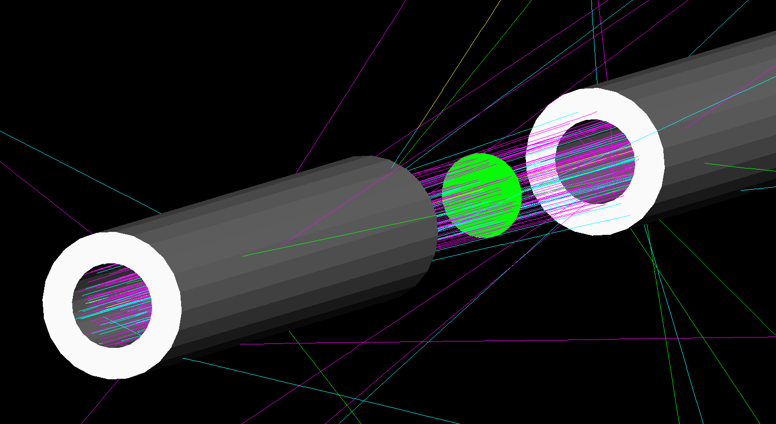
Particle counts are tallied here.
100 Particles:
Pi+: light blue
Proton: magenta
Mu+: yellow
Pi-: green
Q5 location

Slide 12
Reducing spot size and using horizontal slab L=118mm/W=0.75mm: + 127%
+41%
+61%
-20%

Slide 13
Pi+ Yield for Various Target Shapes Within 40 mm-mrad Acceptance at End of 4th Quad in M2
Width (mm) | Vert: Length = 59 mm | Vert: Length = 74 mm | Vert: Length = 89 mm
0.60 | 2.54287E-05 | 2.77825E-05 | 3.36832E-05
0.75 | 2.66361E-05 | 3.10372E-05 | 3.17890E-05
0.90 | 2.69972E-05 | 2.85593E-05 | 3.09538E-05
Simulations of vertical slab, horizontal slab, and cylindrical targets used the small spot size for the proton beam.
Width (mm) | Horiz: Length = 59 mm | Horiz: Length = 74 mm | Horiz: Length = 89 mm | Horiz: Length = 118 mm | Horiz: Length = 148 mm
0.60 | 2.45023E-05 | 2.73169E-05 | 3.16638E-05 | 3.30027E-05 | 3.58901E-05
0.75 | 2.63160E-05 | 2.99048E-05 | 3.24831E-05 | 3.57695E-05 | 2.87882E-05
1.00 | 2.59983E-05 | 2.63805E-05 | 3.02156E-05 | 3.18718E-05 | 3.06861E-05
1.25 | 2.54539E-05 | 2.91986E-05 | 3.02426E-05 | 3.13497E-05 | 3.14825E-05
+41% by change using horiz slab w/ L=118 mm vs. pbar target.
Cyl: Length = 74 mm, d = 0.75 mm | 2.95287E-05
Def Target: Chord=75mm, Small Spot Size | 2.53507E-05
Def Target: Chord=75mm, Default Spot Size | 1.57235E-05
Def Target: Chord=75mm, Default Spot Size, PMAG=5.123T (3 deg) | 1.26200E-05
+61% by reducing spot.
-20% by changing B to 5.123T (3deg)..
Reducing spot size and using horizontal slab L=118mm/W=0.75mm: + 127%

Slide 14
+35%
+64%
-3%

Slide 15
Proton Yield for Various Target Shapes Within 40 mm-mrad Acceptance at End of 4th Quad in M2
Width (mm) | Vert: Length = 59 mm | Vert: Length = 74 mm | Vert: Length = 89 mm
0.60 | 3.89352E-05 | 4.61446E-05 | 4.48560E-05
0.75 | 4.04468E-05 | 4.38372E-05 | 4.93412E-05
0.90 | 3.68139E-05 | 4.52548E-05 | 4.48008E-05
Simulations of vertical slab, horizontal slab, and cylindrical targets used the small spot size for the proton beam.
Width (mm) | Horiz: Length = 59 mm | Horiz: Length = 74 mm | Horiz: Length = 89 mm | Horiz: Length = 118 mm | Horiz: Length = 148 mm
0.60 | 3.92125E-05 | 4.31890E-05 | 4.39131E-05 | 4.95187E-05 | 5.20420E-05
0.75 | 3.73686E-05 | 4.22816E-05 | 4.49157E-05 | 5.11215E-05 | 5.19444E-05
1.00 | 3.72859E-05 | 4.04309E-05 | 4.54260E-05 | 5.12864E-05 | 4.17479E-05
1.25 | 3.55667E-05 | 3.93833E-05 | 4.33852E-05 | 4.63706E-05 | 4.49900E-05
+35% by change using horiz slab w/ L=118 mm vs. pbar target.
Cyl: Length = 74 mm, d = 0.75 mm | 4.79903E-05
Def Target: Chord=75mm, Small Spot Size | 3.77751E-05
Def Target: Chord=75mm, Default Spot Size | 2.30317E-05
Def Target: Chord=75mm, Default Spot Size, PMAG=5.123T (3 deg) | 2.23453E-05
+64% by reducing spot.
-3% by changing B to 5.123T (3deg)..
Reducing spot size and using horizontal slab L=118mm/W=0.75mm: + 122%

Slide 16
Yields for mu+’s at end of 4th quad are statistically challenged.

Slide 17
Mu+ Yield for Various Target Shapes Within 40 mm-mrad Acceptance at End of 4th Quad in M2
Width (mm) | Vert: Length = 59 mm | Vert: Length = 74 mm | Vert: Length = 89 mm
0.60 | 0.00000E+00 | 0.00000E+00 | 0.00000E+00
0.75 | 0.00000E+00 | 0.00000E+00 | 0.00000E+00
0.90 | 0.00000E+00 | 0.00000E+00 | 0.00000E+00
Simulations of vertical slab, horizontal slab, and cylindrical targets used the small spot size for the proton beam.
Width (mm) | Horiz: Length = 59 mm | Horiz: Length = 74 mm | Horiz: Length = 89 mm | Horiz: Length = 118 mm | Horiz: Length = 148 mm
0.60 | 0.00000E+00 | 0.00000E+00 | 1.87010E-08 | 9.20250E-08 | 1.83350E-08
0.75 | 0.00000E+00 | 0.00000E+00 | 0.00000E+00 | 0.00000E+00 | 7.37850E-08
1.00 | 0.00000E+00 | 7.37330E-08 | 0.00000E+00 | 5.55840E-08 | 0.00000E+00
1.25 | 0.00000E+00 | 0.00000E+00 | 7.29230E-08 | 0.00000E+00 | 0.00000E+00
Cyl: Length = 74 mm, d = 0.75 mm | 0.00000E+00
Def Target: Chord=75mm, Small Spot Size | 0.00000E+00
Def Target: Chord=75mm, Default Spot Size | 0.00000E+00
Def Target: Chord=75mm, Default Spot Size, PMAG=5.123T (3 deg) | 0.00000E+00
Obviously need higher statistical runs to get any clue on impact of primordial muons. Or, are the numbers low enough already, so we can neglect? Chris? Peter?
Note the much tighter p requirement for mu+, since it applies to acceptance in final g-2 ring:
  P(pi+ & protons) = 3.15588 GeV/c +/- 2% (1.02 x Pmagic +/- 0.02 x Pmagic)
  P(mu+) = 3.094 GeV/c +/- 0.15%

Slide 18
Summary & Future
Target/beam optimization for g-2 was performed with particle tracking (MARS and g4beamline) up to end of 4th quad in M2 line, along with phase space considerations for downstream beamline acceptance of 40 mm-mrad in each transverse dimension.
Keeping the existing pbar target, but reducing the proton spot size from
  σx = 0.055 mm σy = 1.1066 mm
  σx’ = σy’ = 0.38 mrad
to:
  σx = σy = 0.15 mm, ε = 0.3 mm-mrad
  σx’ = σy’ = 0.6366 mrad
increases pi+ & proton yields by 61% and 64%, respectively.
In addition to the smaller spot size, replacing the existing pbar target by a horizontal slab of inconel 118 mm long and 0.75 mm wide can further increase yield of pi+ by 41% for a total enhancement of 127%!
Further simulations are needed in the vertical orientation for the longer target sizes that are at or near optimal in order to descern and quantify the optimal target configuration.
Comment: Given the latest budgetary concerns, hopefully funding will be available to take advantage of these enhancements.

Slide 19
Backup

Slide 20
