Slide 1
Li-Lens length options for pion yield (OptiM tracking)
V.Nagaslaev

Slide 2
Motivation:
Valery: small spot size strategy
Sergey: thin target to preserve secondary beam phase space – MARS simulations
Stronger focusing is needed
What gradients can be tolerated?
What is the optimal lens length?
This is a “first-run” simulation

Slide 3
Secondary pion sample generated by Sergey
Sample:
59mm Inconel target
0.45mm width,
Spot size σ_{x,y}=0.15mm
Pπ=3.109GeV
σ_{p}/p=±2%
PRIME=2.4e7

Slide 4
Details of Lens simulation
Scattering in 2 Be windows
Lens divided into 9 blocks with scattering in thin layers (not necessary!)
Nuclear scattering is applied as a common loss factor
Current distribution calculated and introduced by multipoles up to n=9
Optimum delay found to be 45˚ – checked for each case
For each set of lens current and length, adjusted focus point and beta*
Minimum distance = 5cm
No attempt to simulate real beam line: AP2 geometry is used

Slide 5
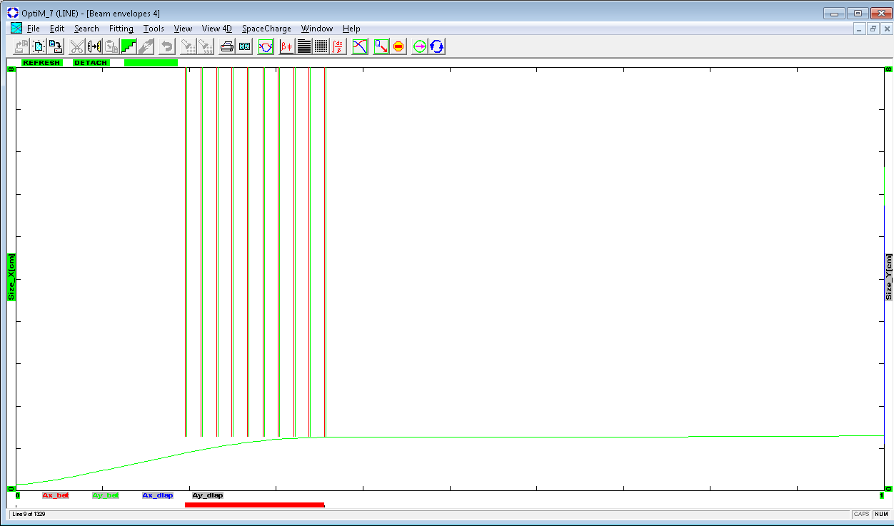
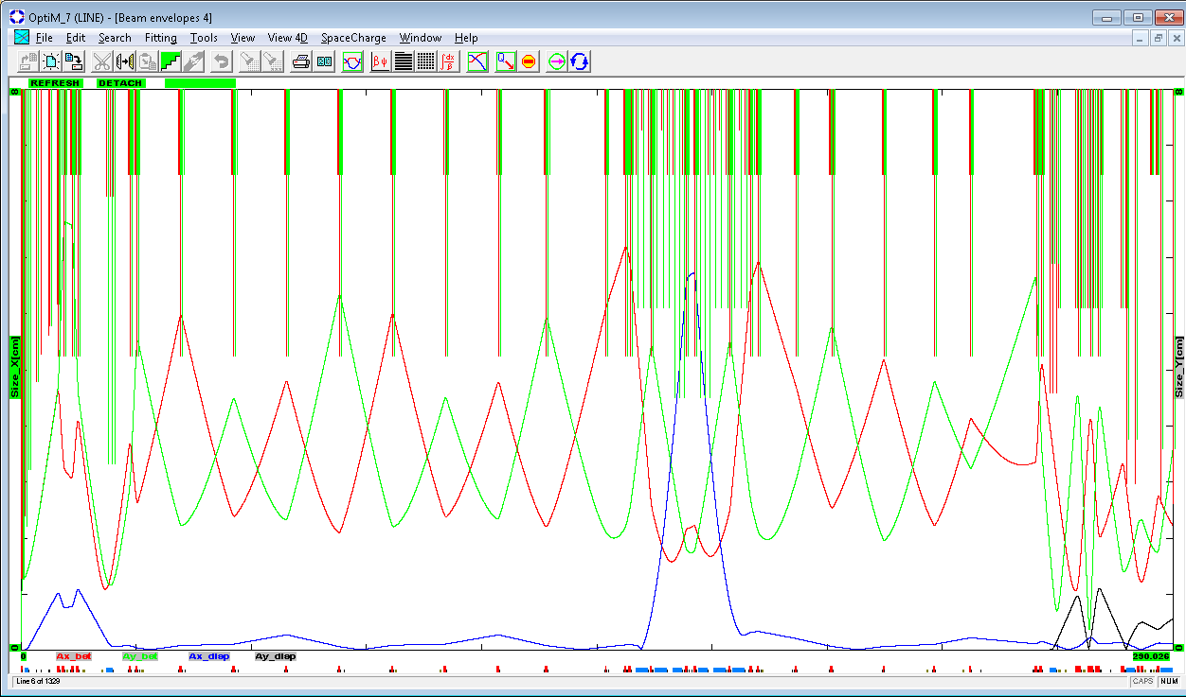
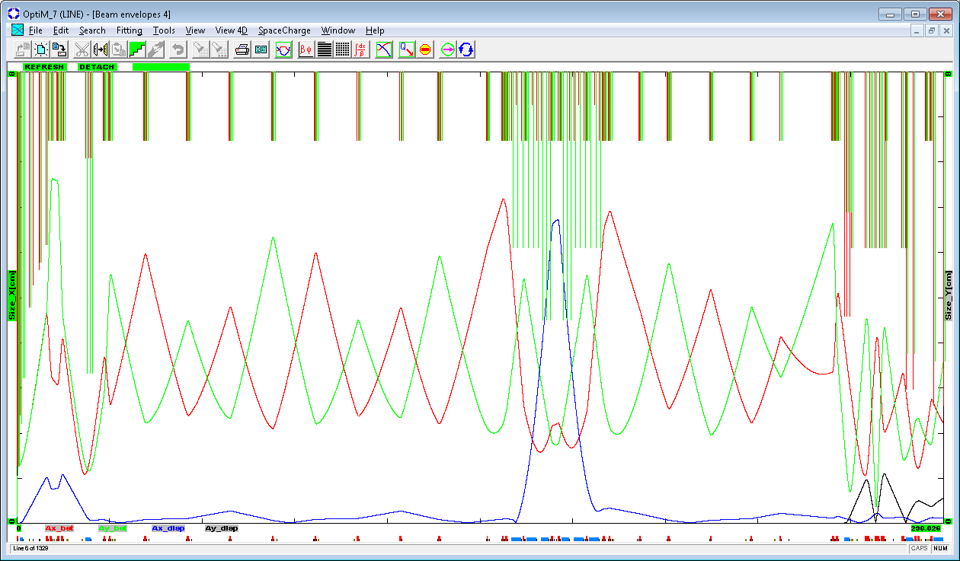
AP2 line apertures
Beam envelope of the 40π:
Close up at the lens:
All line, Rmin at star-chambers
All line, Rmax at star-chambers

Slide 6
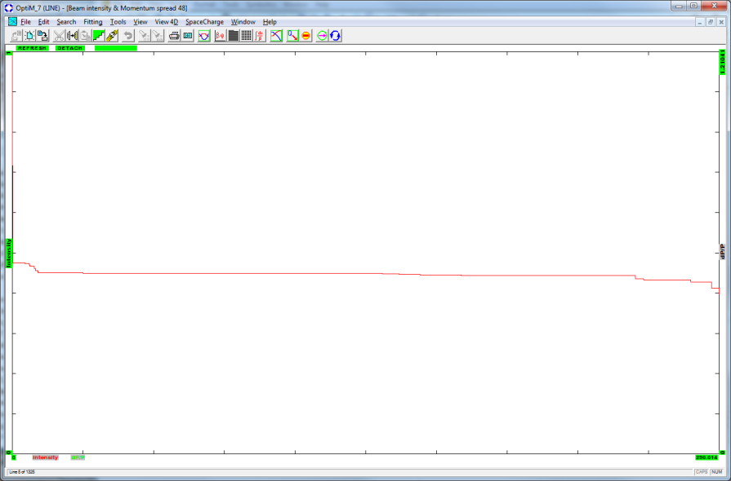
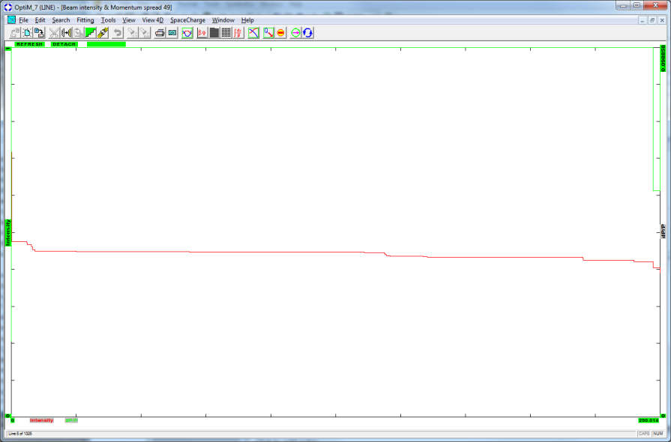
Typical loss pattern
L=20 cm, initial ε=100pi
Intensity along the line
+0.5% dP/P

Slide 7
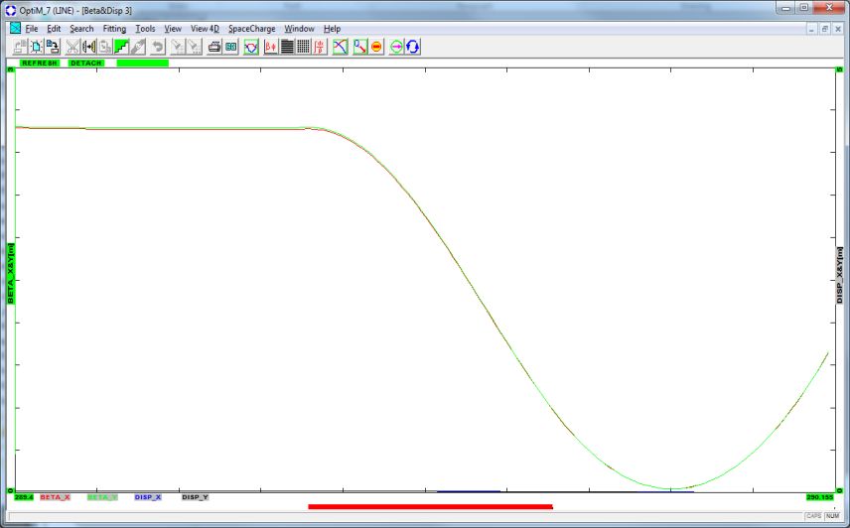
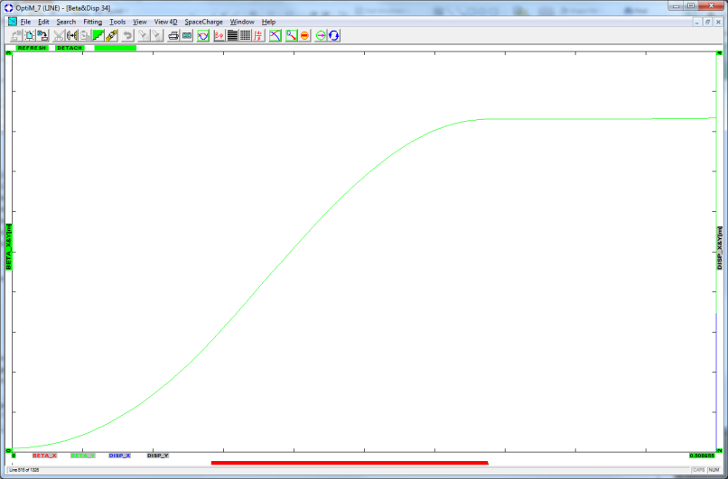
Focus point adjustment
1. Inverse optics projection
2. Adjustment using direct optics
Inverse optics points straight to the focus point, and immediately gives the β* value
Same result may be obtained in in the “working” geometry by adjusting the Target-Lens distance and the β-function on the lens

Slide 8
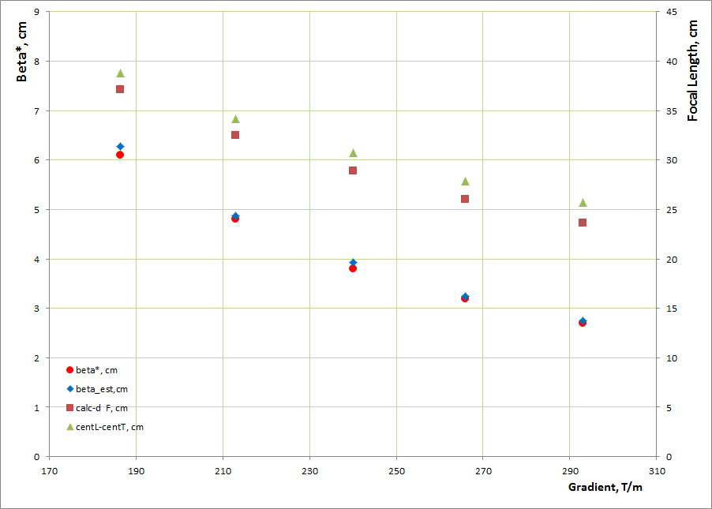
Focusing parameters for 15cm long lens,
varying the lens gradient
What definitions of the “gradient” are we using? Here: “linear part”
Upper 2 sets (right axis): C-C distance vs the “thin lens focus”
Lower 2 sets: calculated beta-function vs “thin lens” beta approximation
Max gradient corresponds to I=188kA (peak)

Slide 9
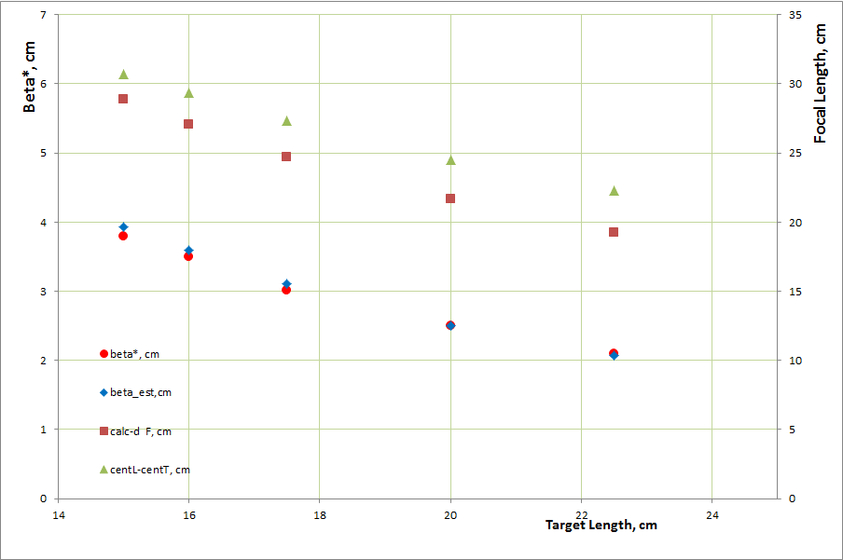
Focusing parameters I=153kA(240T/m),
varying the lens length
C-C distance vs the “thin lens focus” - bigger difference
Actual beta-function vs “thin lens beta” - still close!

Slide 10
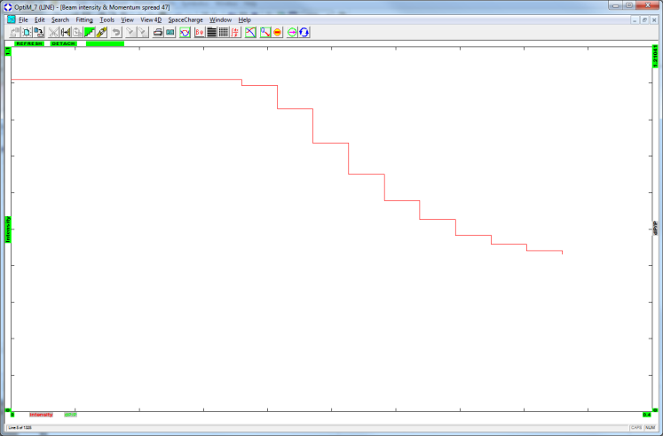
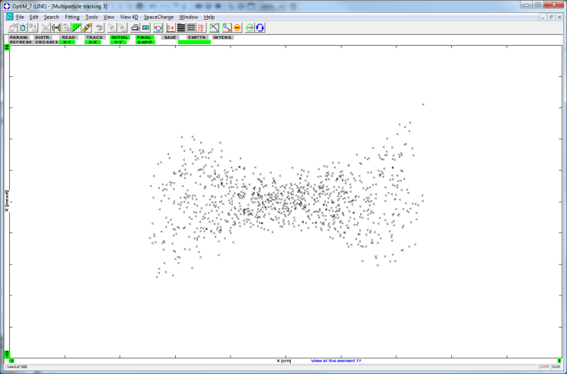
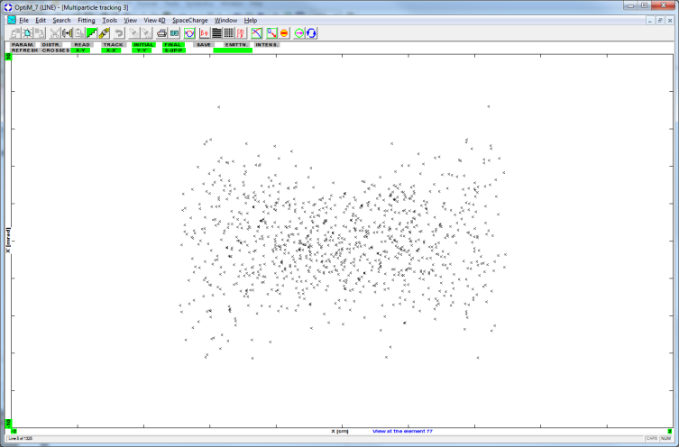
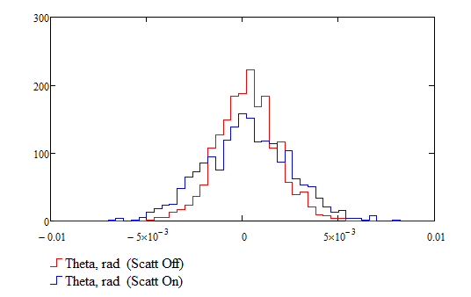
Scattering in the lens
Sig1=1.57mR Sig2=2.24mR
D=1.59mR SigScatt=1.58mR
Factor exp(-L/98cm) is applied

Slide 11
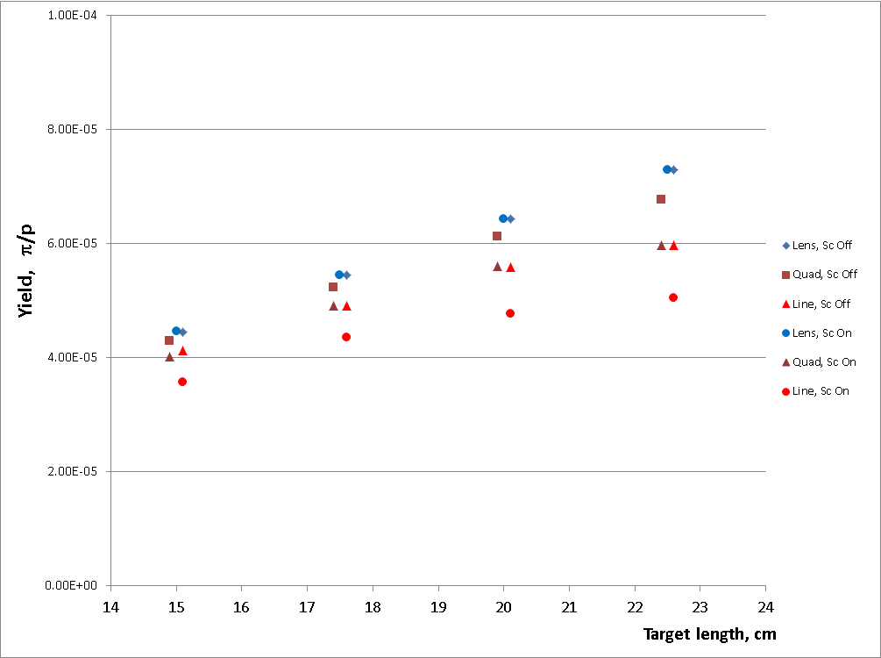
Yield vs target length at 3 locations
Yield is increasing
Dnstr Lens, Bend and line
Multiple scattering ON/OFF
Nuclear scattering ON
Simulation of scattering in the
lens can be made very simple!

Slide 12
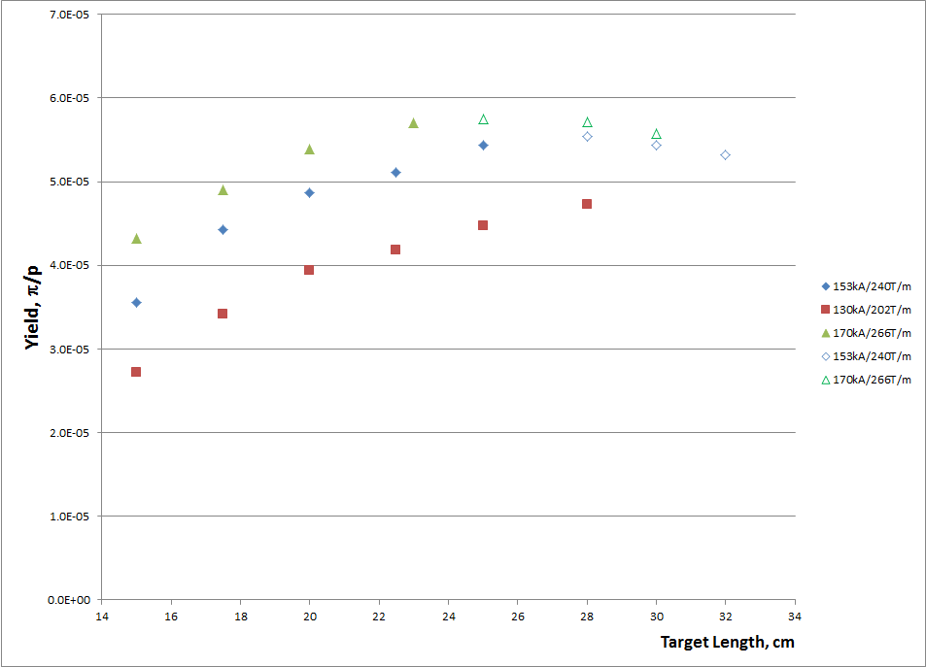
Pion yield vs target length at 3 different currents/gradients
130/153/170 kA (202/240/266 T/m)
Noticeable growth and roll off at large lengths
Assuming 5cm gap between Inconel and Lithium:
Hollow points – outside of this condition
Or Tony’s criteria: 21.74cm D:TGTLNZ max – blue box shows the boundary

Slide 13
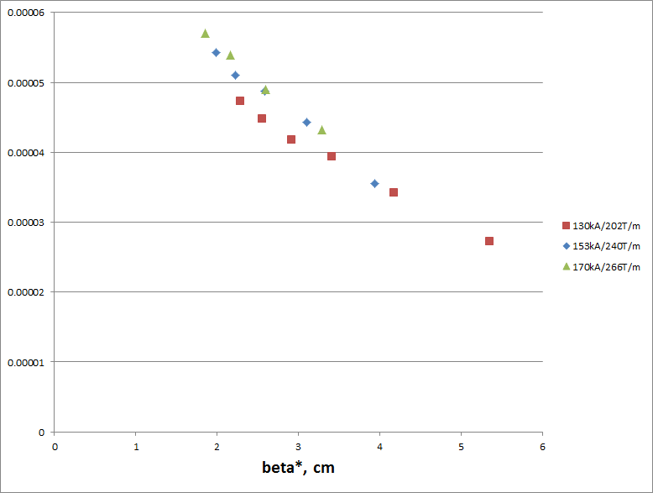
Another look: Pion yield vs beta*

Slide 14
Conclusion
There is a potential for substantial yield increase, which may be achieved at fixed gradient with larger lens lengths.

