Slide 1
RF Protection Interlocks (RFPI)
Niral Patel
PIP-II LLRF Preliminary Design Review
December 7, 2021

Slide 2
Introduction
The RF Protection Interlocks (RFPI) will perform several roles in the PIPII accelerator:
Protect the cryomodule and its RF components.
The RFPI system monitors signals associated with the SRF cavity system and inhibits the low-level RF drive under fault conditions.
It provides the SSA permits.
Provide a status to the accelerator machine protection system (MPS).
Provide diagnostic information (waveforms and status bits) to the control system in real-time during operation of each SSA-Coupler-Cavity being monitored
RFPI PDR | Niral Patel

Slide 3
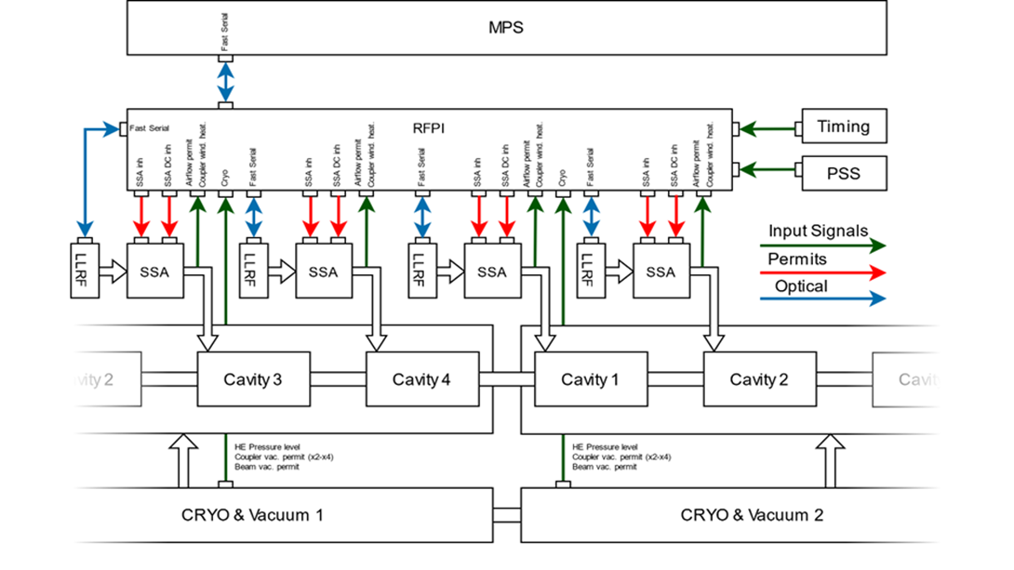
System Block Diagram
One RFPI System will interface with a total of 4 Cavity/Coupler stations as shown in the block diagram below. One LLRF system also supports 4 cavity/coupler stations
- Courtesy of our technical collaborators from Poland/WUT, TUL
RFPI PDR | Niral Patel

Slide 4
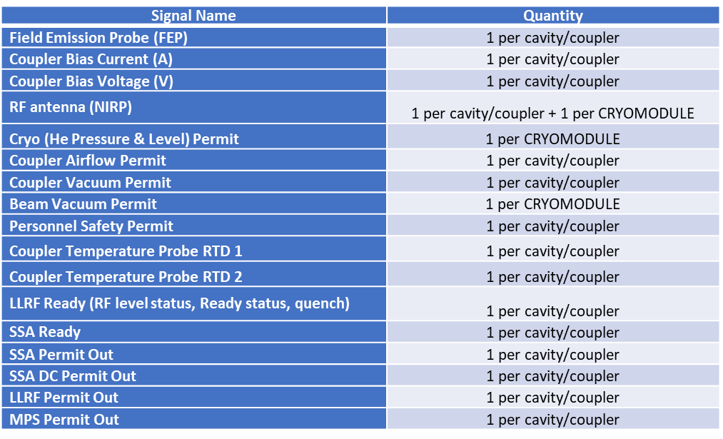
RFPI System Design
The RFPI is designed to interface with many systems which will provide inputs to the RFPI systems. The parameters of all these systems are shown below. The SSA, LLRF and MPS systems will receive permits from the RFPI system and these are also listed below.
The functionality of this system design was tested throughout the PIP2IT run.
December 6, 2022
RFPI PDR | Niral Patel

Slide 5
Design Maturity
The functional design has been successfully proved out during the PIP2IT program at CMTF/Fermilab with a legacy RFPI system (hardware & software) throughout the duration of the run.
This design would not be cost effective for producing at a larger scale such as PIPII and also includes parts not recommended for new designs
This system continues to operate at CMTF to support the Cryomodule Stand for HB/LB 650 MHz and SSR1/2 Cryomodules
Several requirements changes were made for PIPII RFPI and or the current cryomodule test stand RFPI based upon what was learned from this run
Established a close partnership with other key system owners to create a framework for developing new system
MPS – Arden Warner and team
LLRF – Phil Varghese and Brian Chase
HLRF – Dave Peterson and team
Control System – Dennis Nicklaus and Pierrick Hanlet (EPICS)
The RFPI hardware and software for PIPII will be based on a new design treated as a “green field” project
Requirements for new system have been developed and documented
Prototype design is underway with an expectation to eventually test at CMTF
RFPI PDR | Niral Patel

Slide 6
End

