Slide 1
RF Protection Interlocks (RFPI) Requirements
Niral Patel
PIP-II LLRF Preliminary Design Review
December 6, 2022

Slide 2
Agenda
Overview
System Design Requirements
Interface Specifications
Operational Requirements

Slide 3
Overview
Over the past several years the requirements for the RFPI for the PIPII Accelerator have been carefully developed.
Input for the requirements have been developed in collaboration with many teams
  PIP2IT
    LLRF, HLRF, MPS, Control System, Cryomodule (including Vacuum, Cryogenics), Safety Interlock
  Other labs
    Curt Hovater & Ramakrishna Bachimanchi (Jefferson Lab)
  Team from Poland (Wojtek Cichalewski, Wojtek Jalmuzna and team)
A Technical Requirements Specification document (initial release in 2021) ED0013972 has been developed and referenced for the RFPI design

Slide 4
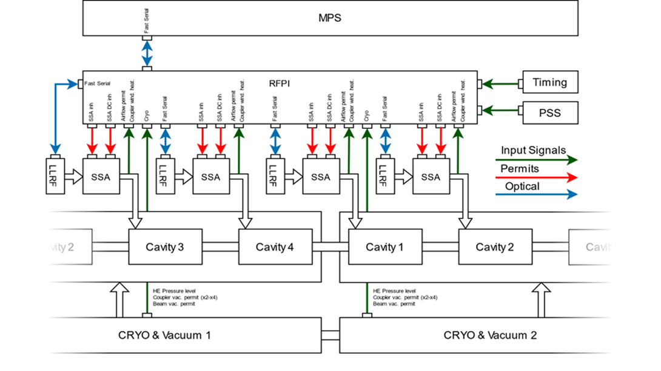
System Block Diagram
One RFPI System will interface with a total of 4 Cavity/Coupler stations as shown in the block diagram below. One LLRF system also supports 4 cavity/coupler stations
- Courtesy of our technical collaborators from Poland/WUT, TUL

Slide 5
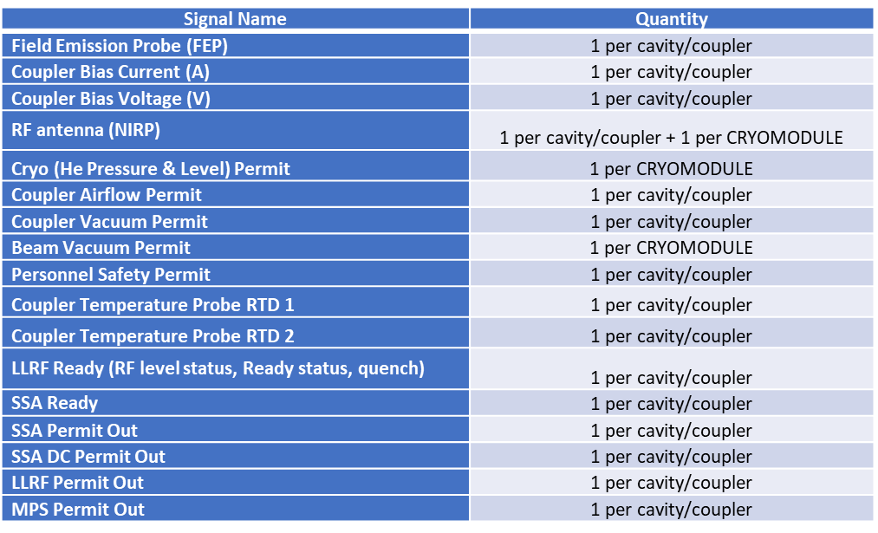
RFPI System Design
The RFPI is designed to interface with many systems which will provide inputs to the RFPI systems. The parameters of all these systems are shown below. The SSA, LLRF and MPS systems will receive permits from the RFPI system and these are also listed below.
The functionality of this system design was tested throughout the PIP2IT run.

Slide 6
RFPI Functional Diagram
Table below shows how the permits from RFPI are made up
 | Output Permits from RFPI (LB/HB)
Inputs to RFPI | LLRF permit | SSA Permit | SSA_DC Permit | MPS
FEP | x |  |  | x
RF antenna (NIRP) | x | x |  | x
Personnel Safety Permit | x | x |  | x
Vacuum Status | x | x |  | x
Coupler Vacuum Permit (Multipacting) |  |  |  | x
He Level & Pressure (Cryo) | x | x |  | x
Temperature Sensors (RTD 1& 2) | x | x |  | x
Coupler Airflow Sensor | x | x |  | x
HV Coupler Bias voltage | x | x |  | x
HV Coupler Bias current | x | x |  | x
SSA Ready | x |  |  | x
LLRF Ready | x | x |  | x

Slide 7
Detailed Interface Specifications

Slide 8
Detailed Interface Specifications (continued)

Slide 9
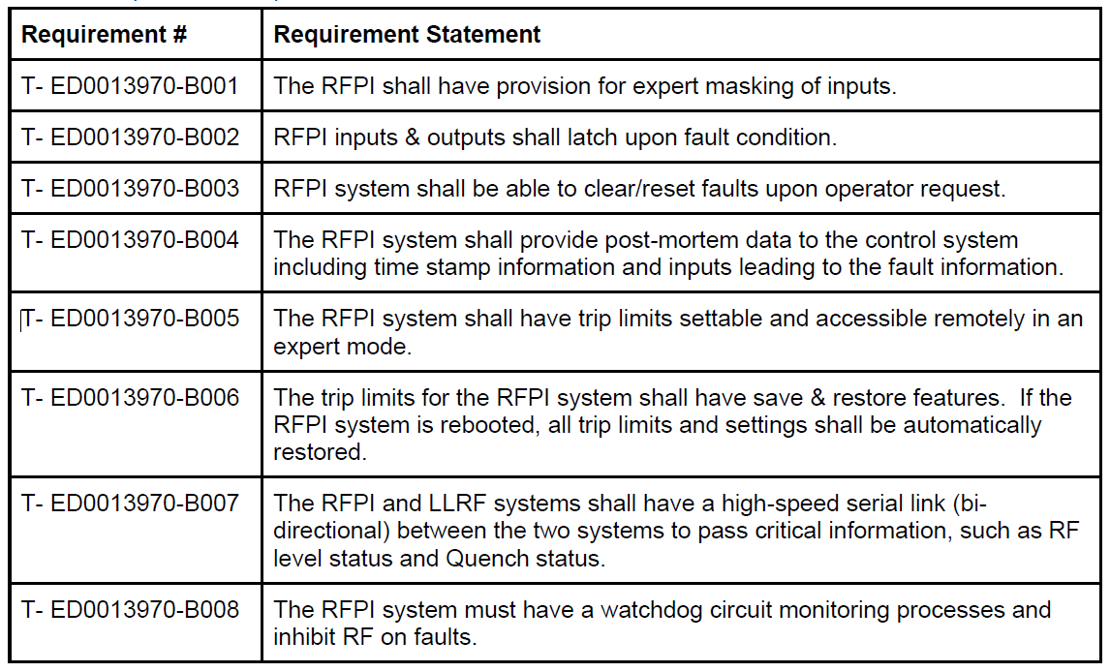
Operation Requirements

Slide 10
End

