Slide 1
PIP-II Low Level RF Protection Interlocks
Preliminary Design Review
Elvin Harms
L2 Manager, PIP-II Accelerator Systems
6-7 December 2022

Slide 2
Welcome
PIP-II Purpose & Scope
Logistics & Schedule
Introductions

Slide 3
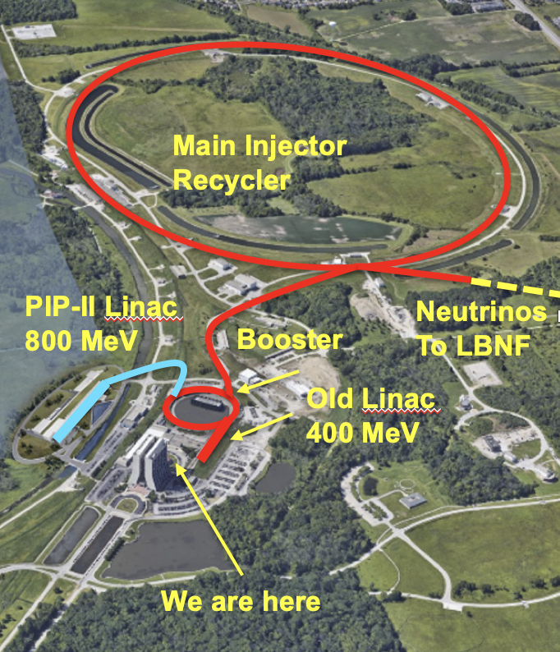
PIP-II Purpose & Scope
An 800-MeV superconducting H⁻, CW-compatible Linac
Beam transport of 800-MeV H⁻ from the SRF Linac to the Booster.
A new injection area in the Booster.
Modifications to the Booster, Main Injector, and Recycler Ring to enable >1 MW power on LBNF target for 60-120 GeV.
Associated conventional facilities. The linac enclosure is compatible with upgrades.
Tailoring strategy
PIP-II is the first US/DOE accelerator to be built with significant international contributions/partnerships.
Status
CD-3 IPR 1-3 March
ESAAB approval on April 18
Construction approval received last week - expected to start imminently

Slide 4
PIP-II Layout
Linac consists of:
Room temperature front end (up to 2.1 MeV)
Superconducting (cold) linac
5 types of SC cavities: HWR, SSR1, SSR2, LB650, HB650
3 RF frequencies are used for acceleration
All SRF SSAs are In-Kind Contributions from DAE:
design, fabrication, delivery

Slide 5
Global Requirement Document (GRD, #ED0001222) Defines Performance Requirements and Scope
Performance requirements for PIP-II are established based on the P5 report and the approved Mission Need Statement
Deliver >1 MW of proton beam power from the Main Injector over the energy range 60 – 120 GeV and 1.2 MW at 120 GeV
Support the current 8-GeV program at Fermilab including the Mu2e, g-2, and short-baseline neutrinos experiments
Provide a platform for extension of beam power to LBNF to >2 MW
Provide a path to increase the beam power to the Mu2e experiment to ~100 kW at 800 MeV, with a duty factor of up to 100%
Provide a platform for extension of capability to flexible bunch pattern, high duty factor/higher beam power operations to multiple experiments simultaneously.
The above capabilities should be provided in a cost-effective manner.

Slide 6
Key Performance Parameters
# | Scope | Threshold KPPs | Objective KPPs
1 | Linac Beam Energy | Accelerate H- beam to 600 MeV | Accelerate H- beam to 700 MeV Linac systems required to accelerate beam to 800 MeV installed and tested
2 | Linac Beam Intensity | Beam delivered to Beam Dump at the end of Linac | Beam with intensity of 1.3E12 particles per pulse (H-) at 20 Hz delivered to Beam Line Dump
3 | Booster/ Recycler/ Main Injector upgrades | Booster, Recycler, and Main Injector Upgrades to support operations with beam power of 1.2 MW on the LBNF target are installed and tested without beam | Linac beam injected and circulated in Booster
Objective KPPs are aligned with the baseline project scope and assure that the accelerator facility, as constructed, is capable of meeting the scientific needs of the Fermilab program.(Project Execution Plan, PIP-II-doc-3036)

Slide 7
Purpose/Charge
The review committee is charged with critically evaluating the preliminary design of the PIP-II Radio Frequency Protection Interlock [RFPI] to assess design, implementation, procurement, fabrication and installation activities’ maturity. For the PIP-II project, preliminary design is defined as 60% complete. The PIP-II RFPI system is responsible to prohibit the LLRF system and the SSA operation in case of cavity and cryomodule failure or misbehavior. For this reason the RFPI is constantly monitoring predefined subset of the module and cavities signals and reacts instantaneously for any thresholds violation. The single PIP-II RFPI unit is dedicated for up to four cavities protection and monitoring.
The purpose of the review is for the review committee to assess the preliminary design of the PIP-II RFPI system. • Are the design requirements clearly stated and reasonable? • Are the proposed system architectures and chosen technology sound and viable? • Is the designs’ maturity at the preliminary design level (60%) • Are the available documentation consistent with this level of design maturity? • Are risks and interfaces sufficiently identified? • Has ESH, especially Prevention through Design, been properly addressed for this level of design? Are the procurement and quality control plans consistent with this level of design maturity? • Is the cost and schedule presented reasonable? Are there sufficient staff resources and competence assigned to the team by Polish partner to allow to progress with work in accordance with activities, durations and milestone dates shown, • In-kind partnership: Does the RFPI requires additional input from the Fermilab (PIP-II) or other partners to proceed to the RFPI detailed design? • Are the strategy, policies and regulations for procurement, manufacture and assembly sufficiently identified, defined, documented and understood by the partner • Does the committee recommend approval of the designs under review and endorse proceeding to Final Design?

Slide 8
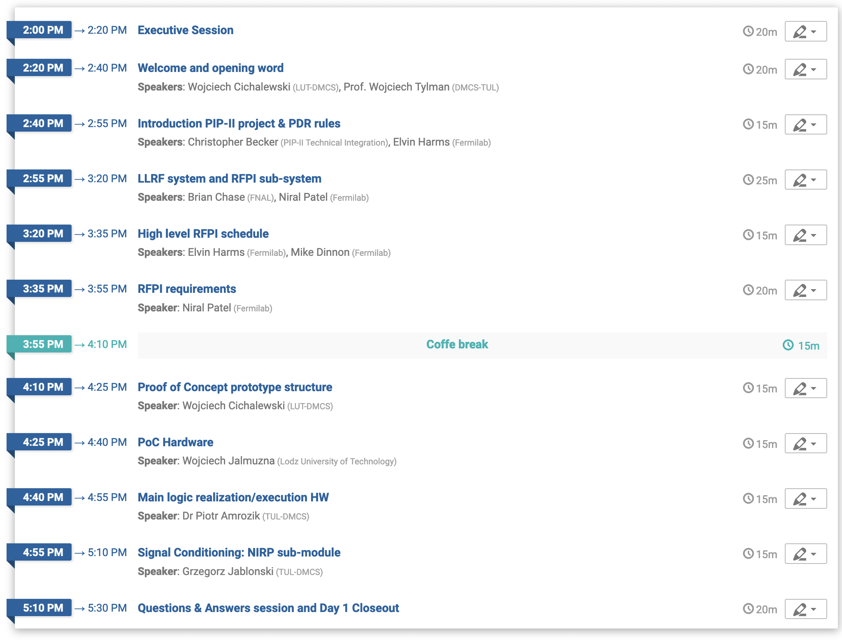
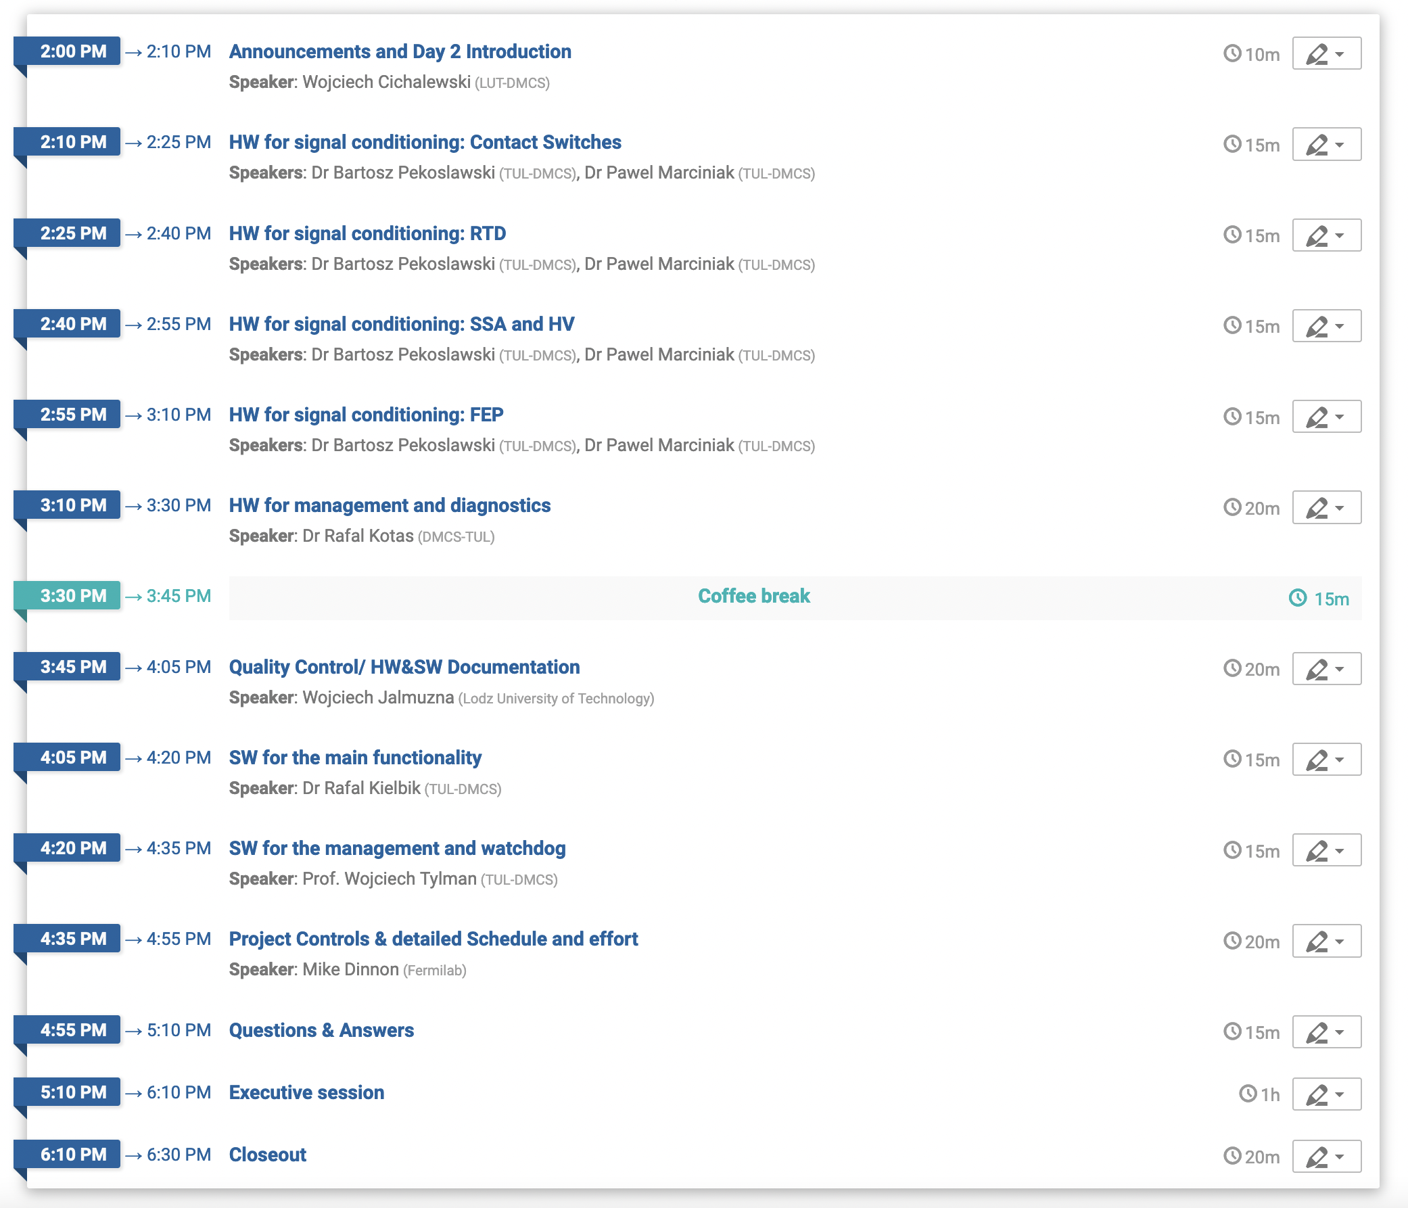
Logistics & Schedule
Times listed are local. Fermiab time are T-7 hours.
2-day format – locally conducted at Łódź University of Technology, Poland plus remotely
18 Presentations plus Discussion, Q&A
Formal committee report within 2 weeks
Safety
Be aware of your surroundings
Identify alerts and exits in case of emergency

Slide 9
Introductions
Invited participants include
Review committee:
Curt Hovater (Jefferson Lab) - chair
Gustavo Cancelo (Fermilab)
Morton Jensen (ESS)
Partners & PIP-II project management
Thank you to all for making time for this review
Reviewers, especially
Presenters

Slide 10
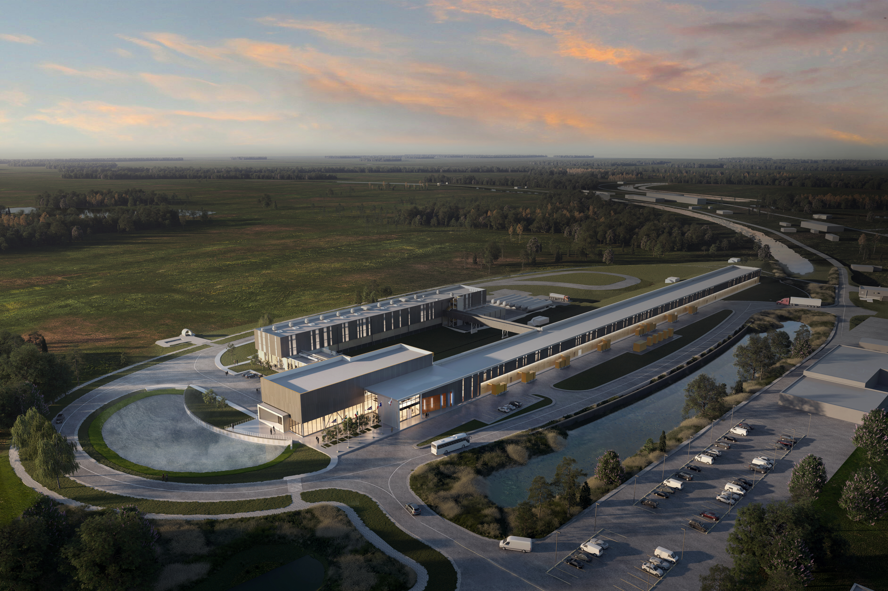
Thank you for your attention & participation

