Slide 1
TPC Electronics OPC/UA Implementation
David Christian
February 9, 2022

Slide 2
TPC Electronics Architecture
Front End Mother Boards (FEMBs) are mounted on the APA frames (in the liquid argon).
The FEMBs are controlled by and read out into Warm Interface Boards (WIBs) located in a crate mounted on the cryostat penetration.
Each WIB has two “10” Gbps links to FELIX and a Gbit optical Ethernet link for control, configuration, and monitoring.
The WIB uses a Xilinx Znyq SoC FPGA with integrated ARM processor.

Slide 3
WIB Control Software
Ben Land (U. Penn) wrote the software that runs on the WIB Zynq processor and also the software that communicates with it.
His original implementation used ZeroMQ, an open source asynchronous message-passing system, to pass messages between DAQ and slow control programs and programs running on the WIB.
When we learned that the DAQ group was planning to support only OPC/UA for message passing, Ben implemented an OPC/UA server on the Zynq and also wrote programs for artdaq (with OPC/UA client calls) that could be used to control and configure the WIB and FEMBs.

Slide 4
Ben Land’s OPC/UA Implementation
Ben presented a summary of his (at that time planned) implementation at a meeting on July 20, 2021 (https://indico.fnal.gov/event/50146/).
I include some of Ben’s slides in the following.

Slide 5
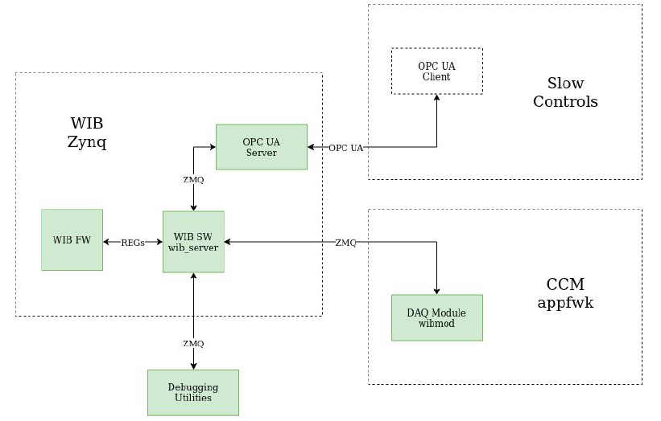
Communications Architecture
This part is show with a dashed box because it is not yet implemented (Slow Controls is no longer part of DAQ)
CCM = Configuration Control and Monitoring?
appfwk = application framework

