Slide 1
protoDUNE Slow Controls NP04 HD NP02 VD
CERN
##/02/2022
E. Gamberini, X. Pons

Slide 2
DCS Supervisory control and data acquisition
Siemens link
Ignition link
PCView link

Slide 3
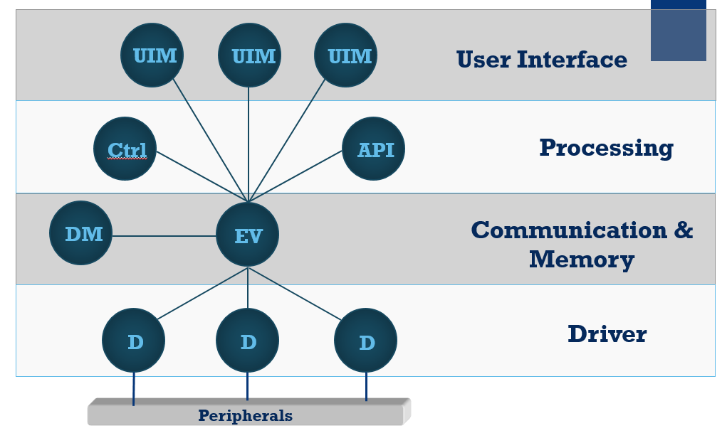
WINCC OA Single System

Slide 4
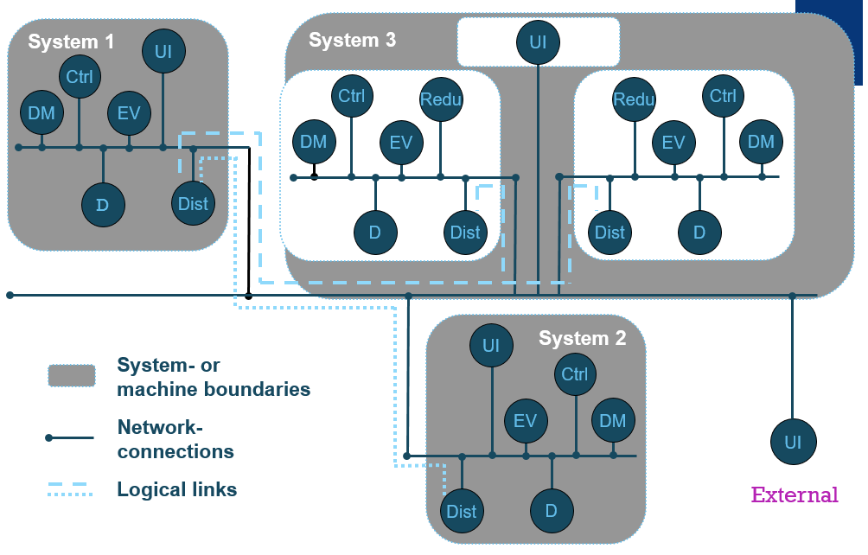
WINCC OA as Distributed System

Slide 5
WINCC OA openness

Slide 6
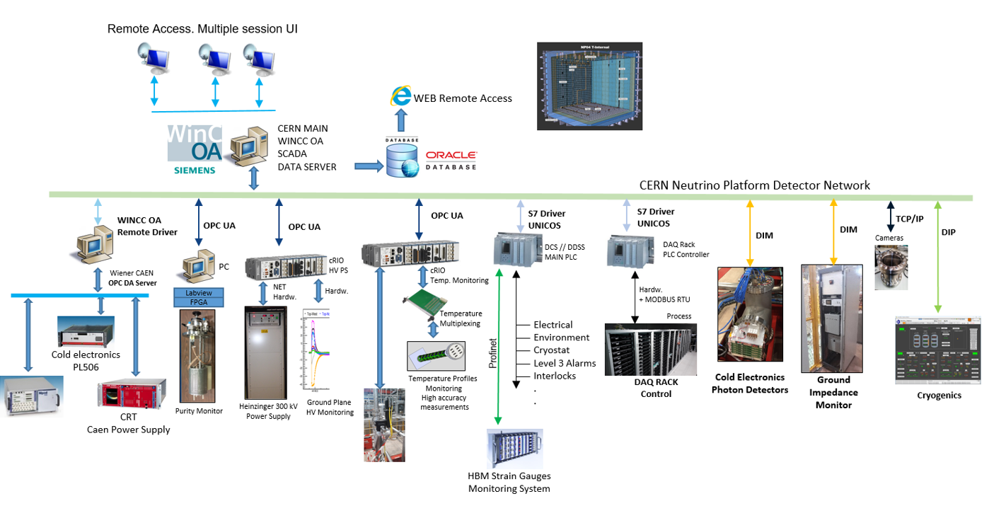
protoDune Single Phase - Slow Control layout

Slide 7
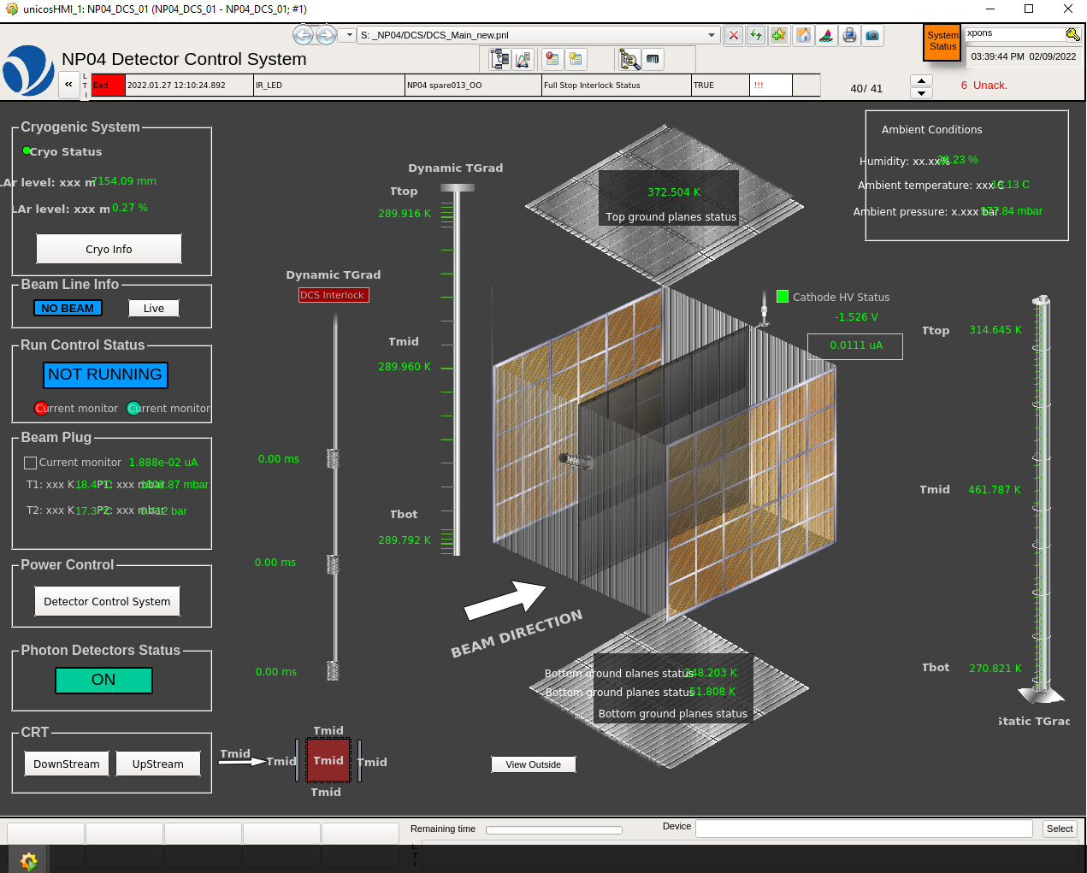
Vertical Drift Coldbox Slow Control layout

Slide 8
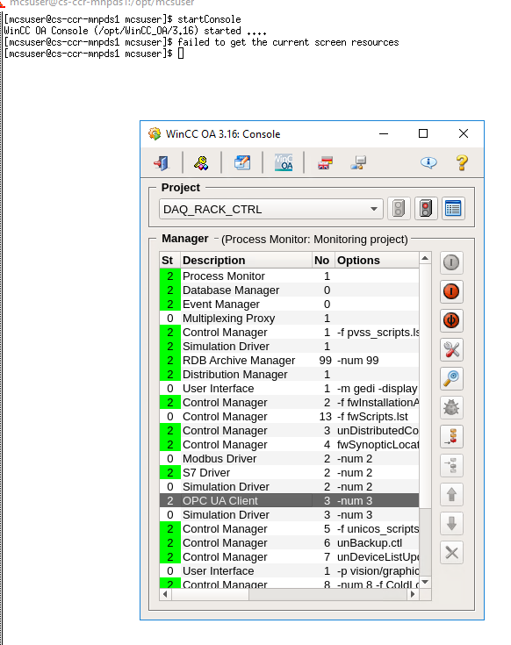
WINCC OA Step-by Step - Console
OPC UA - Manager parametrization
WINCCOA Driver number assignment

Slide 9
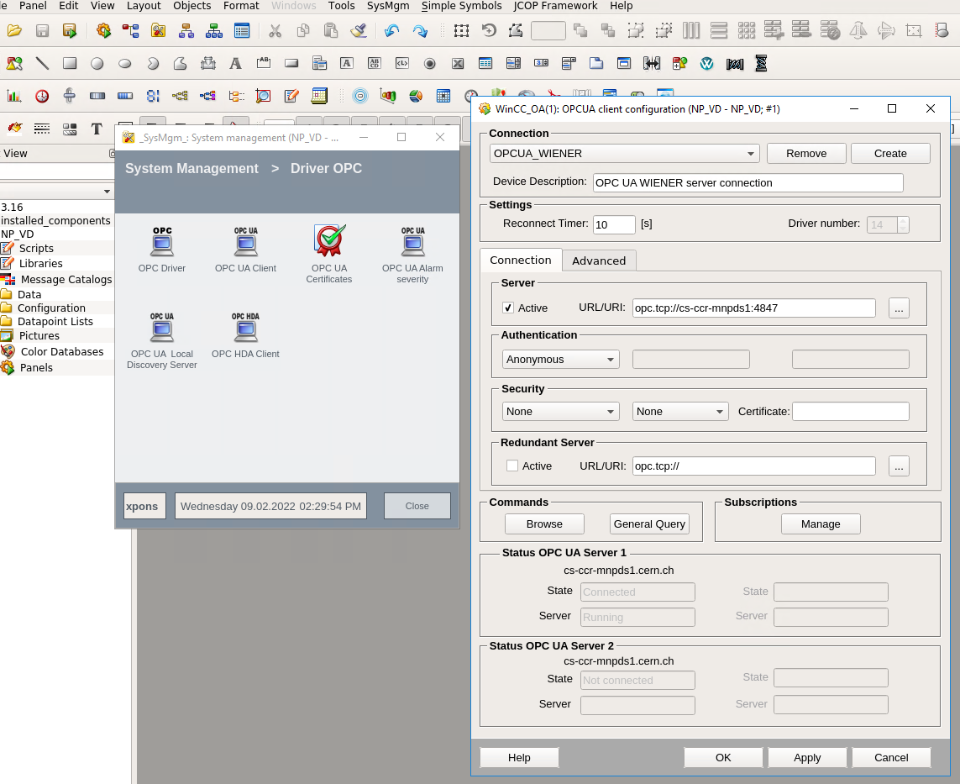
WINCC OA Step-by Step
OPCUA Client URL parametrization

Slide 10
OPC UA Step-by Step - Client URL parametrization

Slide 11
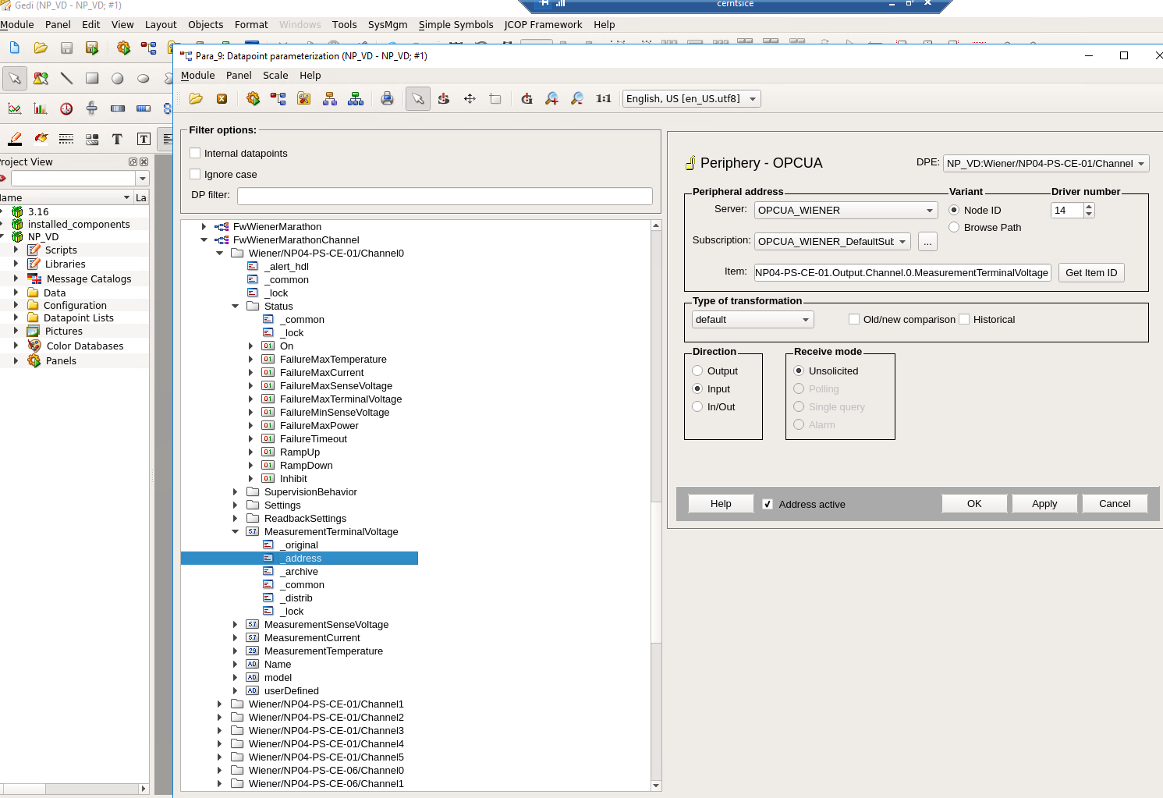
Step-by –Step – OPC UA Item address parametrization item hierarchy

Slide 12
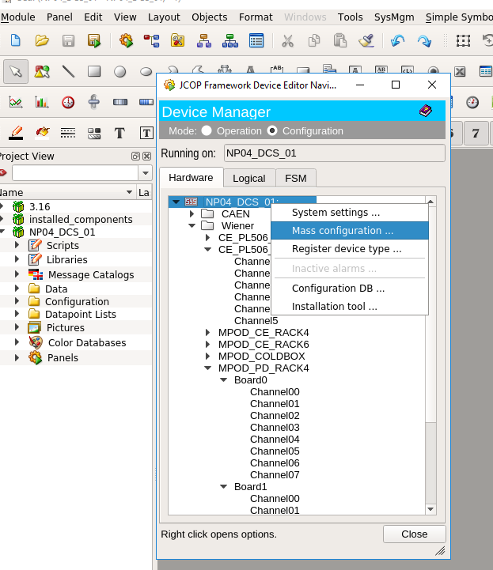
protoDune - Cold Electronic interface specifications for Slow control integration
Cold Electronics – OPC UA Server URL
Cold Electronics – Item hierarchy
Configuration, parametrization , interlock in the SC (What we do with the items)

Slide 13
protoDune - Cold Electronic interface specifications for Slow control integration
Cold Electronics – OPC UA Server URL
Cold Electronics – Item hierarchy
Wat we do with the data, configuration, parametrization in the SC

Slide 14
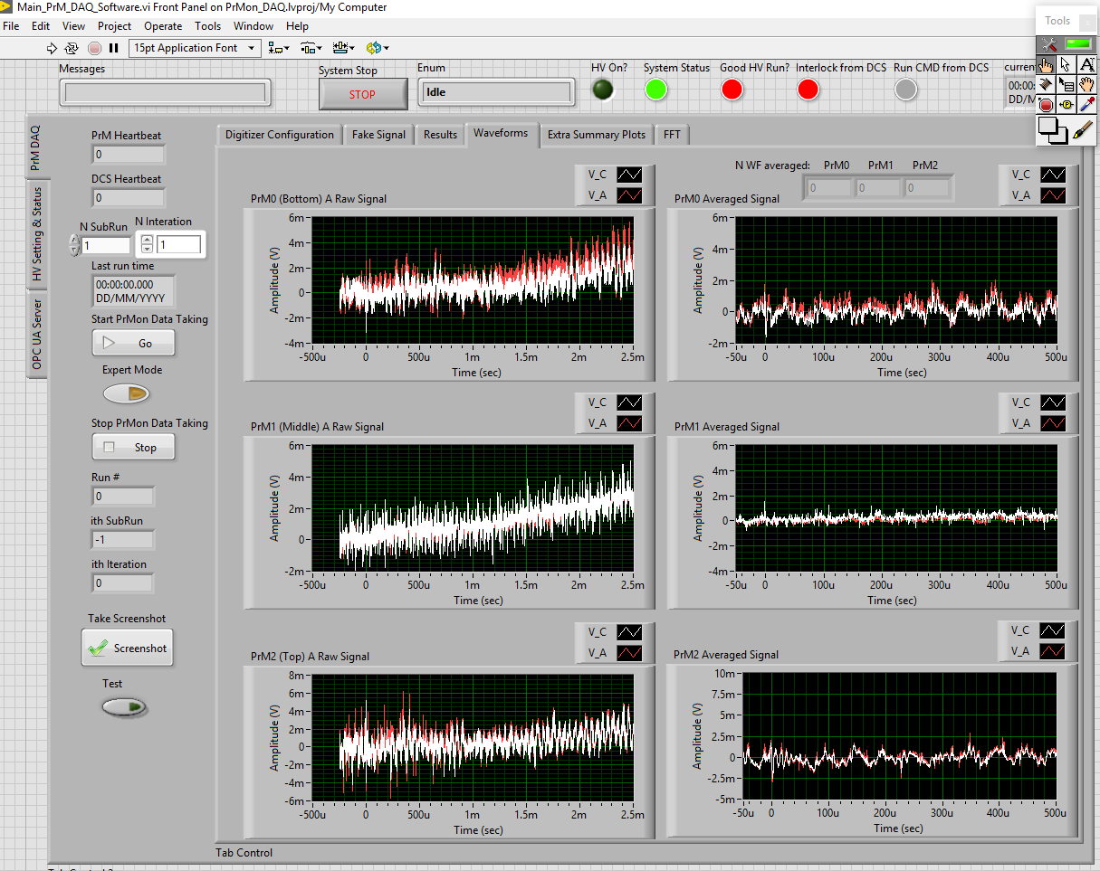
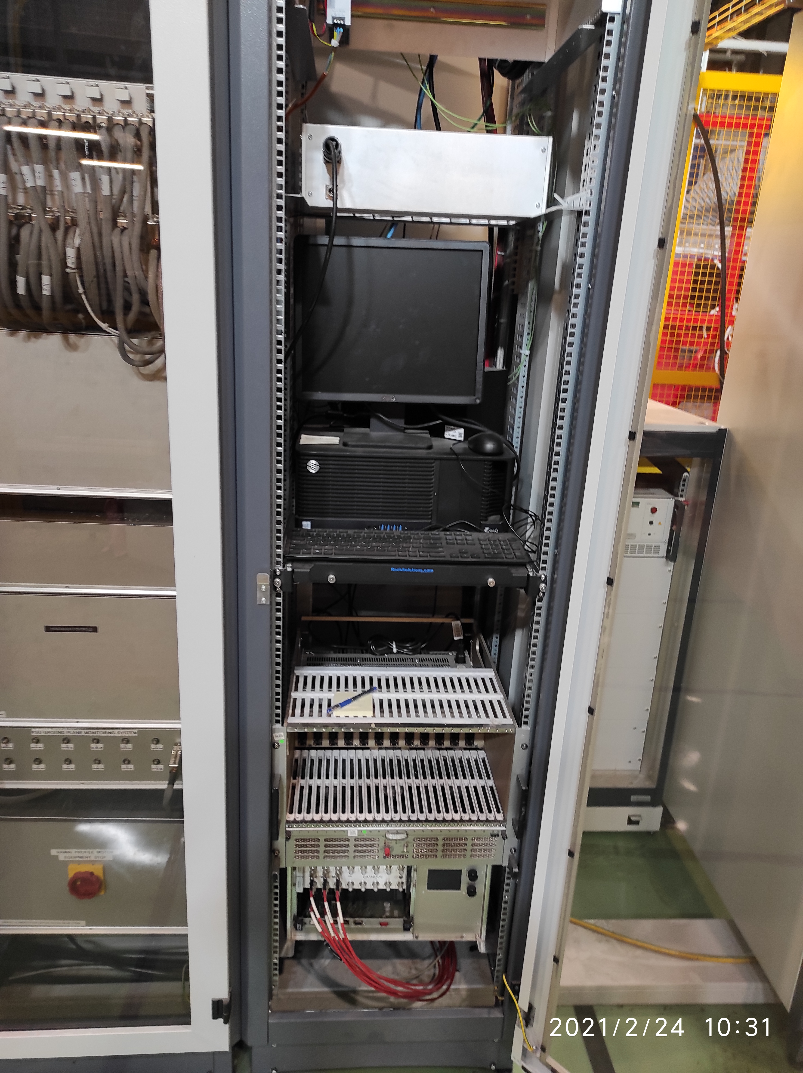
protoDune 1- Purity Monitor integration in the Slow controls
Labview Purity Monitor Control Software
Purity Monitor Rack

Slide 15
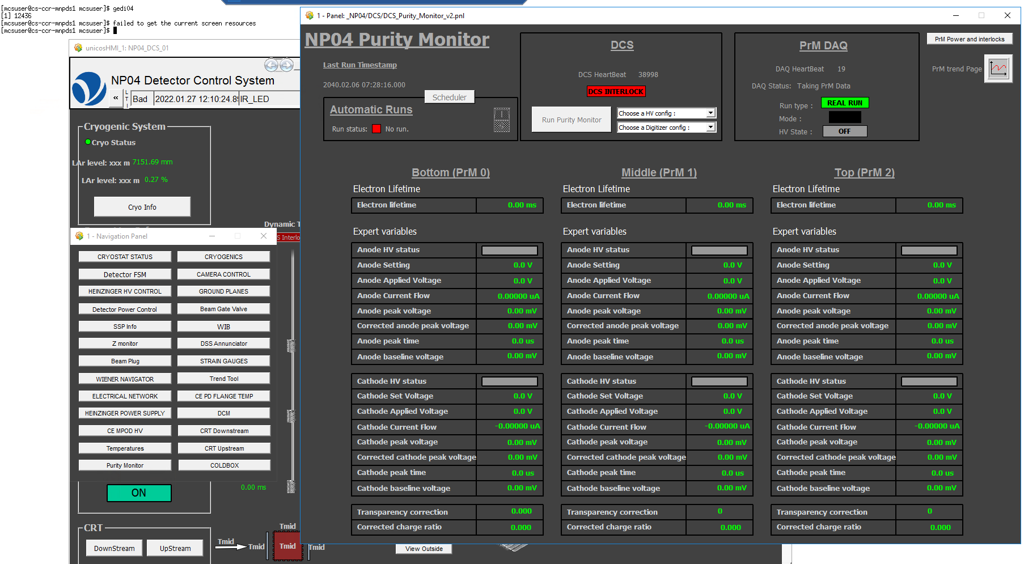
protoDune 1- Purity Monitor integration in the Slow controls
Purity monitor – Operation panel from NP04 slow controls

Slide 16
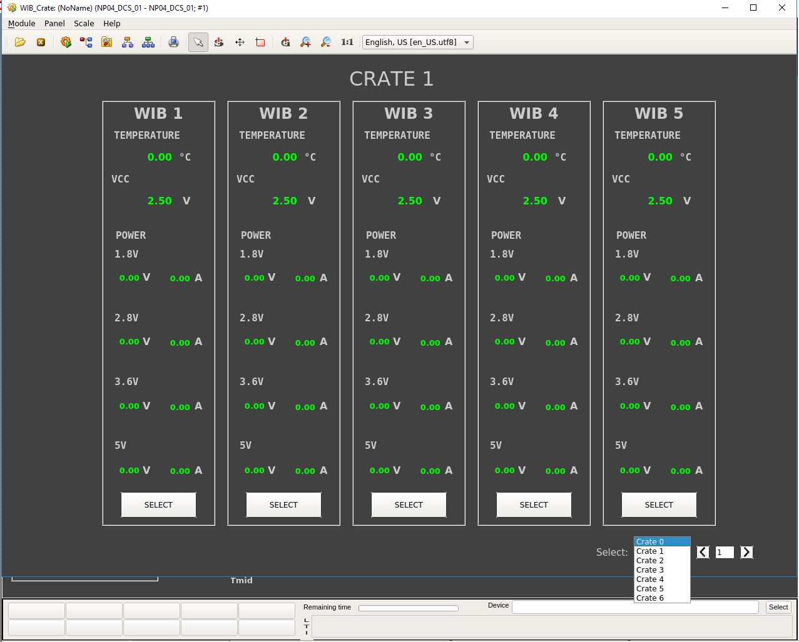
protoDUNE 1 – CE integration in the SC by using DIM. WIB Data

Slide 17
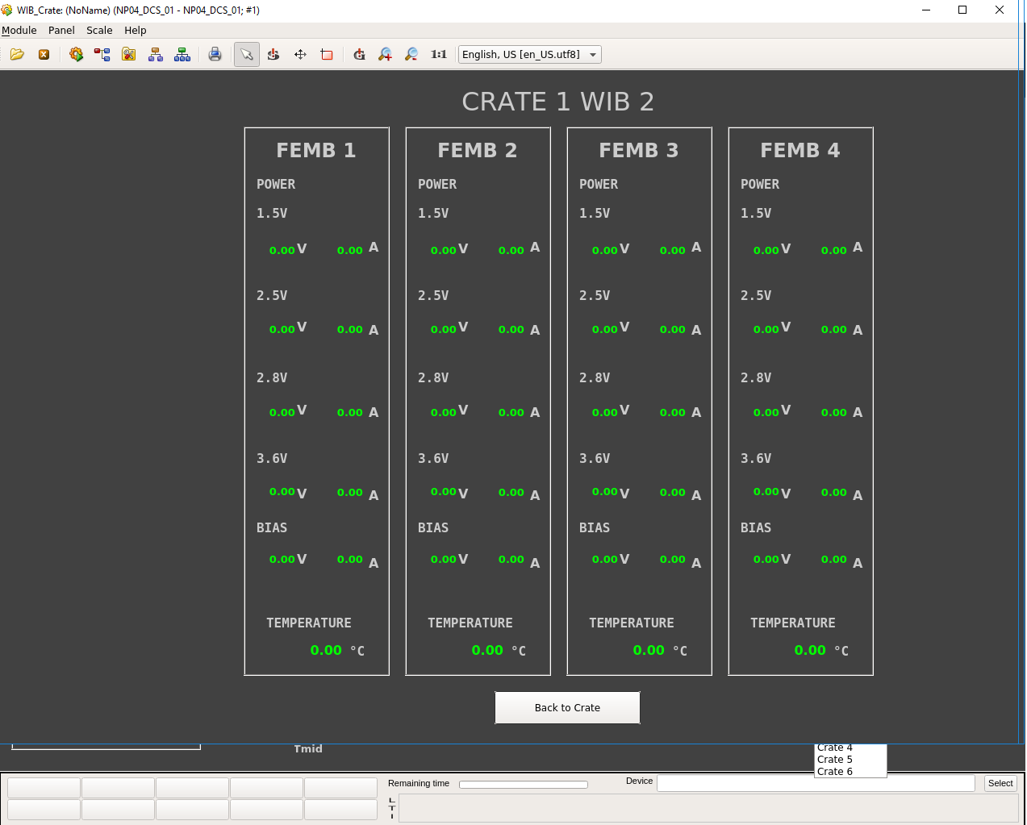
protoDUNE 1 – CE integration in the SC by using DIM

Slide 18
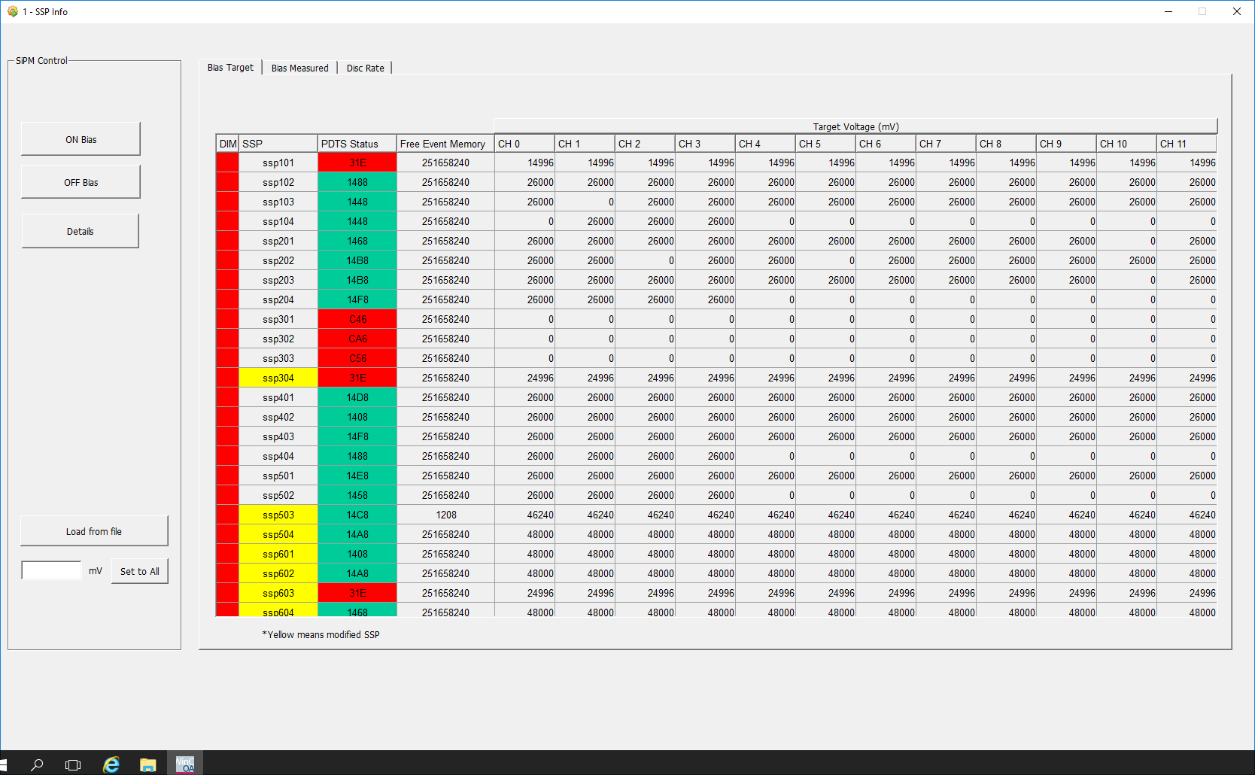
protoDUNE 1 – SSP’s Info

Slide 19
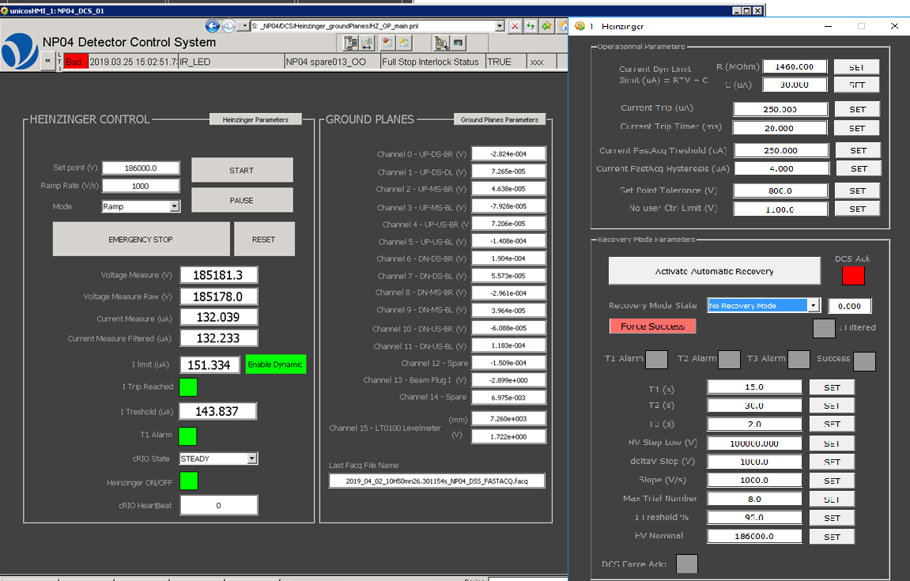
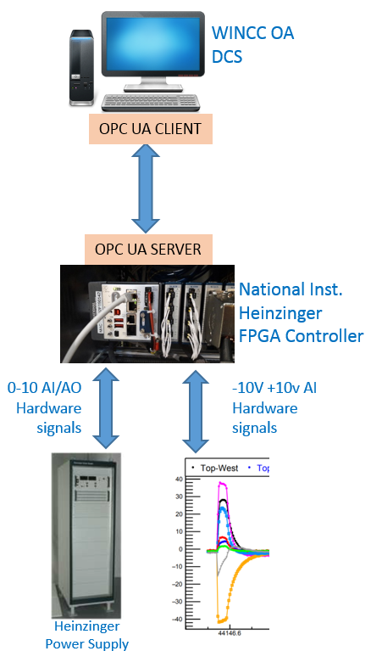
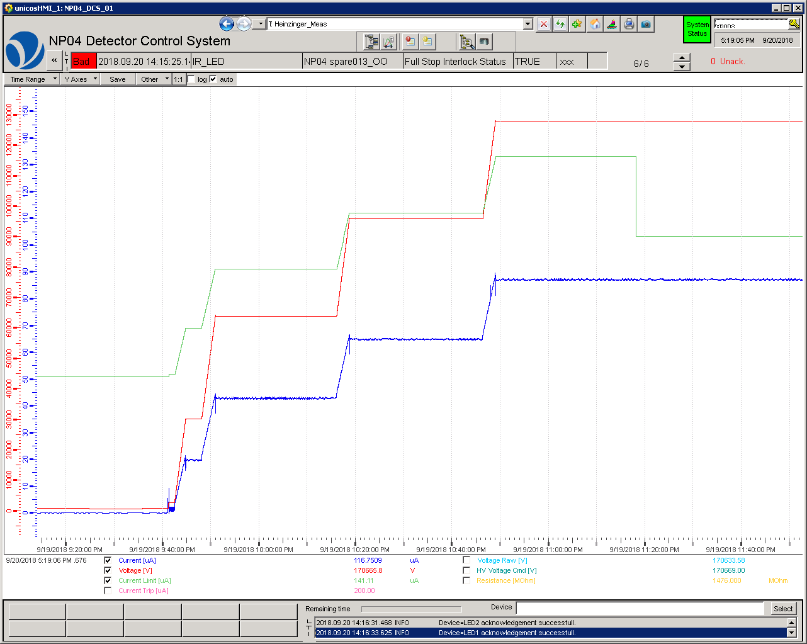
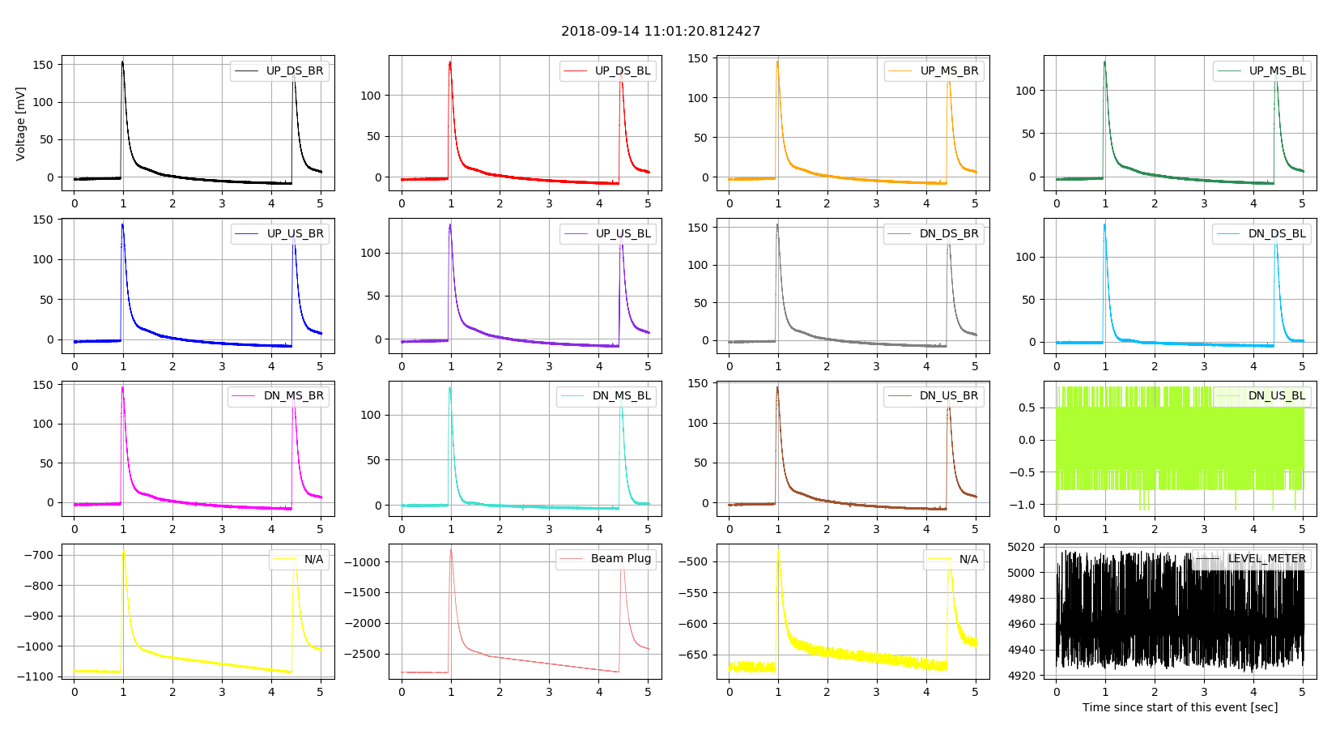
protoDUNE Single Phase Slow Control. HV integration Example
The data is transmitted to Real-Time controller, connected and integrated to the SCADA DCS program by means of the OPC UA driver for HV control, operation and monitor.
Slow Control
SCADA Software
VD SC SCADA
Heinzinger HV Control Panel
Ground Planes & Beam Plug discharge
event on 14/09/2018
Ramp up by steps on 20/09/2021 at 9:40 PM

Slide 20
Vertical Drift Coldbox Slow Control Power Supply panels

