Slide 1


MQXFA08 SG Data History
L. Garcia Fajardo, D. Cheng, P. Ferracin, G. Vallone
02/17/2022
LBNL

Slide 2
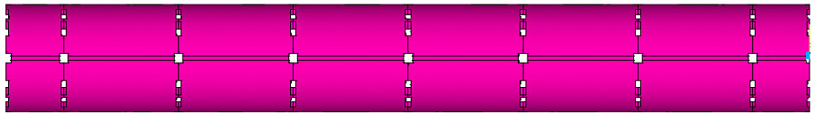
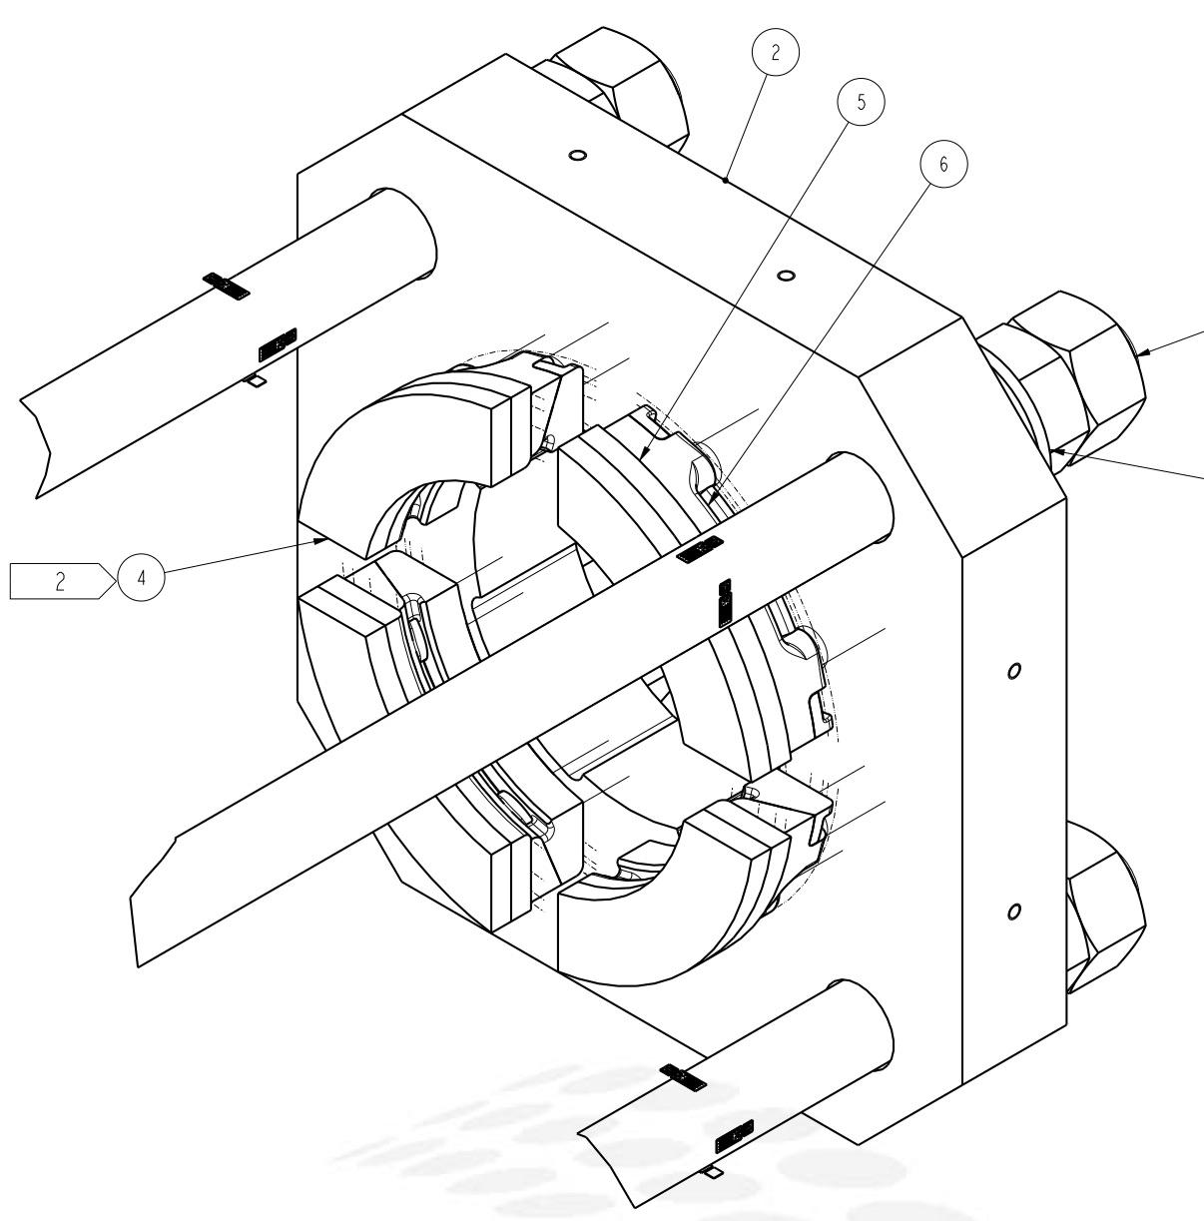
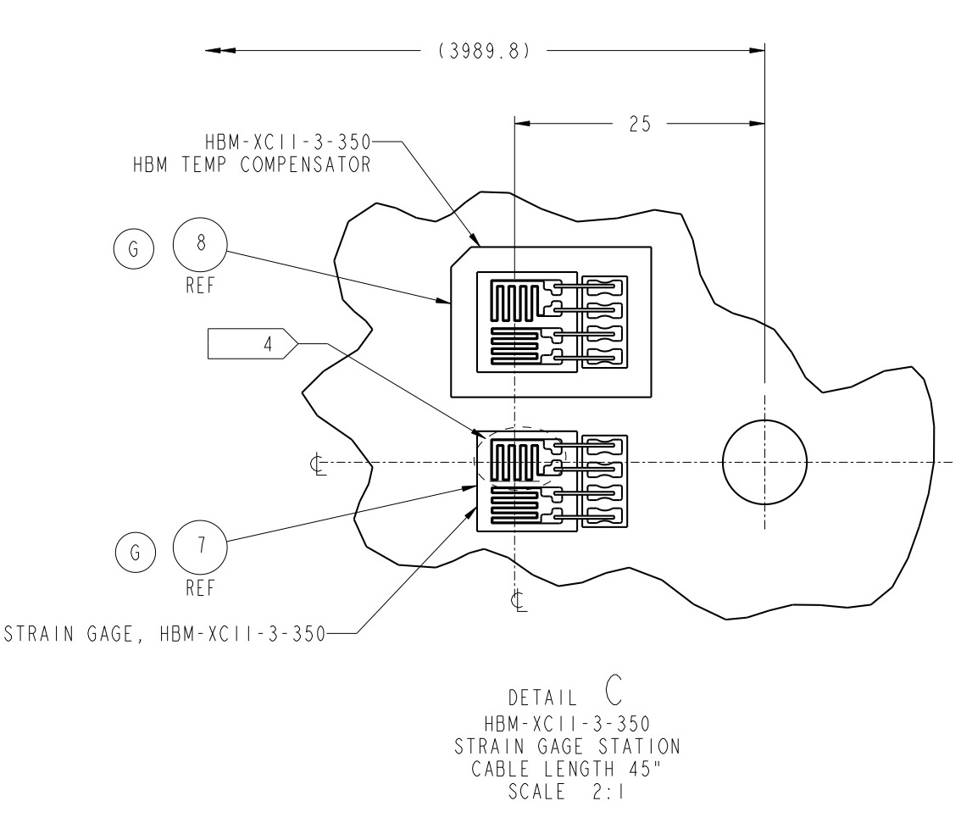
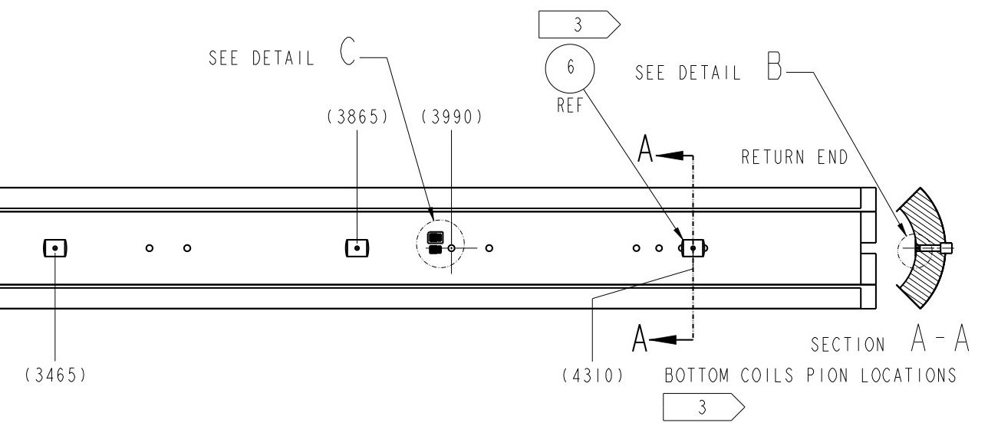
MQXFA08 SG Gauges Layout
LE
MID
RE
Shell 2
Shell 4
Shell 7
Coil Stations
Rod Stations
Only HBM gauges are installed.
Shell gauges --- three axial locations:
  Shell gauges (T & Z): on shell 2, 4, & 7
Coil gauges (T & Z): on the axial location of 3989 mm (RE) from LE.
Rod stations are located on the RE
  Each station is full bridge with four individual gauges.
Coil Stations
RE axial plate assembly

Slide 3
MQXFA08 test timeline
1st Thermal Cycle: From 10/28/2021 to 11/22/2021 (1st Cooldown to 1st Warmup)
2nd Thermal Cycle: From 12/04/2021 to 12/20/2021 (2nd Cooldown to 2nd Warmup)
3rd Thermal Cycle: From 01/07/2022 to 02/10/2022 (3rd Cooldown to 3rd Warmup)

Slide 4
Process History
(includes preload, thermal cycles, all quenches and some ramps)

Slide 5
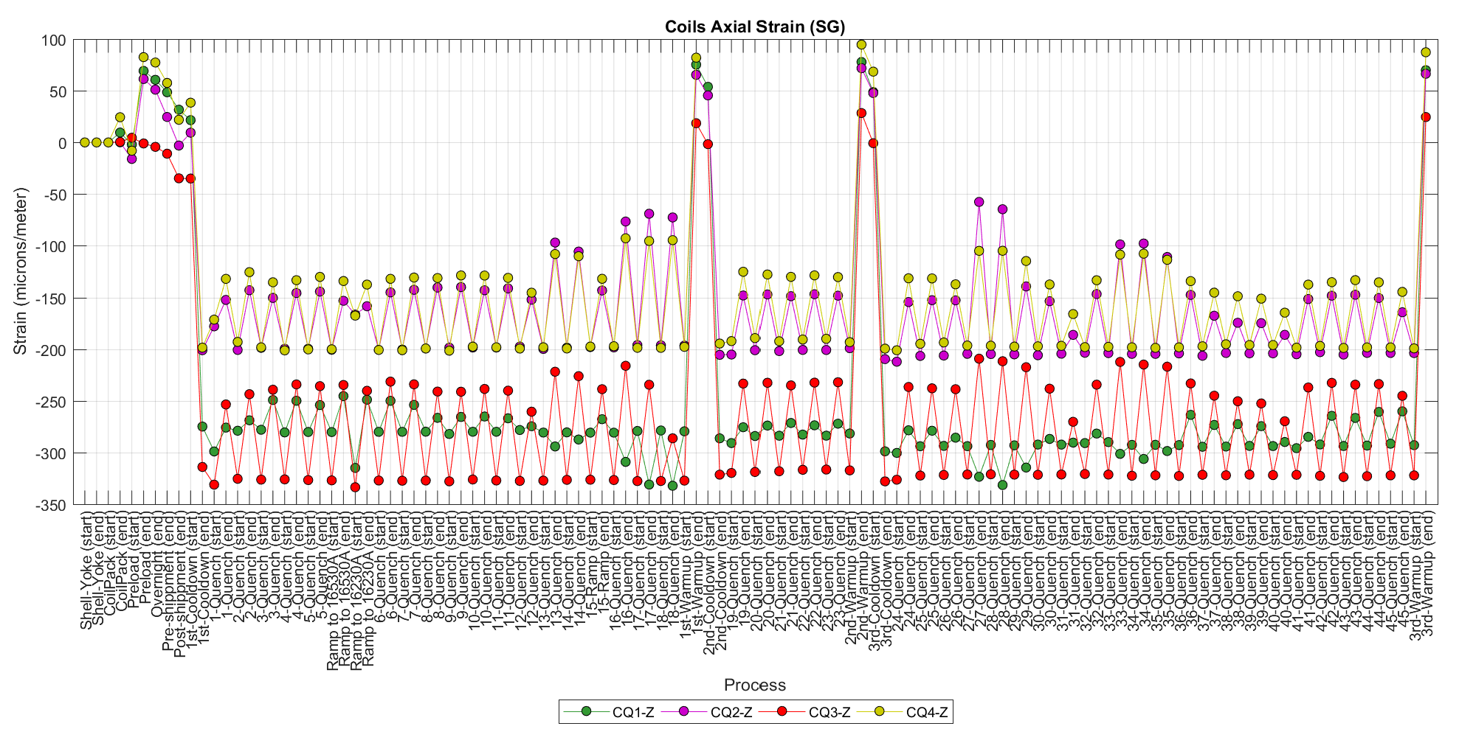
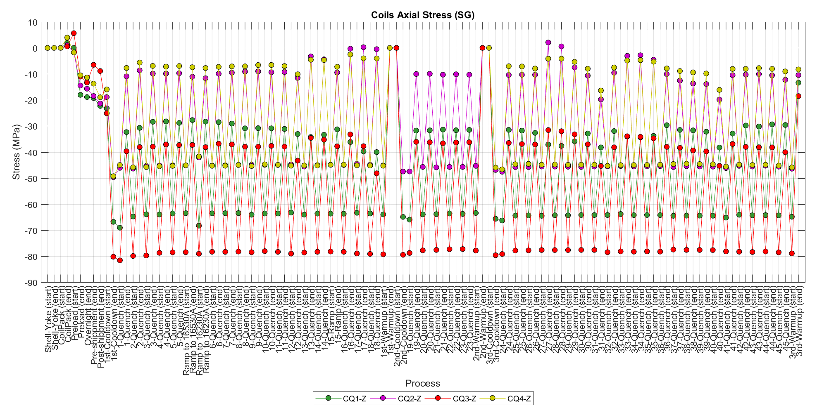
SG Data History (only quenches and some ramps) – Coils Axial
Quenches at 4.5 K:
12, 17, 18, 32-36, 42-44
Ramps at 20 A/s:
1-12, 15, 19-26, 30, 32, 36, 37, 41, 42, 45

Slide 6
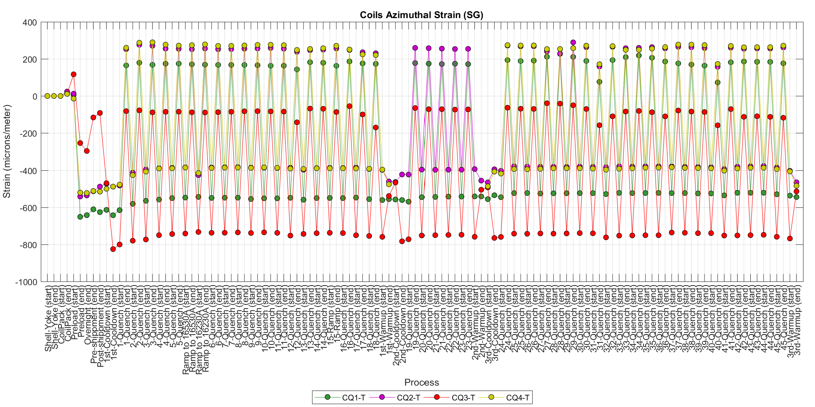
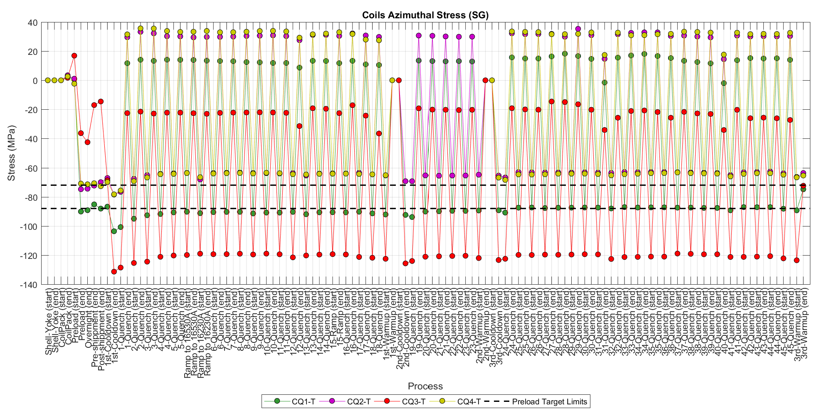
SG Data History (only quenches and some ramps) – Coils Azimuthal

Slide 7
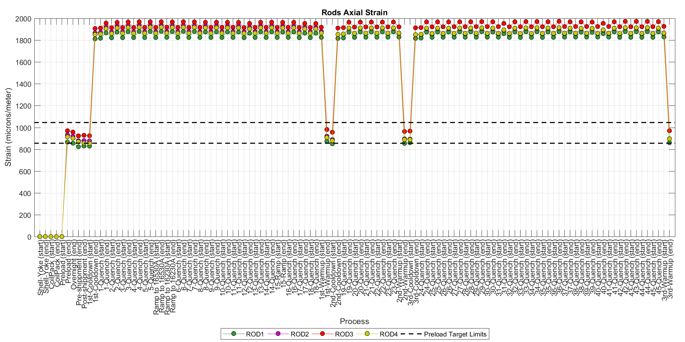
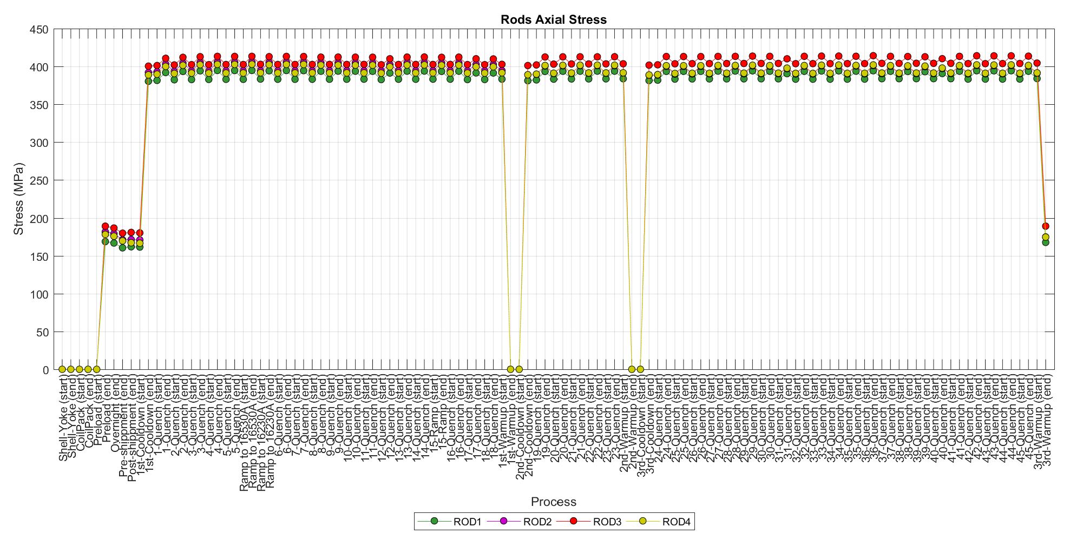
SG Data History (only quenches and some ramps) – Rods Axial

Slide 8
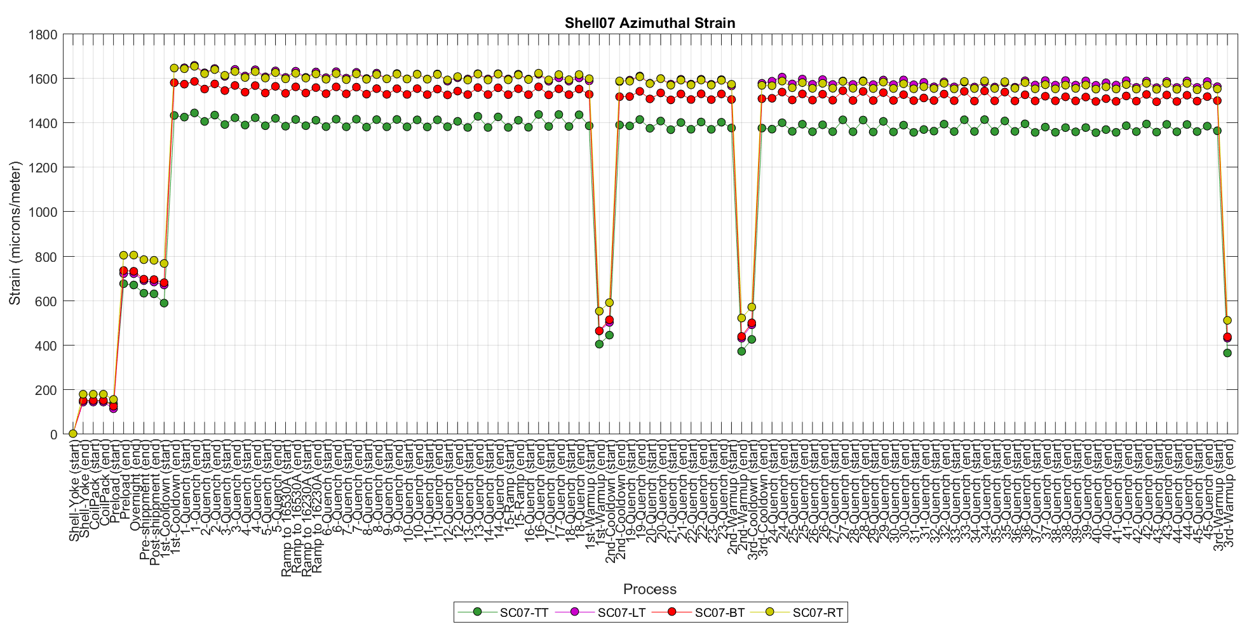
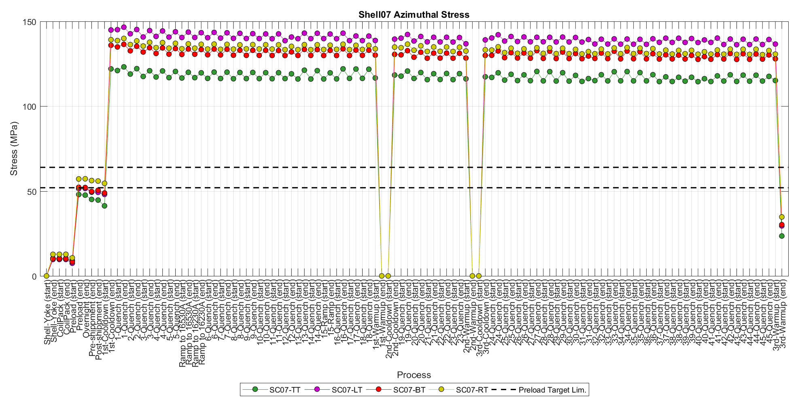
SG Data History (only quenches and some ramps) – Shell07 Azimuthal

Slide 9
Cooldown
(coils’ axial behavior)

Slide 10
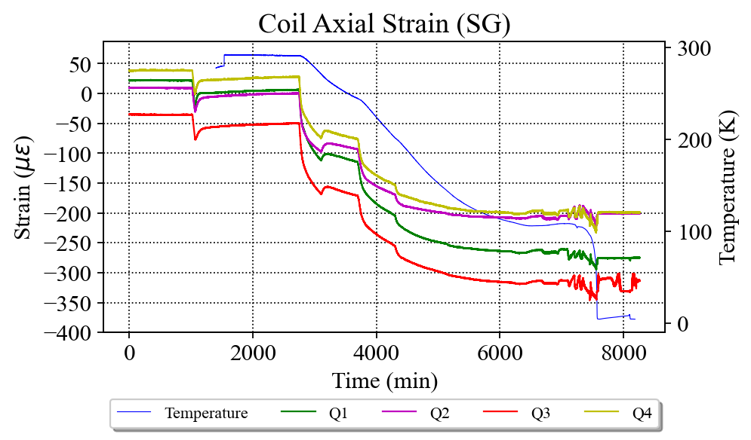
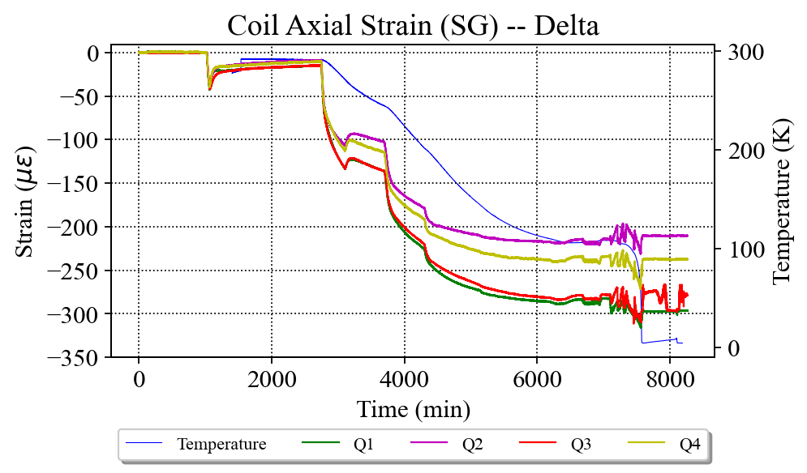
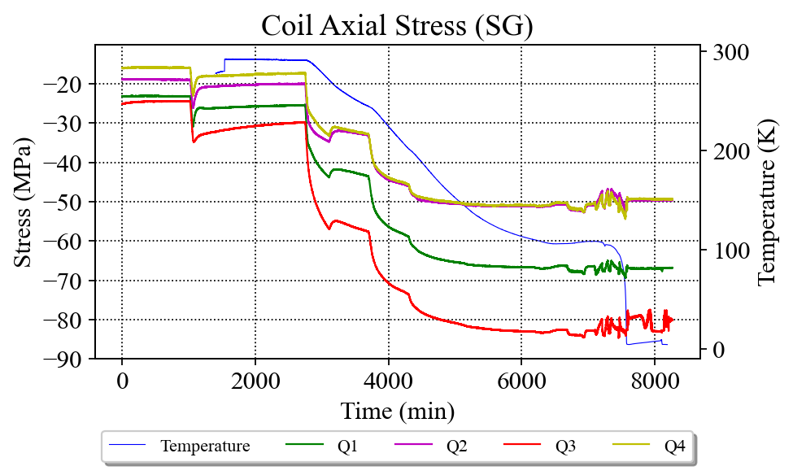
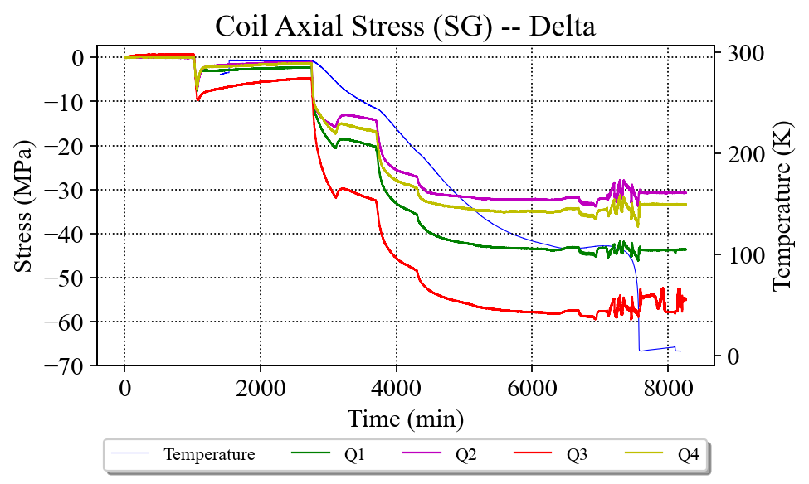
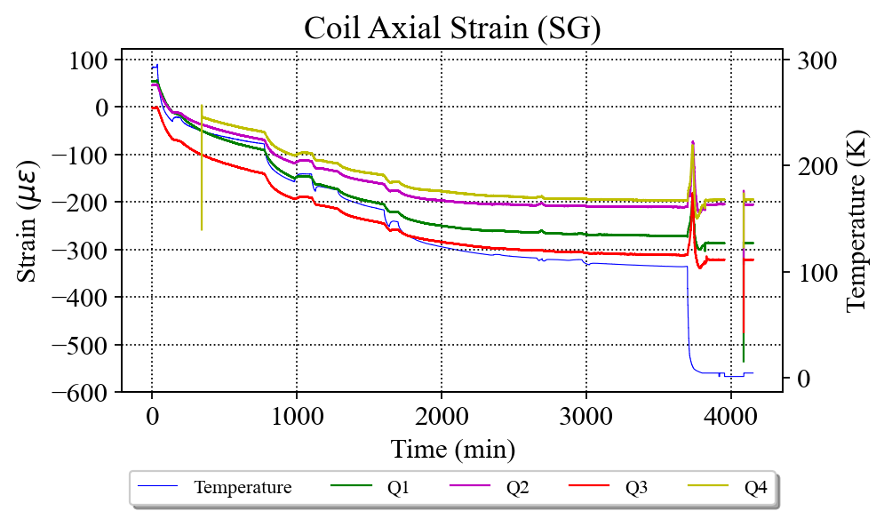
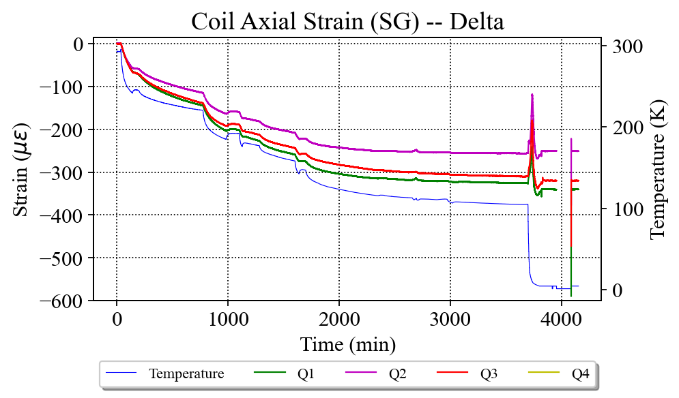
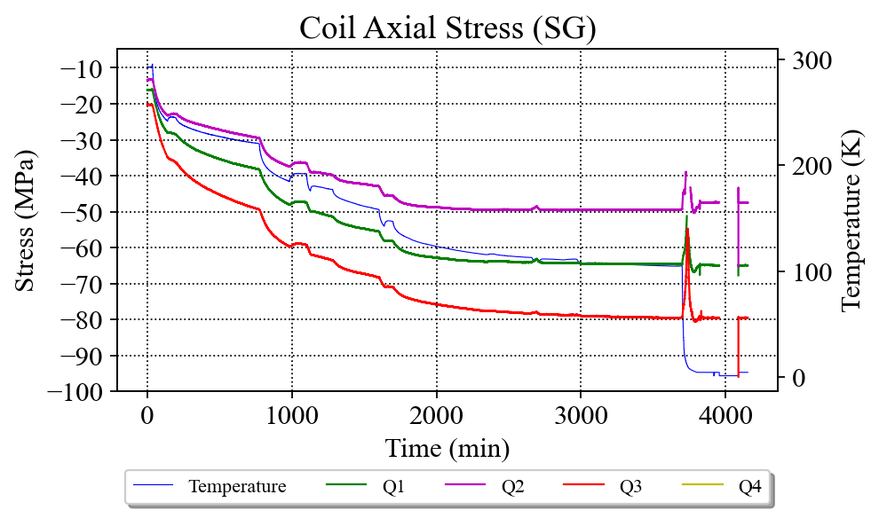
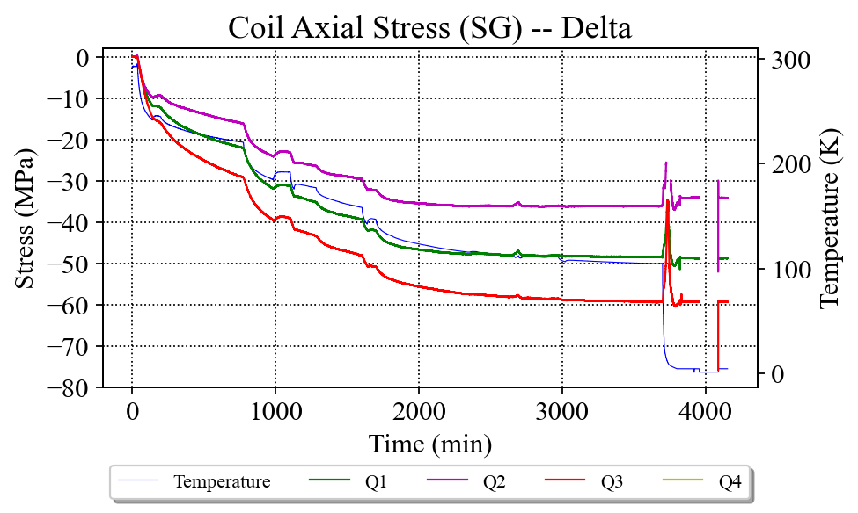
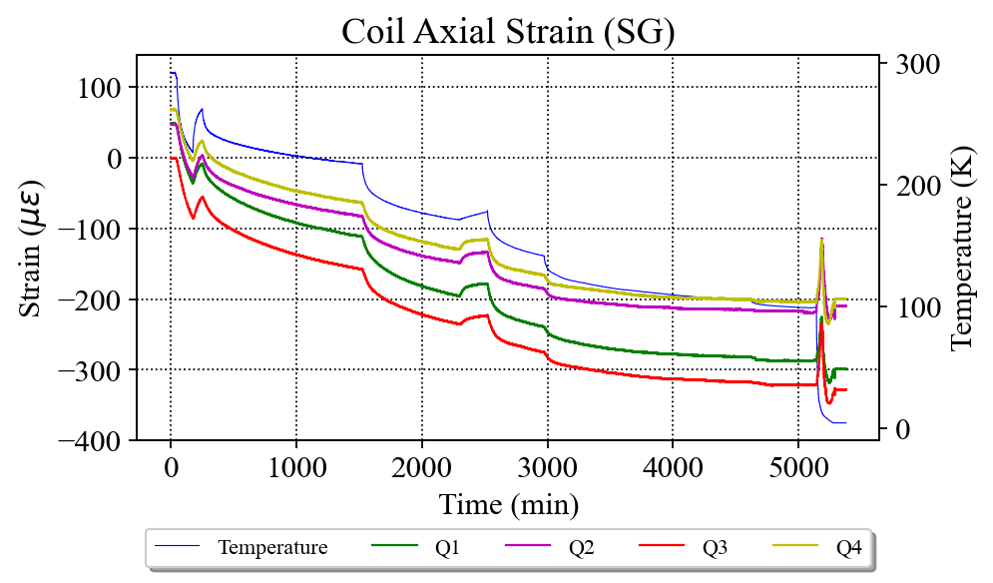
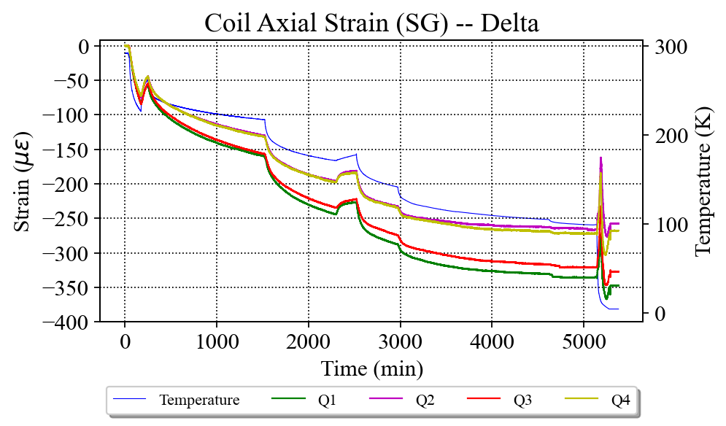
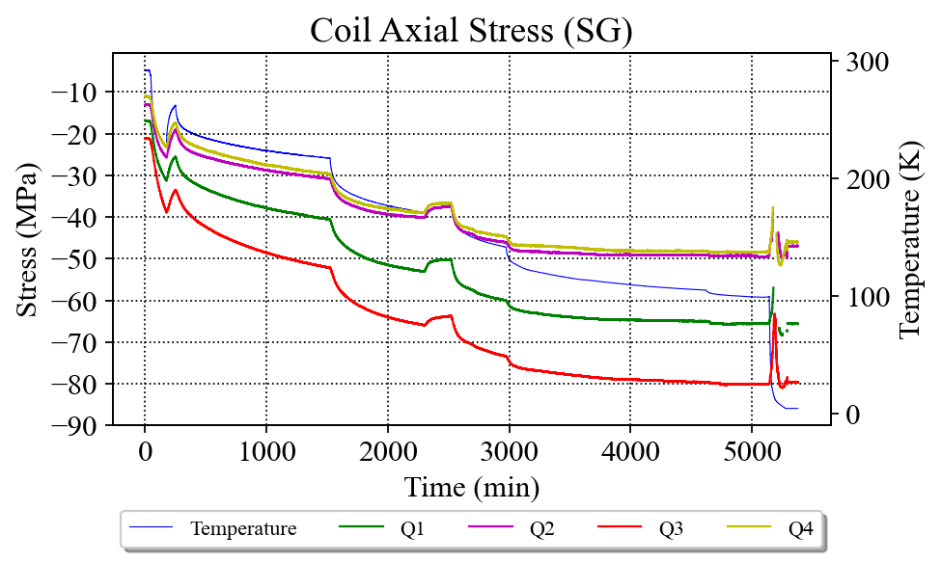
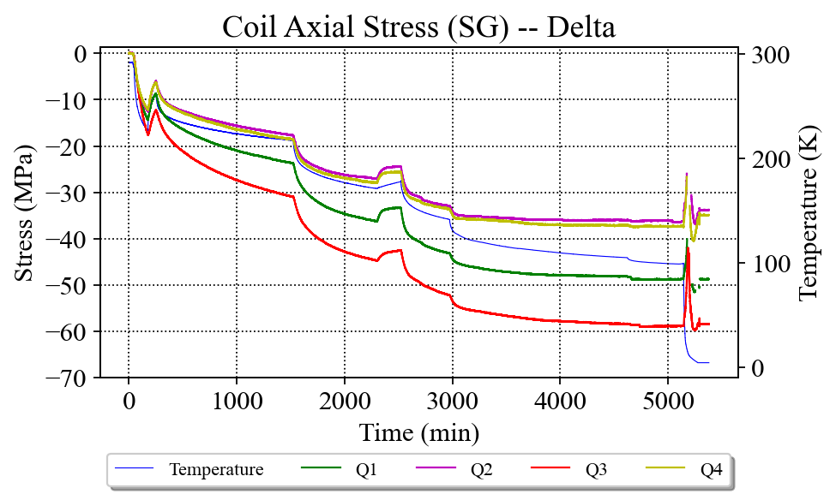
Cooldown – Coils Axial behavior
1st Cooldown
2nd Cooldown
3rd Cooldown

Slide 11
Quenches 1 and 16
(coils’ azimuthal and axial behavior, and rods’ axial behavior)

Slide 12
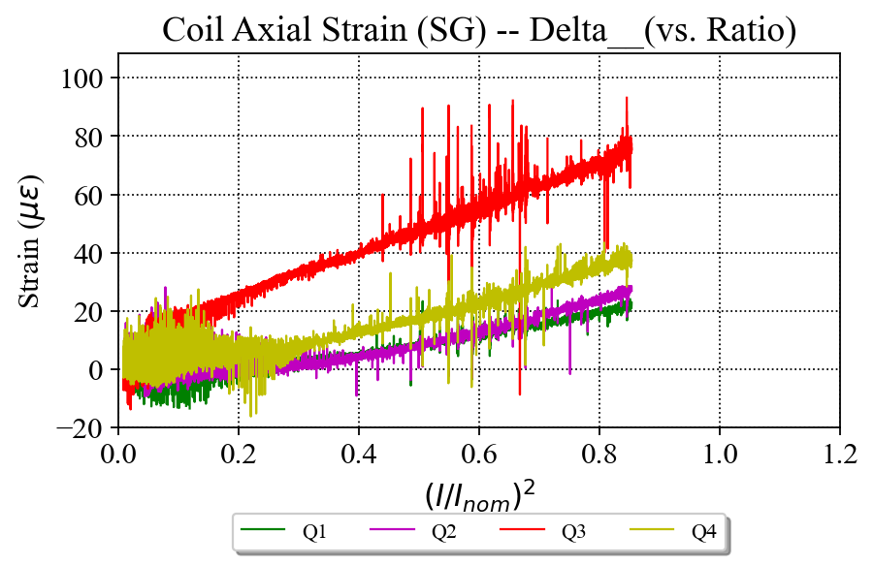
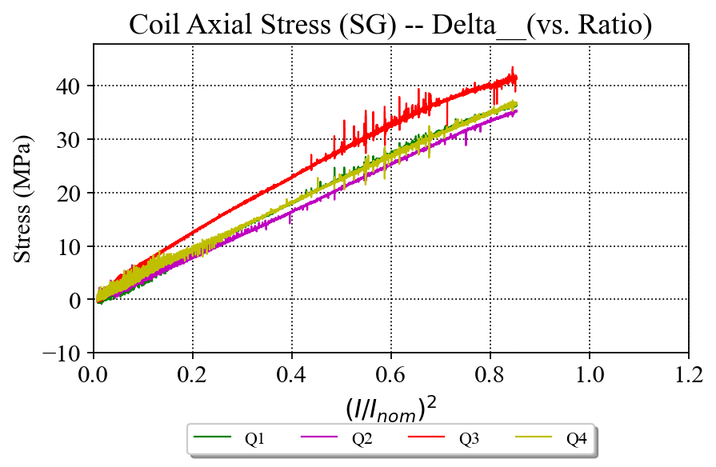
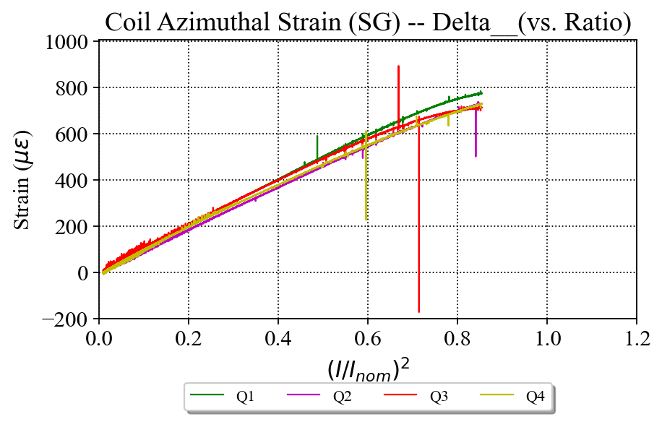
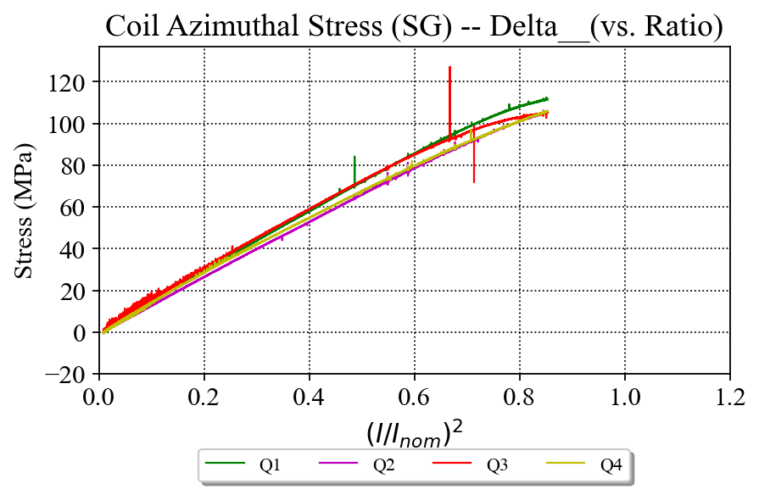
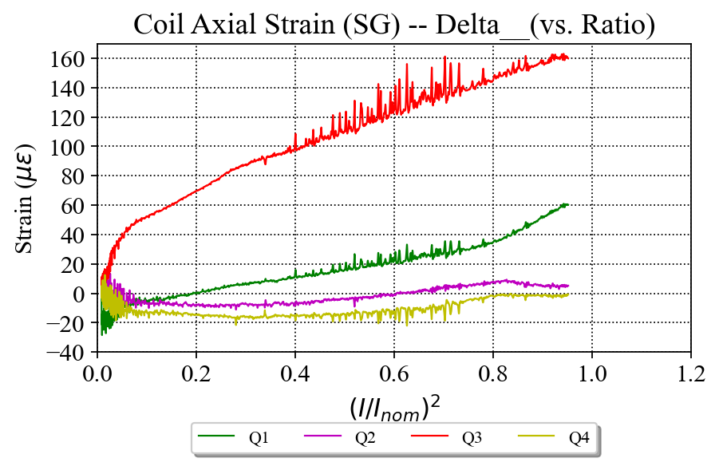
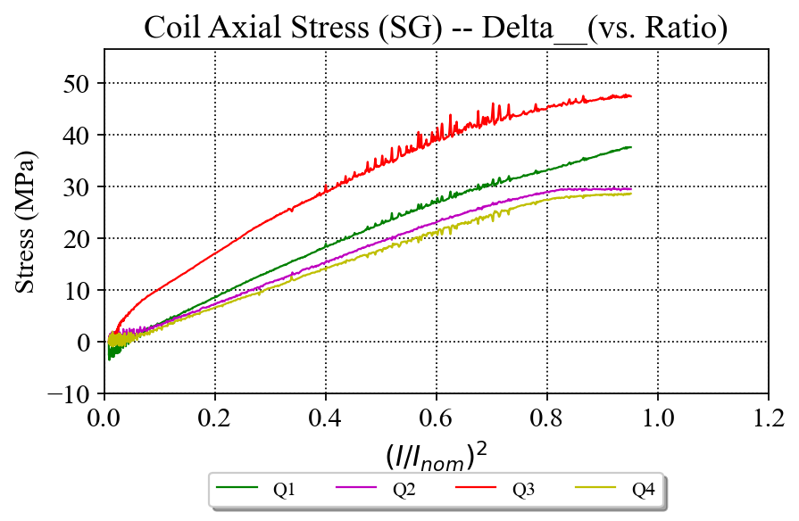
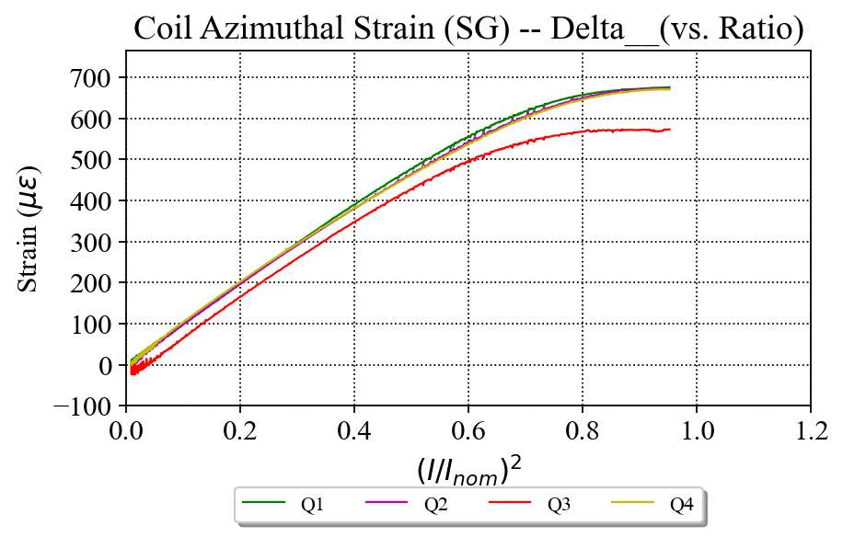
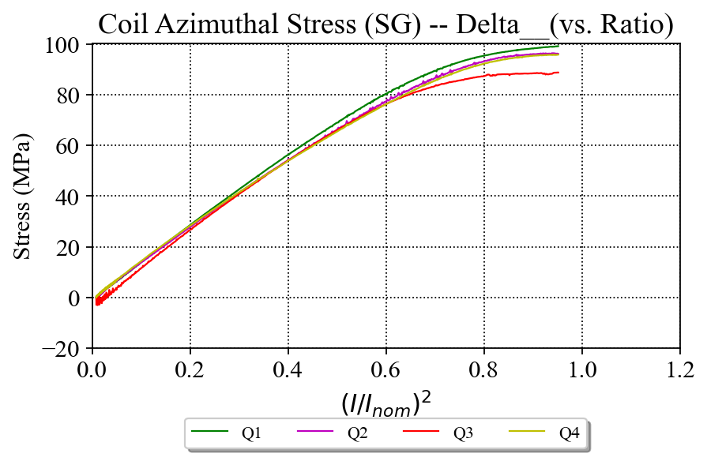
Quenches 1 and 16 – Coils Azimuthal and Axial behavior -- Delta
Quench 1 (20 A/s)
Quench 16 (100 A/s)

Slide 13
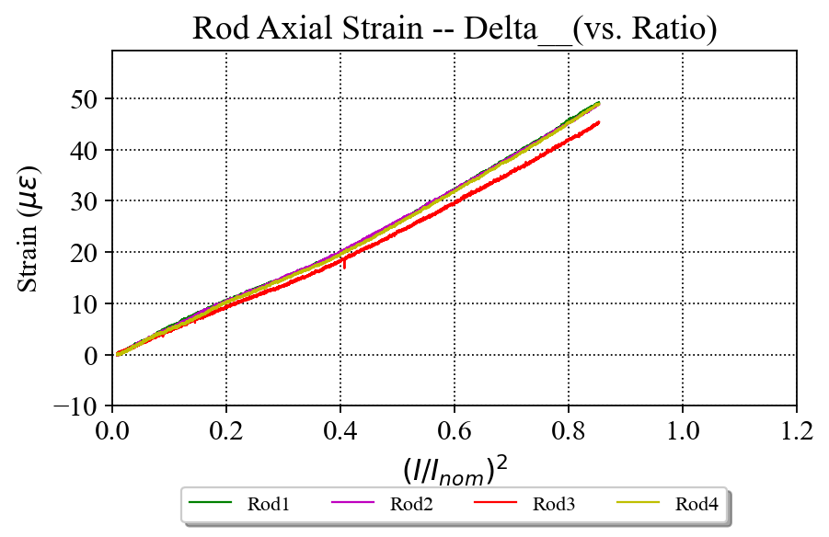
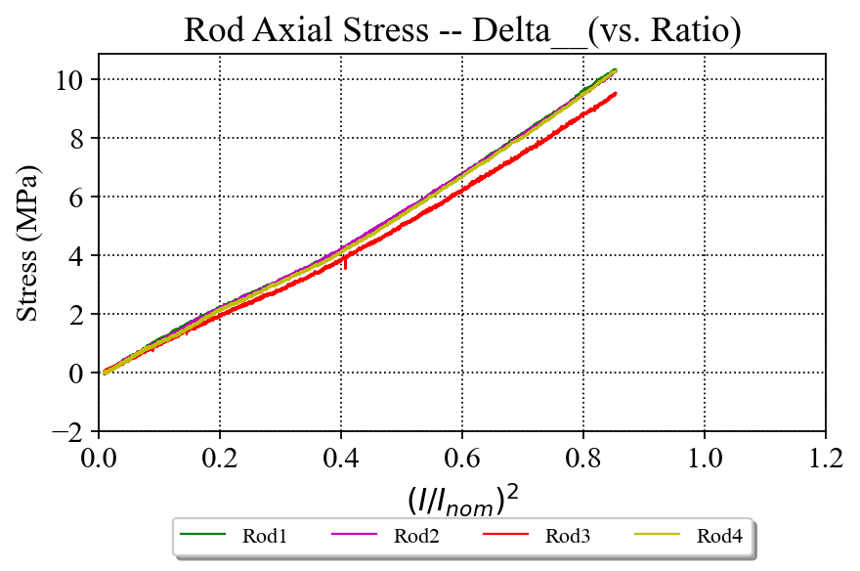
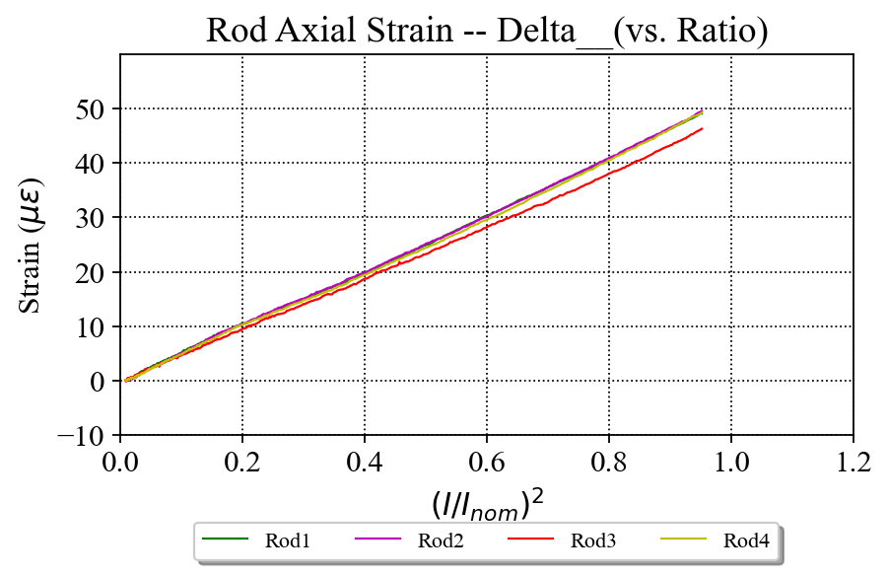
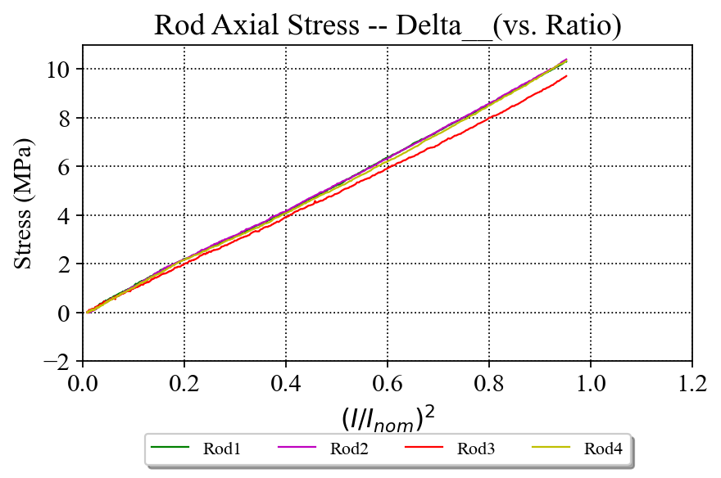
Quenches 1 and 16 – Rods Axial behavior -- Delta
Quench 1 (20 A/s)
Quench 16 (100 A/s)

Slide 14
MQXFA06, 07 and 08: Coils’ azimuthal stress corrected with averaging up- and down-ramps

Slide 15
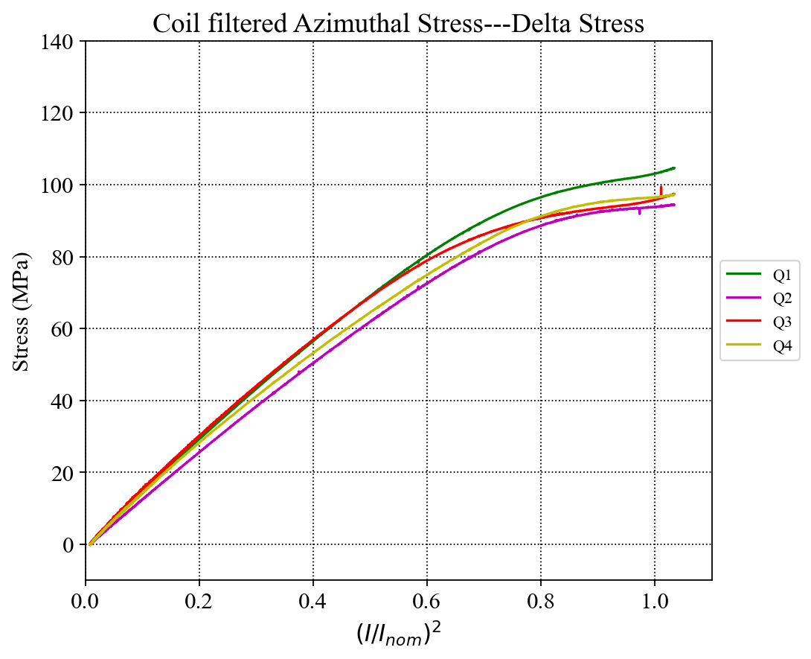
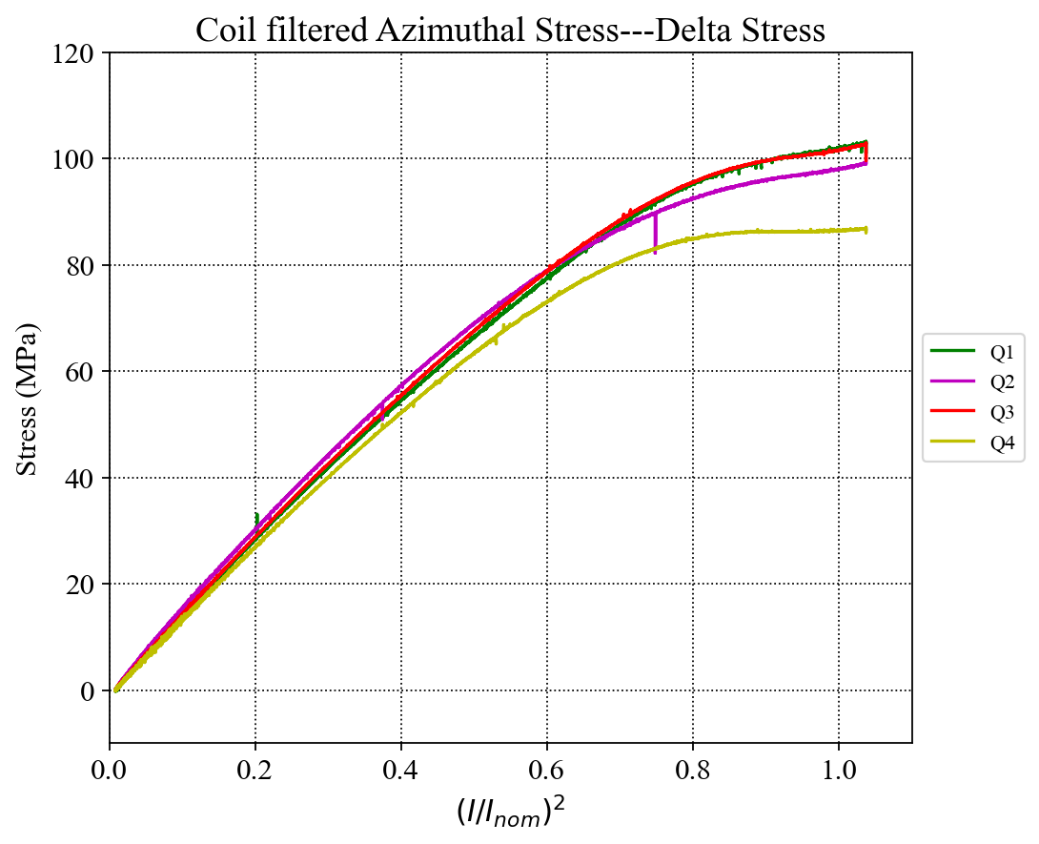
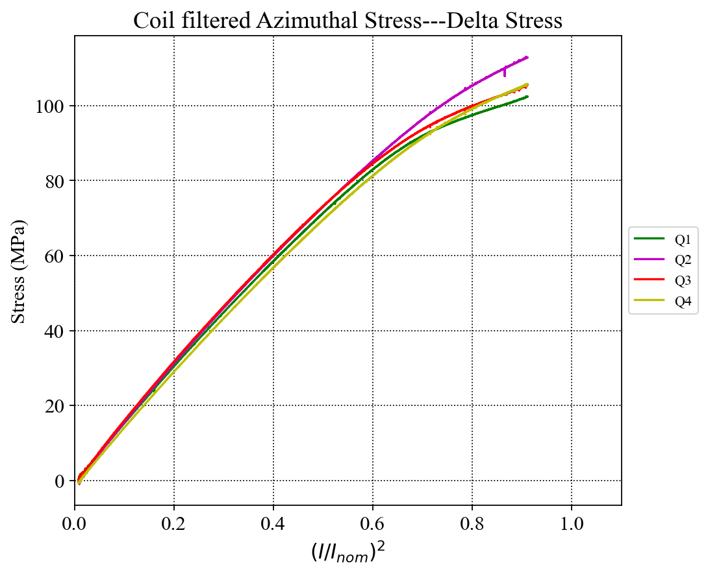
MQXFA06-MQXFA08 Unloading Comparison, corrected Ramps, Deltas
MQXFA06
Ramp to 16530 A
MQXFA07
Ramp to 15500 A
MQXFA08
Ramp to 16530 A

Slide 16
Appendix
Quenches 12, 17 and 18: quenches at 4.5 K during the 1st thermal cycle

Slide 17
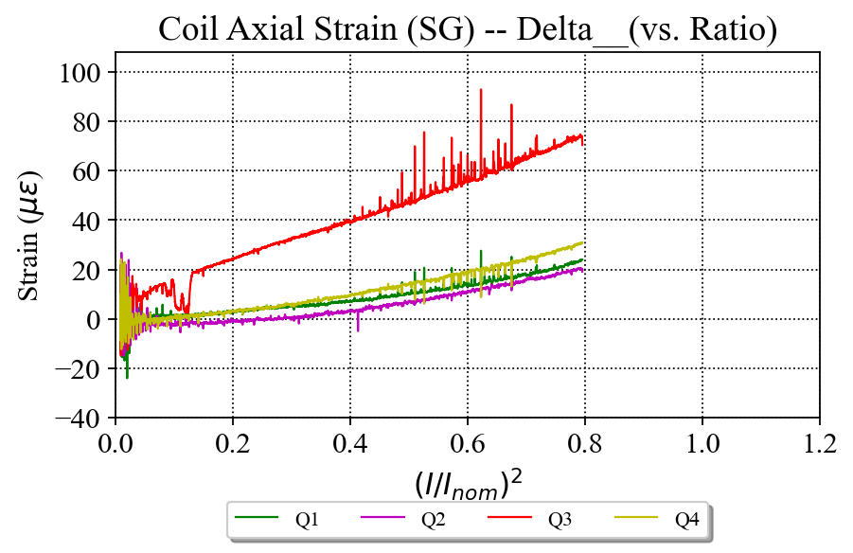
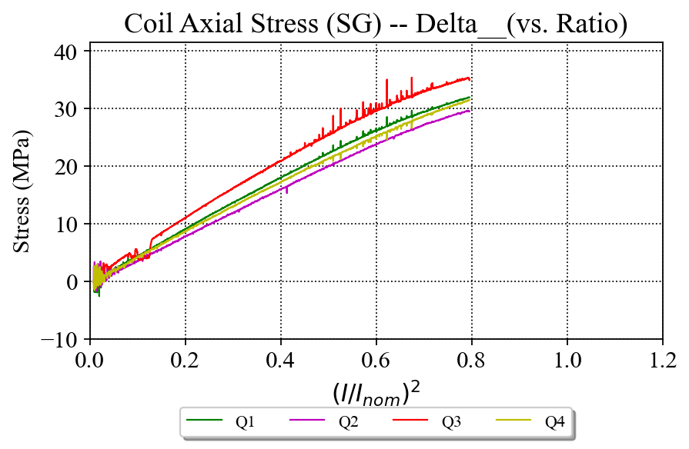
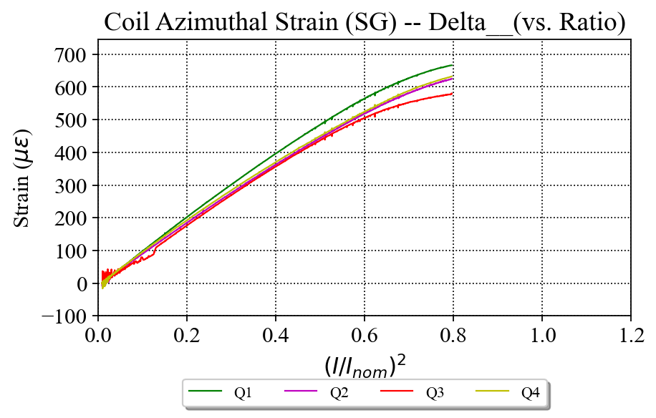
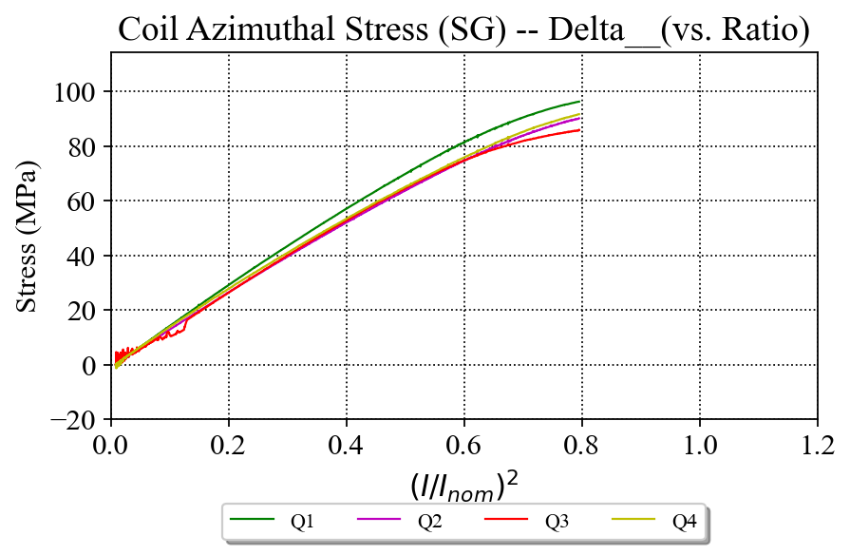
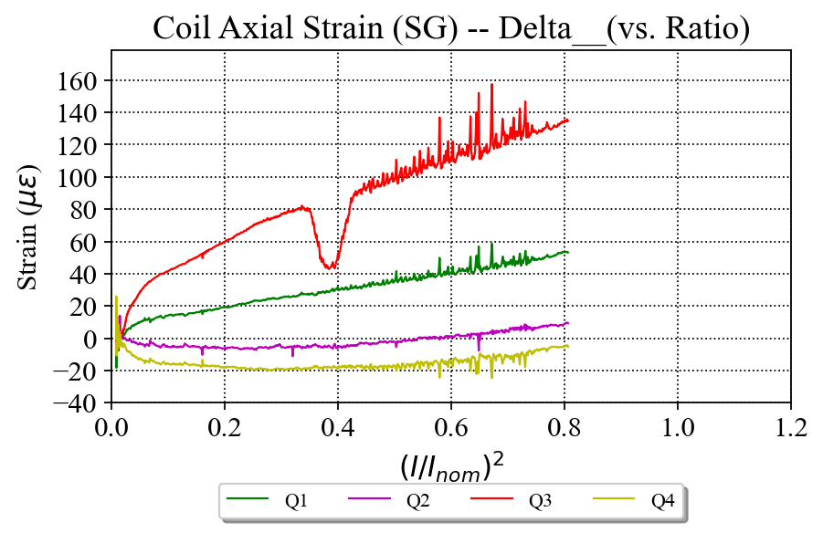
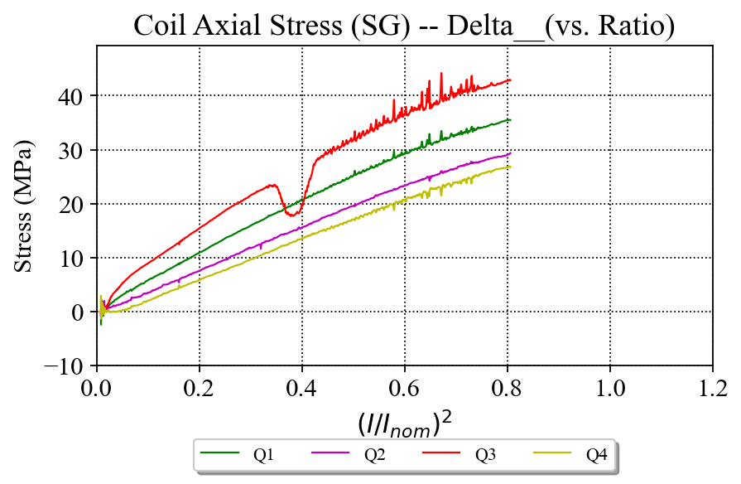
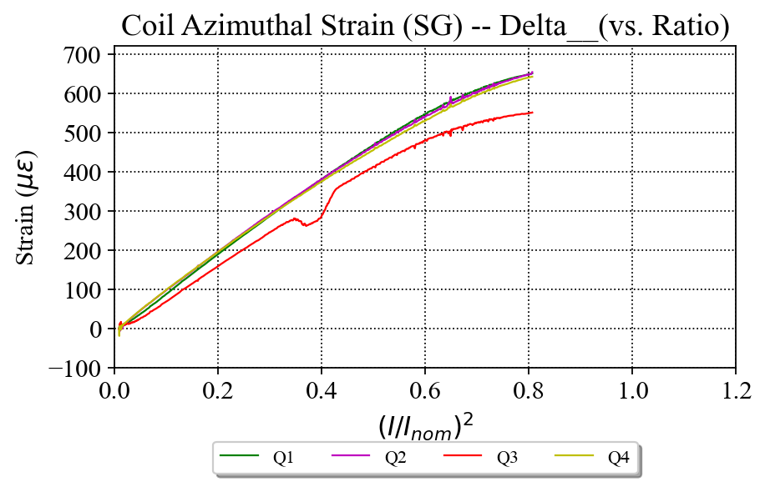
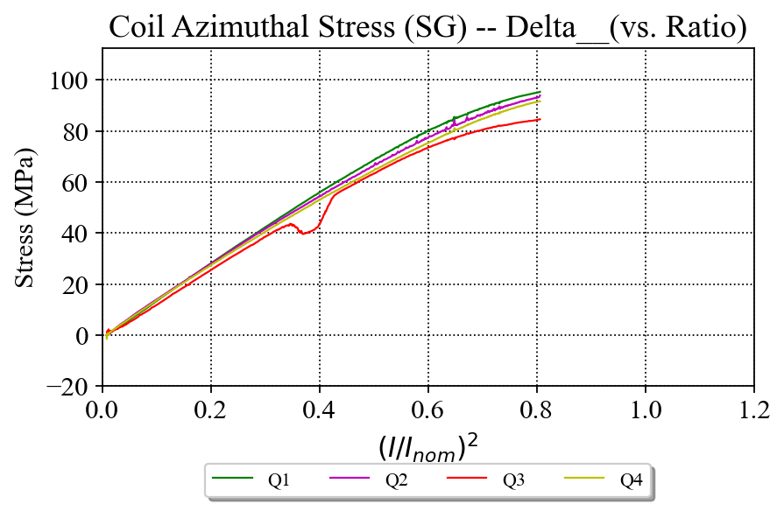
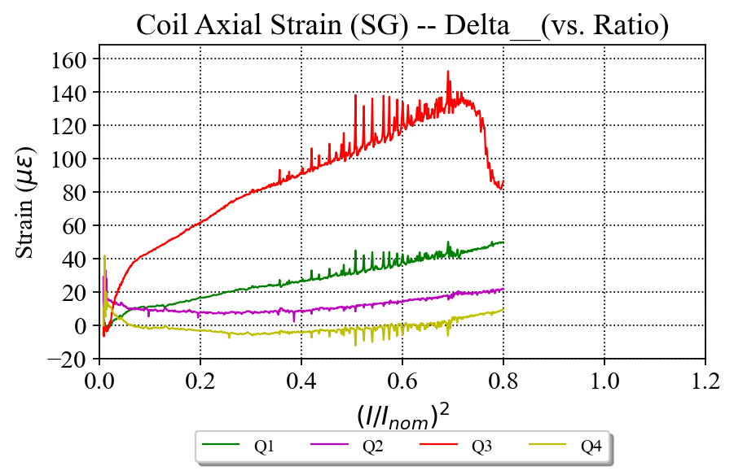

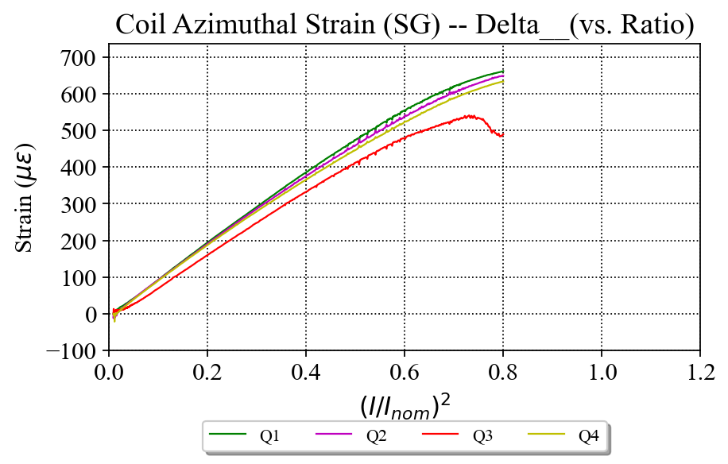
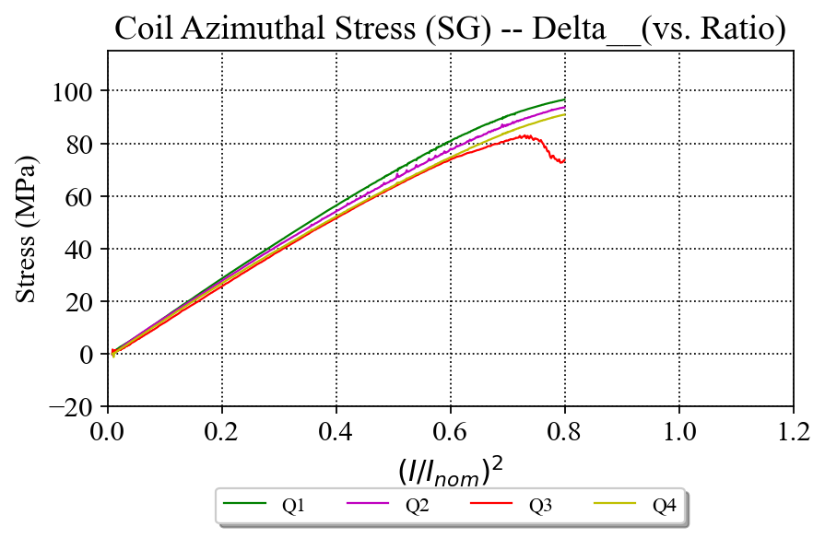
Quenches 12, 17 and 18: quenches at 4.5 K during the 1st thermal cycle
Quench 12
Quench 17
Quench 18

Slide 18





E.M. Effect is Apparent on Coils and Shell 7
(this example is for magnet 5 but applies to all)
Despite not yet fully processing the files, the gauge readings of the coils and the shell 7 appear to be noisy during current ramps
Similar effects have been observed in earlier magnets
The noise on the signals is most likely from the dI/dt.
Noisy signal
LP Filter
Cutoff frequency:0.25 Hz
Clean signal
Clean signal
Noisy signal
(note the different scale from Shells 02 and 04 plots)

Slide 19


Reference: MQXFA03 Coil Azimuthal --- over I²
C204 ramp up
C204
LP Filter
Cutoff frequency:0.25 Hz
C110 & 111 ramp down
C110 & 111 ramp up
C110
Combined the ramp up and ramp down data, the three coils actually behave identically.
The readings of the “turn around” part are likely to be combined with inductive components;
The “up-warp” on the curves of C110 & 111 may be not mechanical. It is “bended” by the field.
C204 ramp down
The readings of this part may the combination of actual SG and inductive components
C111
I_{norm} = 16.47 kA

Slide 20


MQXFA04 Coil Strain --- over I²
The exact same behavior as seen in MQXFA03 (next slide).
From what we have learned from MQXFA03, there is no issue in the 10 kA ramp tests.
I_{norm} = 16.47 kA

