Slide 1
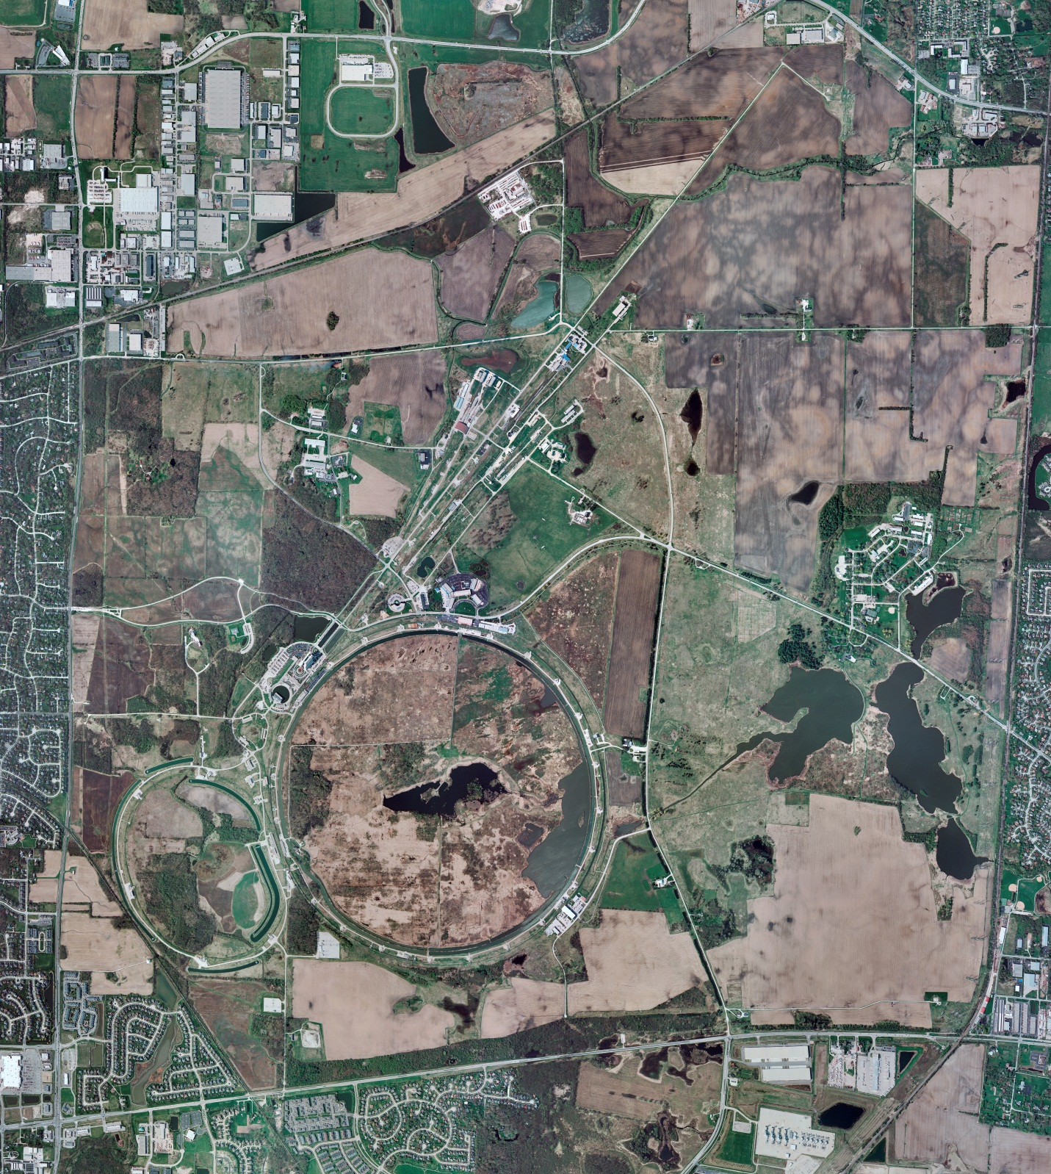
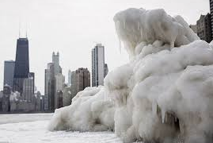
Helium Cryogenics
Status 2/11/2022 J.Makara
CMTF: SCP cryo system cold and operating fine, though investigating excessive nitrogen contamination to Purifier
CMTS: 1.3 GHz HEvCM removed
PIP2IT: SSR1 cooldown was completed and testing in progress at 2 K
HB650 installation prep continues
MCTF: cryo system shut down at RT though LN2 Tank cold
MDB/HTS: at RT
MDB/STC: at RT
MDB Magnet: at RT
NML/FAST: Cryo system shut down and isolated at RT except LN2 tank cold
CC1/CC2/CM: CC1, CC2, and CM at RT with cave configured for ODH=0
IB1: cryo system cold and running fine with test stands at 4 K and 2 K
HAB: BA comprs and Fridge shut down at RT and isolated; system under dry N2 purge
STF: isolated and not active
Muon Campus: A0 comprs (3) online with MC-1 g-2 cryogenic system cold at 5 K, though required expander maintenance last Friday and yesterday to restore full excess capacity; running well now
MISC:

