Slide 1
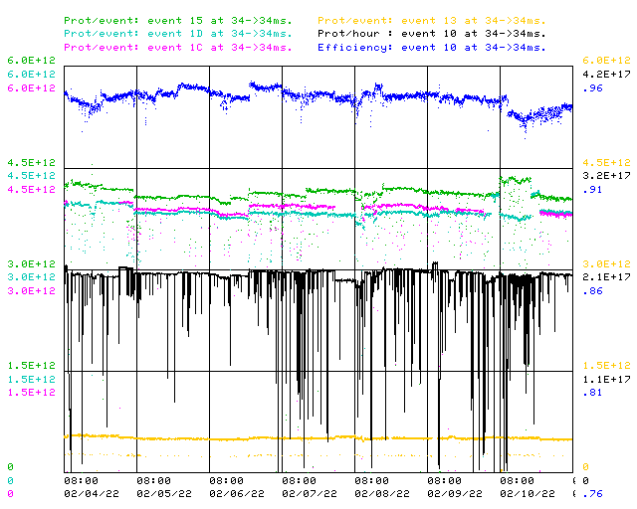
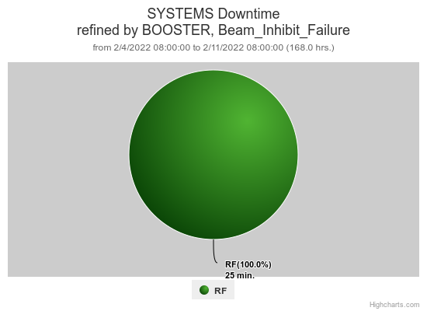
Booster Operations 02/04/22 – 02/11/22
F
F
Sa
Su
M
Tu
W
Th
F
Downtime:
~ 25 minutes for the week
Minor RF trips
Also:
Thanks to Controls folks for investigation of ORBMP timer unexpected settings changes, that work continues.
RF Folks made nice adjustment to BRF7 to stop blocking
Thanks to FESS for AC adjustments this week
Thanks to Ops for their good work throughout the week!
Requesting 2ea $17’s per supercycle for 2 - 3 hours for studies as needed.
This week:
Lots of tuning to maintain output with acceptable losses
Beam to Numi $15 from ~4.0E12 @ 14.8T –> ~4.4E12 @ 16.2T
Beam to Muon $1C ~3.9E12+ @14.1T
Beam to BNB $1D from ~3.8E12 @ 13.8T –> ~4.1E12 @ 15.5T 5Hz
Steady running through the week

