Slide 1
Muon Campus Report
Jim Morgan
February 11, 2022

Slide 2
Weekly overview and current issues
g-2 cryo degrading
Two cryo valve flushes in the past week
Eventually will need several days down for purification
Last purification was week of December 13
Generally good up time when g-2 could take beam
Thursday down day for maintenance
In parallel with second g-2 cryo flush
Priority was to reduce LCW loss rate, three magnets repaired
Numerous other smaller jobs
Ongoing problems
Bad D:IB transformer to power supply cable prevents 8 GeV operation
CTAGs about 15% lower than previous runs (a bit better then last week)
Two tuning and measurement sessions
Tuesday, M1 optics and spot size on target
General tuning of the Muon beamlines and Delivery Ring
Intentional Accelerator
Standby Period
Downstream D30 Crossover Pipe

Slide 3
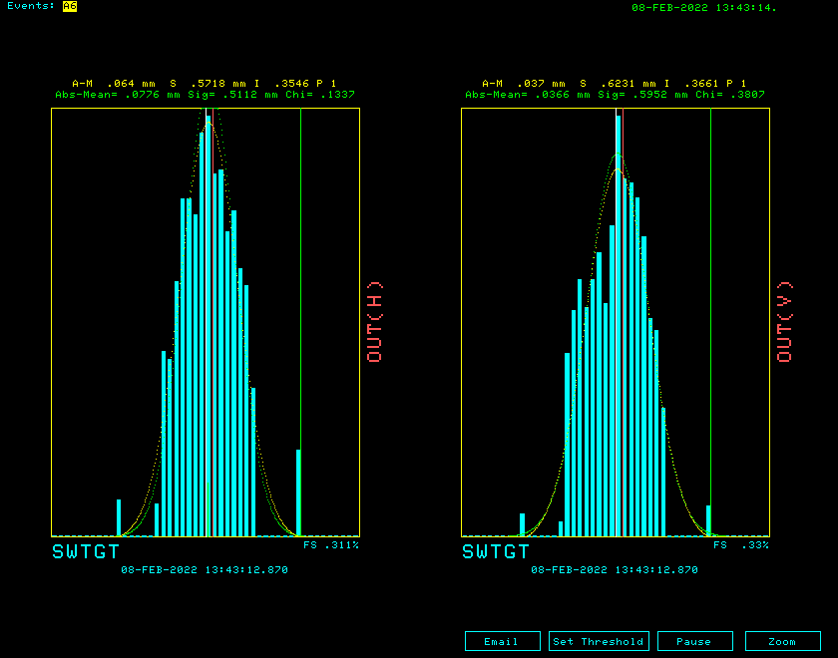
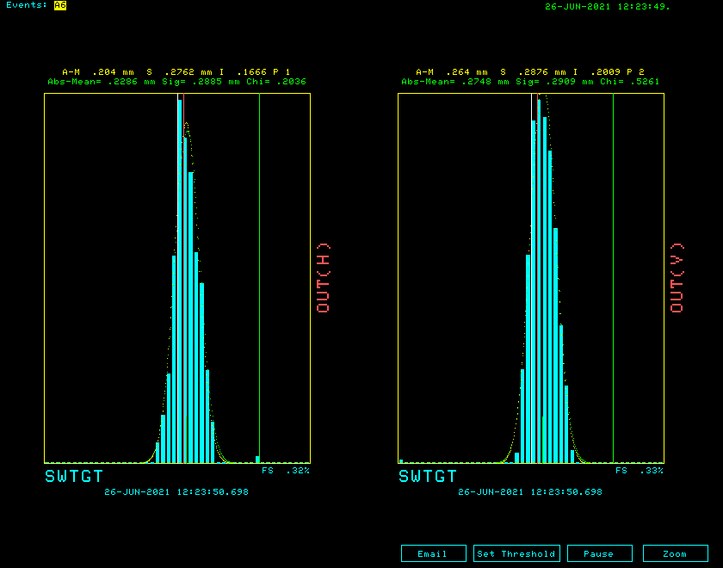
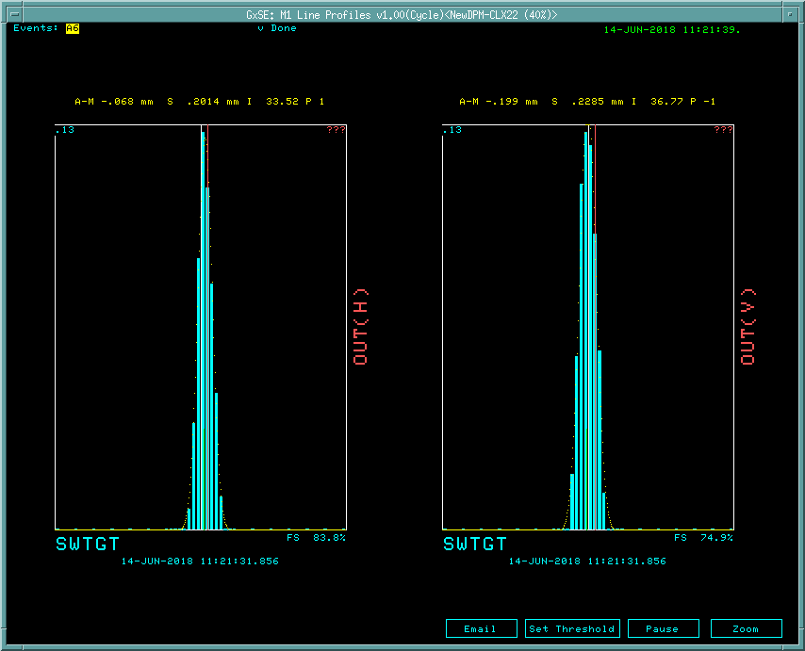
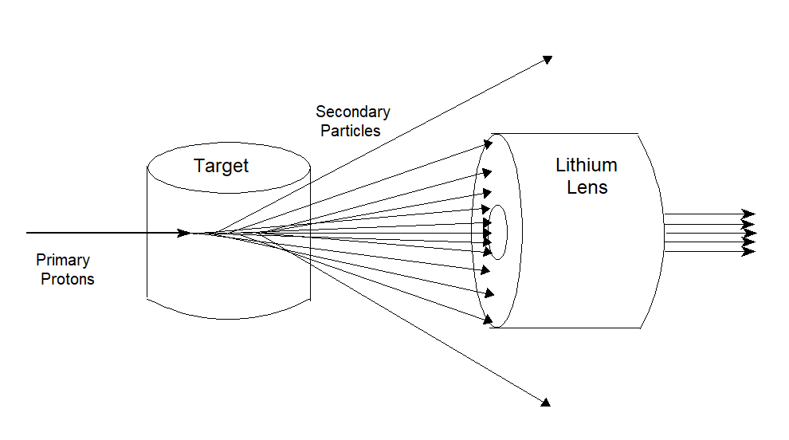
Target SEM beam profiles
February 8, 2022
June 26, 2021
June 14, 2018
Target SEM wire spacing
0.125 mm inner wires
0.500 mm outer wires

Slide 4
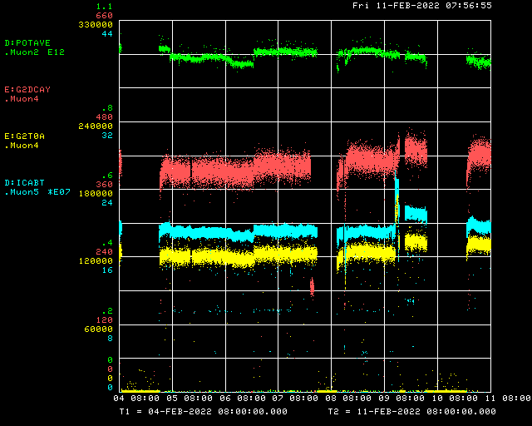
Beam to g-2 this week
Beam to AP-0 target
g-2 access
Trolley Run
Trolley Run
Trolley Run
Trolley Run
Trolley Run
g-2 Cryo valve flush
g-2 kicker problem
g-2 Cryo valve flush
Decay Positrons
Tuning
M1 studies
Muon accesses
Delivery Ring
g-2 T0 Detector

Slide 5
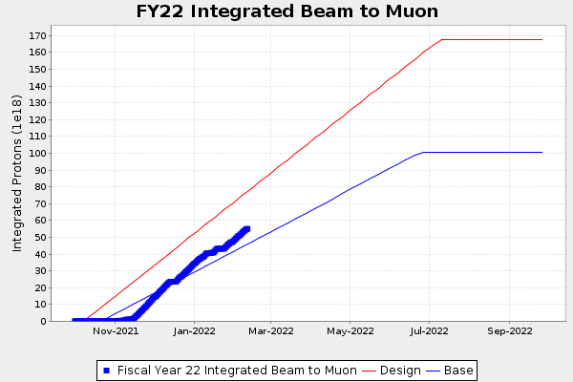
g-2 Run 5 Protons on Target
Detectors shifted upstream

Slide 6
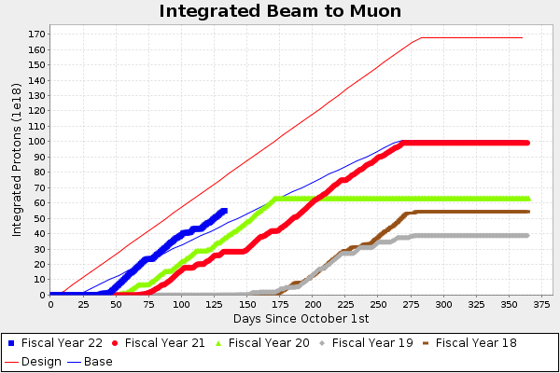
g-2 Protons on Target
Detectors shifted upstream

Slide 7
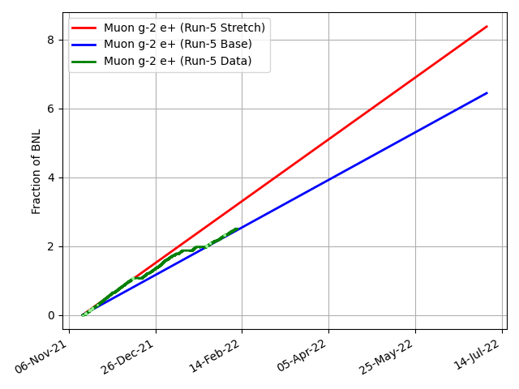
g-2 Performance this run
2.50 BNL

Slide 8
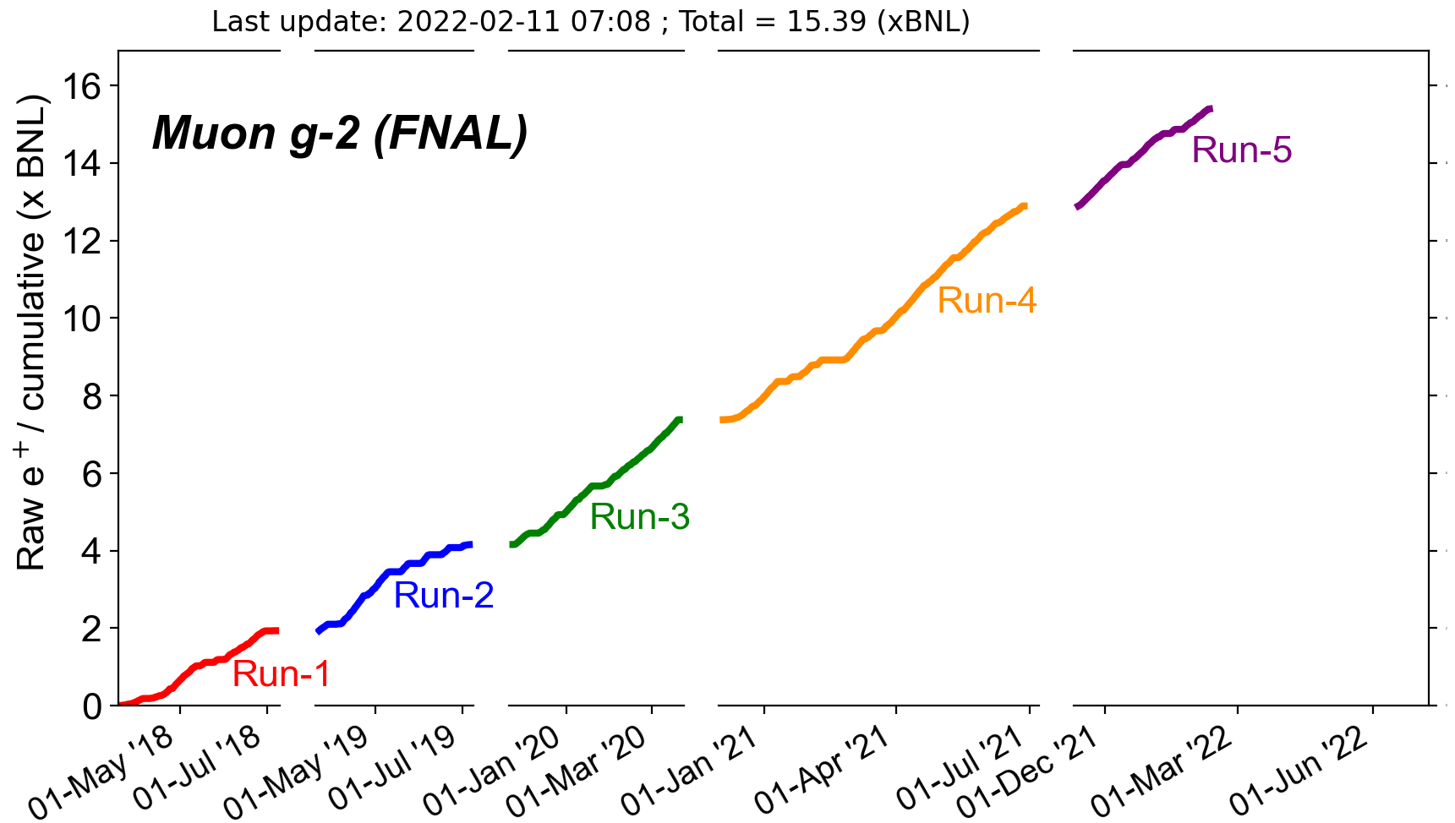
g-2 Overall Performance
2.50 BNL
5.51 BNL
3.22 BNL
2.21 BNL
1.94 BNL

Slide 9
Short term plan
Keep running beam to g-2
No 8 GeV studies possible until D:IB is repaired
Hope to align D:IB repair and other work with g-2 cryo purification
Continue investigating low CTAGs
Investigate why spot is large and isn’t improving with normal tuning knobs
Periodic tuning sessions and studies to identify problem areas
When tuned up, presently getting around 430 CTAGs @ 1E12 POT (normal ~500)
More protons on target always helps and is greatly appreciated

