Slide 1
9 O’Clock Meeting
Gilberto Perez
MCR Crew Chief
Friday, February 11, 2022

Slide 2
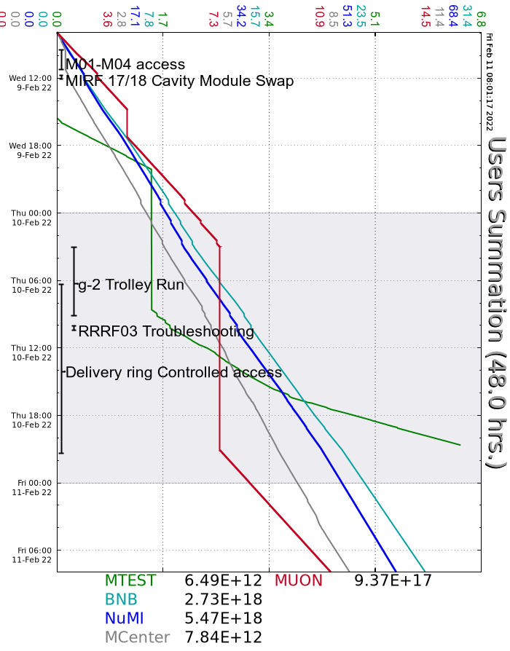
Since Wednesday…
Wednesday
Had a few more instances of the ORBUMP trigger changing on the $13.
Prepared M01 and M04 for access as planned. Beam to MCenter by 11:20.
Thursday
g-2 started a Trolley run at 3:00am.
Ops prepared PreTarget/PreVault and Delivery Rings for access at 6am. Accesses finished at 15:00. Beam to g-2 late in the evening.
Source A boiler heater PS faulted off a few times.
Ops and experts investigated NuMI permit trips on low intensity.
Lost readback for QXRMI.
Friday
MCenter intensity dropped a few times.

