Slide 1
RR/MI status
Rob Ainsworth
9am ops meeting
11 Feb 2022

Slide 2
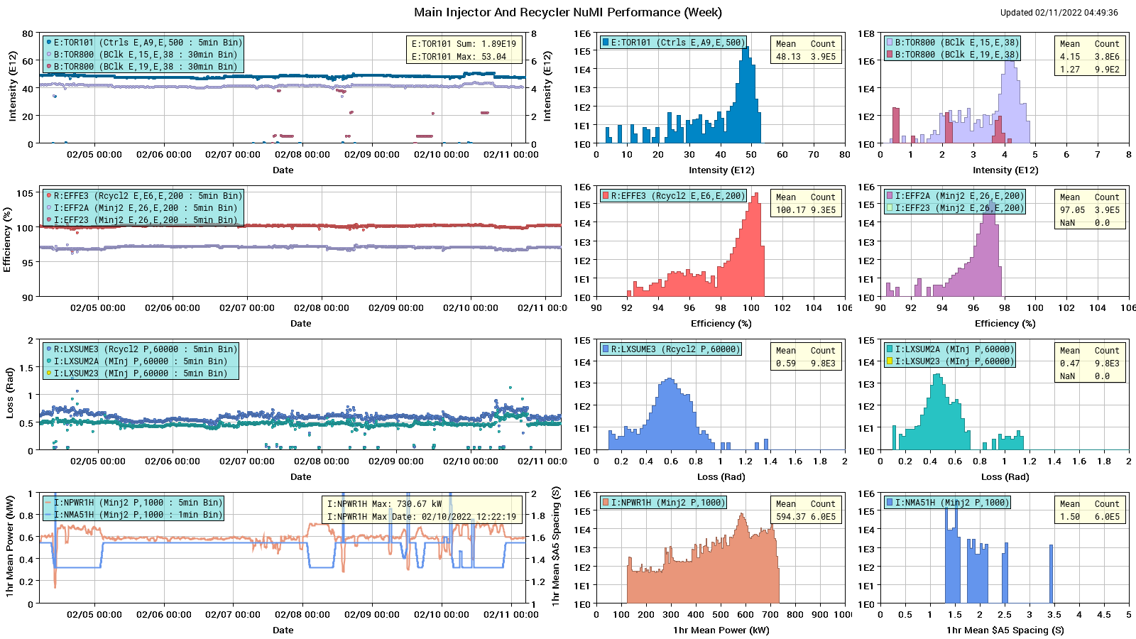
NuMI

Slide 3
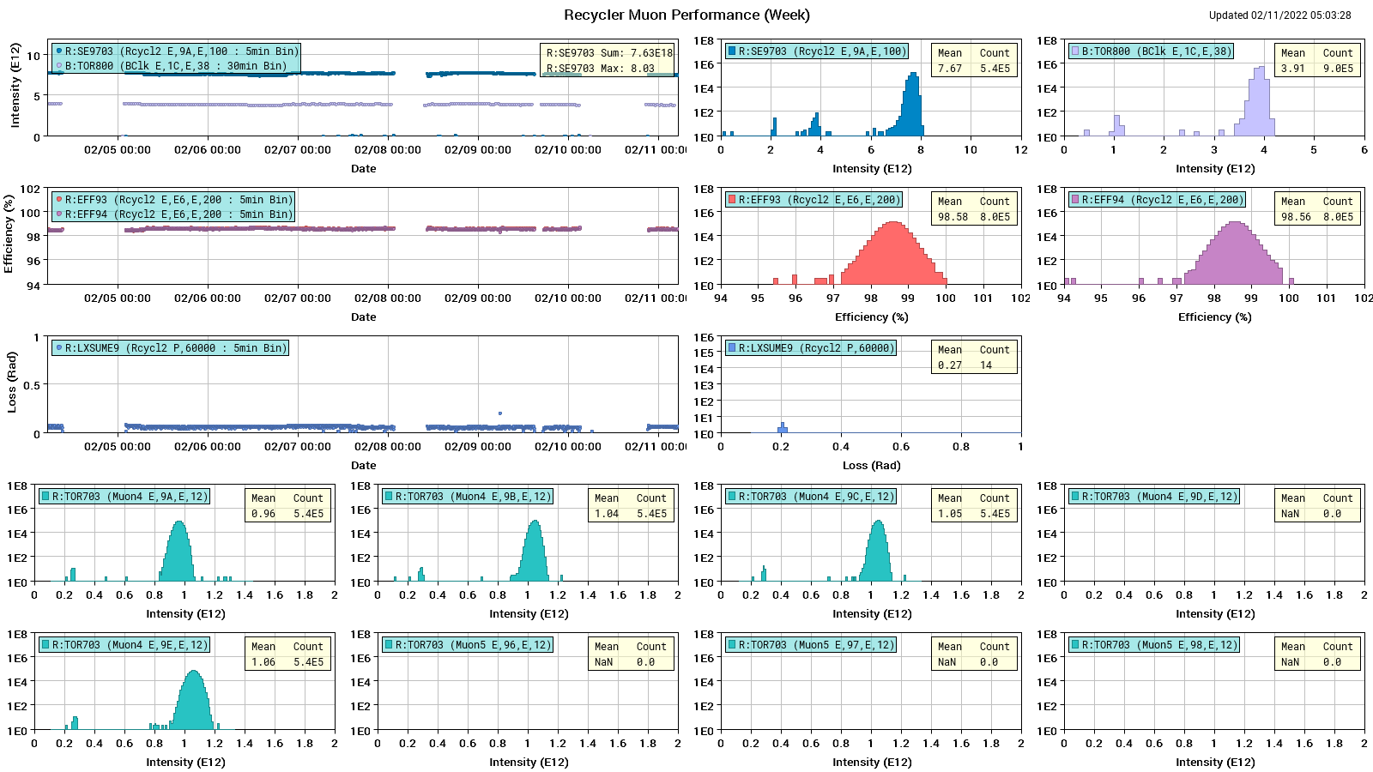
Muon

Slide 4
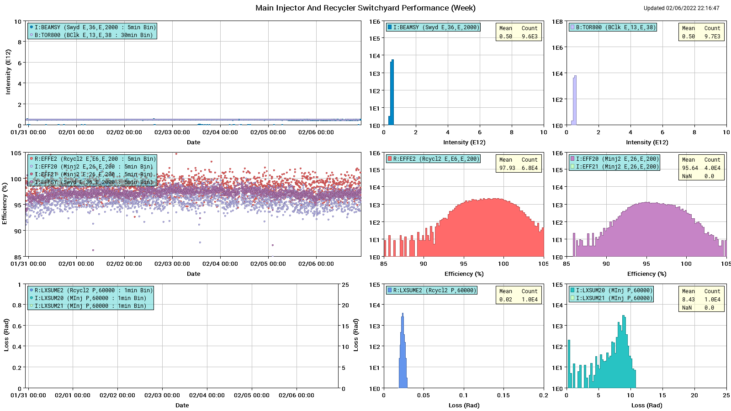
SY

Slide 5
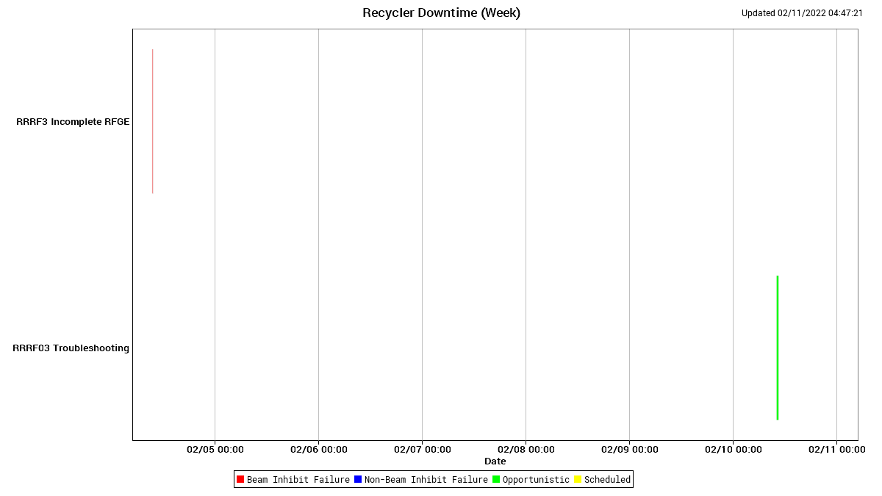
RR Downtime

Slide 6
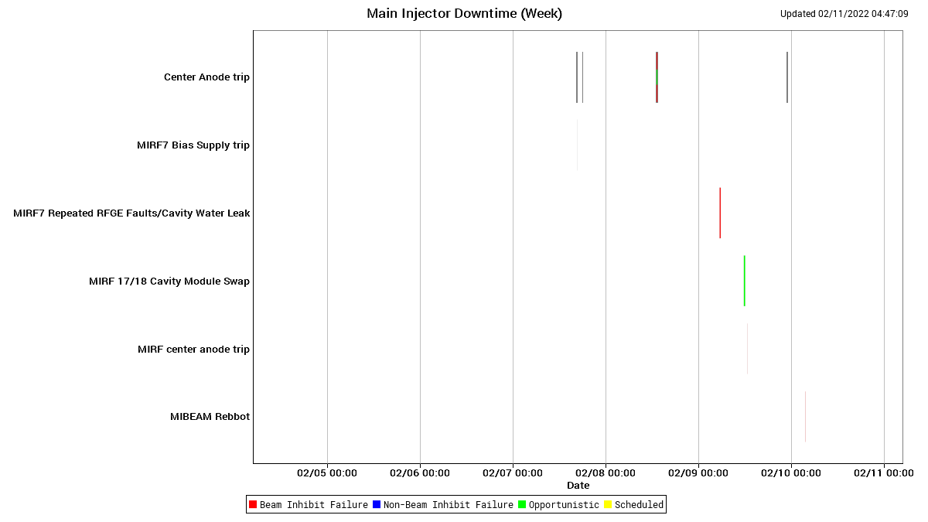
MI downtime

Slide 7
Summary + Next week
$2D studies going on now
Loss of two $2A
Expected to last until end of day shift
Issues
Down an RF station (MIRF7), possibly a water leak
MI60 magnet system has a leak
MI30 BLM was not pulling the permit
Traced a McClure box set to TCLK instead of MDAT
QXR readback issue
Next week
Study requests - $E0 under the $20 most days

