Slide 1
Preacc/Linac operation — February 04 – 11 2022
Kiyomi Seiya
Friday 9 o'clock meeting
11 February 2022

Slide 2
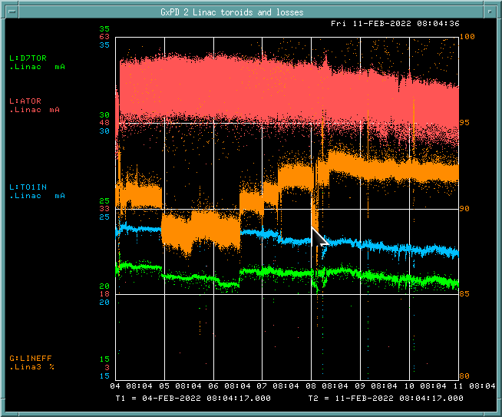
Operation (February 04– 11 2022)
ATOR: 53.7mA
TO1IN: 23.3mA
D7TOR: 21.2mA
LINEFF: 90.9%

Slide 3
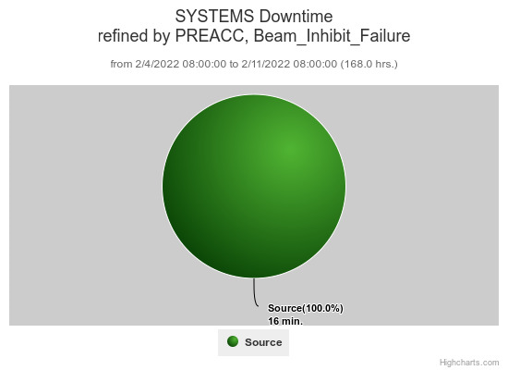
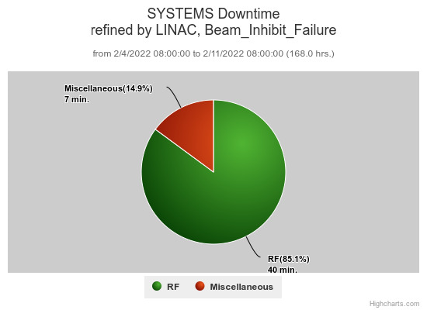
Downtime and issues
Beam inhibit downtime PREACC: (16 min)
LINAC: (47 min)
Issues
Source A boiler heater PS
Debuncher phase loop issue
Tuning for beam loss in the Booster
Beam studies
Preacc LEBT beam size, MEBT emittance measurements (15 min)

