Slide 1
Fermilab Young Professionals Buddy Program
New Employee
Michael Geelhoed AD/MSD
New Engineers to FNAL
February 22nd 2022

Slide 2

FYP Buddy Program – Mission and Objective
Fermilab Young Professionals mission is to offer a platform for young professionals to connect with fellow Fermilab community members to learn about Fermilab, advance their careers and reach their highest potential.

Slide 3
FYP Buddy Program – Mission and Objective
The mission of the Buddy Program is to be a catalyst to help employees transition to their roles and provide support for them to succeed on an individual basis. The goal is to ensure all new employees feel the sense that they are part of our culture and help them navigate Fermilab.
Through 3 active phases, the program introduces new employees to the Fermilab environment and common lab expectations. We promote Fermilab’s internal functions, processes, and continue to endorse personal and professional growth.

Slide 4
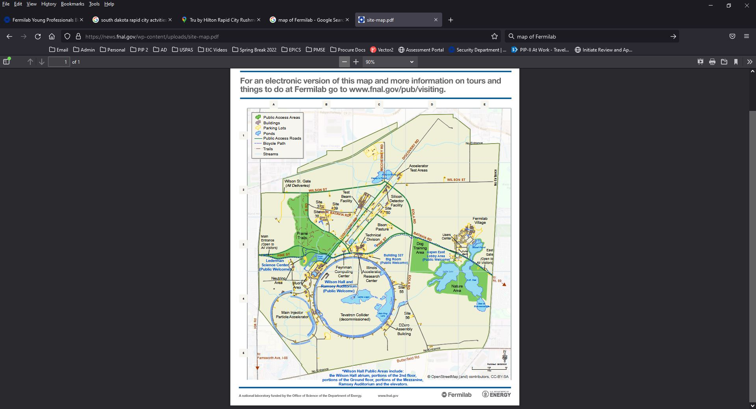
FYP Buddy Program – Mission and Objective
The mission of the Buddy Program is to be a catalyst to help employees transition to their roles and provide support for them to succeed on an individual basis. The goal is to ensure all new employees feel the sense that they are part of our culture and help them navigate Fermilab.

Slide 5
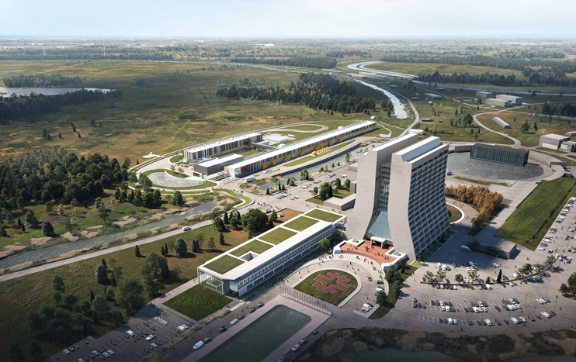
FYP Buddy Program – Mission and Objective
The mission of the Buddy Program is to be a catalyst to help employees transition to their roles and provide support for them to succeed on an individual basis. The goal is to ensure all new employees feel the sense that they are part of our culture and help them navigate Fermilab.

Slide 6
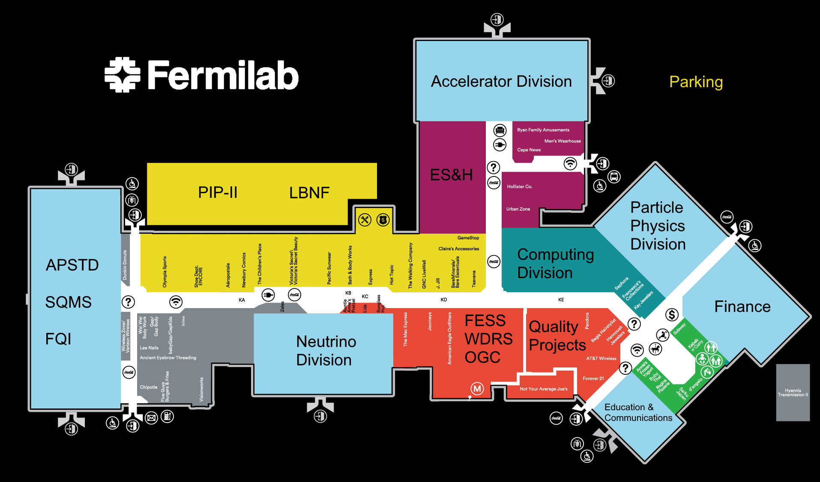


FYP Buddy Program – Mission and Objective
The mission of the Buddy Program is to be a catalyst to help employees transition to their roles and provide support for them to succeed on an individual basis. The goal is to ensure all new employees feel the sense that they are part of our culture and help them navigate Fermilab.
Where’s the good coffee?

Slide 7
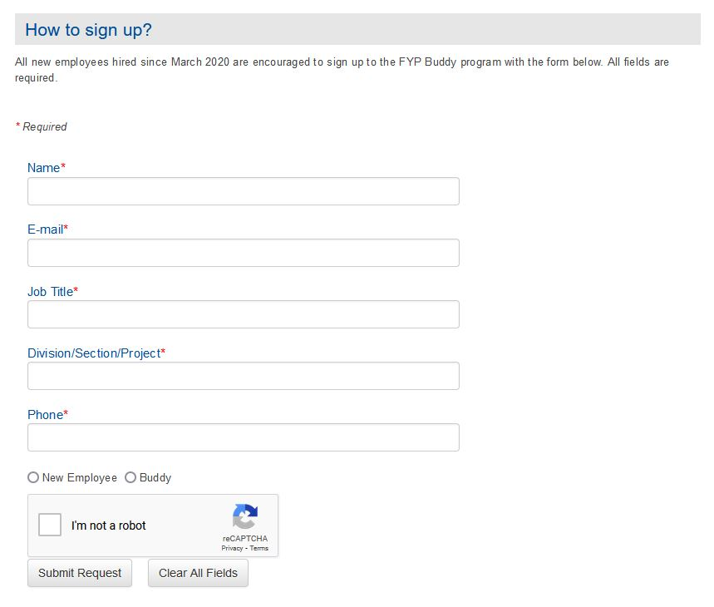

FYP Buddy Program
New Employees
Paired with Buddy
Phase 1
Phase 2
Phase 3
New Employees
In Fermilab’s welcome packet from WDRS, there is information from EDI on numerous LRGs. Within there the Fermilab Young Professionals has information on this program.
https://diversity.fnal.gov/fyp/fyp-buddy-program/

Slide 8
FYP Buddy Program
New Employees
Paired with Buddy
Phase 1
Phase 2
Phase 3
Pairing
Members of our executive board will send a response email and pair new employees with buddies. We attempt to not pair within the same line management within the respective D/S/P.

Slide 9
FYP Buddy Program
New Employees
Paired with Buddy
Phase 1
Phase 2
Phase 3
Phase 1
Introduce the new employee to the Fermilab environment and general lab expectations:
Get to know one another and provide a space for more informal status update
How is the new employee adjusting?
What obstacles are they facing?
What questions do they have about Fermilab?
Questions we expected:
What to wear/etiquette?
Work culture at Fermilab?
Vacation/sick leave/floating holiday?
Work hours/lunch?
How do I navigate a computer system (ServiceNow, Kronos, etc.)?

Slide 10
FYP Buddy Program
New Employees
Paired with Buddy
Phase 1
Phase 2
Phase 3
Phase 2
Share resources, organizational knowledge and broaden the new employee’s network. Encourage them to join:
Other LRGs
Recreation
Clubs
Groups
Questions we expected:
What is the Fermilab Arts & Lectures Series? Artist in Residence?
What connections does the Education & Public Outreach office provide?
When is the Fermilab Colloquium, Wine & Cheese, Accelerator Physics and Technology Seminar series, Neutrino social events?

Slide 11
FYP Buddy Program
New Employees
Paired with Buddy
Phase 1
Phase 2
Phase 3
Phase 3
Any other Fermilab resource/opportunity, discuss professional/personal growth such as:
Courses
Training
Conferences
Tuition Assistance
Return lessons learned to FYP, EDI, and WDRS
Questions we expected:
Anything….

Slide 12
FYP Buddy Program – Success
New Employees
Paired with Buddy
Phase 1
Phase 2
Phase 3
Cohort 1
New Employees
Paired with Buddy
Phase 1
Phase 2
Phase 3
Cohort 2
New Employees
Paired with Buddy
Phase 1
Phase 2
Phase 3
Cohort 3
NovXXXXXXDecXXXXXXJanXXXXXXFebXXXXXXMarXXXXXXAprXXXXXXMayXXXXXXJunXXXXXXJulXXXXXXAugXXXXXXSepXXXXXXOctXXXXXXNovXXXXXXDec
2021 2022

Slide 13
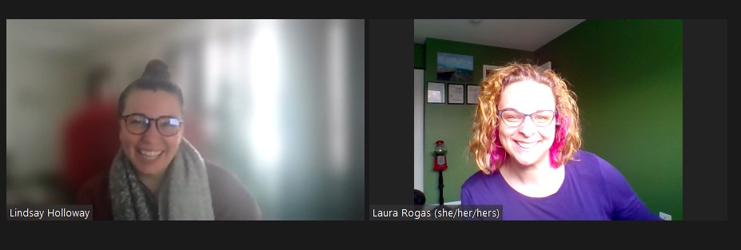
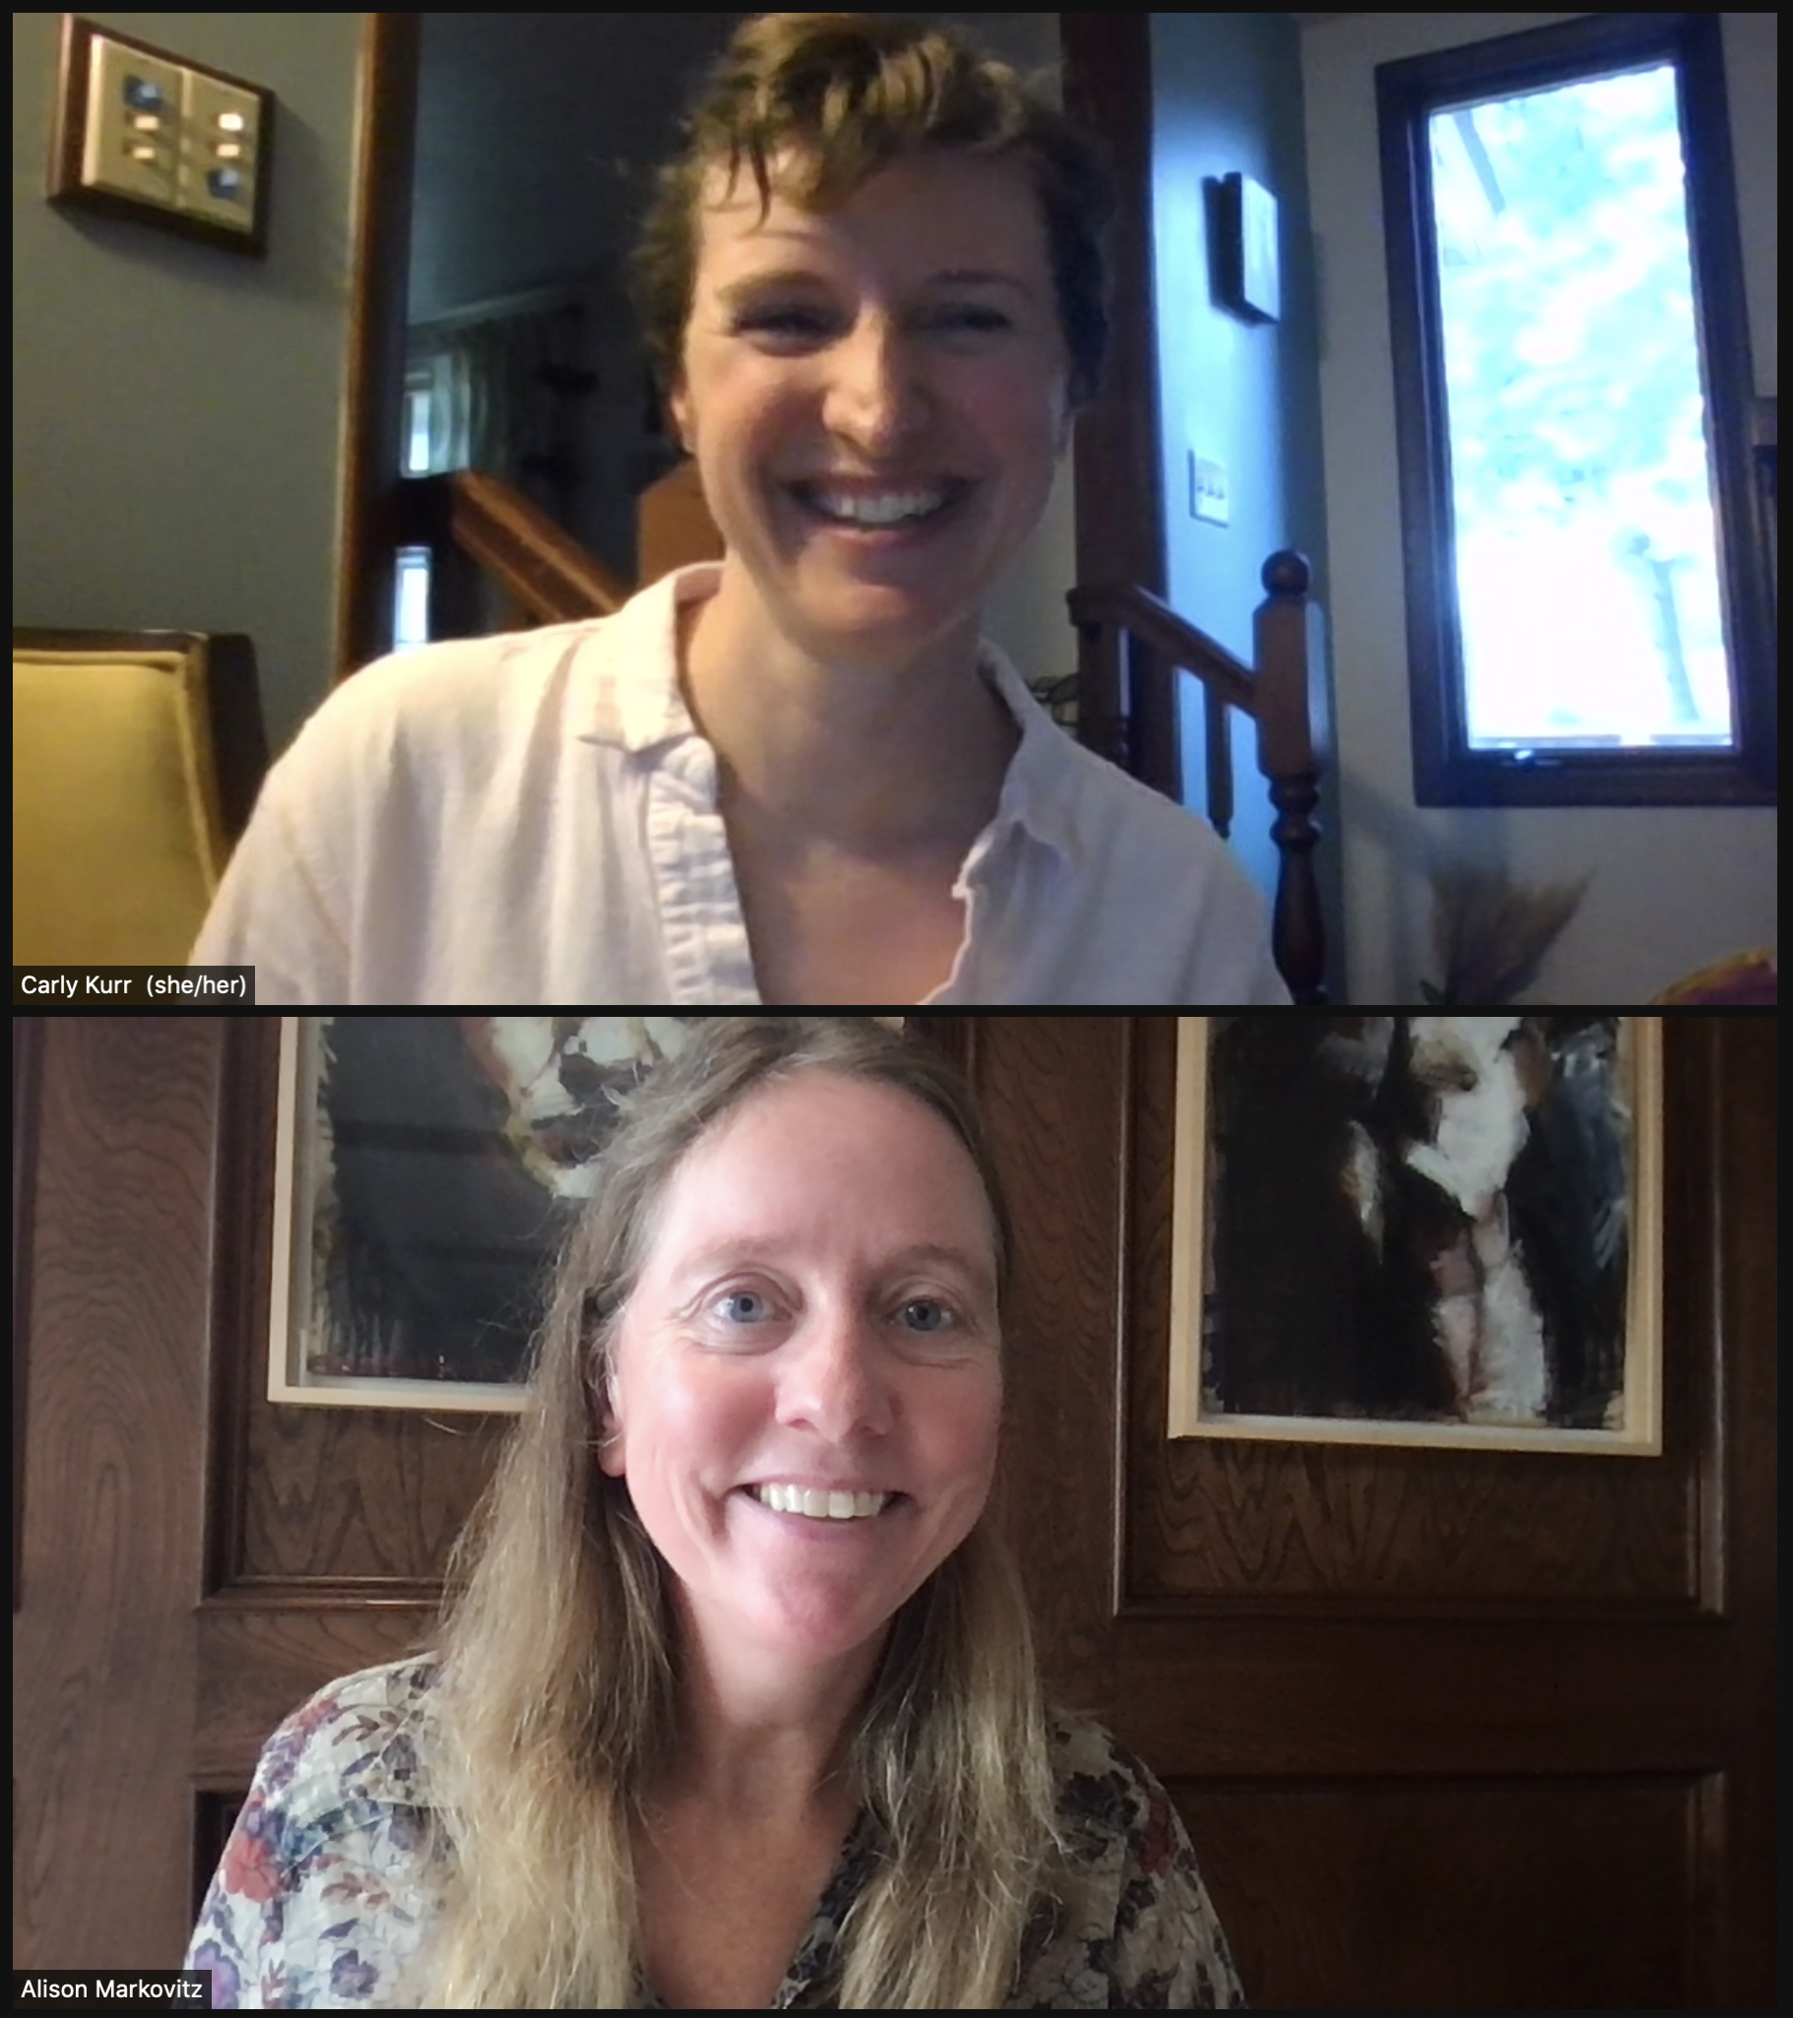
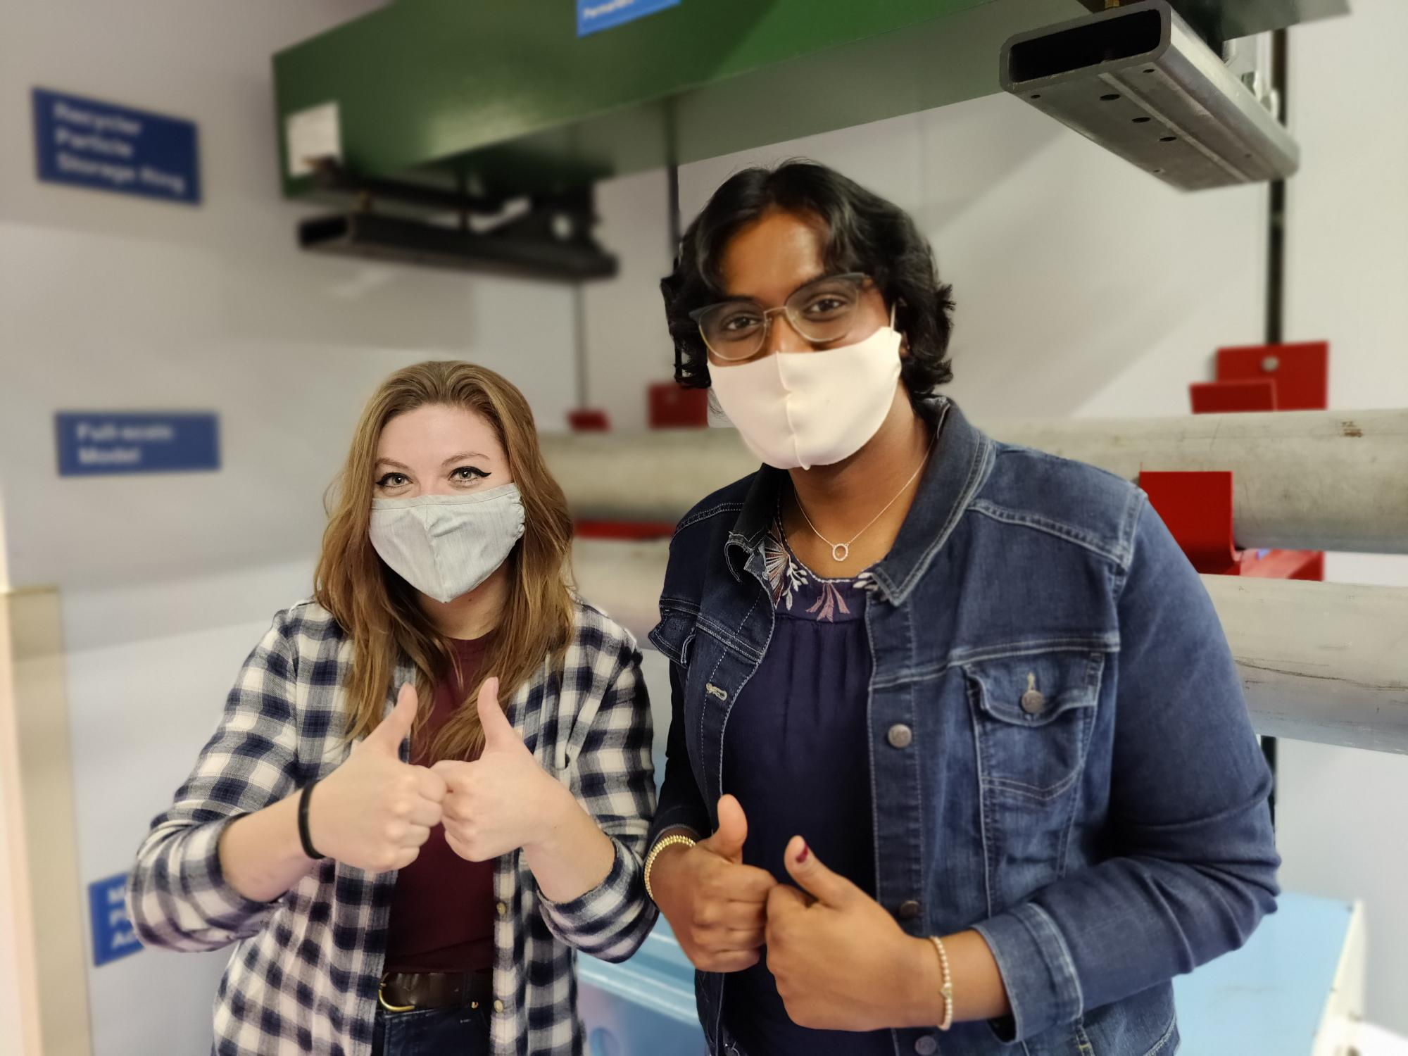
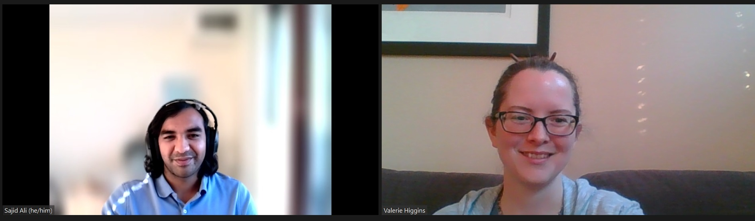

FYP Buddy Program – Success

Slide 14
FYP Buddy Program
        https://diversity.fnal.gov/fyp/fyp-buddy-program/
Questions?
        fyp_board@fnal.gov

