Slide 1
PIP-II Updates
Lidija Kokoska, Project Engineer
All Engineers Retreat 2022
February 22, 2022
*Content presented by Lia Merminga & PIP-II technical teams for CD-3

Slide 2
PIP-II Updates – Overview
PIP-II Mission & Scope Overview
World Class Engagement
Recent Highlights & Engineering Accomplishments

Slide 3
PIP-II Mission & Scope Overview

Slide 4
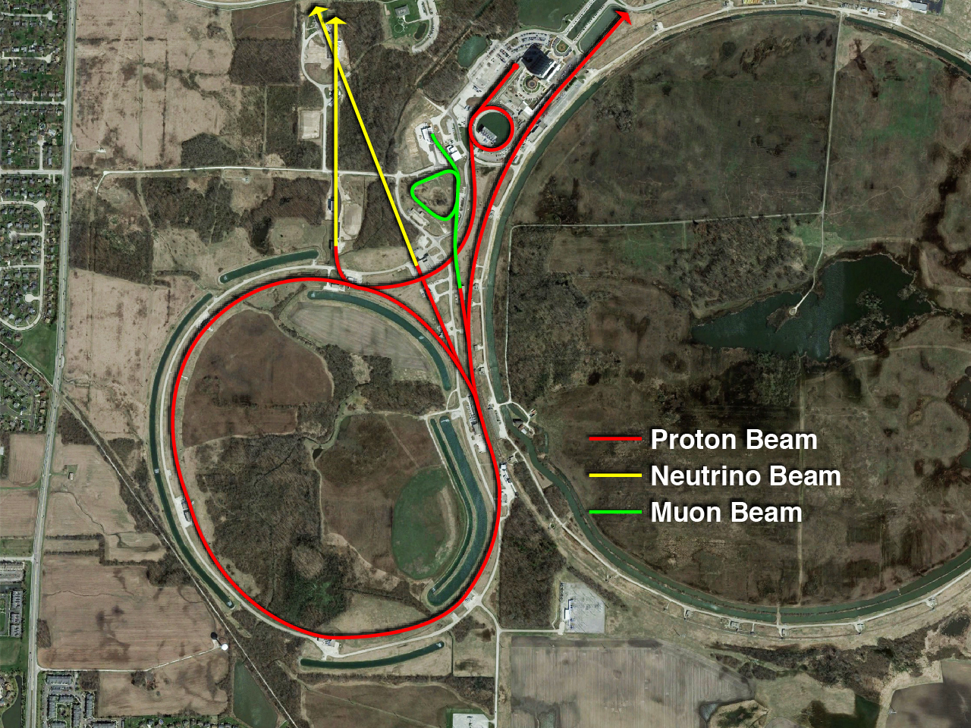
Present Fermilab accelerator complex & beamlines
Notes:
Present Complex with existing Linac
shows beamlines going to:
(from right to left)
Fixed Target Experiments & Test Beam Facility
Muon Experiments (g-2, Mu2e)
High Energy Neutrino Experiments (NOvA, MINERvA - LBNF/DUNE)
Low Energy Neutrino Experiments (MicroBooNE – ICARUS, SBND)
750kW Beam Power

Slide 5
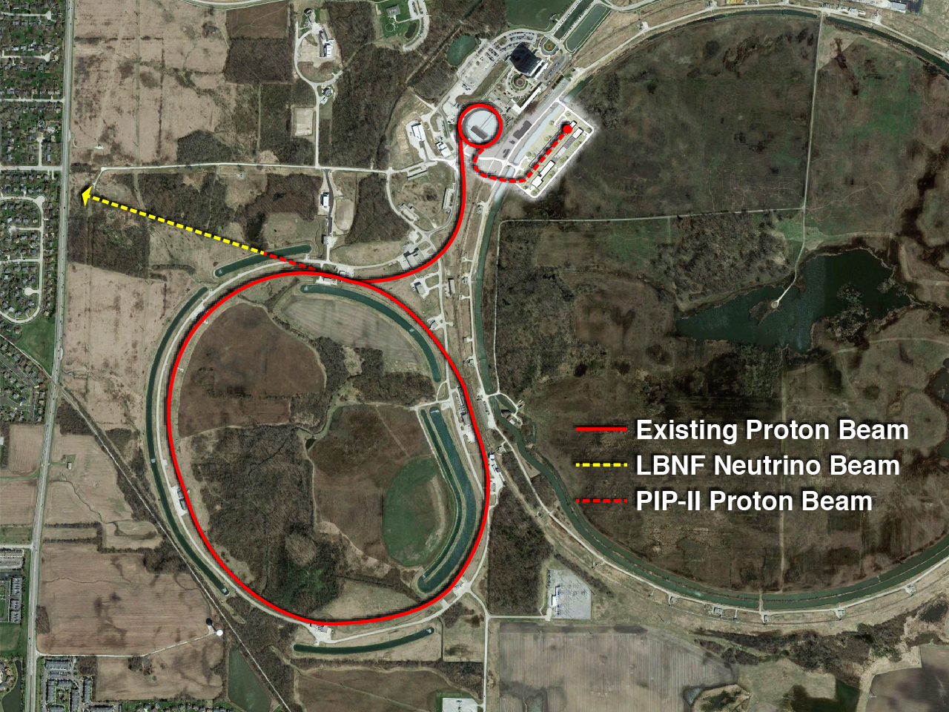
PIP-II Accelerator and LBNF Beamline – capable of >2 MW in the future
Notes:
The PIP-II Accelerator and LBNF Beamline combined will be capable of over 2 MW in the future

Slide 6
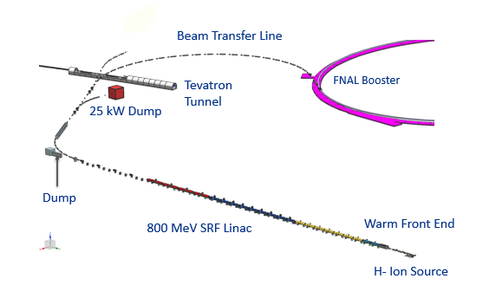
PIP-II Mission
PIP-II is an essential upgrade to Fermilab accelerator complex to enable the world’s most intense beam of neutrinos to LBNF/DUNE, and a broad physics research program for decades to come.
PIP-II Capabilities
Beam Power
1.2 MW proton beam
Upgradeable to multi-MW
Flexibility, multi-user capability
CW-compatible
Customized beams
Multi-user delivery
Reliability
Modernizes Fermilab accel complex
PIP-II Scope
800 MeV H− SRF linac
  CW RF Operations
Linac-to-Booster transfer line
Accelerator Complex Upgrades
  Booster
  Recycler
  Main Injector
Conventional Facilities
  Space reserved for two CMs for 1 GeV Upgrade
The PIP-II scope enables the accelerator complex to reach 1.2 MW proton beam on LBNF target
Notes:
The PIP-II project at Fermilab is building a SUPERCONDUCTING Linac to fuel the next generation
of INTENSITY frontier experiments. By capitalizing on advances in (SRF) technology, FIVE families of superconducting cavities will accelerate H− ions to 800 MeV for
injection into the Booster.
Upgrades to the existing Booster, Main Injector, and Recycler rings
will enable them to operate at a 20 Hz repetition rate and will provide a 1.2 MW proton beam for
the Long Baseline Neutrino Facility.
Future upgrades for Mu2e and for 2 MW beam power to LBNF are supported by the:
LOCATION, and the TECHNOLOGIES employed within the Linac. The enclosure for the beamline, connecting the
Linac to the existing Booster, will include a short extension to allow for a future beamline to
serve Mu2e. The Linac site also takes advantage of electrical, water, and cryogenic infrastructure
already available in the vicinity

Slide 7
PIP-II Scope
Main Injector
Transfer Line
PIP-II
SRF Linac
Booster
PIP-II will provide a highly capable, reliable, upgradeable and expandable scientific infrastructure.

Slide 8








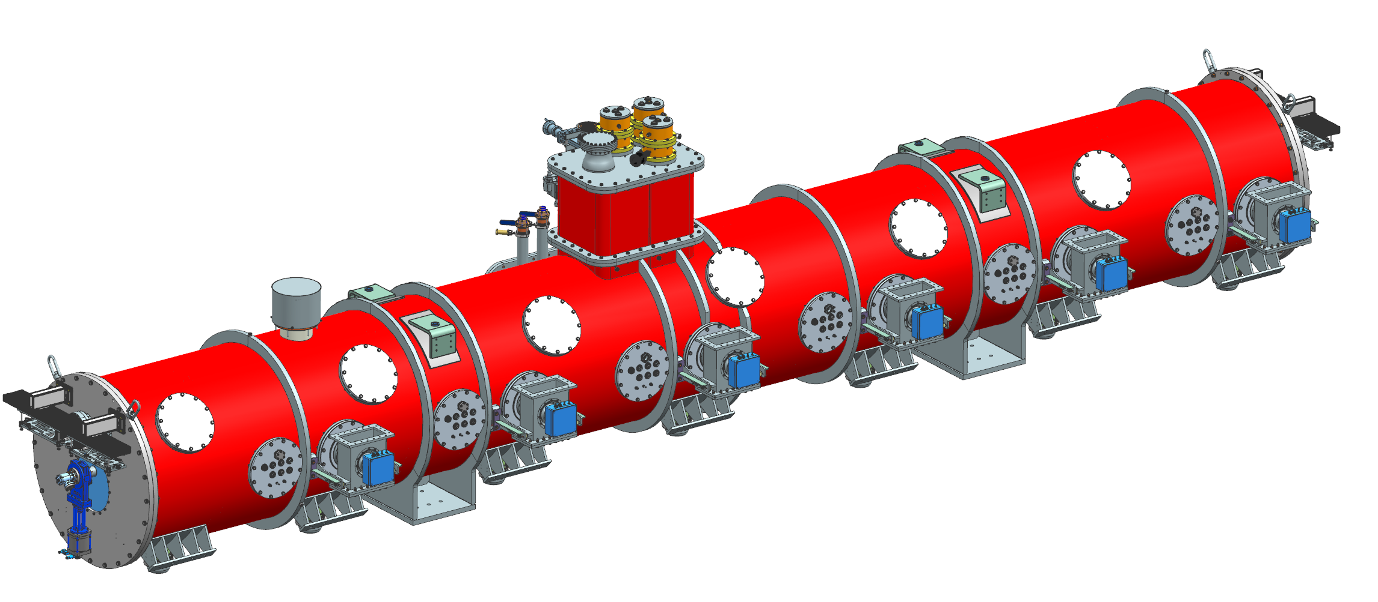

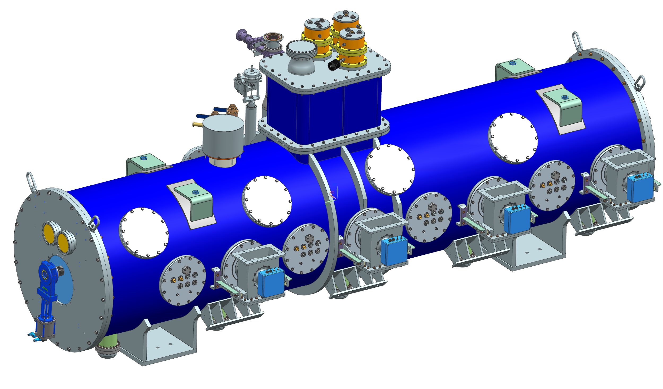
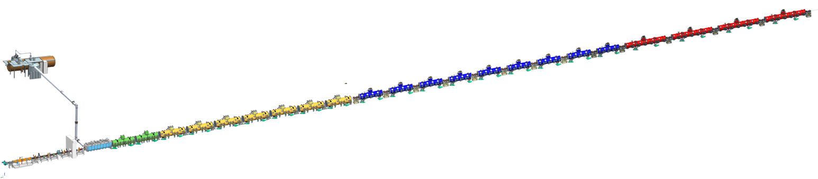

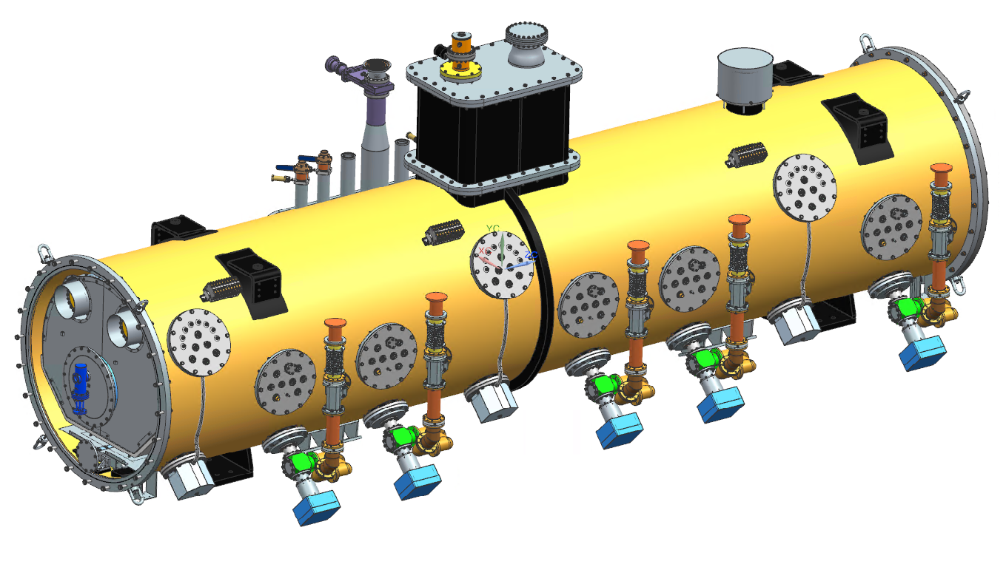
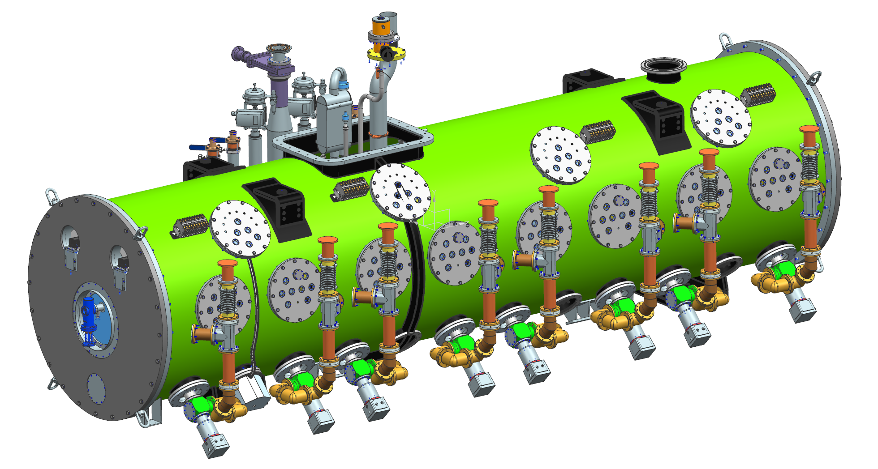


PIP-II 800 MeV SRF Linac
Elliptical
HB650 X 4
650 MHz
Elliptical
LB650 X 9
650 MHz
Single Spoke 2
SSR2 X 7
325 MHz
Single Spoke 1
pSSR1 X 2
325 MHz
HWR
162.5 MHz
833 MeV
Cryoplant
2.5kW @ 2K
516 MeV
177 MeV
Superconducting
CDS
Beam energy 800 MeV
Beam current 2 mA
CW-compatible
RFQ
32 MeV
H- Ion source
10 MeV
2.1 MeV
Room Temperature
PIP-II is the world’s highest energy CW RF proton linac
Notes:
A closer look shows more details on the PIP-II scope with the specific RF systems highlighted. A room temperature warm front end made up of the ion source and RFQ, accelerate beam initially to 2.1 MeV.
The PIP-II Superconducting Linac is highlighted here showing the five families of the SRF cavities.
The superconducting RF Linac is composed of fully segmented cryomodule units installed in the
cold Linac portion of the accelerator.
The strong expertise Fermilab has developed in 1.3 GHz SRF, leads naturally to the PIP-II Linac
designed around 162.5, 325 and the 650 MHz cavities of the same harmonic family. Cryogenic
infrastructure and expertise from Tevatron operations also provide an advantage. The choice of a
superconducting Linac compatible with continuous-wave operation allows an upgrade path for a
second-generation Mu2e experiment

Slide 9
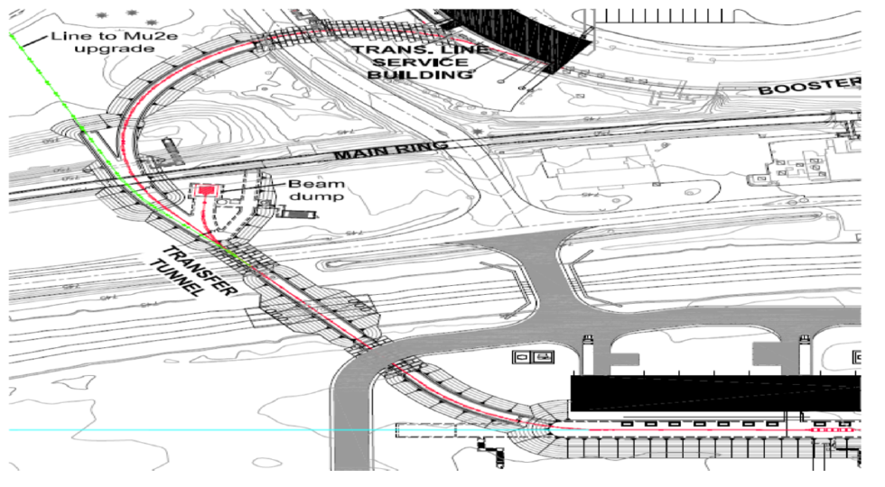
Linac to Booster Transfer Line
Notes:
The Linac-to-Booster Transfer Line transports the beam from the exit of the SC Linac to the
injection girder of the Booster.
This figure shows the transport line layout. The transport line has two arcs and a straight section connecting them.
In this straight section the Booster line splits into two additional lines.
One goes to the Linac beam dump and the other one goes to the Mu2e
experiment which in a future upgrade is expected to receive 800 MeV beam from the SC Linac.
As can be seen in the figure, the second arc crosses the Tevatron tunnel. In the vicinity of this
crossing, the line has a local vertical bump bringing the line close to the Tevatron tunnel ceiling.
This is done to allow a free passage for personnel and equipment along the Tevatron tunnel, which
contains the operating 120 GeV transfer line. This line brings beams extracted from the Main
Injector to the Fermilab Test Beam Facility and is scheduled to be still in use at the time of PIP

Slide 10
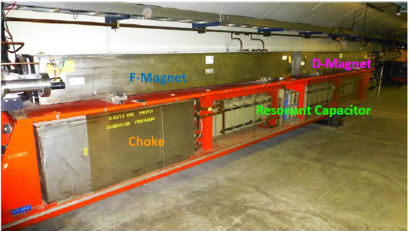
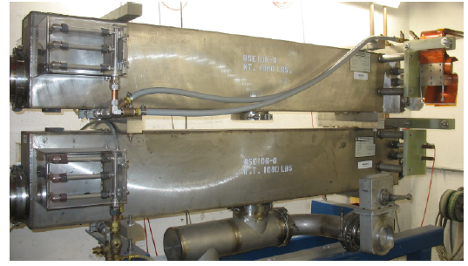
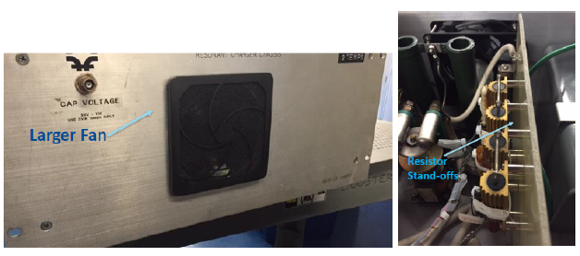
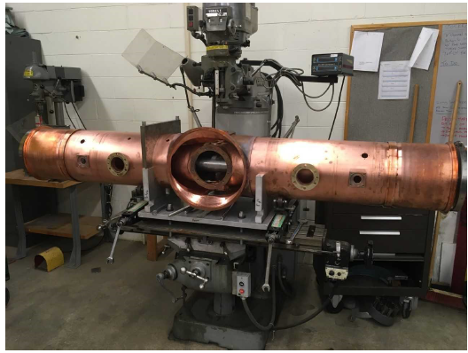
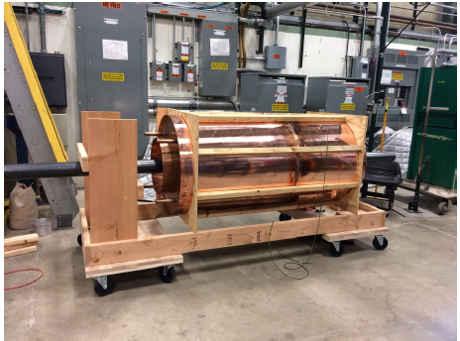
Upgraded Booster, Recycler, and Main Injector
Booster Injection
Resonant Magnet Upgrade
Booster Power Supply Upgrade
Booster Dampers
Booster Collimators
Booster RF Cavities
MI RF Upgrades
Recycler RF Upgrades
Notes:
Upgraded Booster
20 Hz, 800 MeV injection
New injection area
Upgraded Recycler & Main Injector
RF in both rings
Existing Booster girder with 2 gradient magnets
Power supply chassis mods for running at 20 hz, 2 septa magnets
New Booster Cavity
Prototype of Recycler 53 MHz cavity

Slide 11
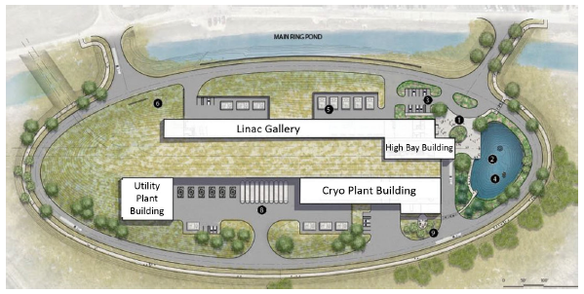
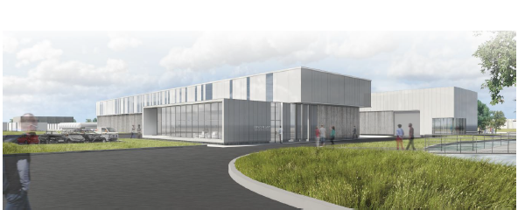
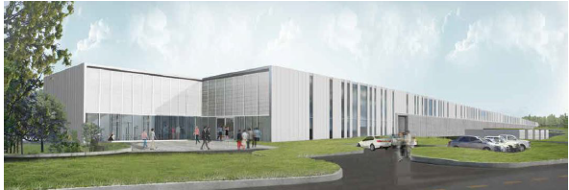
Conventional Facilities
Site Plan
Cryo Plant Building
Linac Gallery
Notes:
Site preparation
Cryoplant Building
Linac Complex
Booster Connection

Slide 12
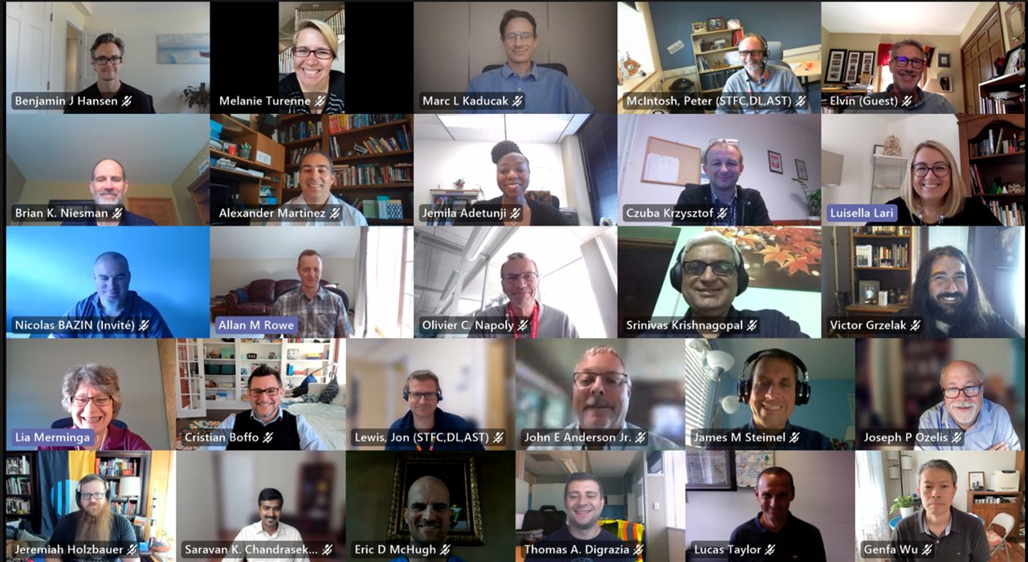
World Class Engagement
Notes:
Cryoplant
LB650 design & production
nine 7kW S SAs
MEBT magnets
SSR1 cavity
HB cavities

Slide 13
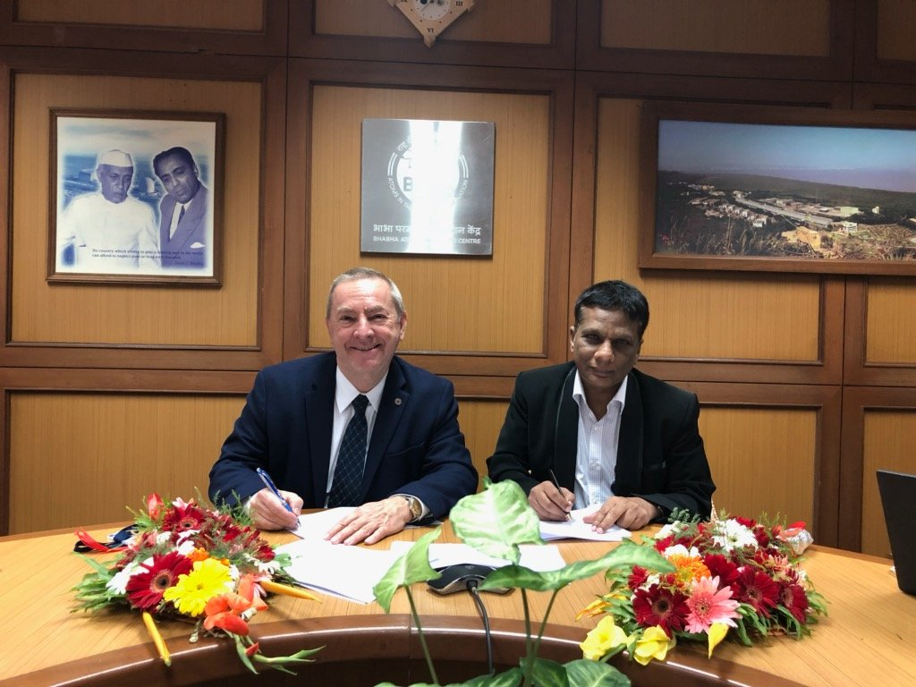


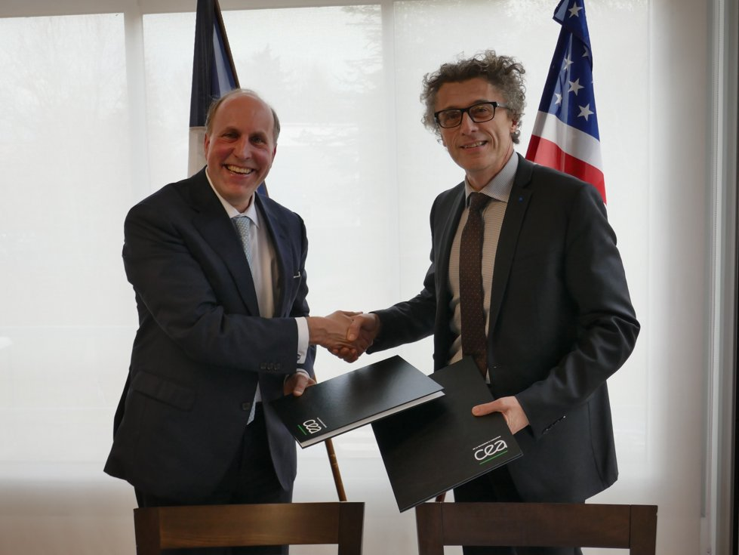

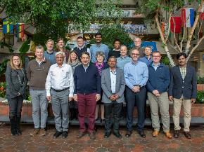

PIP-II International Partners, Expertise and Capabilities
Charge #4
India, Department of Atomic Energy (DAE) (started 2009)
BARC, RRCAT, VECC; also IUAC
    Substantial engineering / manufacturing experience; Superconducting magnets for LHC; 2 GeV synch light source
Italy, INFN (started 2016)
  Internationally recognized leader in superconducting RF technologies
  SRF cavity and cryomodule fabrication for XFEL; SRF cavities for ESS
UK, STFC UKRI (started 2017)
  Substantial engineering and manufacturing experience; Construction, operation of synch light & neutron sources SRF cavity processing and testing for ESS
France, CEA, CNRS/IN2P3 (started 2017)
  Internationally recognized leader in large-scale CM assembly
  CM assembly for European XFEL and ESS; SSR2 cavities and couplers for ESS
Poland, WUST, WUT, TUL (started 2018)
  Substantial engineering / manufacturing experience; CDS, LLRF, QC for XFEL, ESS
PIP-II is the U.S. first accelerator project to be built with major international contributions; benefits from world-leading expertise, capabilities
Notes:
Highlighted already, but wanted to note that PIP-II is the the first U.S. accelerator project to be built with significant International Contributions.
DAE partner issued purchase order for PIP-II cryoplant
Single largest in-kind contribution valued at ~$30M
Multiple contributions can be seen on single cryomodules, requiring careful planning and communication, but benefiting from the diverse expertise of world reknown leaders in Superconducting technologies.
The success of the PIP-II injector test to date, has relied on components such as magnets from
India, for the medium-energy beam transport.

Slide 14
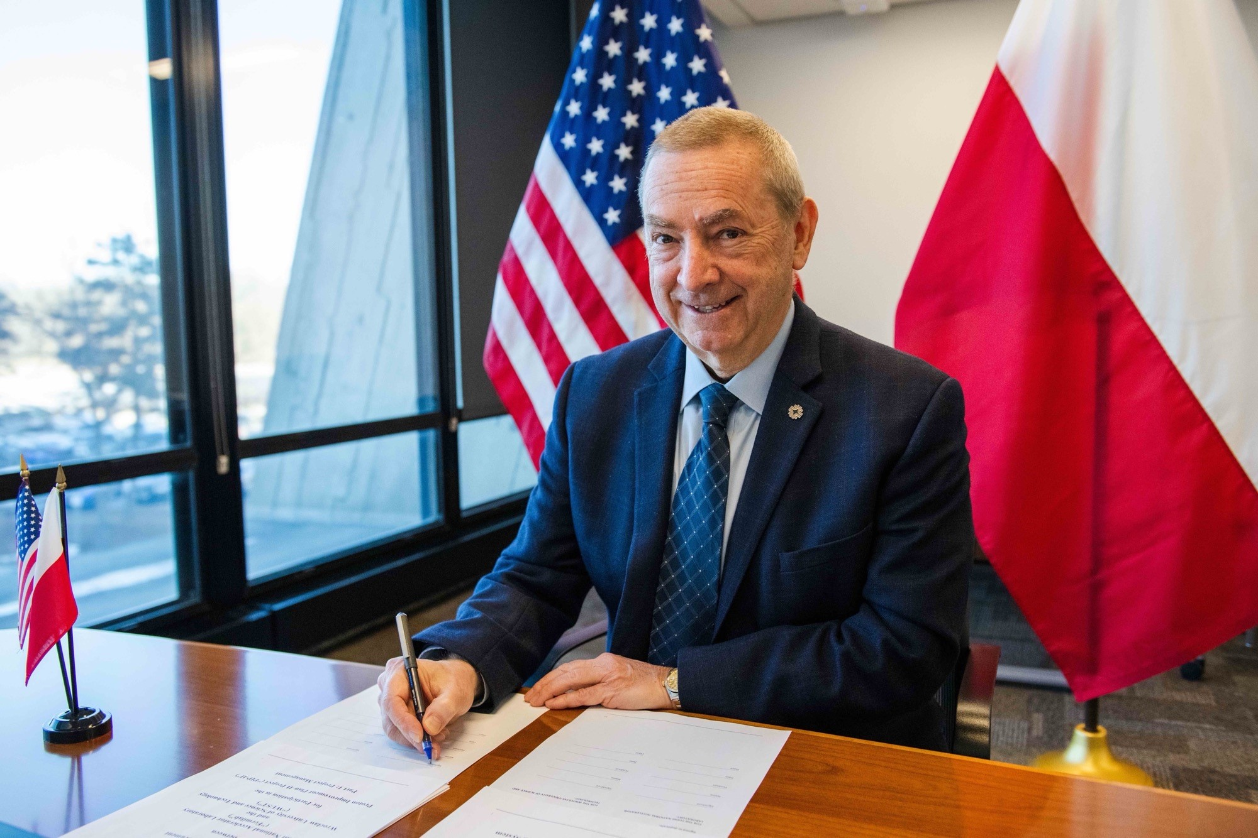


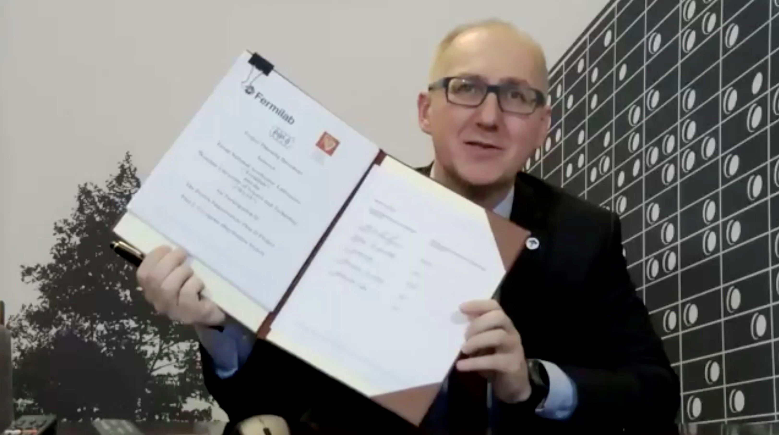
Project Planning Documents (PPDs) Status
PPDs with STFC UKRI/UK, INFN/Italy, WUST/Poland are signed
May-2021
June-2021
January -2022
PPDs with CEA, CNRS/IN2P3/France, DAE/India are in progress

Slide 15
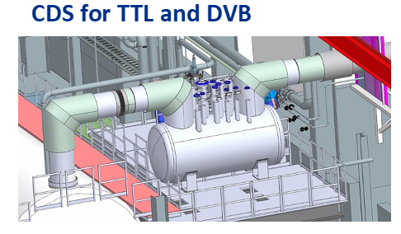
PIP-II In-Kind Contributions Ensures No Scope Gaps
Cryogenic Distribution Lines
Cryoplant is the largest single IKC contribution to PIP-II
MEBT magnets
SSR1 cavity
HB cavities
Nine 7kW S SAs
Notes:
Cryoplant
LB650 design & production
nine 7kW S SAs
MEBT magnets
SSR1 cavity
HB cavities

Slide 16
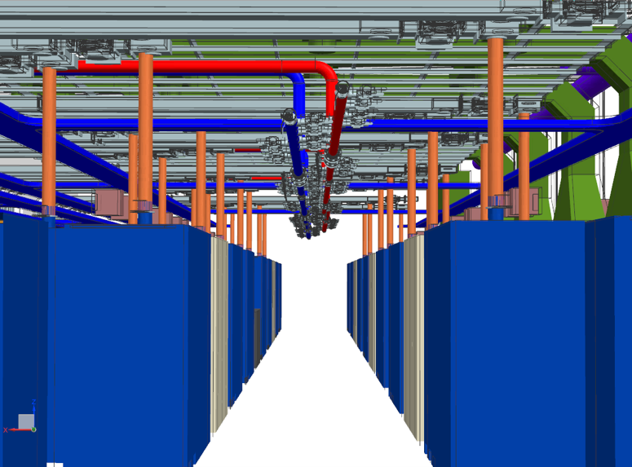
Recent Highlights & Engineering Accomplishments

Slide 17
PIP-II Status
In the last 1.5 years, three Critical Decisions (CD) were approved
    CD-2/3 of Early Conventional Facilities (ECF) subproject – Jul 2020
    CD-2 Performance Baseline – Dec 2020: TPC $978M (+$310M IKC), Early CD-4 Dec 2028
    CD-3a for Long Lead Procurements – Mar 2021
Beam tests at PIP2IT successfully completed, critical technologies demonstrated
Cryogenic plant building construction is ~92% complete
International partners strongly engaged: DAE/BARC cryogenic plant contract under execution
CD-3 DOE review – Start of Construction/Execution
    Held successful Director’s review (Dec 2021)*, DOE IPR scheduled 1-3 March 2022
    Project is ready for execution
*“The level of international engagement and ownership in the success of PIP-II is impressive.”
PIP-II is blazing a new trail in major accelerator projects in DOE/SC with international partners

Slide 18
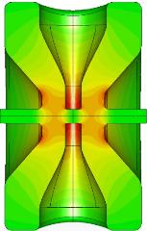
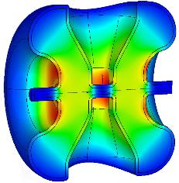
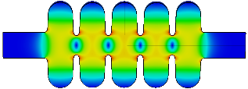
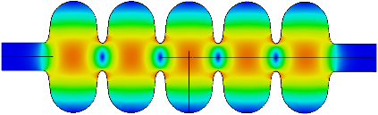

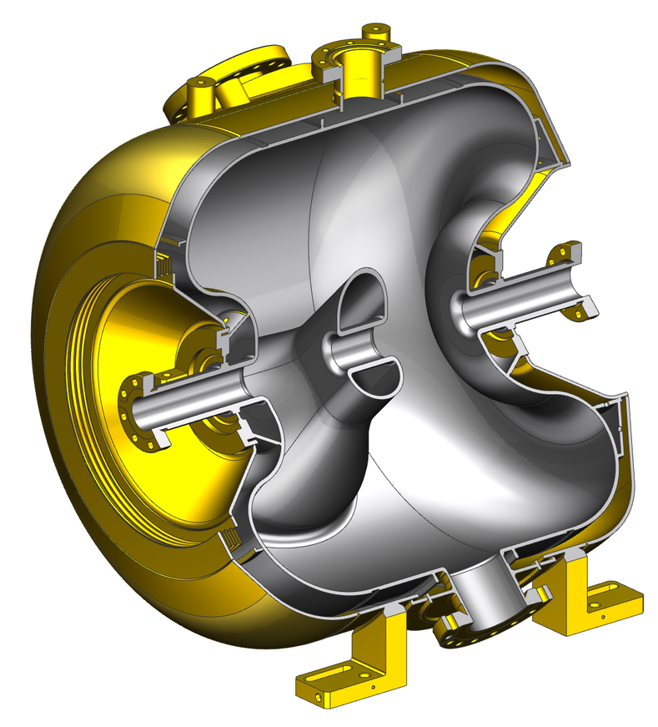
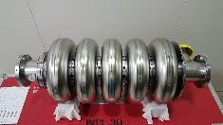
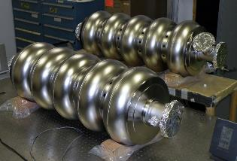
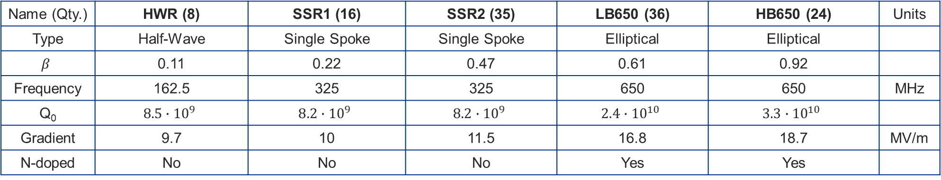
PIP-II Cavity Development
Name (Qty.) | HWR (8) | SSR1 (16) | SSR2 (35) | LB650 (36) | HB650 (24) | Units
Type | Half-Wave | Single Spoke | Single Spoke | Elliptical | Elliptical
$$β$$ | 0.11 | 0.22 | 0.47 | 0.61 | 0.92
Frequency | 162.5 | 325 | 325 | 650 | 650 | MHz
Q₀ | $$8.5∙{10}^{9}$$ | $$8.2∙{10}^{9}$$ | $$8.2∙{10}^{9}$$ | $$2.4∙{10}^{10}$$ | $$3.3∙{10}^{10}$$
Gradient | 9.7 | 10 | 11.5 | 16.8 | 18.7 | MV/m
N-doped | No | No | No | Yes | Yes
Prototypes validated

Slide 19
PIP-II Cavity Development
Name (Qty.) | HWR (8) | SSR1 (16) | SSR2 (35) | LB650 (36) | HB650 (24) | Units
Type | Half-Wave | Single Spoke | Single Spoke | Elliptical | Elliptical
$$β$$ | 0.11 | 0.22 | 0.47 | 0.61 | 0.92
Frequency | 162.5 | 325 | 325 | 650 | 650 | MHz
Q₀ | $$8.5∙{10}^{9}$$ | $$8.2∙{10}^{9}$$ | $$8.2∙{10}^{9}$$ | $$2.4∙{10}^{10}$$ | $$3.3∙{10}^{10}$$
Gradient | 9.7 | 10 | 11.5 | 16.8 | 18.7 | MV/m
N-doped | No | No | No | Yes | Yes
State of the art
Prototypes validated

Slide 20
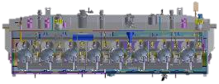
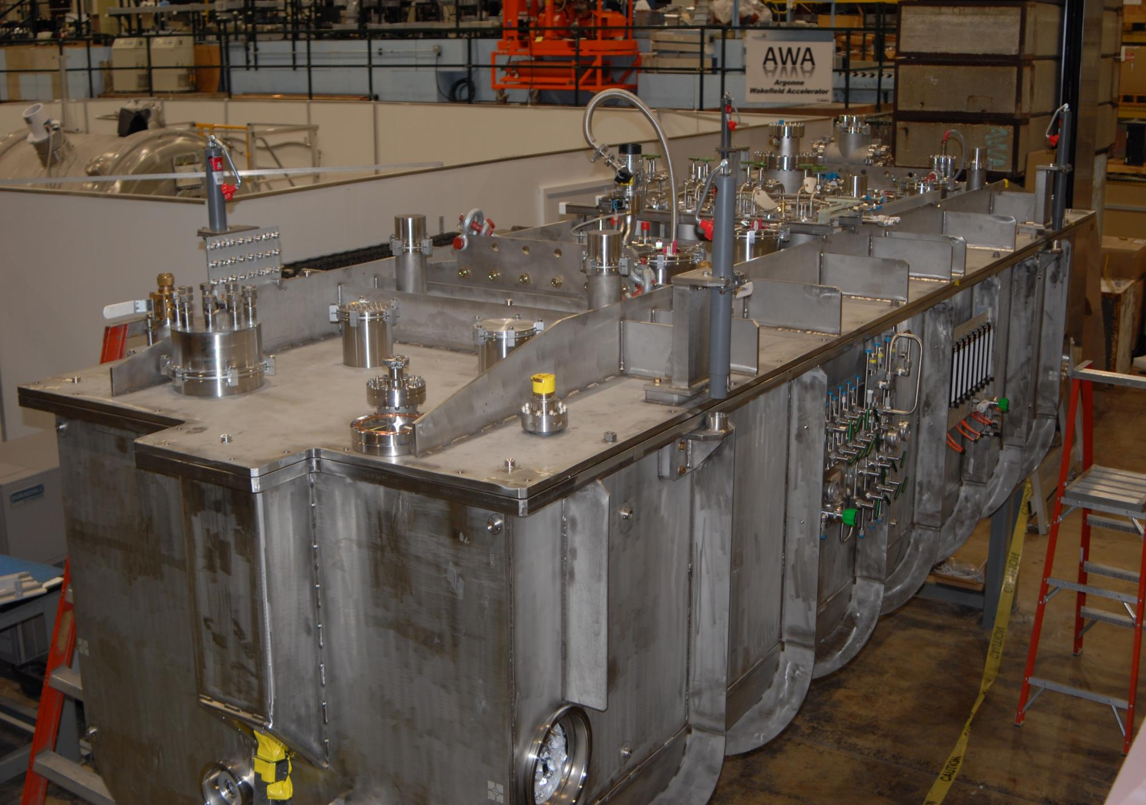

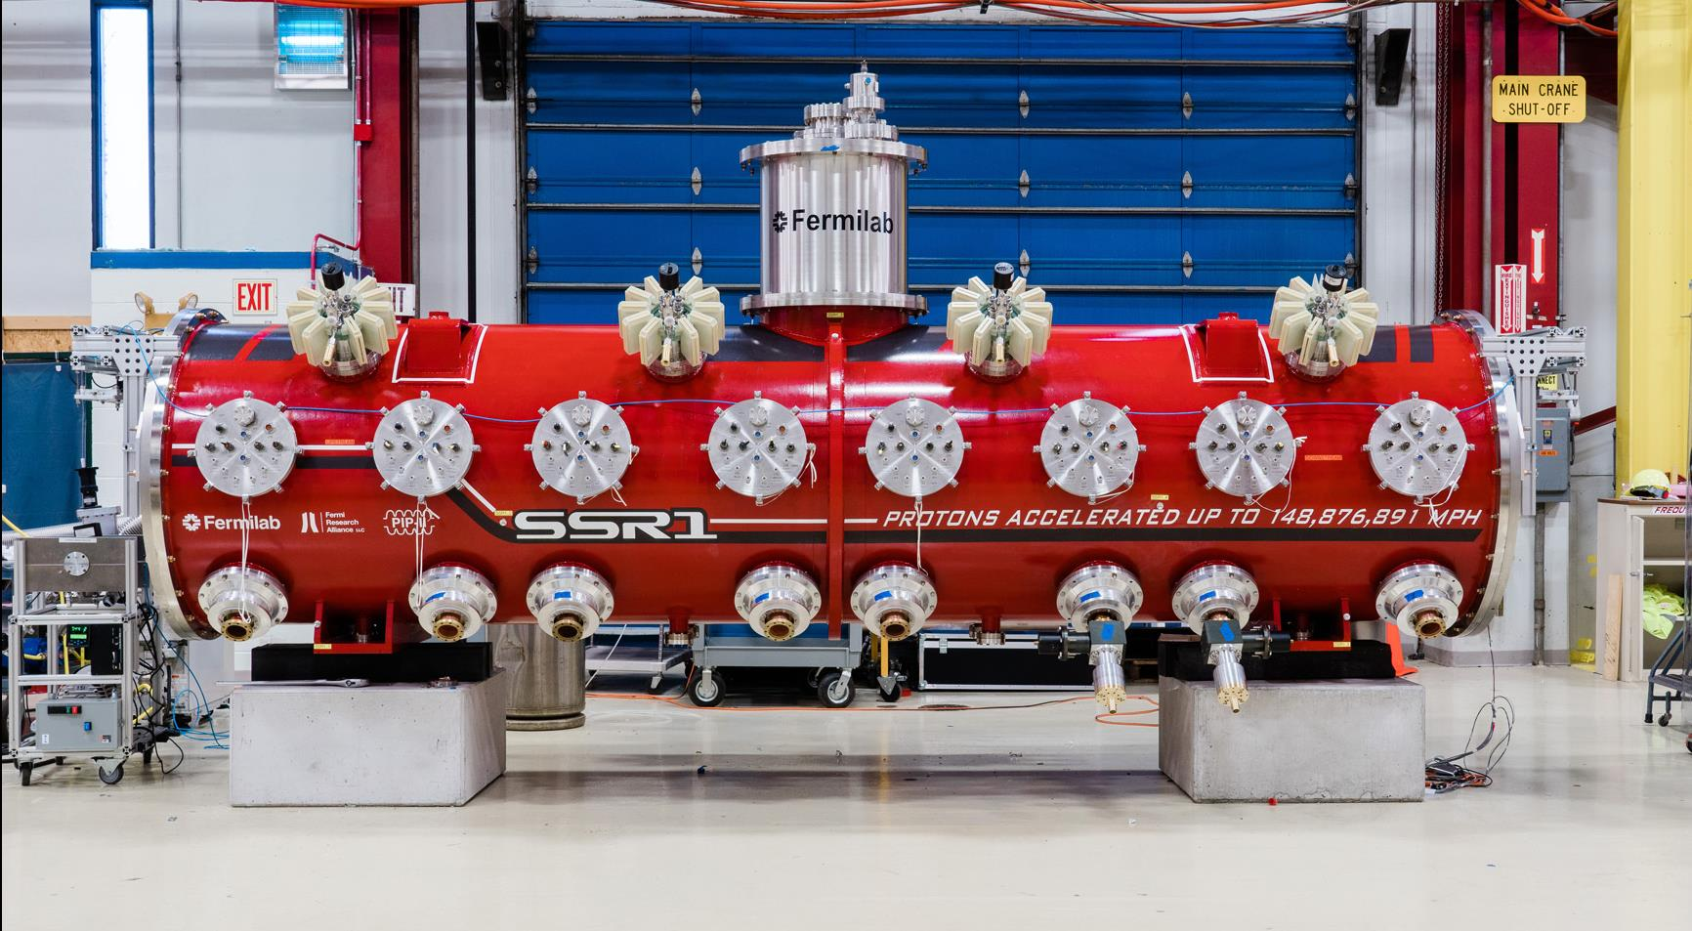
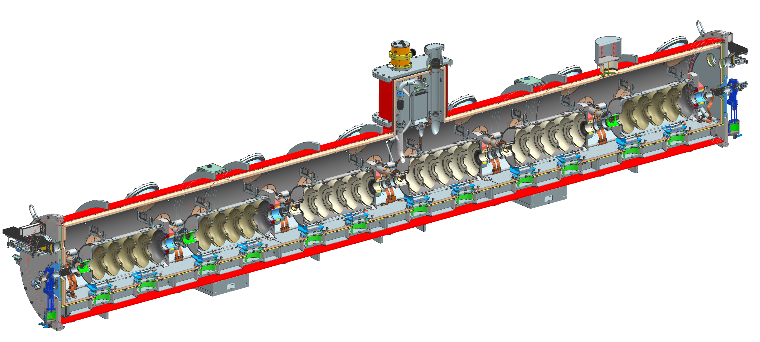
PIP-II Cryomodule Development:
HWR, SSR1 Prototypes Demonstrated, HB650 Prototype in Fabrication
5.9 m
5.3 m
6.5 m
5.5 m
9.9 m
HWR
SSR1
SSR2
LB650
HB650
Prototypes validated

Slide 21
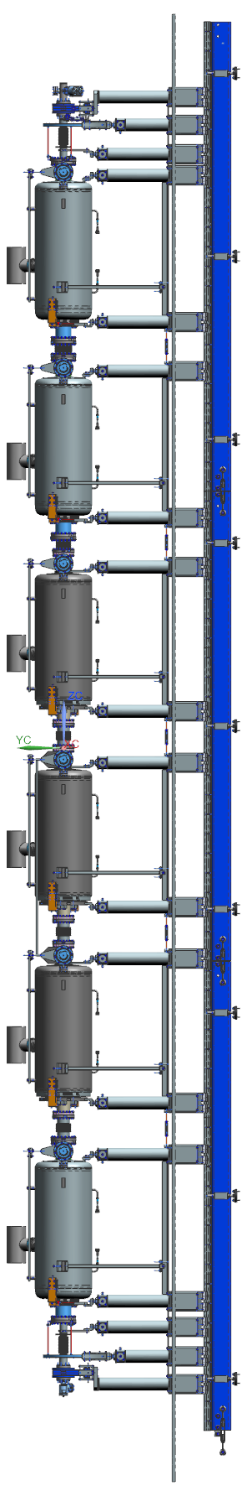



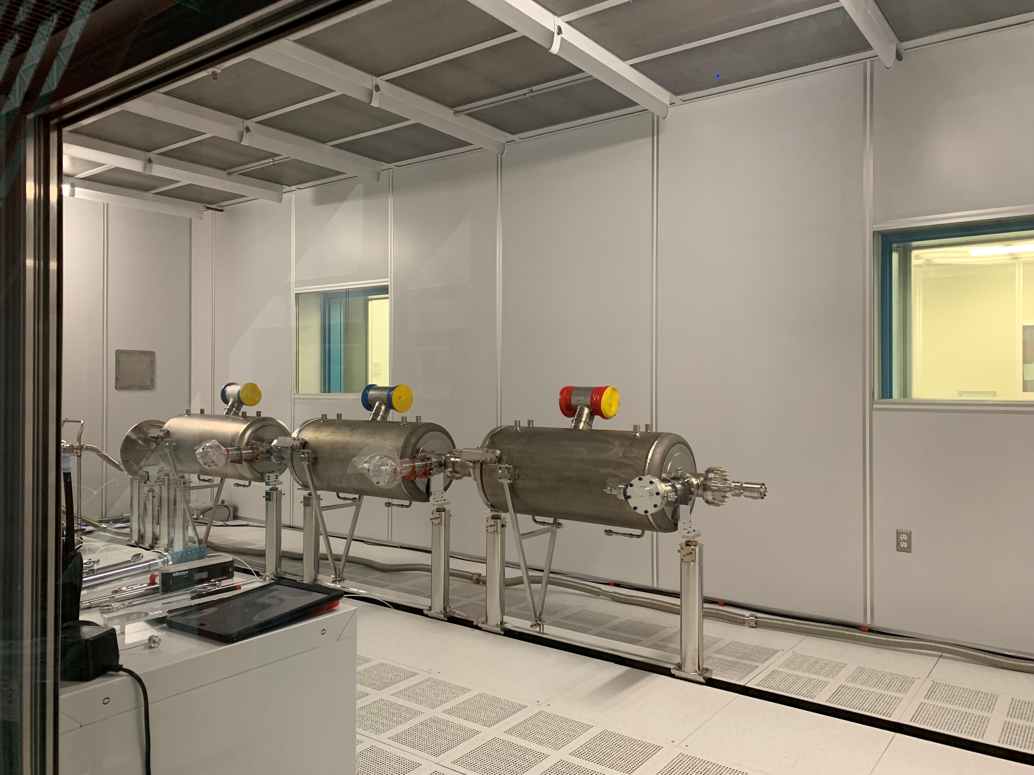

HB650 Prototype Cryomodule Integration
HB650 proto cryomodule integration/testing a major FY21-22 technical goal
  First high beta CW cryomodule ever built!
  Q₀, Gradient → 3.3 x10¹⁰ and 18.7 MV/m – unprecedented for β <1
Significant technical challenges are overcome by tour-de-force effort by Fermilab and international teams
  Excellent SRF cavity manufacturing capability at RRCAT
  UKRI, CEA strongly engaged in process
String assembly in progress
RF and transportation tests in 2022
RRCAT-506 AES007 AES008 AES009 RRCAT-504 RRCAT-502

Slide 22

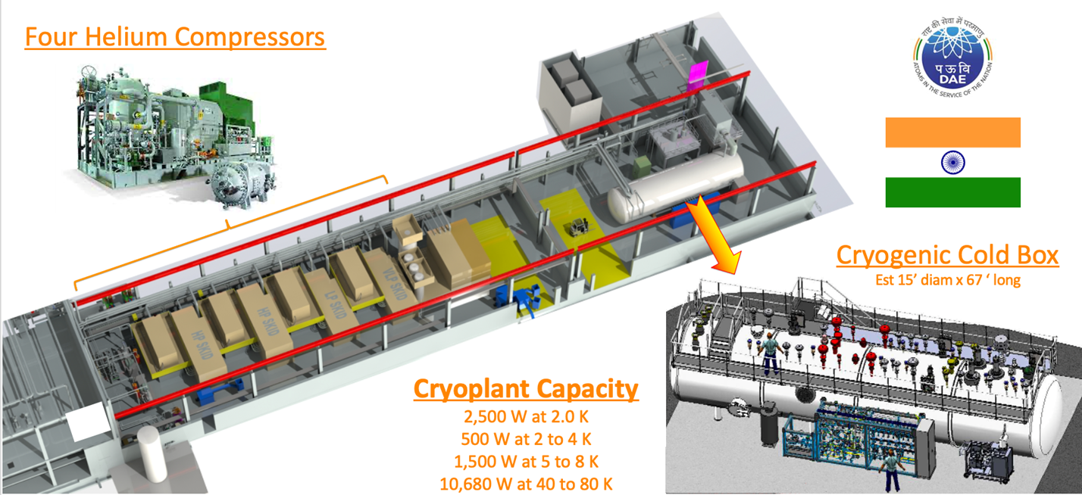
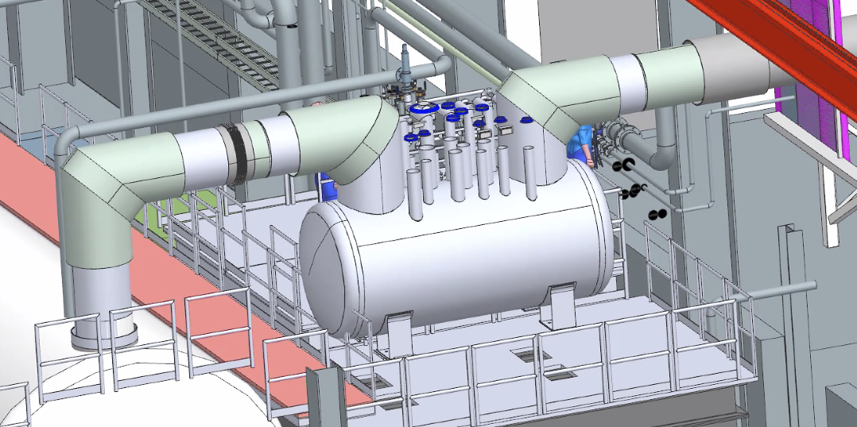
Cryogenic Plant & Cryogenic Distribution System (CDS)
DAE Contract for Cryogenic Plant Launched
PIP-II Cryogenic Plant is the single largest in-kind contribution from DAE/India
Design/Build contract with ALAT. Kickoff Meeting occurred in October. 60% Design review expected in June 2022
CDS designed in collaboration with Fermilab and Wroclaw University of Science and Technology
CDS Final Design complete
Integration with Conventional Facilities well defined and stable
ALAT: Air Liquide Advanced Technologies

Slide 23



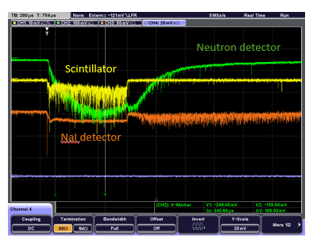
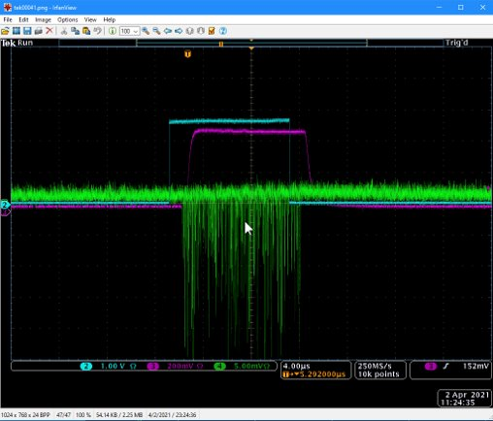
Accelerator Systems
Scope
  Design, procurement, fabrication, and testing of various accelerator system hardware and software including: Machine Protection Systems, High Power RF & RF distribution, Low Level RF, Magnets & Power Supplies; Vacuum; Controls; Safety Systems; Beam Instrumentation
Focus
  PIP2IT support for beam operation and SRF testing
  Complete technical requirements, mature designs
Highlights
  The PIP2IT program was a successful integrated system test for majority of Accelerator Systems
    First implementation of EPICS-based controls realized
    Eight ECIL/BARC 325 MHz 7 kW amplifiers power SSR1 cavities
    LLRF/RFPI with resonance control operational in HWR, SSR1
    Laser profile monitor demonstrated ability to generate transverse and longitudinal profiles
    MPS successfully validated detecting low energy (2.1 MeV) beam loss with a diamond detector
Loss monitor detectors tested at PIP2IT: neutron (on loan from FRIB), sodium iodide, scintillator-based monitor
Beam loss detected by diamond detector

Slide 24
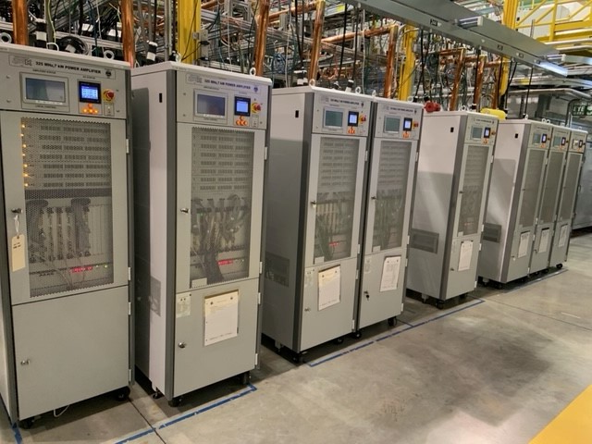
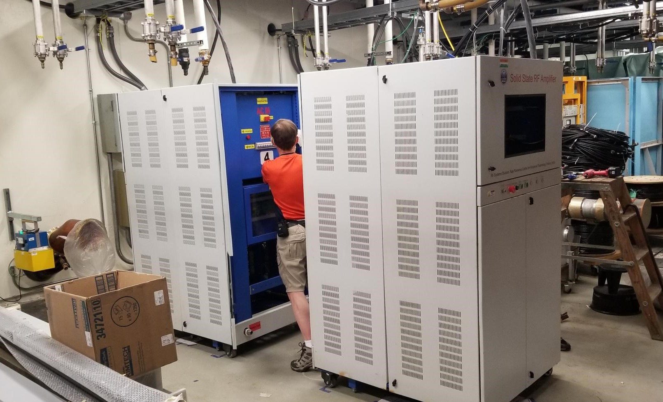
DAE RF Amplifiers advanced prototypes tested at FNAL
ECIL/BARC 7 kW 325 MHz amplifiers powered
all eight SSR1 cavities during beam testing at PIP2IT
RRCAT 40 kW 650 MHz prototype amplifier under testing at Fermilab. Will power 650 MHz cryomodule testing at PIP2IT
Extensive operational experience and testing at Fermilab & BARC/RRCAT led to refined RF amplifiers Technical Specifications agreed upon & signed

Slide 25

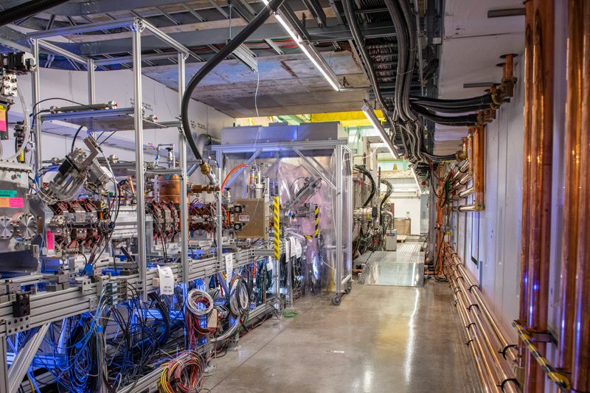
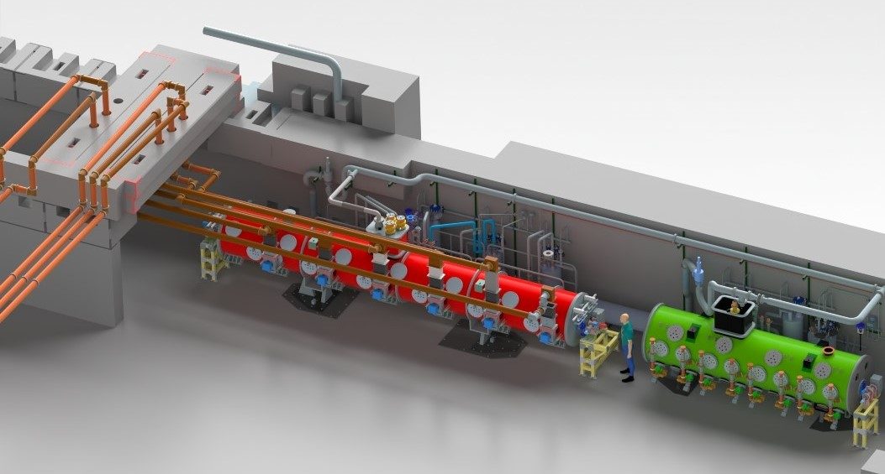
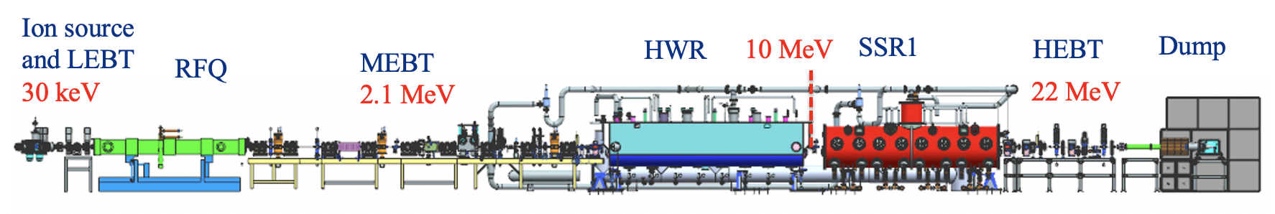
PIP-II Injector Test (PIP2IT) –Testbed for PIP-II Technologies
PIP2IT was a near full-scale Front End of PIP-II, incl. first two cryomodules and IKC from partners
Last April a very successful multi-year beam test program concluded
Conversion to a PIP-II 2-Cryomodule Test Stand in progress - new cryo distribution, RF amplifiers, fully EPICS
Test Stand on track to enable RF testing of proto HB650 cryomodule
650 MHz CM Test Stand
SSR CM Test Stand

Slide 26
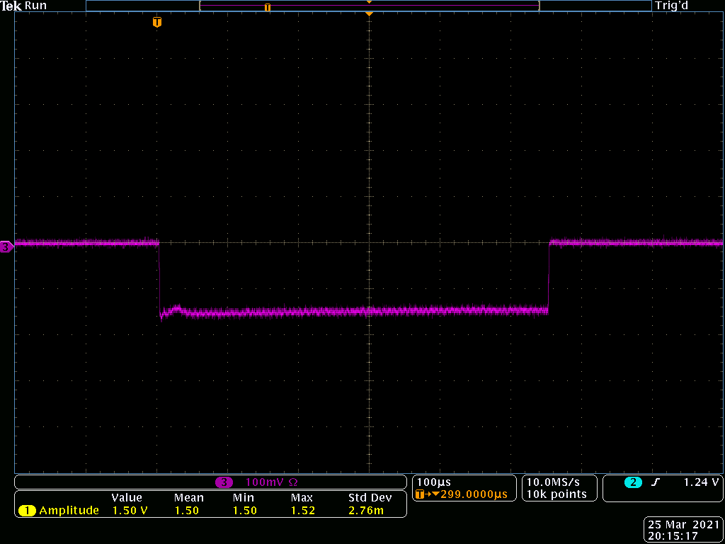
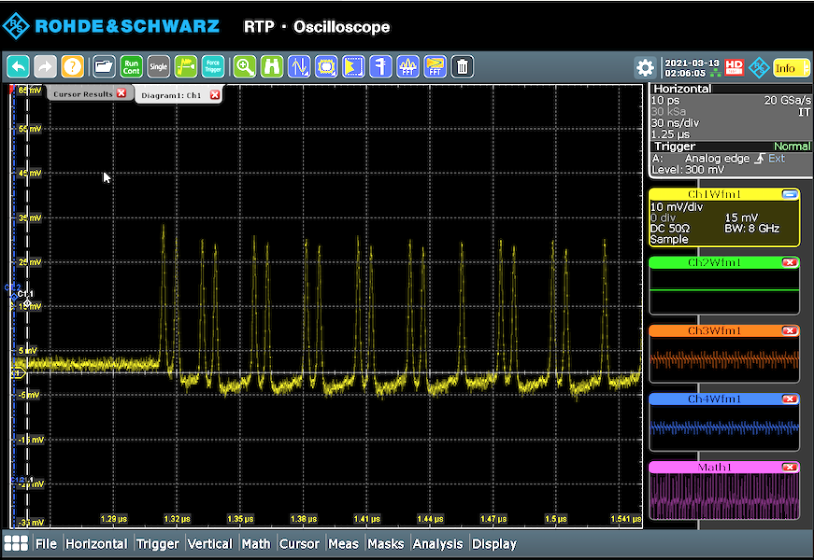





PIP2IT Tests Successfully Completed
PIP-II design beam parameters demonstrated
Energy = 16 MeV
Pulse beam cur = 2 mA
Pulse length = 550 $μ$s
Pulse rep rate = 20 Hz
Chopped beam pattern
Bunch-by-bunch chopping pattern required for LBNF demonstrated
MEBT chopper is critical for PIP-II operations, capable of removing individual bunches, provides arbitrary bunch pattern capability
Critical technologies demonstrated
Beam accelerated to 17 MeV
HWR and SSR1 Prototype cryomodules performance validated with beam
ML algorithm applied successfully to align orbit
Partner deliverables seamlessly integrated
Eight 7 kW amplifiers
SSR1 Cavity
RF MEBT magnets
Radio frequency quadrupole
Half Wave Resonator cryomodule
PIP-II ushers in new era of SRF proton acceleration at Fermilab

Slide 27



Accelerator Complex Upgrades
Beam Transfer Line / Absorber Line
  Completed the Final Design Review for the BTLBA Absorbers
  Finalized design of the Transfer Line collimators
Booster
  The ORBUMP magnet design is being finalized
  Completed PDR and finalizing design of Booster collimators
  New Booster DCCT has been received and is ready for installation (CD-3a)
  Testing area refurbished and ready for Booster magnet testing at 20 Hz
MI/RR/Booster RF
  Completing the assembly of prototype modulator with 2 power tubes
  Final Design Review of the MI RF Upgrade was held
  Prototype medium bore Booster cavity installed in tunnel and is operating
  Working on the tuning of the RR mock-up cavity
  Preliminary Integration Review for the Accelerator Upgrades was successfully completed
Upgraded MI RF #5 in MI tunnel
Booster Magnet Girder in E4R

Slide 28


Conventional Facilities
Cryoplant Building Construction underway
  Construction complete scheduled for ~June 2022
Site Work
  Notice to Proceed issued on Nov 29, 2021
  Construction complete scheduled for October 2022
Linac Complex Design integrated w/ technical systems
  Final design 100% complete in April 2021
  RFP Review underway
  Construction award scheduled for Oct 2022
Booster Connection
  Started final design April 2021, ahead of schedule
  60% design review completed August 2021
  100% design complete February 2022

Slide 29


PIP-II Cryogenic Plant Building construction is ~92% complete
https://app.truelook.com/?u=fc1599677013#tl_live
https://app.truelook.com/?m=16002500832205565503647
Cold Box Station

Slide 30

Linac Complex Design is Complete – Ready to Execute Civil Construction
Linac Complex design enables PIP-II multi-user capability and upgrade/expansion to 2 GeV linac in support of 2.4 MW program

Slide 31

The PIP-II Project benefits from Fermilab’s highly talented engineers to build the infrastructure for scientific advancement!
THANK YOU!

