Slide 1
Ethical Engineering Disasters: What Can We Learn From Them?
Kathrine Laureto – AD/MSD
Engineers Week – February 23rd, 2022

Slide 2
Overview
“Every engineering failure, no mater how small, erodes the public’s trust in the profession. Without trust, engineers lose the ability to freely innovate and improve our quality of life. Studying engineering disasters is very useful because it allows us to learn from the mistakes of others, thereby reducing the likelihood of another tragedy” [1].
In today’s session:
Two ethical engineering disasters
One ethical engineering success
Lessons we can learn
Resources

Slide 3
Disaster #1 – Bhopal Chemical Plant
Background
Union Carbide pesticide plant in Bhopal, India
One ingredient used to manufacture pesticides was methyl isocyanate (MIC), which is a highly toxic chemical.
Bhopal facility housed three underground liquid MIC storage tanks (~70,000L) that were deemed “safe from leakage.” [2]
MIC can be stored in a leak-tight system, but presence of water causes a significant exothermic reaction.
Poor, densely populated neighborhoods surrounded the Union Carbide plant.
Figure 1: Abandoned Bhopal chemical plant, 2014 [3]

Slide 4
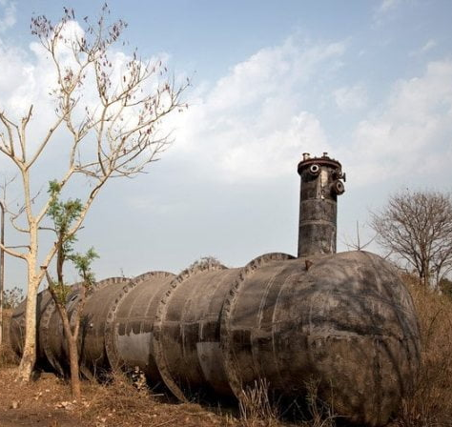
Disaster #1 – Bhopal Chemical Plant
Background
Around 1am on December 3, 1984, there was a chemical leak from one of the MIC storage tanks.
Water had entered an MIC tank, causing an exothermic reaction that fractured the storage tank and released 45 tons of dangerous gas into the air [2]. “Worlds worst industrial disaster.”
The cloud of gas drifted out of the tank and toward the surrounding neighborhoods, where thousands of people were sleeping.
Thousands of people were killed immediately. Survivors suffered respiratory problems, eye irritation or blindness, and other serious ailments resulting from the gas release [2].
Figure 2: Abandoned MIC tank [10]

Slide 5
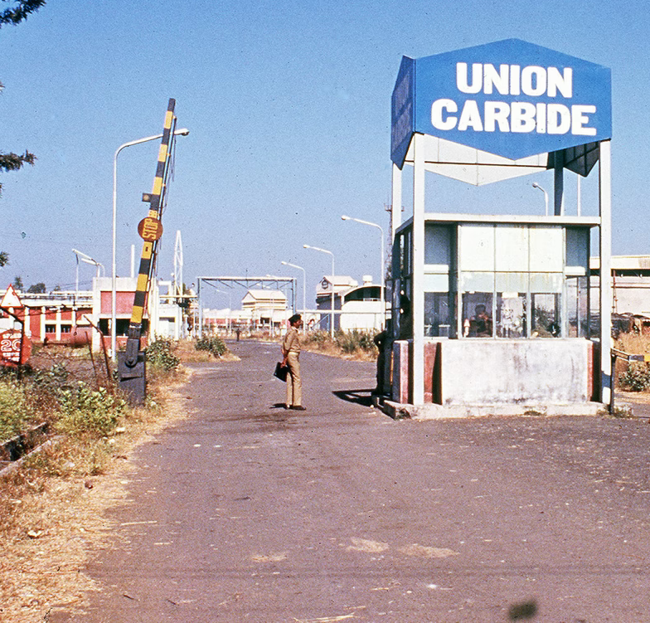
Disaster #1 – Bhopal Chemical Plant
Effects
Trees and other foliage in the vicinity of the UC plant were destroyed.
170,000 people were treated at hospitals and temporary aid stations.
2,000 animals died from the gas inhalation.
The remaining two MIC tanks were emptied (there were no other safe alternatives found), which caused a second forced evacuation from Bhopal.
A legal battle began between UC, the US and Indian governments, local Bhopal authorities, and the victims.
Gas victims experience long-term health effects (eyes, respiratory systems, neurological systems, and others).
Soil and groundwater in the area are polluted to this day [15].
Figure 3: Union Carbide plant after the gas leak [3]

Slide 6
Disaster #1 – Bhopal Chemical Plant
Causes [2]
From 1976 – 1984, there were dozens of recorded occupational hazards at the plant, many resulting in serious injury due to small MIC leaks.
Many of the safety systems were not functioning properly and piping/valves/instruments were in bad condition.
A vent gas scrubber, used to neutralize escaping gas, was undergoing maintenance at the time and was not working properly.
A public siren had briefly sounded but was quickly turned off. This was standard company procedure put in place to avoid alarming the public over tiny leaks.
The police were not initially notified because company management had an informal policy to not involve local authorities in gas leaks.
Surrounding residents had never been informed of the severe side effects of MIC gas inhalation. Medical personnel hadn’t been informed on what the gas was or how it needed to be treated.

Slide 7
Disaster #1 – Bhopal Chemical Plant
Causes
Management at the Bhopal plant and management at its parent company, Union Carbide in the USA, failed to invest in proper safety. This caused a dangerous working environment.
Some of the safety-related factors included: poor maintenance, shutting off safety systems to save money, management deficiencies, lack of skilled operators, and inadequate emergency plans.
Safety audits at the West Virginia UC plant found numerous defects and malfunctioning equipment, but the report was not shared with the Bhopal UC plant, even though they shared the same overall plant design.
The audit warned that "a runaway reaction could occur in the MIC unit storage tanks, and that the planned response would not be timely or effective enough to prevent catastrophic failure of the tanks“ [2].

Slide 8
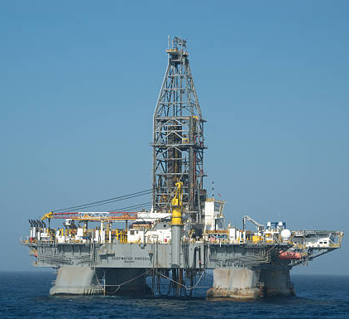
Disaster #2 – BP Deepwater Horizon Oil Spill
Background
Deepwater Horizon offshore oil drilling rig in the Gulf of Mexico, approximately 40 miles off the coast of Louisiana.
Owned and operated by offshore-oil-drilling company Transocean, leased by BP.
In February 2010, the rig began drilling an exploratory well that was planned to be 3.5 miles below sea level [5].
A concrete barrier was poured at the well by subcontractor Halliburton in order to seal the well for later use.
Figure 4: The Deepwater Horizon drilling rig [6]

Slide 9
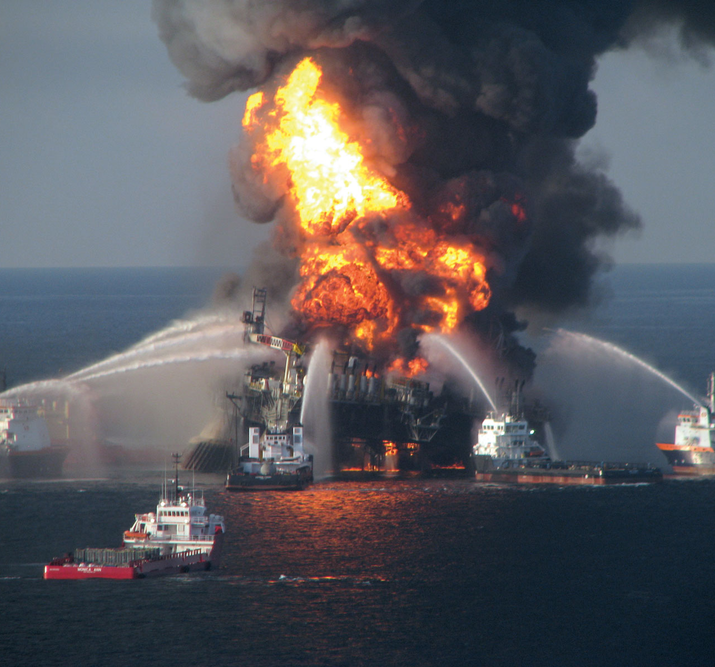
Disaster #2 – BP Deepwater Horizon Oil Spill
Background
On April 20, 2010, an explosion was caused by natural gas that broke through the concrete barrier at the well.
There was a blowout preventer on the rig that workers attempted to activate, but the device failed.
The explosion caused a large fire that engulfed the rig and sank it two days later, on April 22.
Rescue efforts evacuated the 126 people on board, but 11 workers were killed during the explosion/fire.
On April 22, the Coast Guard reported that oil started leaking from the rig at a rate of 340,000 gallons per day [5].
The leak was finally sealed in September 2010 after 170 million gallons of oil had been released into the ocean [8].
Figure 5: Post-explosion of the Deepwater Horizon rig [7]

Slide 10
Disaster #2 – BP Deepwater Horizon Oil Spill
Effects [5]
Immeasurable, devastating impact on wildlife (fish, birds, turtles, marine mammals).
It’s estimated that 1 million birds died as a result of the spill.
Studies found chemicals from this oil spill in migratory birds as far away as Minnesota.
The number of fish with deformities and lesions increased from 0.1% before the spill to over 20%.
As of 2012, there were severe signs of coastal erosion and oil found in marshes.
People involved in clean-up efforts were exposed to a dangerous combination of oil and the dispersant chemical. Has been described as “the biggest public health crisis from a chemical poisoning in the history of this country” [5].

Slide 11
Disaster #2 – BP Deepwater Horizon Oil Spill
Causes
The concrete barrier had been completed just 20 hours before the explosion. A BP memo was drafted indicating that the concrete was likely to be unsuccessful.
BP and Halliburton both had test results showing the concrete slurry, created by injecting nitrogen into cement, used to seal the well did not meet industry standards for stability [9].
The well had a blowout preventer, but it had been five years since it was last inspected. There were unreported incidences of damage to the blowout preventer just a month prior to the explosion.
The blowout preventer did not have a remote-controlled activation device. The remote-controlled activation device was considered but was ultimately not installed because its cost and effectiveness were questioned.
A BP-owned oil rig in the Caspian Sea had a near-disaster in 2008 due to the same concrete-related failure. In this case, there were no deaths. This incident was covered up and not well-publicized.

Slide 12
Disaster #2 – BP Deepwater Horizon Oil Spill
Causes
There were many, many safety concerns identified and documented by numerous BP engineers, rig workers, and outside agencies. In many cases, the concerns were not addressed due to the company focus on saving time and money [4].
There were reports of poor safety culture and pressure to keep on schedule that caused rig workers to avoid raising safety concerns for fear of losing their jobs. They were under the impression that drilling took priority over maintenance.
In 2009, BP filed an exploration and environmental impact plan for the well. The report stated it was "unlikely that an accidental surface or subsurface oil spill would occur from the proposed activities” [5].
The Department of the Interior deemed the Deepwater Horizon operation exempt from an environmental impact study after they concluded that a catastrophic oil spill was unlikely.
Regulations were loosened in 2008 and as a result, BP was not required to file a detailed blowout plan.

Slide 13
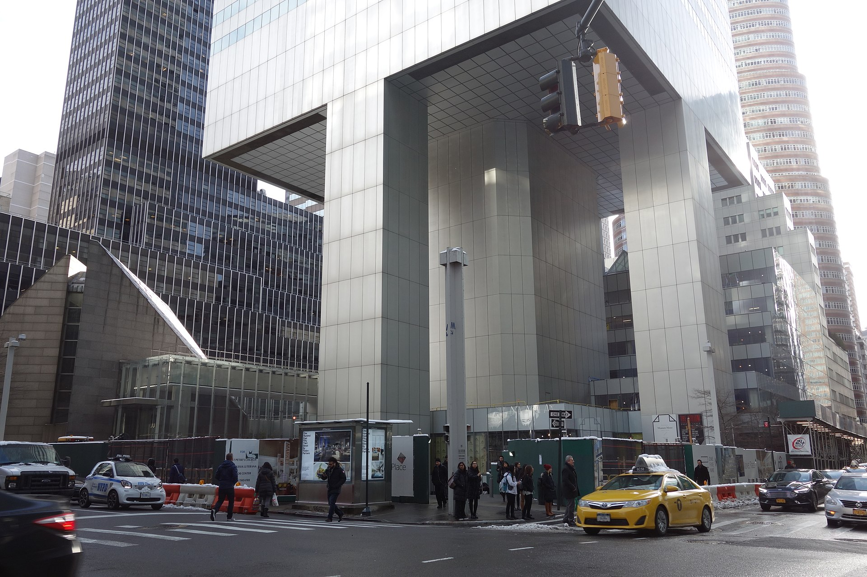
Success – Citicorp Building
Background
59-story building in New York City designed and built in 1877 by the nations leading structural engineer at the time, William LeMessurier.
The building sits on four giant 9-story tall stilts, positioned in the center of each side.
A design flaw was discovered in 1987 by an engineering student at Princeton who was working on their thesis.
LeMessurier dismissed the student’s concern but thought it would be a good exercise for his own students (he was a professor at the time).
In preparation for the lecture, he revisited his analysis.
Figure 6: Citicorp Center, 2018 [13]

Slide 14
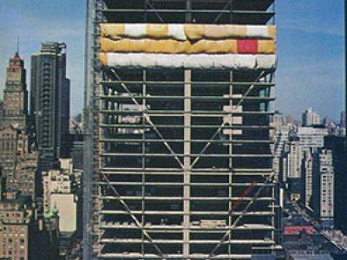
Success – Citicorp Building
Background
LeMessurier originally verified the strength of the columns under perpendicular winds (that was all that was required by NYC building code).
In preparation for his lecture, he considered the impact that 45-degree winds (quartering winds) would have on the columns. [14].
The quartering wind increased the strain in parts of the columns structure by 40%. Under normal circumstances, the wind braces in the columns would have easily absorbed the extra load.
However, a few weeks before, he learned the braces were joined using bolts instead of being welded [14].
Figure 7: Citicorp Center under construction [16]

Slide 15
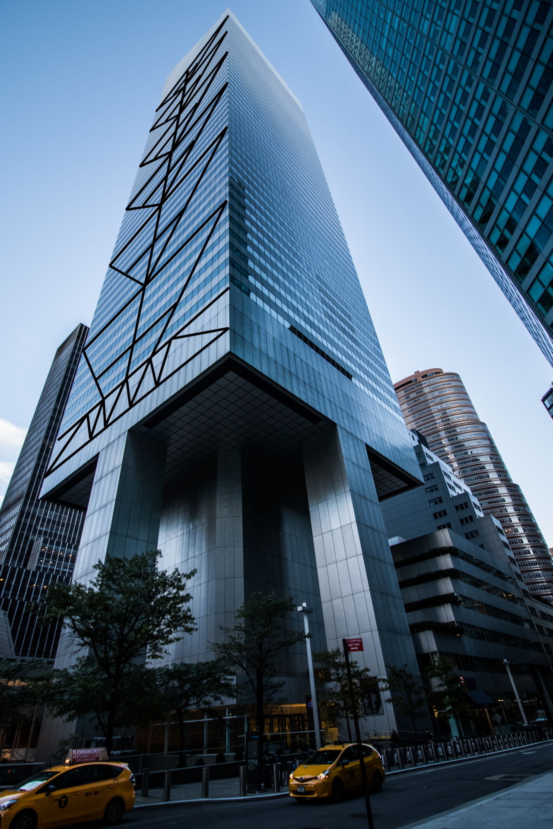
Success – Citicorp Building
Background
At the time of the change, LeMessurier had agreed to switch from welds to bolts. The bolts were more practical (welding is more labor-intensive), cheaper, and were still a safe option.
After learning about the increased load from the quartering wind, he thought he should revisit the analysis on the bolted joints.
He discovered that the 40% increase in parts of the column led to a 160% increase on the building's bolts, due to the immense leverage from higher wind forces [14].
A near-hurricane force quartering wind would exceed the strength of the bolted joints [13]. LeMessurier learned that a storm that severe has the statistical probability of happening in NYC once every 16 years (a “sixteen-year storm”).
Figure 7: Citicorp Center, 2021 [5]

Slide 16
Success – Citicorp Building
Ethically Sound Decisions
LeMessurier started notifying Citicorp officials, lawyers, and his insurer of his concerns. He had a proposed plan to weld heavy steel plates over the bolted joints.
His plan was agreed upon by the Citicorp chairman, so LeMessurier started working on issuing the necessary repairs with Leslie Robertson, an engineer who had been a structural consultant for the World Trade Center.
LeMessurier and Robertson coordinated the installation of strain gauges on numerous structural members throughout the building. The strain gauge results were constantly monitored for unusual movement.
They assembled a group of weather experts (some of which worked at Brookhaven) to closely monitor the winds and provide wind predictions.
Their team produced emergency plans with the police, the mayor’s Office of Emergency Management, and the Red Cross in case they needed to quickly evacuate the building or in case there was a building failure.
Welding the steel plates took over a month but was successfully completed and the building was deemed strong enough to withstand a “700-year storm.”
The city officials commended LeMessurier for originally coming forward and working quickly to solve the problem. This is commonly used as an example of how engineers should respond when faced with ethical decisions.

Slide 17
What Can We Learn?
Don’t ignore the experts. If issues are discovered, they should be promptly investigated instead of being ignored or considered to be too expensive to remedy.
In these examples, concerns and issues were brought forward and for one reason or another, were ignored by people in charge. This can result in disaster, as we’ve seen.
The principle of “free and informed consent” is very important.
People of Bhopal weren’t informed of the dangers of MIC or what they should do if there was a gas leak. How would the outcome have changed if the surrounding population had been aware of the hazards?
Blind faith in technology fixes can be dangerous. Adding complexity to a system increases the number of components that interact and can cause unexpected outcomes and failures [4].
“It’s not enough to guard against the failures that have already occurred. Those that haven’t happened yet are the ones to fear most. When something goes wrong, the focus should be on what was the thinking that got us in this position?” [4].
“Engineers have the opportunity to create some ground-breaking and life-changing designs. To ensure they benefit humanity and society, engineers need to strictly adhere to rules, regulations and processes, as well as have high ethical standards” [1].
People make mistakes, and mistakes often lead to delays and additional costs. We can maintain Fermilab’s culture of safety by not shaming those who do make mistakes. People shouldn’t be afraid to voice their concerns or identify mistakes that have been made.

Slide 18
Resources
FRA Code of Business Ethics and Conduct
Failure to Learn: The BP Texas City Refinery Disaster
Order of the Engineer – “An association for graduate and professional engineers in the United States that emphasizes pride and responsibility in the engineering profession” [11].
National Society of Professional Engineers (NSPE) Code of Ethics for Engineers [12].
Hold paramount the safety, health, and welfare of the public.
Perform services only in areas of their competence.
Issue public statements only in an objective and truthful manner.
Act for each employer or client as faithful agents or trustees.
Avoid deceptive acts.
Conduct themselves honorably, responsibly, ethically, and lawfully so as to enhance the honor, reputation, and usefulness of the profession.

Slide 19
Thank you for your time!

Slide 20
References
[1] https://www.pdh-pro.com/pe-resources/engineering-disasters-ethical-implications-for-professional-engineers/
[2] https://ethicalengineer.ttu.edu/studies/case-study-bhopal-gas-tragedy
[3] https://www.theatlantic.com/photo/2014/12/bhopal-the-worlds-worst-industrial-disaster-30-years-later/100864/
[4] https://www.asme.org/topics-resources/content/the-ethical-lessons-of-deepwater
[5] https://en.wikipedia.org/wiki/Deepwater_Horizon_explosion
[6] https://www.istockphoto.com/photos/deepwater-horizon-oil-rig
[7] https://www.britannica.com/event/Deepwater-Horizon-oil-spill
[8] https://www.epa.gov/enforcement/deepwater-horizon-bp-gulf-mexico-oil-spill
[9] https://www.bbc.com/news/world-us-canada-11648354#:~:text=In%20a%20letter%20to%20the,did%20not%20meet%20industry%20standards
[10] https://www.bhopal.org/continuing-disaster/the-dow-chemical-companys-bhopal-related-legal-liabilities/the-criminal-case-against-ucc-and-dow-chemical/
[11] https://order-of-the-engineer.org/
[12] https://www.nspe.org/resources/ethics/code-ethics
[13] https://en.wikipedia.org/wiki/Citicorp_Center_engineering_crisis
[14] https://www.newyorker.com/magazine/1995/05/29/the-fifty-nine-story-crisis
[15] https://en.wikipedia.org/wiki/Bhopal_disaster
[16] https://onlineethics.org/cases/engineers-and-scientists-behaving-well/william-lemessurier-fifty-nine-story-crisis-lesson

