Slide 1
Connecting to Our Community
Learn about opportunities to extend your network and participate in Fermilab outreach programs
Fermilab Office of Equity, Diversity and Inclusion
February 24, 2022

Slide 2
Today’s Lineup
Fermilab Office of Equity, Diversity and Inclusion
  Introduction of new D&I Specialists: Anahi Ruiz Beltran and Cortez Watkins
  Laboratory Resource Groups
  Procedure to use P/T codes for EDI work
Fermilab Society of Women Engineers – Aisha Ibrahim
Fermilab Young Professionals Buddy Program – Michael Geelhoed
Spectrum Initiatives; Human Rights Campaign Foundation’s Corporate Equality Index – Pete Cholewinski
AABA – DuPage County ACT-SO, NSBE Jr. – Cortez Watkins
African School of Physics – Kavin Ammigan

Slide 3
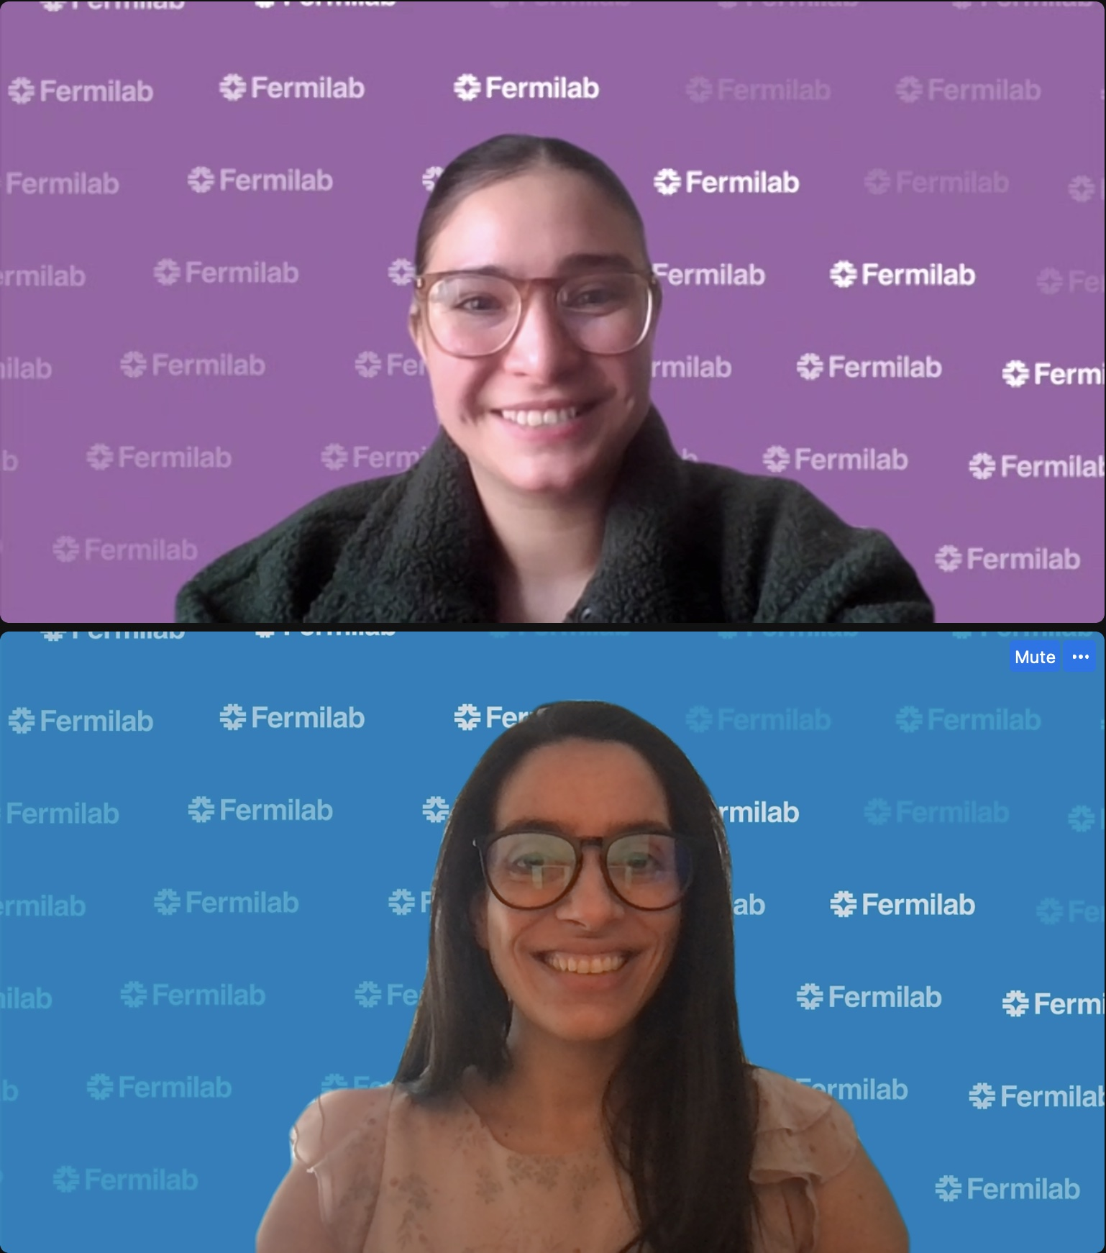
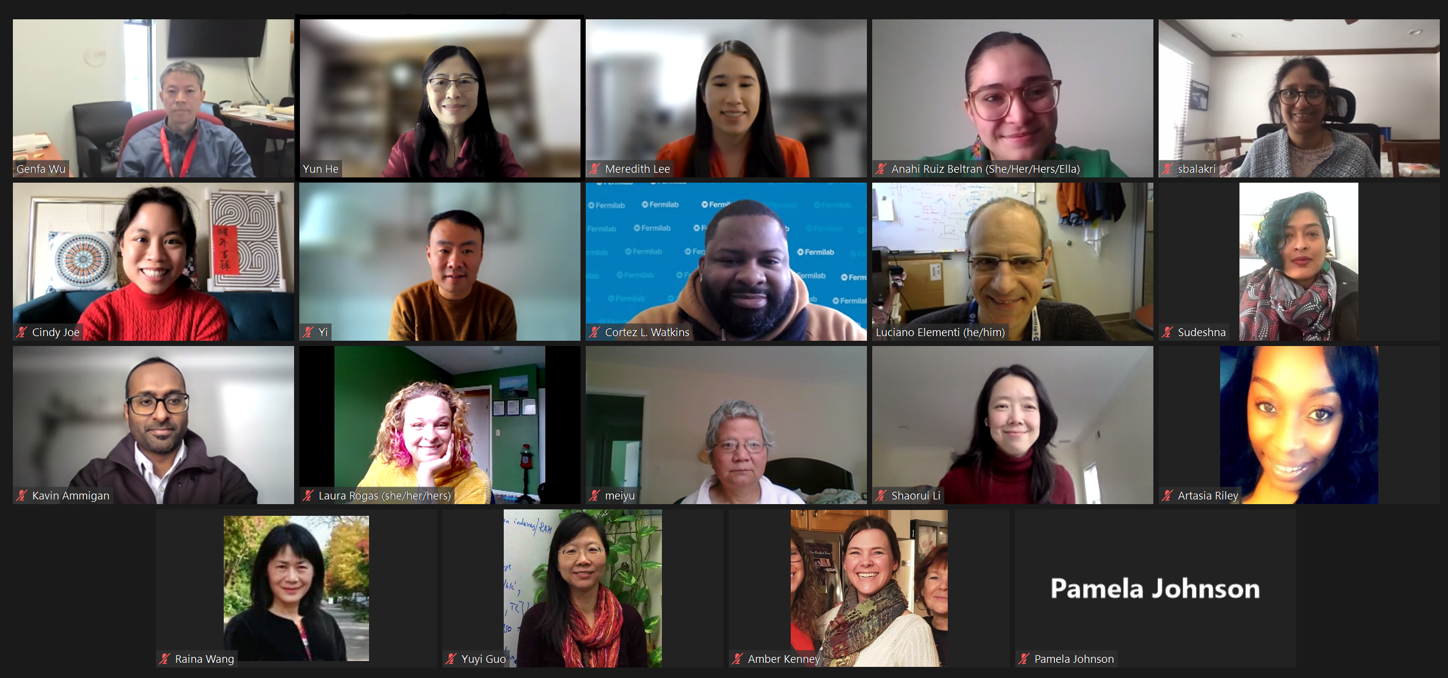
D&I Specialist for Culture, Climate and Belonging at the Office of Equity, Diversity and Inclusion: Anahí Ruiz Beltran
Background:
2019→ BA in Spanish, minor in Sociology and Latin American and Latino/a Studies
→ Graduate Teaching Assistant at Illinois State University for the Department of Languages, Literatures, and Cultures; Spanish
2021→ MA in Languages, Literatures, and Cultures; Theoretical and Applied Linguistics in Spanish
→ Academic and Career Resource Advisor at Saint Xavier University
D&I Specialist role:
→ LRG’s
→ Inclusion Matters Coordinator
→ EDI Task Force Facilitator
→ TARGET Program
Anahi Ruiz Beltran | Connecting to Our Community
02/24/2022

Slide 4
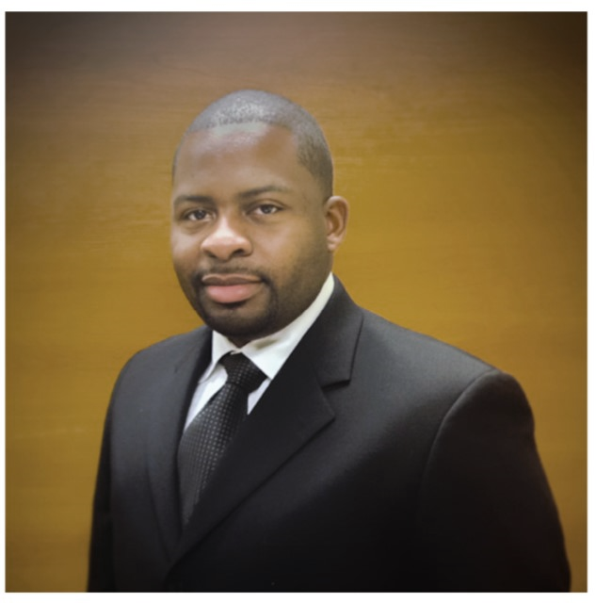
D&I Specialist for Workforce Pathways & Community Outreach
Background:
Hometown: Memphis, TN
Studied Engineering, Physics, Japanese
First-Generation College Graduate
Lyric Tenor
D&I Specialist role:
Implement outreach activities and cultivate community awareness
Hiring Committee Diversity Advocate
Recruitment strategy
LRG support
02/24/2022
Cortez L Watkins | Workforce Pathways & Community Outreach

Slide 5
LRG Key Contacts - https://diversity.fnal.gov/resource-groups/
African-American/Black Association
Executive Sponsor: Jemila Adetunji
Hispanic/Latino Forum
Leadership: Minerba Betancourt, Leo Aliaga Soplin, Cristina Mantilla, Martha Garcia, Miguelangel Marchan, Saul Gonzalez
Executive Sponsor: Marcela Carena
Spectrum (LGBTQ+) Community
Leadership: Erica Snider, Pete Cholewinski
Executive Sponsor: Steve Brice
Women's Initiative
Leadership: The WI Board: Maura Barone, Eileen Beno, Amanda Early, Valerie Higgins, Monika Lasota, Laura Rogas, Julie Saviano
Executive Sponsor: Alison Markovitz
Fermilab Asian Pacific Association
Leadership: Genfa Wu, Yun He, Yi Xie
Executive Sponsor: Amber Kenney
Inclusivity Journal Club
Leadership: Daniel Bowring
Veterans Group
Leadership: Brian Niesman, Brandon White
Executive Sponsor: Christopher Mossey
Fermilab Young Professionals
Leadership: The FYP Board: Kerry Aschenbach, Mohammed Elrafih, Michael I Geelhoed, Trevor Nichols, Roshanda Spillers, Ahmed Syed, Jeny Teheran
Executive Sponsor: Liz Sexton Kennedy
Fermilab Society of Women Engineers
Leadership: Alyssa Miller, Aisha Ibrahim, Chris Ader
Executive Sponsor: Christopher Mossey
Fermilab Society of Hispanic Prof. Engineers
Executive Sponsor: Vanessa Peoples

Slide 6
Labwide EDI and EPE time charging codes
Procedure available at https://policies.fnal.gov/
Launched in cooperation with the EDI Task Force, Sr. Leadership EDI Council, and Finance Section.
“Under the new procedure, employees working 40+ hours a week may charge up to six hours per month on EDI/EPE combined without seeking prior manager approval. This is a change, as manager approval previously was needed. Employees working less than 40 hours per week may charge up to 3% of their regular hours each month without prior manager approval.”
Participation with Laboratory Resource Groups is an established EDI activity!
Contact your Division/Section Field Financial Manager for the EDI/EPE codes.
Regular audits to track use of the codes.
“Lab leadership encourages participation in EDI and EPE, and this important work supports the mission of the lab. Our goal is to remove barriers and establish clear guidance for participation in these activities by employees across the lab.”
- Alison Markovitz, Chief Strategic Partnerships Officer

Slide 7
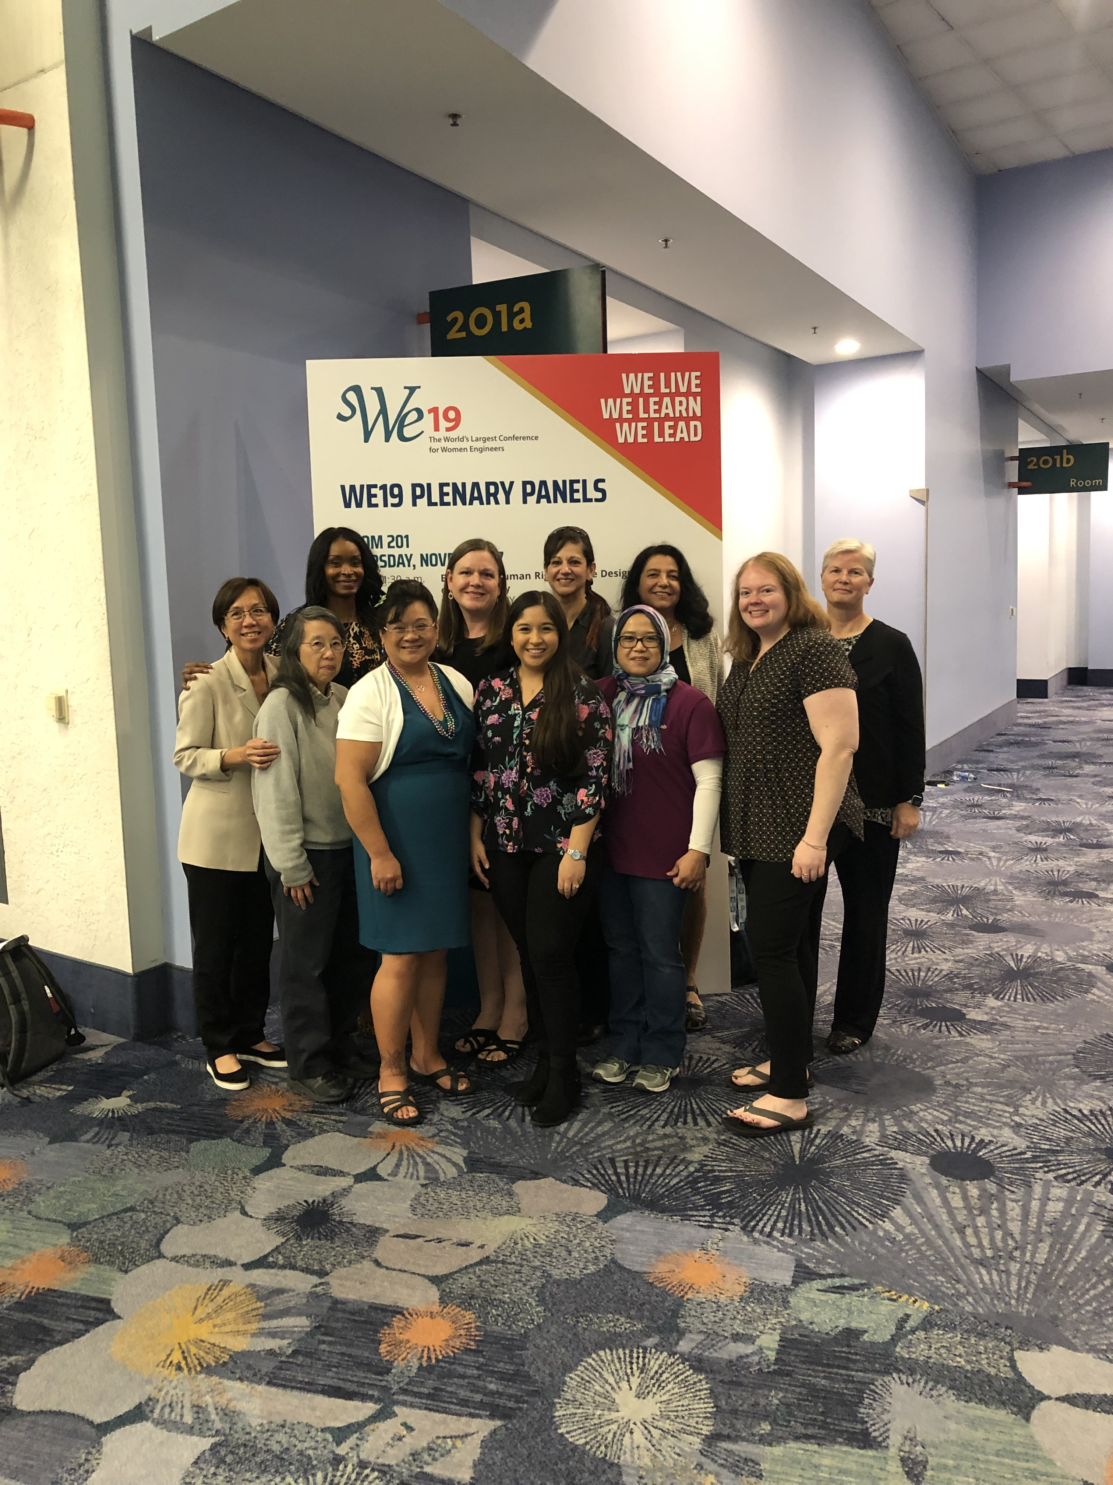
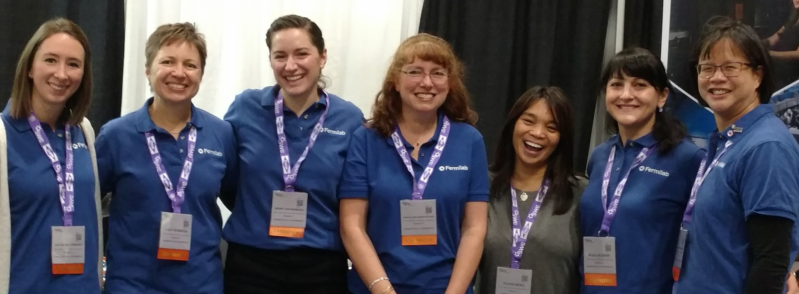
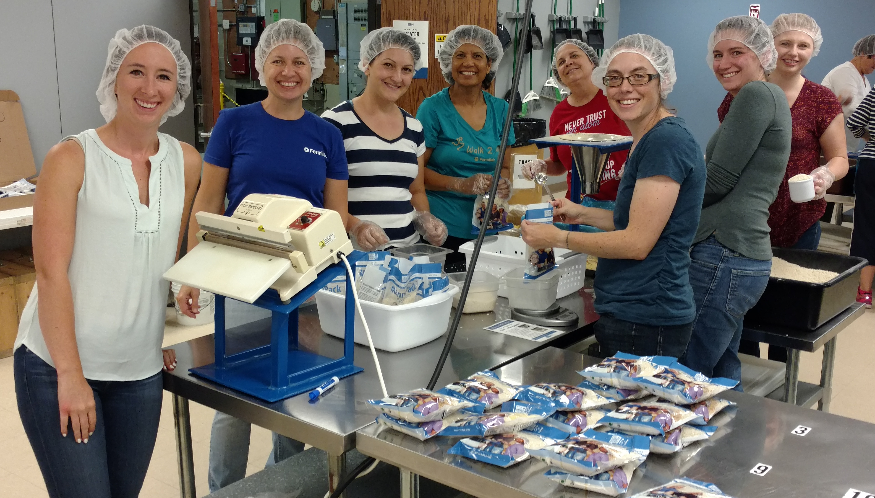
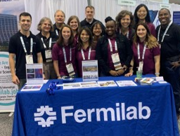
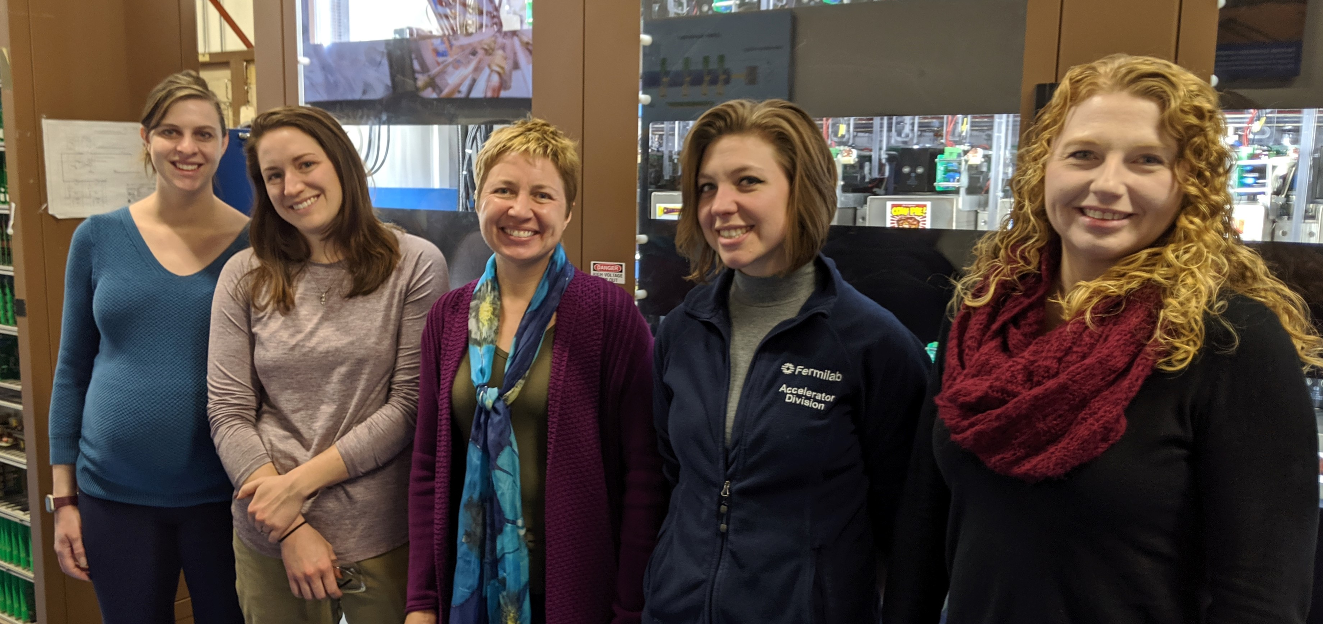
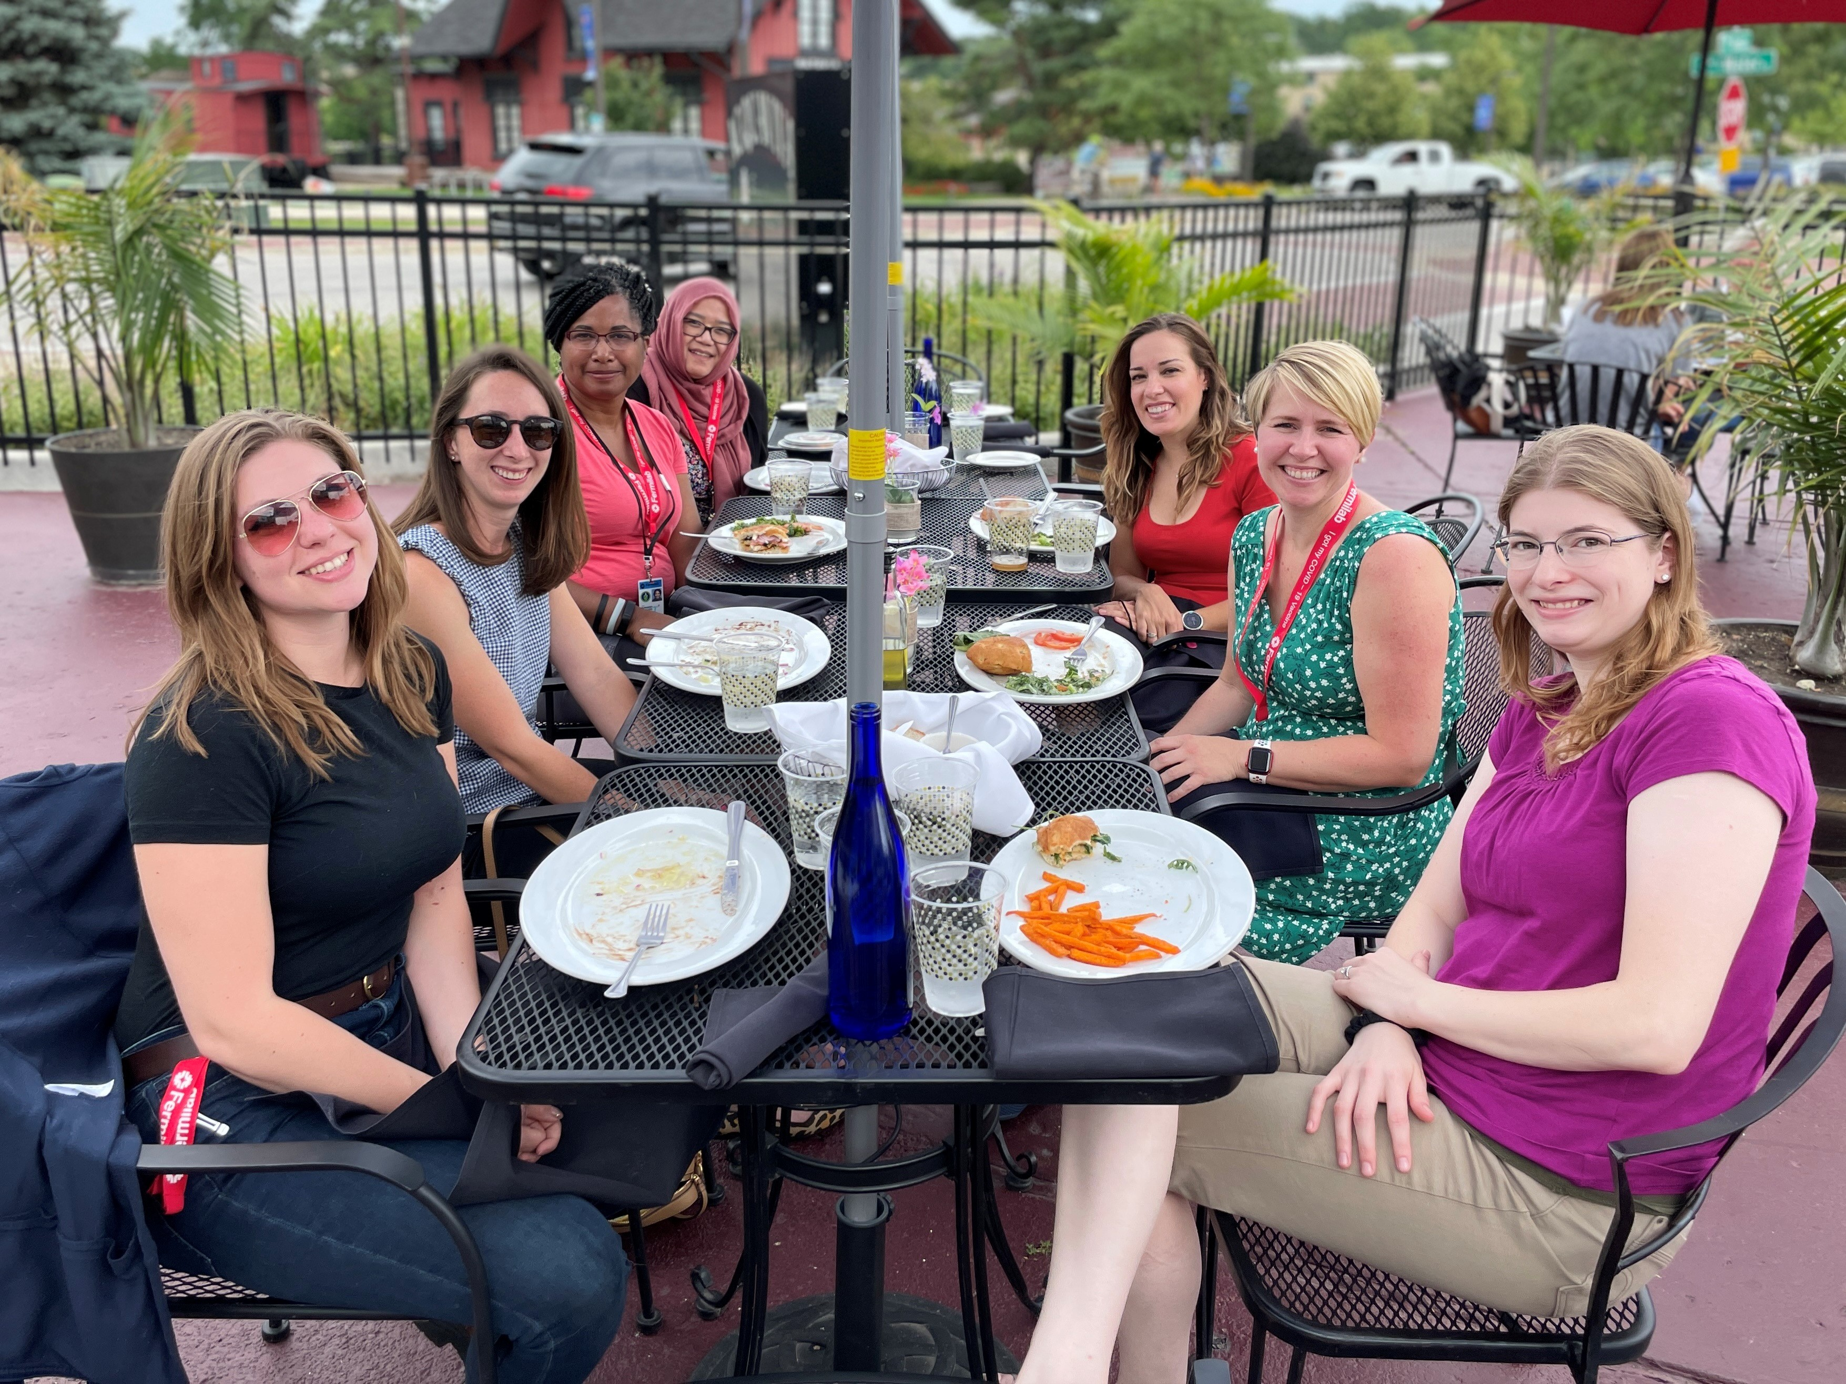
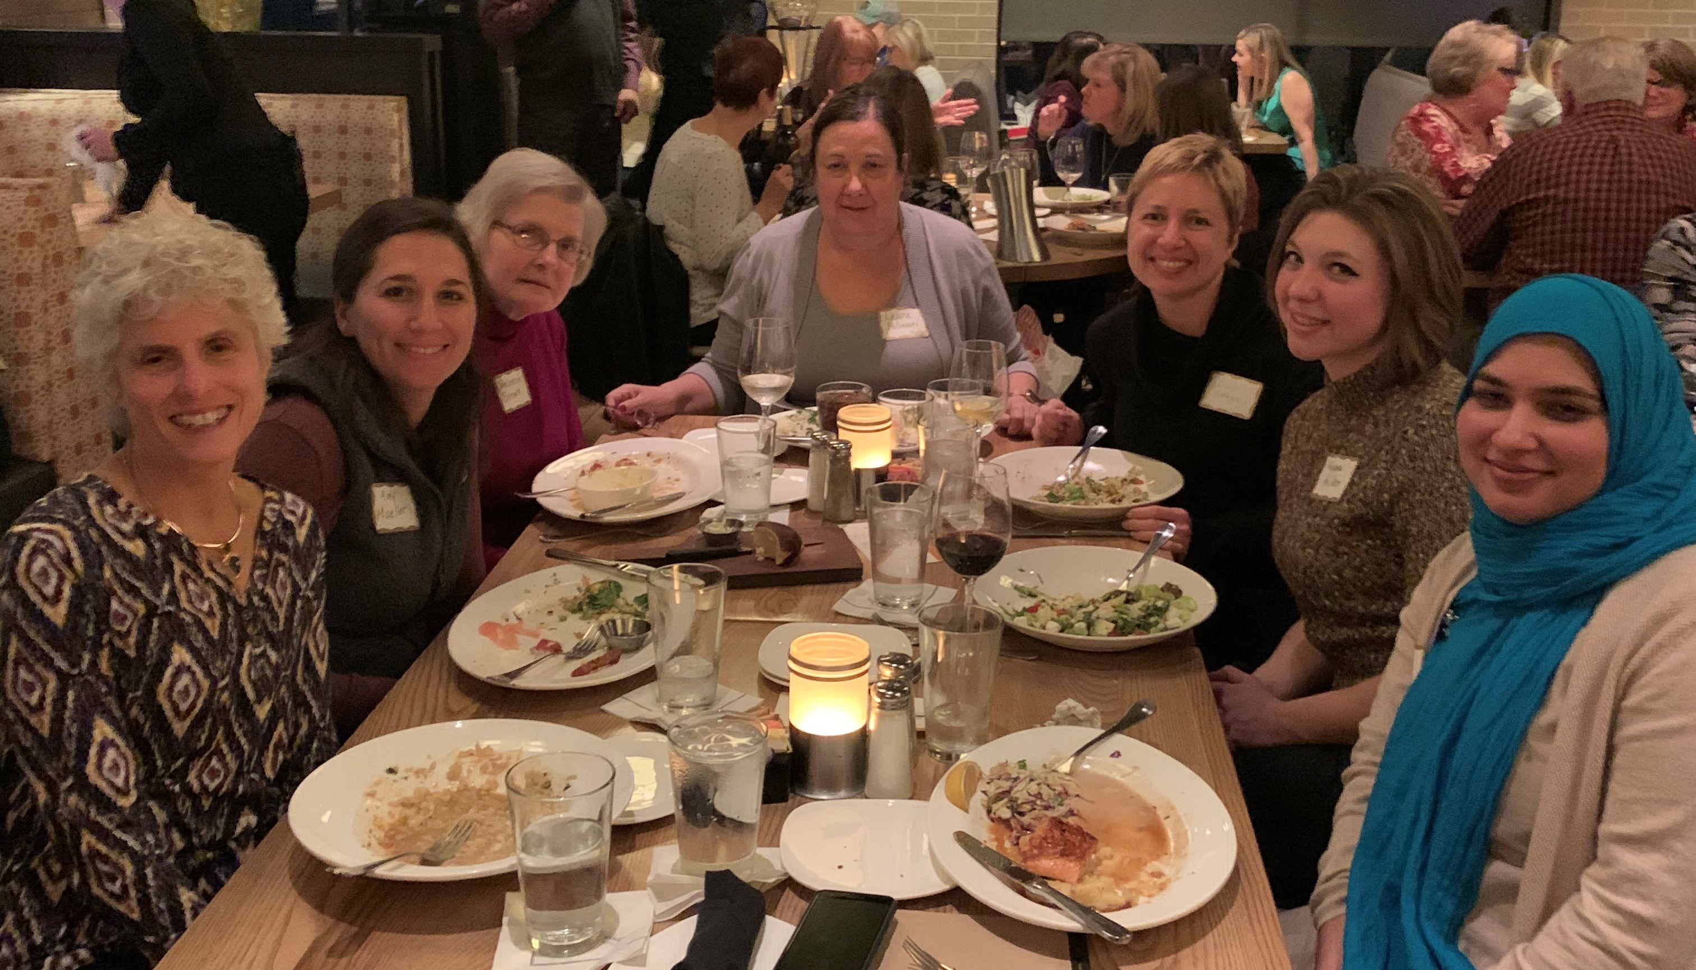

Slide 8


In October 2016, Fermilab became a SWE corporate member and created the fSWE LRG.
fSWE is open to ALL employees in Fermilab, including regular full-time, part-time, hourly, and salaried employees, regardless of gender identity or SWE membership status.
Join anytime by sending an email to listserv@fnal.gov with a BLANK subject and within the body only
SUBSCRIBE FERMI-SOCIETY-OF-WOMEN-ENGINEERS FirstName LastName
Nine lab-paid professional memberships are available each year. Application period is in May/June.
Initial efforts focused on establishing hiring/outreach at the national conference : 8.4% female engineers (2017) -> 12.6% (2021)
WE 2019 : Conducted 23 onsite interviews with “offers in hand”, resulting in 2 new hires from 3 job offers extended
2021: https://youtu.be/486tO1fXk9g
Recent efforts focused on sharing fSWE resources and partnerships with Fermilab community
Fall 2021 : "Leveraging Male Allies to Champion Gender Inclusion and Equity“
Notes:
Society of Women Engineers (SWE) was founded in 1950 with the mission to empower women to succeed/advance in their careers/be recognized as engineers and leaders in industry.
DOE had focused on gender demographics at the national labs. And in response, Fermilab became a SWE corporate partner in 2016 and created LRG to supplement that
SWE encourage allyship so membership is open to all gender indentities in the STEM field. Likewise, fSWE is also open to all employees at Fermilab.
One benefit… With the corporate memberships, comes with 9 professional memberships – which are available to all Fermilab employees at no cost.
Application period is may/June --- give you access to SWE learning center (which is accredited for CEU and PDU) , networking with chicago regional, and swe affinity
Ex . SWE's Virtual Congressional Outreach Days to Advocate with U.S. Elected Officials
Started going to conference in 2017 .. 2022 only participated as attendee (4 spots at cost free)
Made youtube video : https://youtu.be/486tO1fXk9g
Since then moving needle : total female at the lab 23.9%->26%
For engineers : 8.4% ->12.6%
Ex. Strategic Leadership Series // Inclusive Recommendations: Writing, Requesting, and Assessing Them // Navigating Successfully Through Workplaces Shaped by Subtle Bias // POWER // FEW

Slide 9
Fermilab Young Professionals Buddy Program
Buddies
Michael Geelhoed AD/MSD
Connecting to Our Community
February 24th 2022

Slide 10
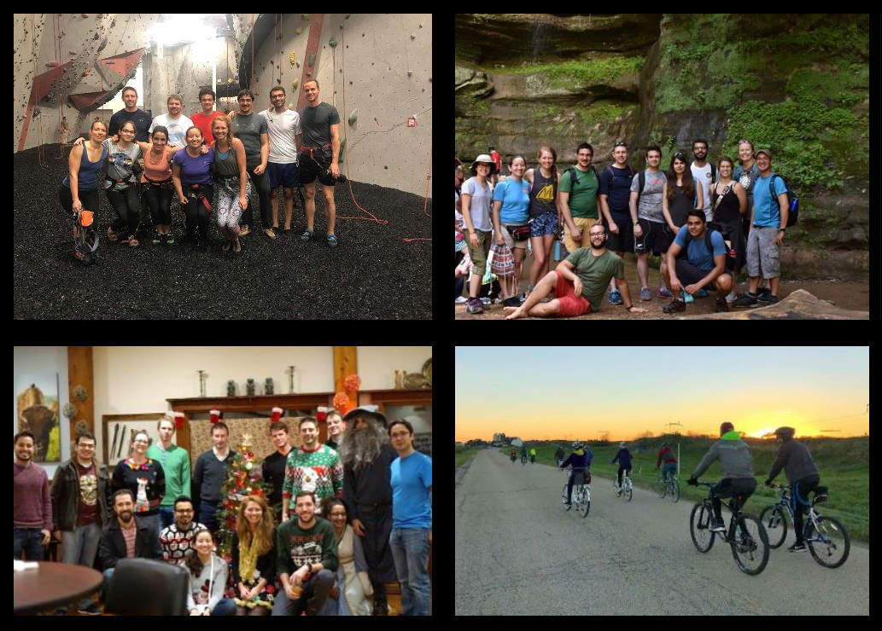
FYP Buddy Program – Mission and Objective
Fermilab Young Professionals mission is to offer a platform for young professionals to connect with fellow Fermilab community members to learn about Fermilab, advance their careers and reach their highest potential.
Notes:
Just prior to and solidified during the pandemic we listened to our members there was a disconnect to the lab.

Slide 11
FYP Buddy Program – Mission and Objective
The mission of the Buddy Program is to be a catalyst to help employees transition to their roles and provide support for them to succeed on an individual basis. The goal is to ensure all new employees feel the sense that they are part of our culture and help them navigate Fermilab.
Through 3 active phases, the program introduces new employees to the Fermilab environment and common lab expectations. We promote Fermilab’s internal functions, processes, and continue to endorse personal and professional growth.

Slide 12
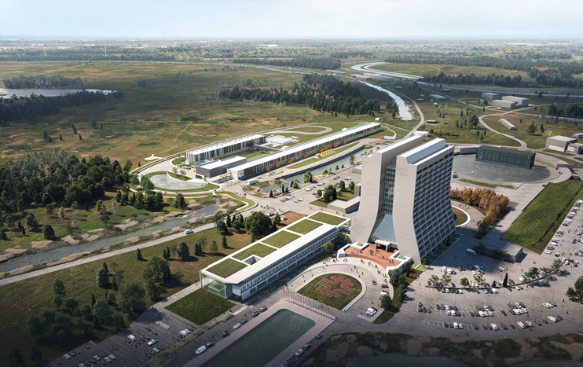
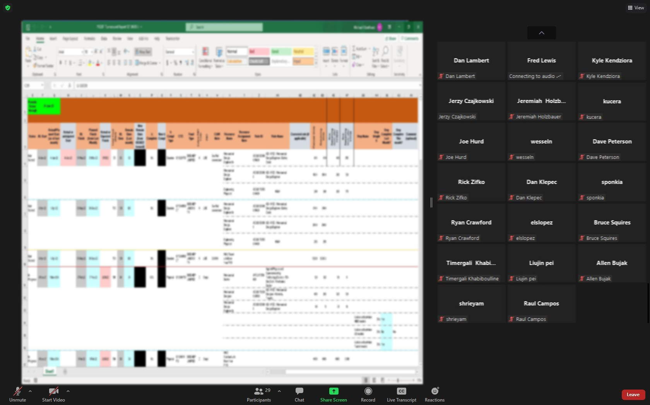

FYP Buddy Program – Mission and Objective
The mission of the Buddy Program is to be a catalyst to help employees transition to their roles and provide support for them to succeed on an individual basis. The goal is to ensure all new employees feel the sense that they are part of our culture and help them navigate Fermilab.
Notes:
“Map” of Fermilab is ever changing, the connection new employees have with Fermi could be as simple as a regular zoom call, can you imagine navigating through the alphabet soup…

Slide 13
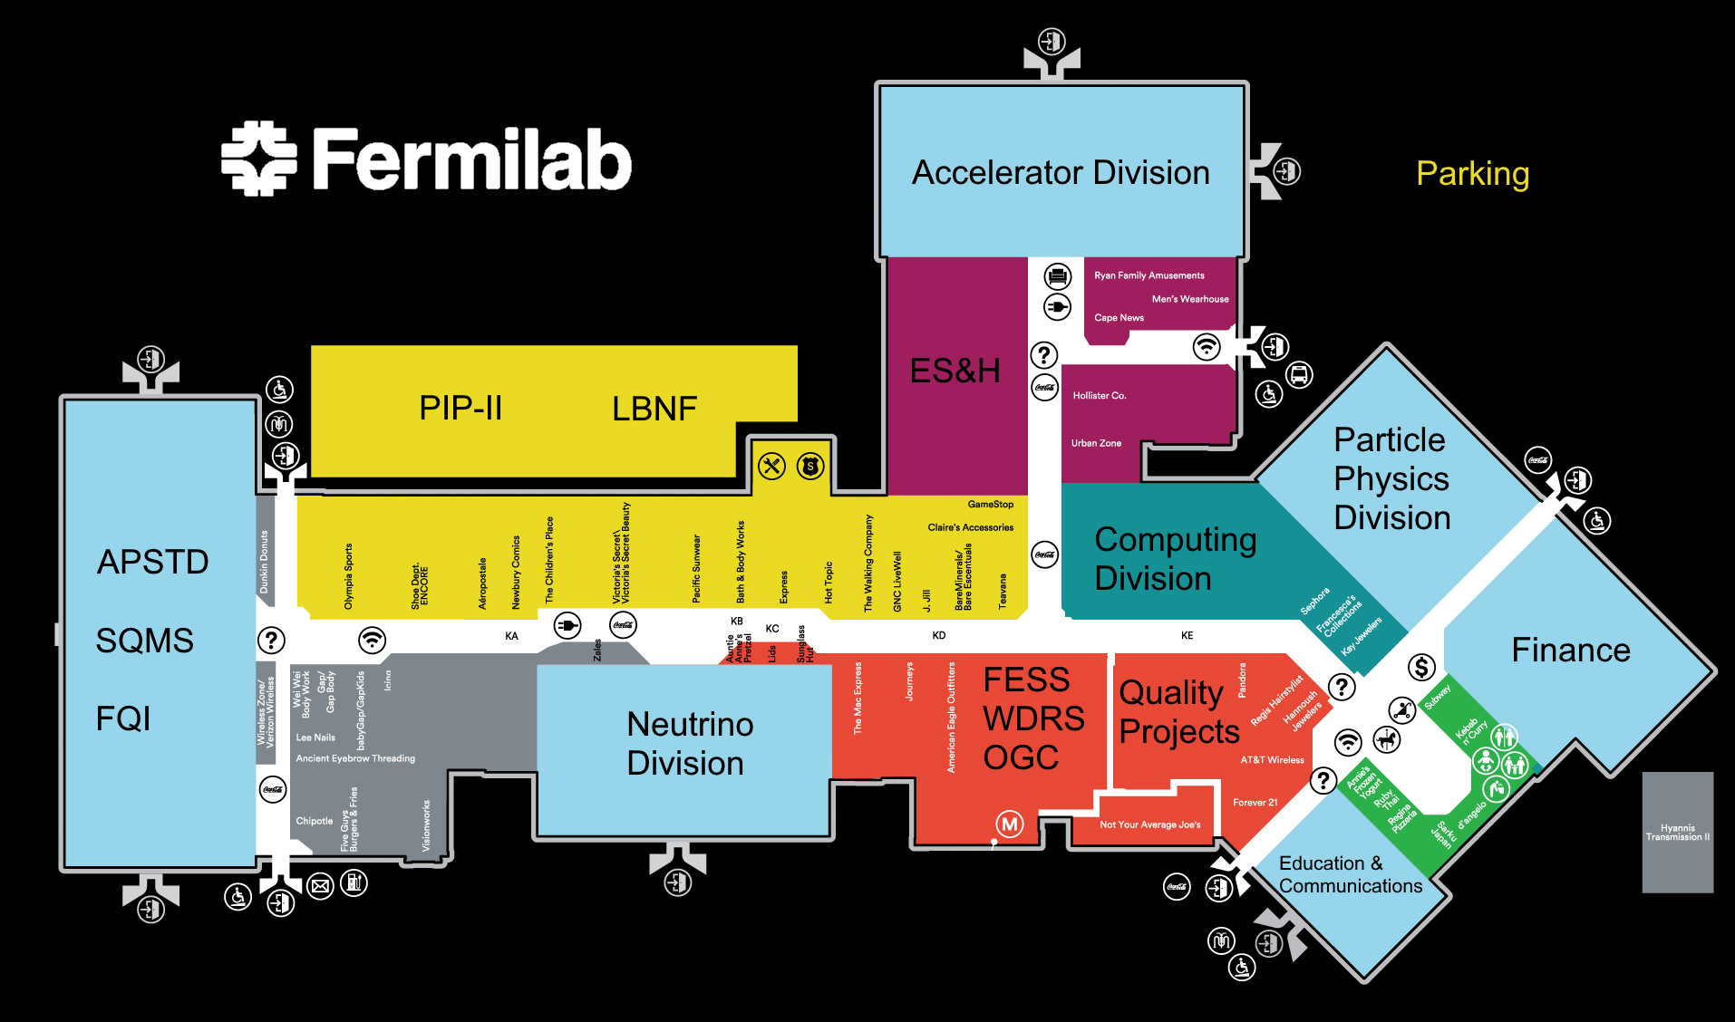

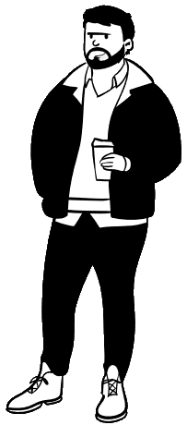
FYP Buddy Program – Mission and Objective
The mission of the Buddy Program is to be a catalyst to help employees transition to their roles and provide support for them to succeed on an individual basis. The goal is to ensure all new employees feel the sense that they are part of our culture and help them navigate Fermilab.
Where’s the good coffee?
Notes:
Just arriving onsite, it could like….

Slide 14
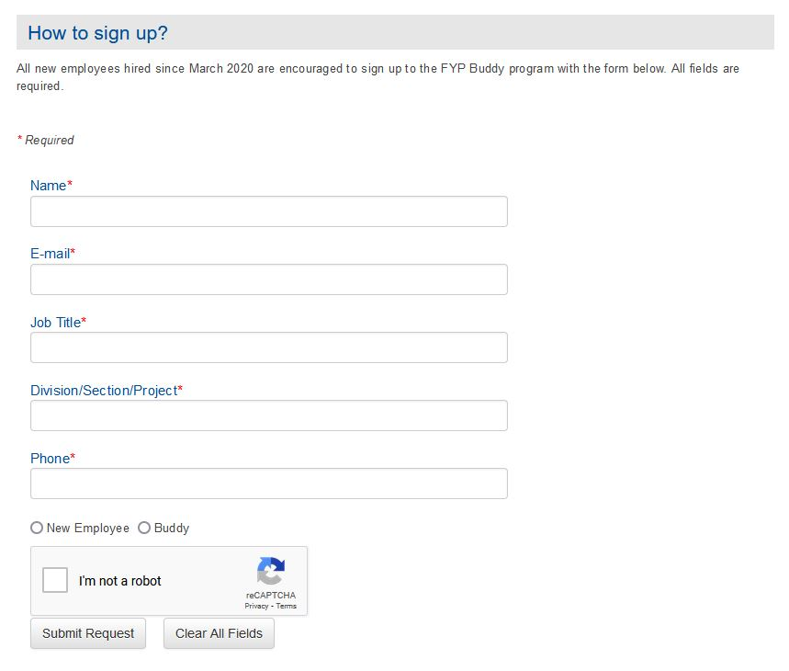

FYP Buddy Program
Buddies
Paired with New Employee
Phase 1
Phase 2
Phase 3
Buddies
In Fermilab’s welcome packet from WDRS, new employees are introduced to Fermilab Young Professionals Buddy Program.
https://diversity.fnal.gov/fyp/fyp-buddy-program/

Slide 15
FYP Buddy Program
Buddies
Paired with New Employee
Phase 1
Phase 2
Phase 3
Pairing
Members of our executive board will send a response email and pair new employees with buddies. We attempt to not pair within the same line management within the respective D/S/P.

Slide 16
FYP Buddy Program
Buddies
Paired with New Employee
Phase 1
Phase 2
Phase 3
Phase 1
Introduce the new employee to the Fermilab environment and general lab expectations:
Get to know one another and provide a space for more informal status update
How is the new employee adjusting?
What obstacles are they facing?
What questions do they have about Fermilab?
Questions we expected:
What to wear/etiquette?
Work culture at Fermilab?
Vacation/sick leave/floating holiday?
Work hours/lunch?
How do I navigate a computer system (ServiceNow, Kronos, etc.)?
Notes:
Recommend once a week meet for ~30 mins

Slide 17
FYP Buddy Program
Buddies
Paired with New Employee
Phase 1
Phase 2
Phase 3
Phase 2
Share resources, organizational knowledge and broaden the new employee’s network. Encourage them to join:
Other LRGs
Recreation
Clubs
Groups
Questions we expected:
What is the Fermilab Arts & Lectures Series? Artist in Residence?
What connections does the Education & Public Outreach office provide?
When is the Fermilab Colloquium, Wine & Cheese, Accelerator Physics and Technology Seminar series, Neutrino social events?
Notes:
Recommend once a week meet for ~30 mins

Slide 18
FYP Buddy Program
Buddies
Paired with New Employee
Phase 1
Phase 2
Phase 3
Phase 3
Any other Fermilab resource/opportunity, discuss professional/personal growth such as:
Courses
Training
Conferences
Tuition Assistance
Return lessons learned to FYP, EDI, and WDRS
Questions we expected:
Anything….
Notes:
Recommend meet every two weeks ~30 mins

Slide 19
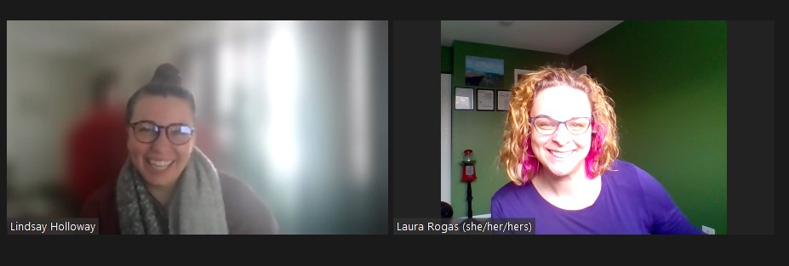
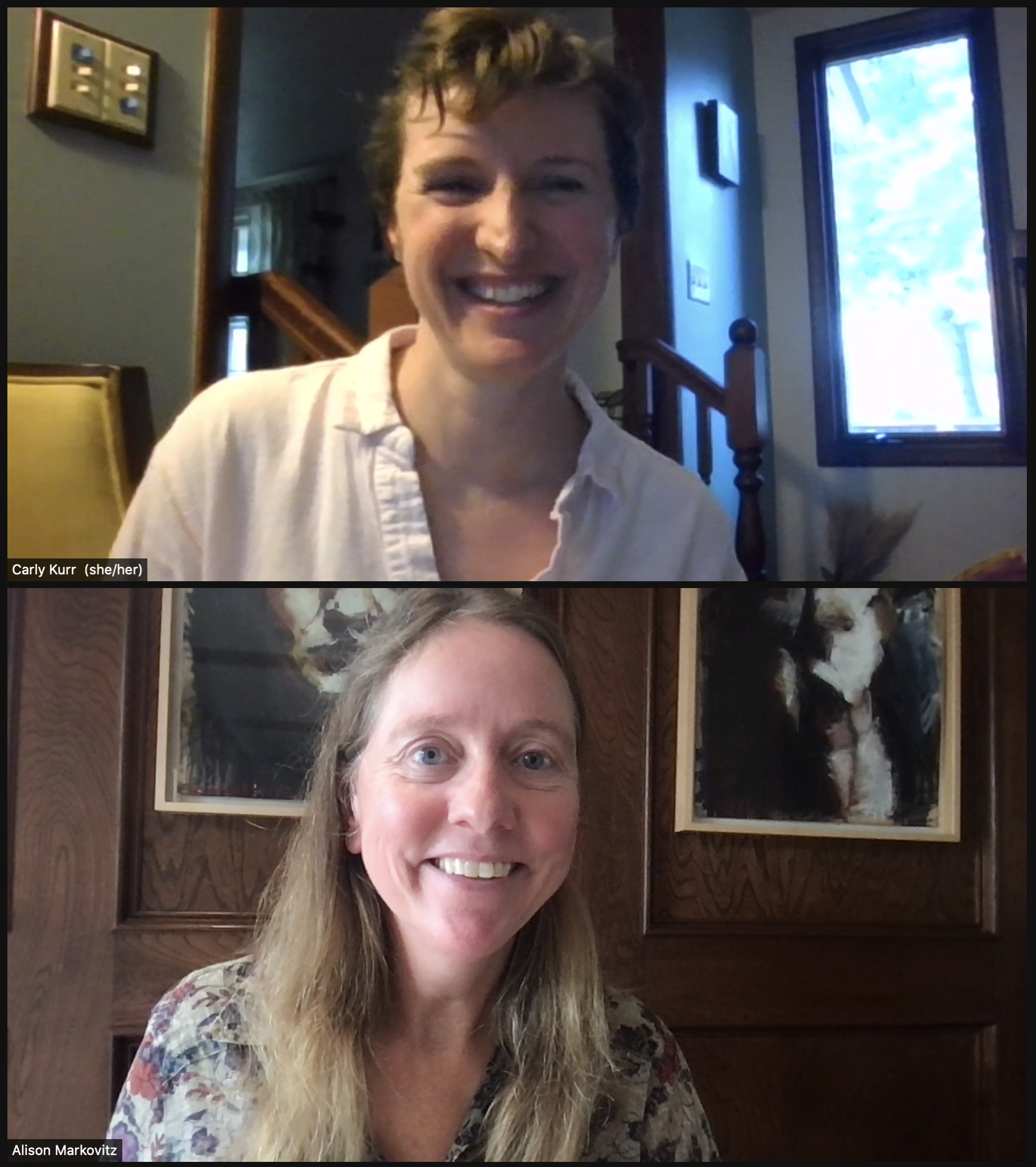
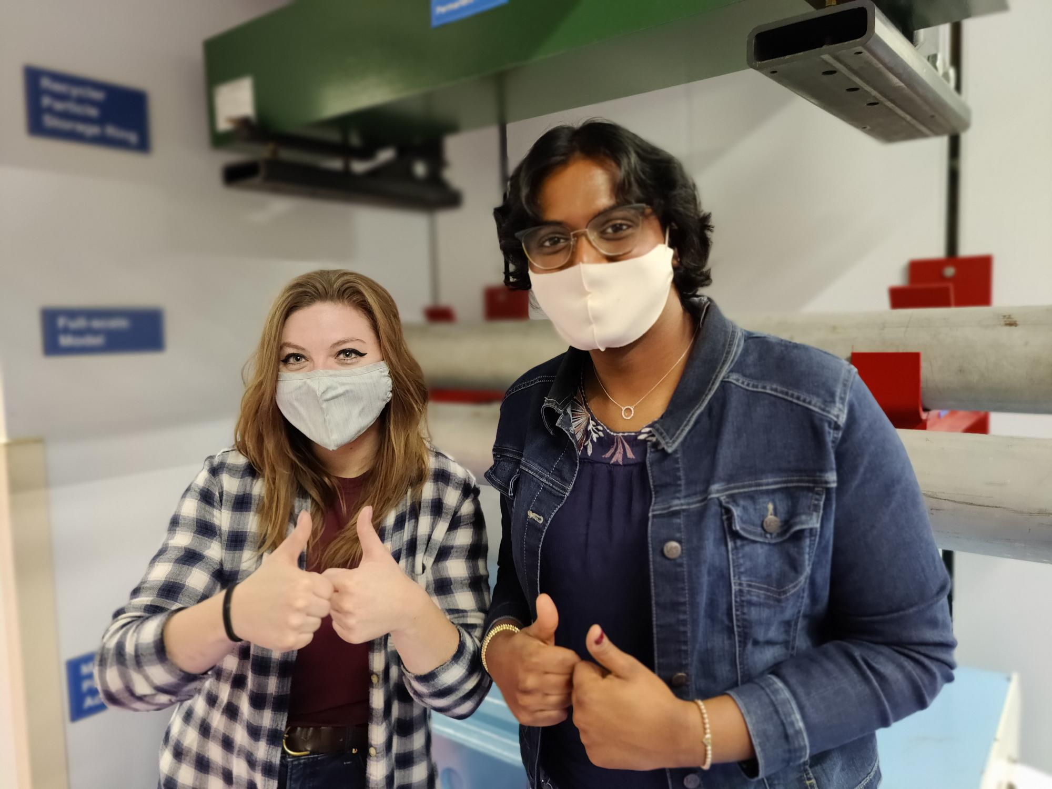
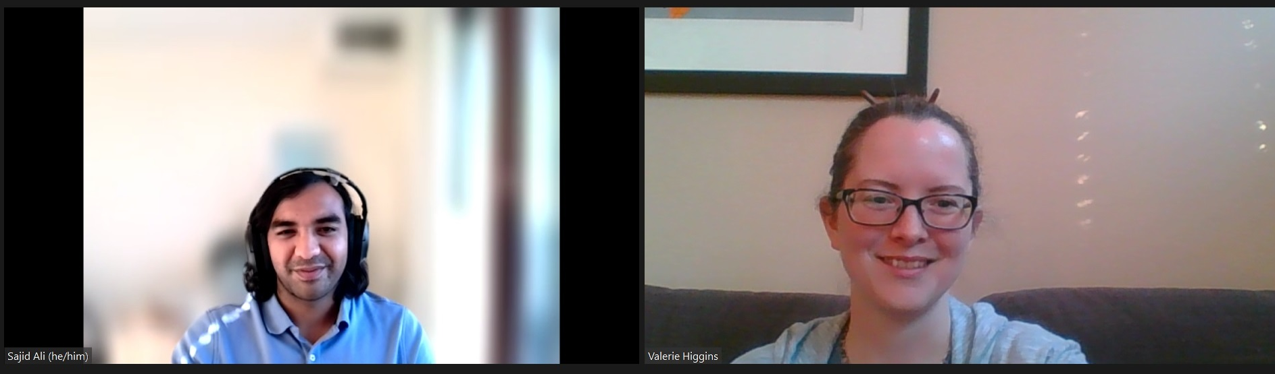
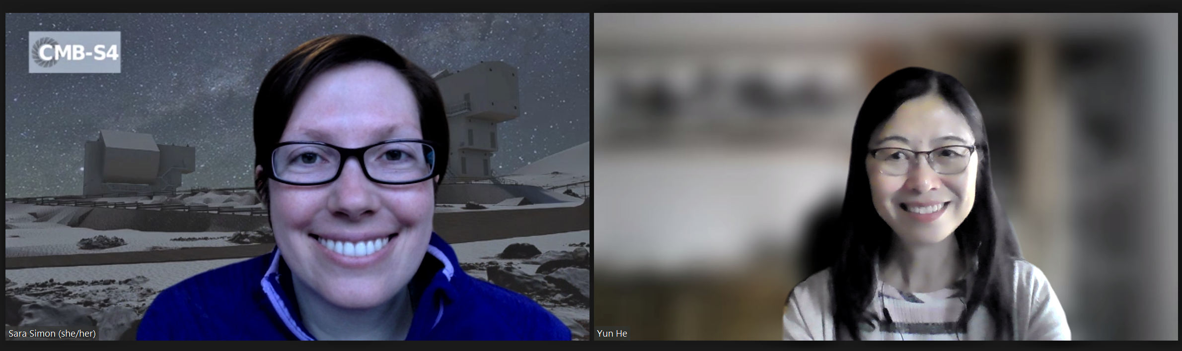
FYP Buddy Program – Success

Slide 20
FYP Buddy Program
        https://diversity.fnal.gov/fyp/fyp-buddy-program/
Questions?
        fyp_board@fnal.gov
Notes:
how long should a person work at the lab before signing up to be a Buddy?

Slide 21



Spectrum - Fermilab’s LGBTQ+ Resource Group
Members from various LGBTQ+ communities and allies
  Co-chairs: Erica Snider and Pete Cholewinski
Human Resource Campaign’s Corporate Equality Index
Want to get involved or show support?
  Join Spectrum!
  Visit our website for resources and join our listserv
  Put your pronouns in your Zoom profile and email signature
Some of our current activities:
  SafeZone Training in the 2022 Inclusion Matters series
  Spectrum Happy Hours – contact Laura Rogas
  Gender neutral restrooms
  Pride Day celebration
  Pride Parade?
Spectrum website: https://diversity.fnal.gov/spectrum/
HRC Corporate Equality Index: www.hrc.org/resources/corporate-equality-index

Slide 22


DuPage County ACT-SO | NSBE Jr.
ACT-SO is the Afro-Academic, Cultural, Technological and Scientific Olympics. Students work with mentors to identify, develop, and complete a research project.
The Pre-Collegiate Initiative (PCI) program is designed to stimulate students interests in STEM fields. Students discover first-hand how engineering and technology relate to the world around them
Why at Fermilab? How to get involved?
  Assist with ACT-SO Research Project Competitions
  Assist with NSBE Jr. Workshops and Competitions
  Advising the next great generation

Slide 23

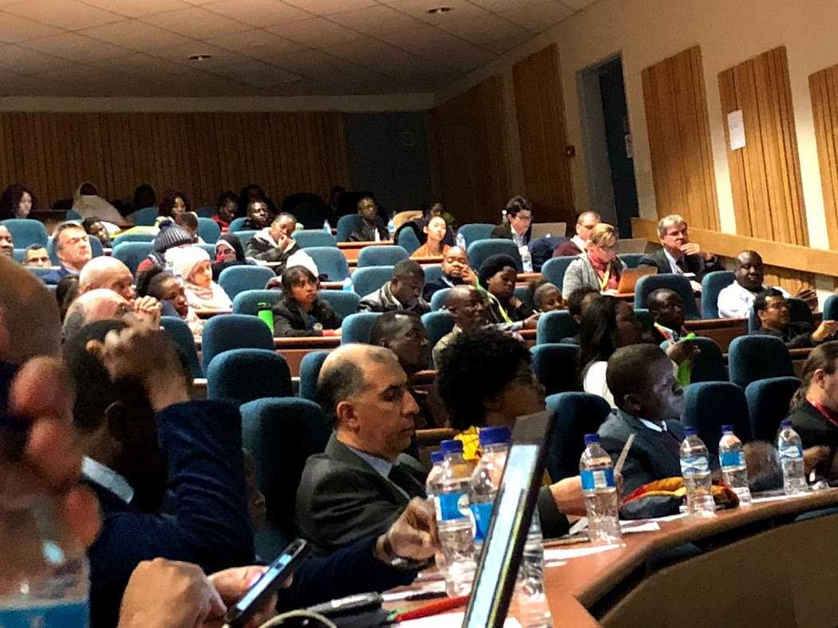
www.africanschoolofphysics.org
Biennial school and conference to improve the quality of higher education in Africa and to build a collaborative network of African and international researchers
Teacher workshops and outreach to motivate students
Continuous mentorship program for graduate students
Forums to engage researchers, teachers, policy makers and industry
Why participate?
Help support, motivate, and provide opportunities to ASP students
Build the international physics community
Share Fermilab’s work and expertise
Join other labs and institutions in contributing to and supporting the goals of the ASP
How to participate?
Attend and give talks at the ASP conferences
Participate in the ASP mentorship program for graduate students
Teaching a course at the school
African School of Physics - Diversity and Inclusion (fnal.gov)

Slide 24
Any final questions?
Fermilab Society of Women Engineers – Aisha Ibrahim
Fermilab Young Professionals Buddy Program – Michael Geelhoed
Spectrum Initiatives; Human Rights Campaign Foundation’s Corporate Equality Index – Pete Cholewinski
AABA – DuPage County ACT-SO, NSBE Jr. – Cortez Watkins
African School of Physics – Kavin Ammigan
Office of Equity, Diversity and Inclusion: https://fermipoint.fnal.gov/org/ocedi/

