Slide 1
Engineering Manual – Mysteries of Engineering Revealed
Paul C Czarapata
Navigating the Engineering Manual
Engineers week 2022

Slide 2
Where did the manual come from?
Problem with LHC CERN quadrupoles built by FNAL that caused damage to part of a string.
Director Pier Oddone asked that I investigate what happened. (I refused death by power point review, so I held a working technical review.)
DOE insisted the lab bring in an outside company to do the same thing. (Beltway Bandits)
History at the lab, at that time, had prototyping as a key element
Could not do it for a large, expensive magnet.
Discovered the information from CERN was incorrect! Actual vent back pressure was higher than stated.
Also, after a design review, verbal communication of an engineering change that was needed went from FNAL to our partner lab.
The partner lab gave a verbal change request to the vendor. This resulted in a MISUNDERSTANDING and there was no follow up.

Slide 3
Early History
The Outside company (Beltway Bandits) faulted the lab for not having an engineering manual.
DOE was also interested in having a manual.
A team was put together by Pier to develop a manual.
Originally, we were told that Lawrence Berkeley Lab had a “black book” for engineering.
When I asked, the engineer at LBL said “what black book?”
A search of available manuals turned up nothing!
The manual was derived from two internal engineering practices that were in place at the lab in two departments.
The Team used the documents to build a commonsense manual.

Slide 4
Engineering Manual

Slide 5
Engineering Process at Fermilab
Project Requirements
Project
Engineering Manual covers bottom blocks
Systems
Assemblies
Sub-assemblies
Necessary & Sufficient Requirements and Consensus Standards

Slide 6
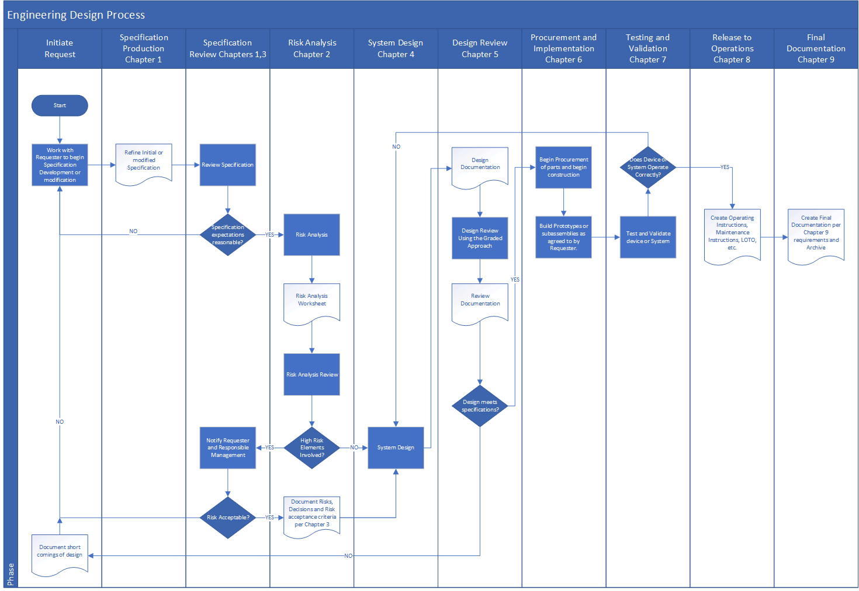
Engineering flow chart
This can be found on the Engineering Resource Guide at
https://ad.fnal.gov/EPG/
Capital letters
You can actually read it there too!
https://policies.fnal.gov
This is where the Engineering Manual link is listed as well as on the EPG page.

Slide 7
Contents
Introduction
Summary of Engineering Process
Chapter 1
Requirements and Specifications
Chapter 2
Engineering Risk Analysis
Chapter 3
Requirements, Engineering and Risk Analysis Reviews
Chapter 4
System Design
Chapter 5
Engineering Design Review
Chapter 6
Procurement and Implementation
Chapter 7
Testing and Validation
Chapter 8
Release to Operations
Chapter 9
Final Documentation
Appendix (hyper old!) Has samples for each chapter
PLEASE GIVE ME NEW EXAMPLES!

Slide 8
Critical Sections
These sections are critical to a successful design.
Chapter 1
Requirements and Specifications
Chapter 2
Engineering Risk Analysis
Chapter 3
Requirements, Engineering and Risk Analysis Reviews
Chapter 4 – DESIGN
Chapter 5 – THIS IS ONE OF THE LARGEST PROBLEMS WE HAVE Engineering Design Review.
Chapter 1 – “I told you what I wanted, and you didn’t give it to me. Now you’ve wasted all my project money! Your boss will hear about this!”
Chapter 2 – “I know I can get “Unobtainium sheets somewhere.”
Chapter 3 – “I know all there is to know on this subject, I’m sure I didn’t miss anything!” or “how can it not work… it’s only cutting-edge (bleeding edge) design.”

Slide 9
Risk Analysis

Slide 10
Risk Summary

Slide 11
Engineering and Project Risk Elements

Slide 12
Design
Don’t forget the Necessary and Sufficient requirements.
This is a list of all the Standards and rules we are required by our Contract with DOE to follow.
Things like the ASME Standards and National Electrical Code etc.
Listed in the Fermilab Contract (Prime Contract) available on Legal’s Web site.
There are also FESHM REQUIREMENTS

Slide 13
Design
Engineering Design Reviews.
This is, in my opinion, the last line of defense we have.
The review team must be made up of knowledgeable Engineers and Scientists who can find the things we should not do in the design.
One that I still remember has to do with the use of grease in radioactive components.
Another is not taking into account the environmental conditions your design will work in for its lifetime.
Remember, a design review is not finding fault with you but trying to help you find things you may not have encountered yet no matter where you are in your career.
Don’t let a weak review condemn your project to failure.

Slide 14
So, what is the Engineering Manual?
Hopefully it is a commonsense method to approach design of a needed item.
Hopefully, it can keep you on track and out of trouble.
The approach works no matter how expensive or critical the item.
The Engineering Manual was developed by Fermilab engineers.
At the time it was written, there were no engineering manuals at any other National lab.
There are at least three other labs that have copied our manual and modified it for their use.
The Manual is not overly prescriptive, it provides what should be done in a graded approach fashion and you decide how to accomplish that.
Graded Approach.

Slide 15
More help
There is a new section on Transportation in the Risk Analysis.
This has not been finalized yet but will be soon.
There is also a new section on Reliability and Availability Calculations
The above two sections can be found on the Engineering Resource Guide.
(the P in EPG originally stood for Process)
https://ad.fnal.gov/EPG/
NOTE: the EPG in the link must be capitalized or the link won’t work.
Check the resource guide out and if you have suggestions, contact me
pcceed@fnal.gov

Slide 16
Your Turn
Questions or comments?

