Slide 1
MZI tuning
Aleksandr Romanov
Quantum optics at IOTA
11 February 2022

Slide 2
MZI alignment
There are 2(+2) free parameters (two planes):
The points of splitting at the last splitter should coincide: 1+1
Incident angles at the last splitter should coincide: 1+1
Horizontal plane:
Point of contact can be adjusted with a single translation stage of any mirror or splitter
Two angular modes:
Rotation of the last splitter
Vertical plane
Translation: +a tilt of the first splitter & -a tilt of the mirror in the reflected arm
Two angles
Tilt of the last splitter

Slide 3
MZI components shifts in plane

Slide 4
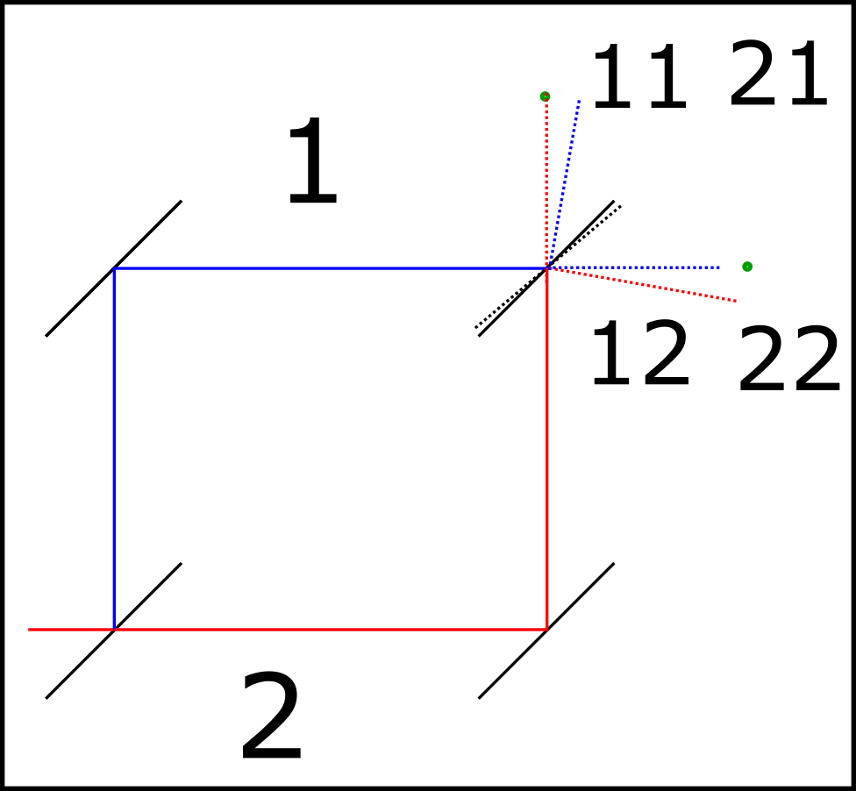
MZI components tilts in plane

Slide 5
MZI delay tuning
Horizontal plane adjustment:
Reflected arm
+a tilt of the first splitter, +a tilt of the second mirror & shift of the second mirror to keep spot at the last splitter fixed
Path-through arm
+a tilt of the second mirror, shift of the second mirror to keep spot at the last splitter fixed & +a tilt of the last splitter

