Slide 1
MQXFA Welding Shim FE Analysis
G. Vallone, J. Ferradas Troitino, etc.
3-Feb-2022
LBNL

Slide 2
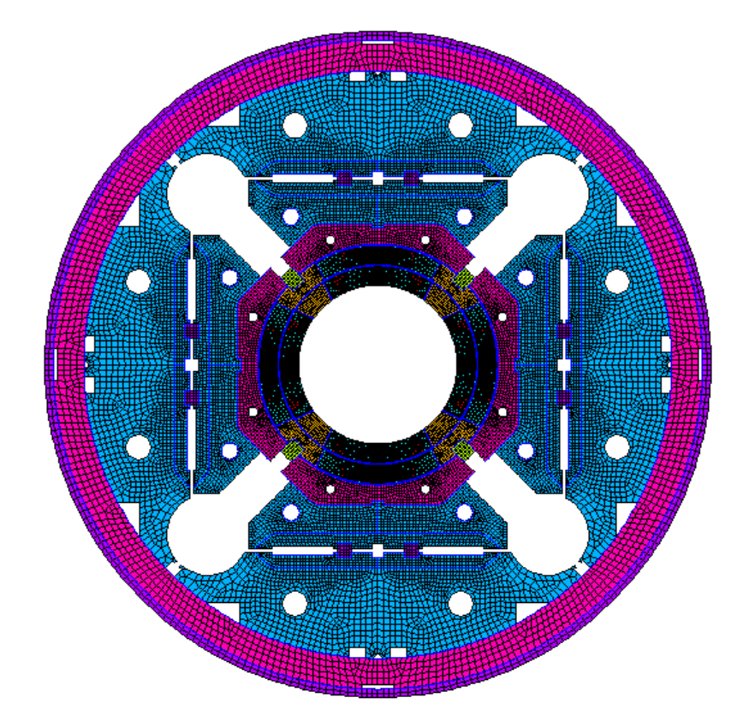
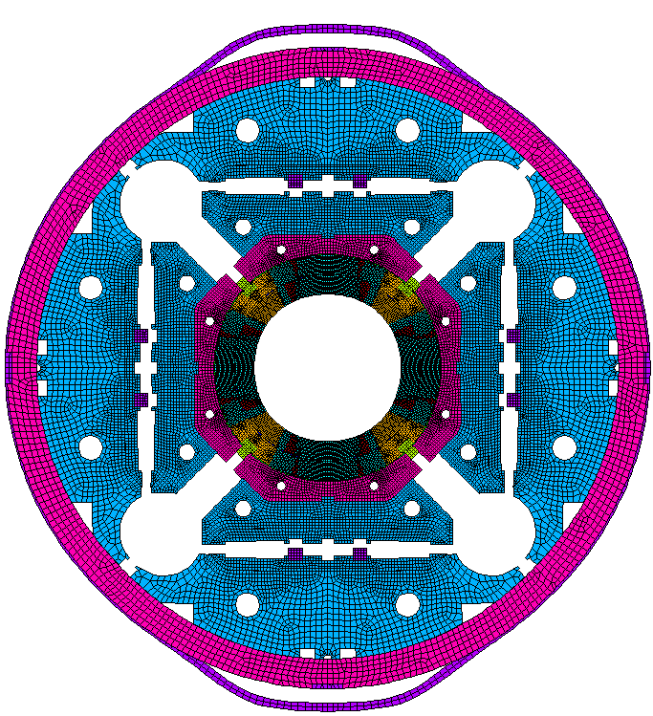
Model Description (1)
Welding
Shim
Full 2D, variable welding shim size and shell/vessel interference
Welding shim introduced as shell/vessel interference

Slide 3
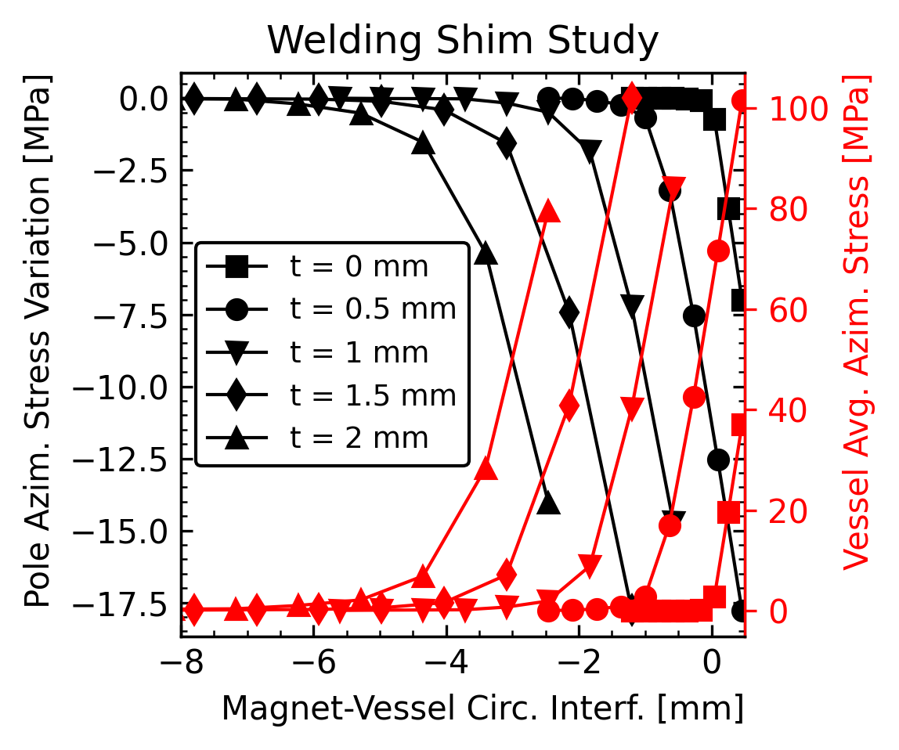
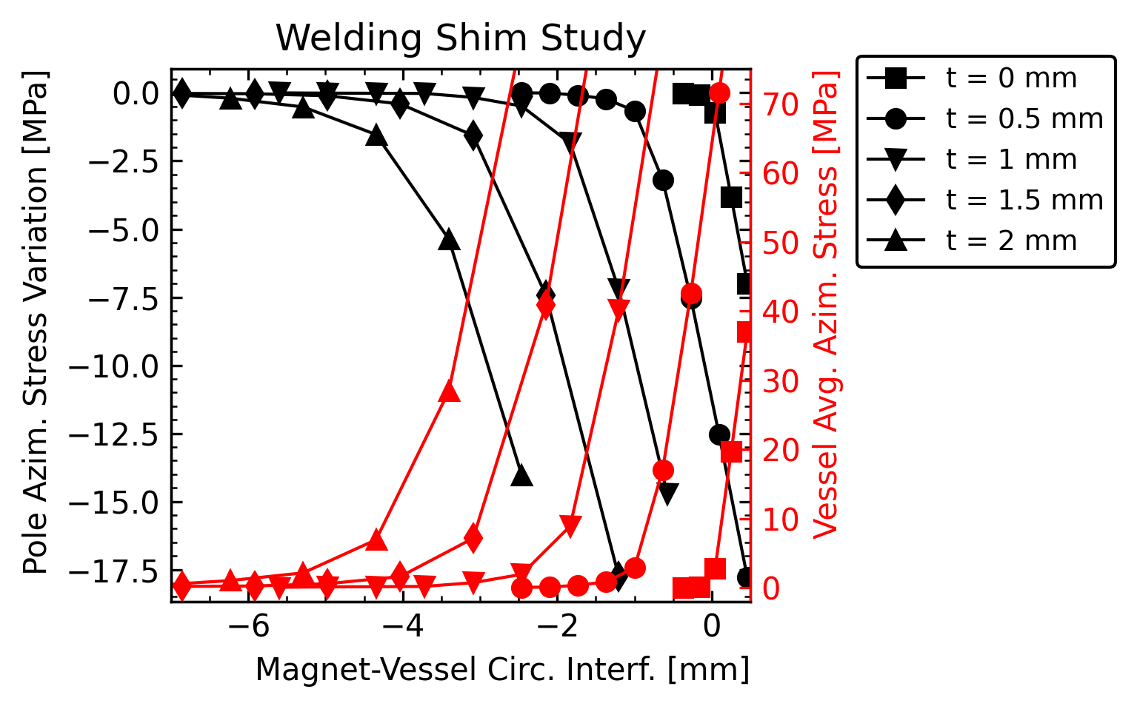
Results
Circ. interf. computed on the ‘loaded’ magnet
The welding shim can allow for a lower sensitivity to the circumferential interference especially in the regions with low vessel stress
What is the expected tolerance?
Allowed stress increase on the coil: 5 MPa at

Slide 4
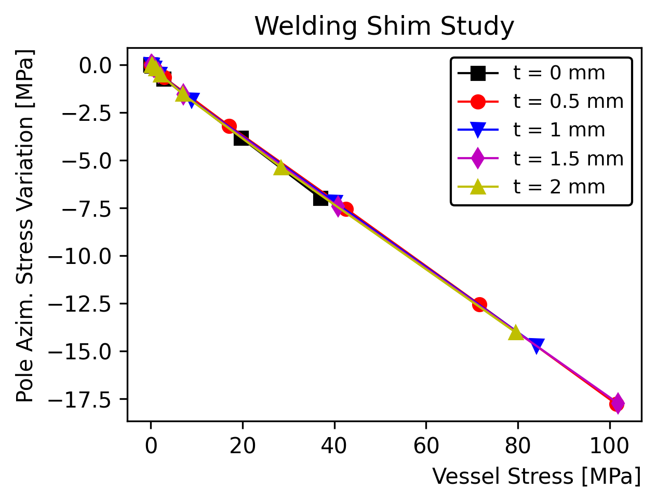
Vessel stress / Pole Stress
The relationship between the vessel stress and the pole stress does not depend on the shim thickness

Slide 5
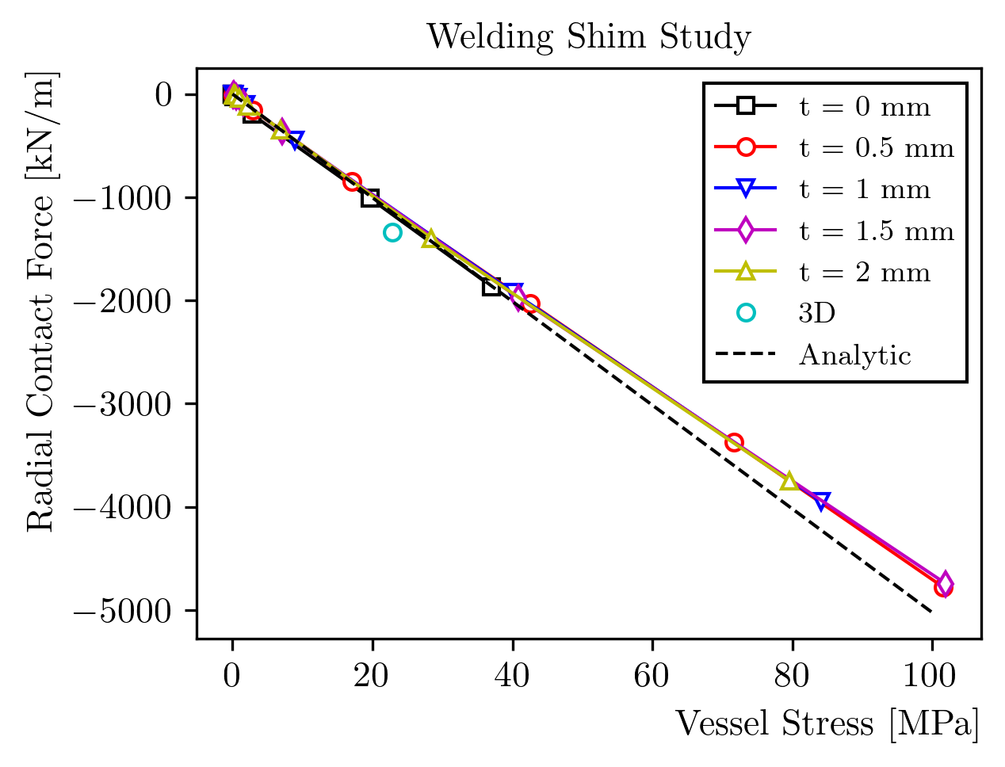
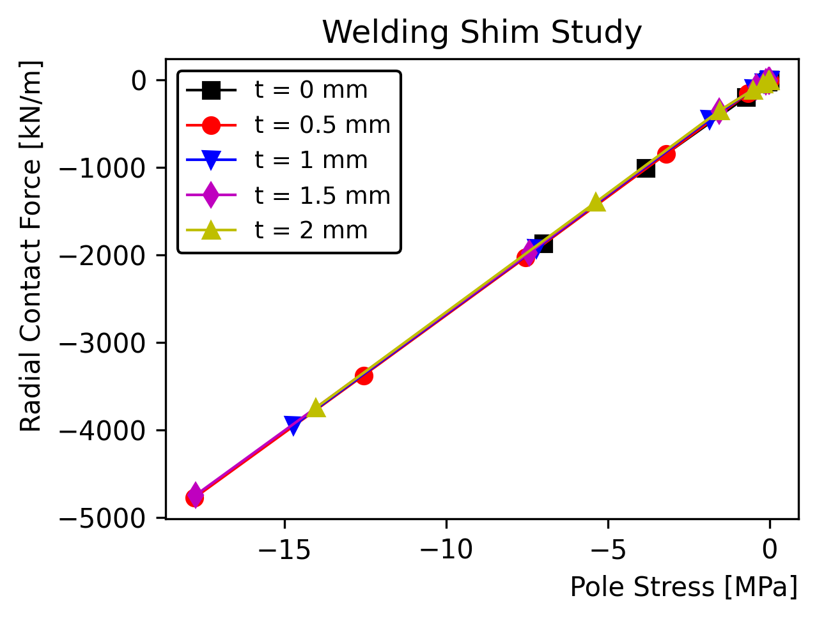
Radial Contact Force
Radial contact force can be used to estimate the frictional force
Total force in cross-section
Can be used to prevent motion during transportation and during test at cold temperature
How much force do we need at warm?
The relationship between vessel/pole/force is linear – not affected by shim thickness
From the required force, we can easily compute the minimum vessel and pole stress
3D and 2D models give similar results, but there is a very suspicious mismatch with the analytical ‘model’

Slide 6
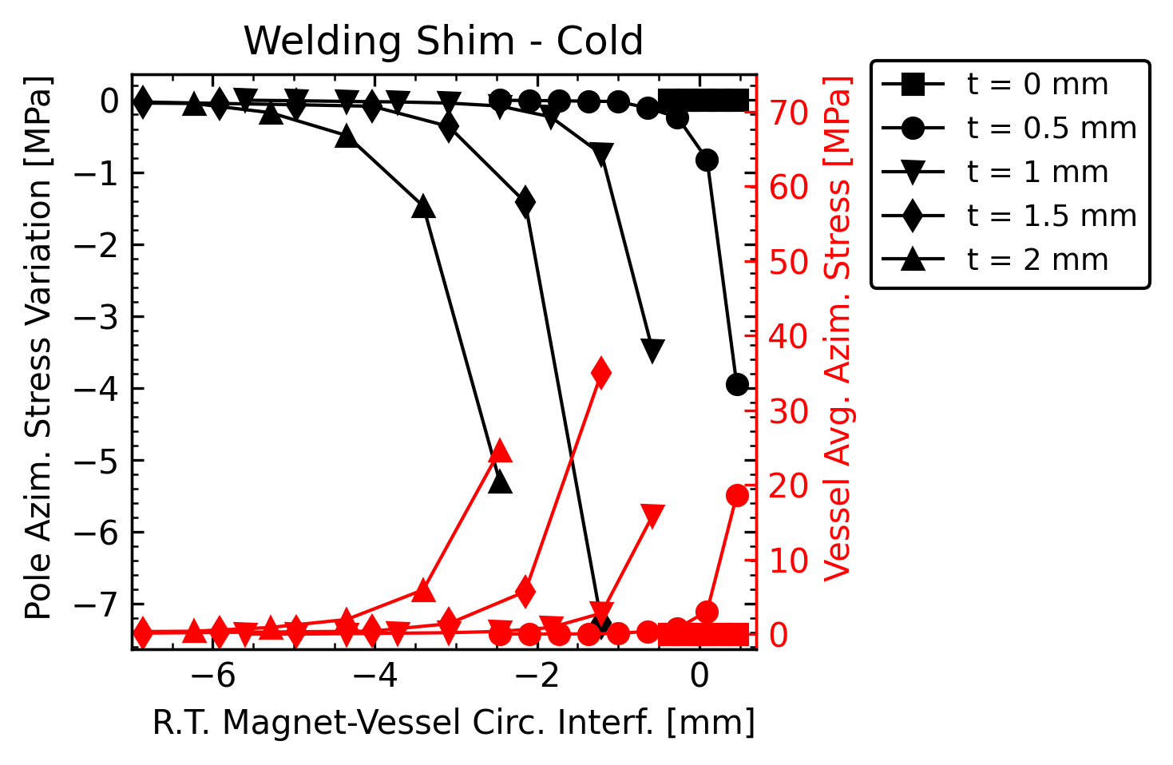
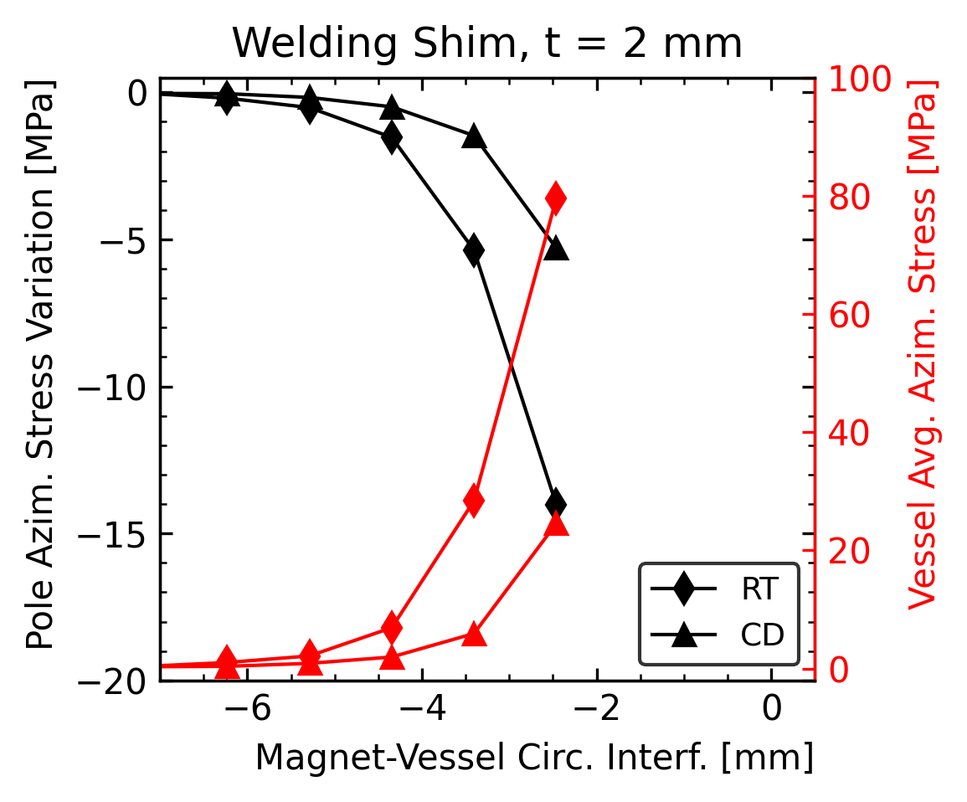
Coldown
Increase in circular interference to get back to the same stresses: 1.2 mm
Integral contraction of the magnet: 3.54 mm/m
Stainless steel contraction: 2.95 mm/m
In the range below 10 MPa, shims < 1 mm might be too sensitive to the interference
Easy to ‘loose’ contact with small errors
Need to compare with actual error

Slide 7
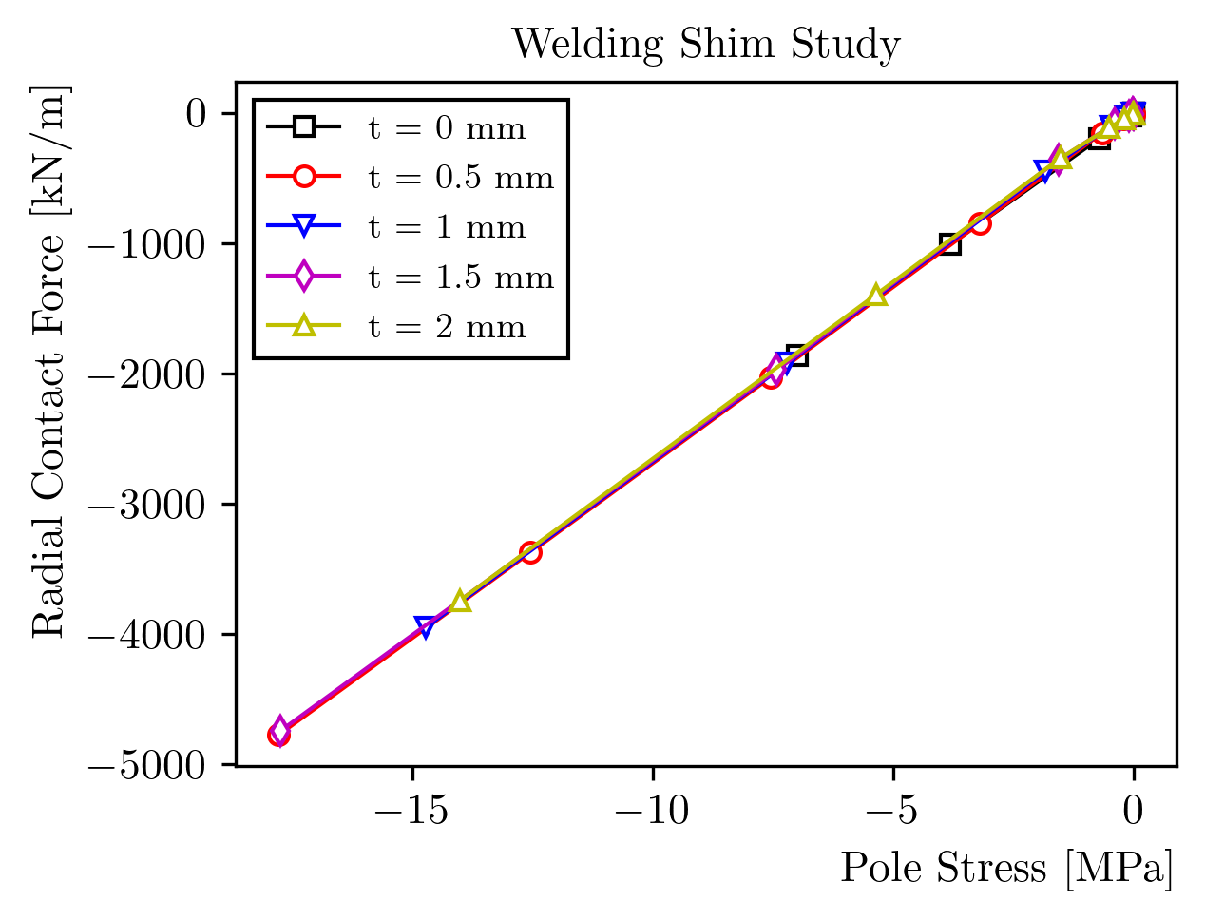
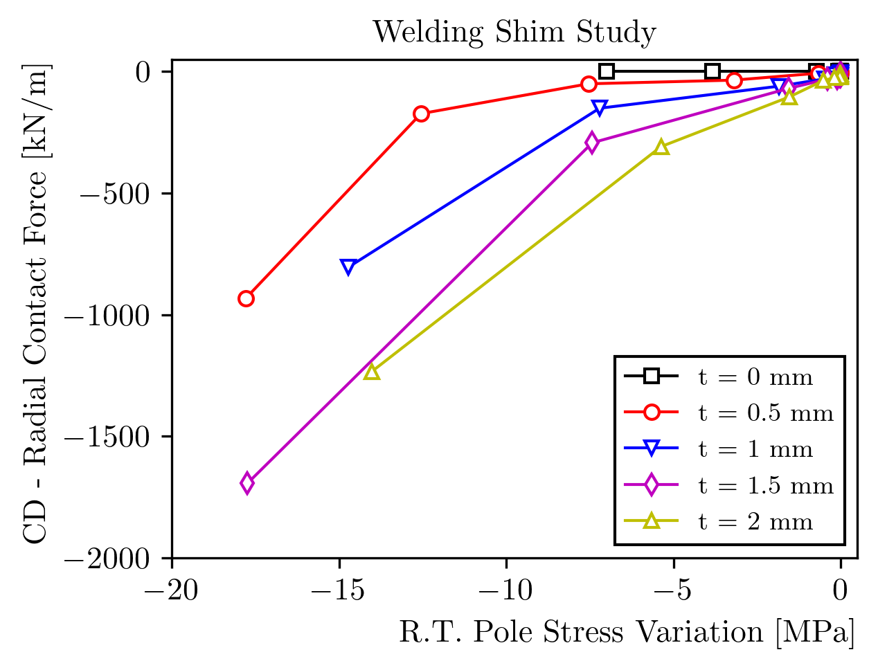
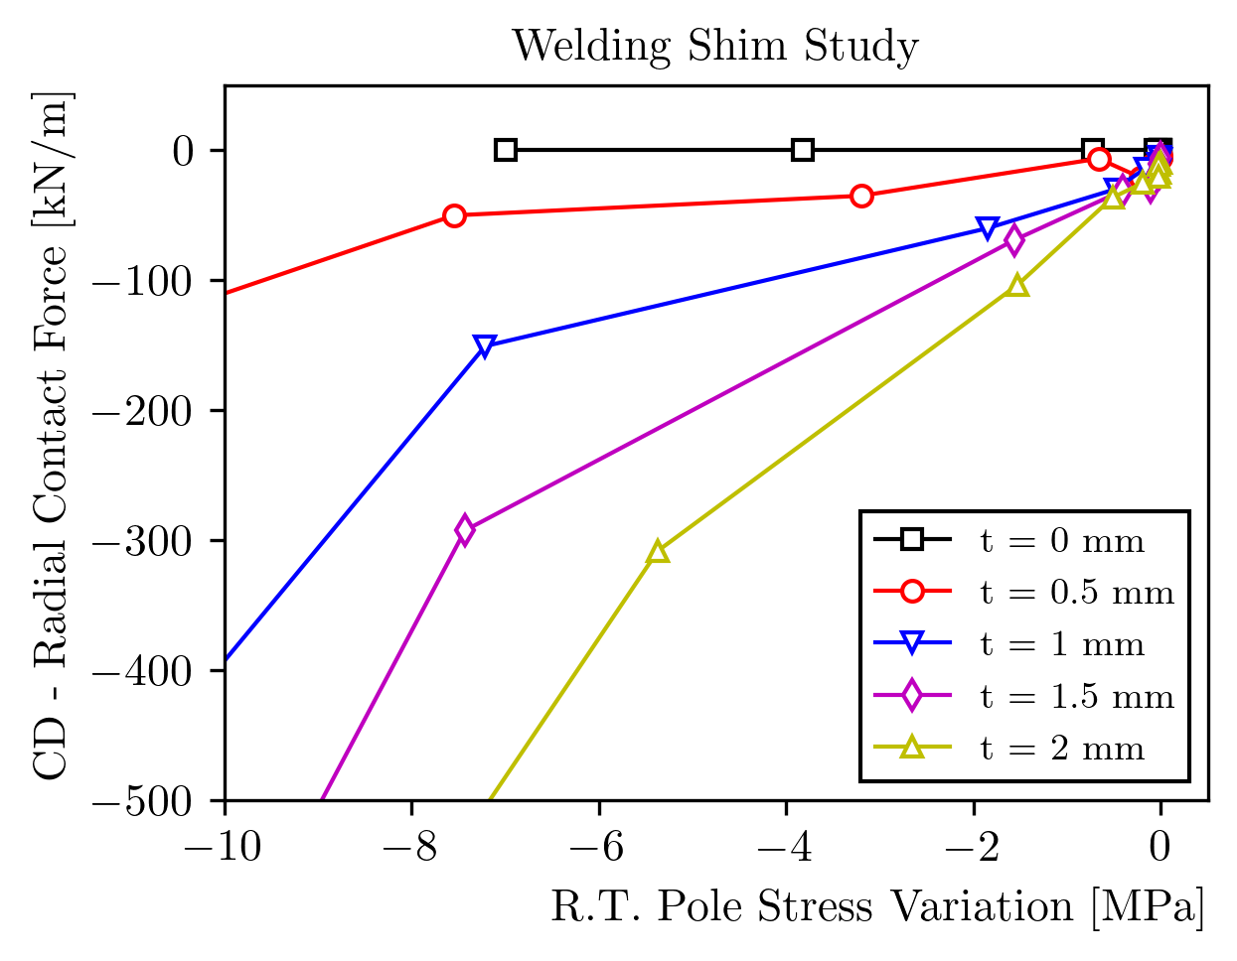
Cooldown
Radial contact force can be used to estimate the frictional force
How much force do we need at cold?
123 kN long, with 0.1 friction: 1230 kN, or 307 kN/m
154 kN/m with 0.2, 51 kN/m with 0.6
Relationship between R.T. pole stress and radial force at cold non-linear. This is expected as we are in the ‘non-linear’ region of the shim
Stress increase required is below 3 MPa with a shim of at least 1 mm
Something strange in the 0.5 mm simulation
Very small numbers…

Slide 8
Cooldown
If want to keep the pole stress below 5 MPa at warm (2 mm shim), very roughly:
With 0.1 friction coefficient it does not work
With 0.2 it can work. Range of acceptable circular interference ~ 1 mm.
With 0.6 close to 2 mm
We would need to prove that the friction coefficient is so high!

Slide 9
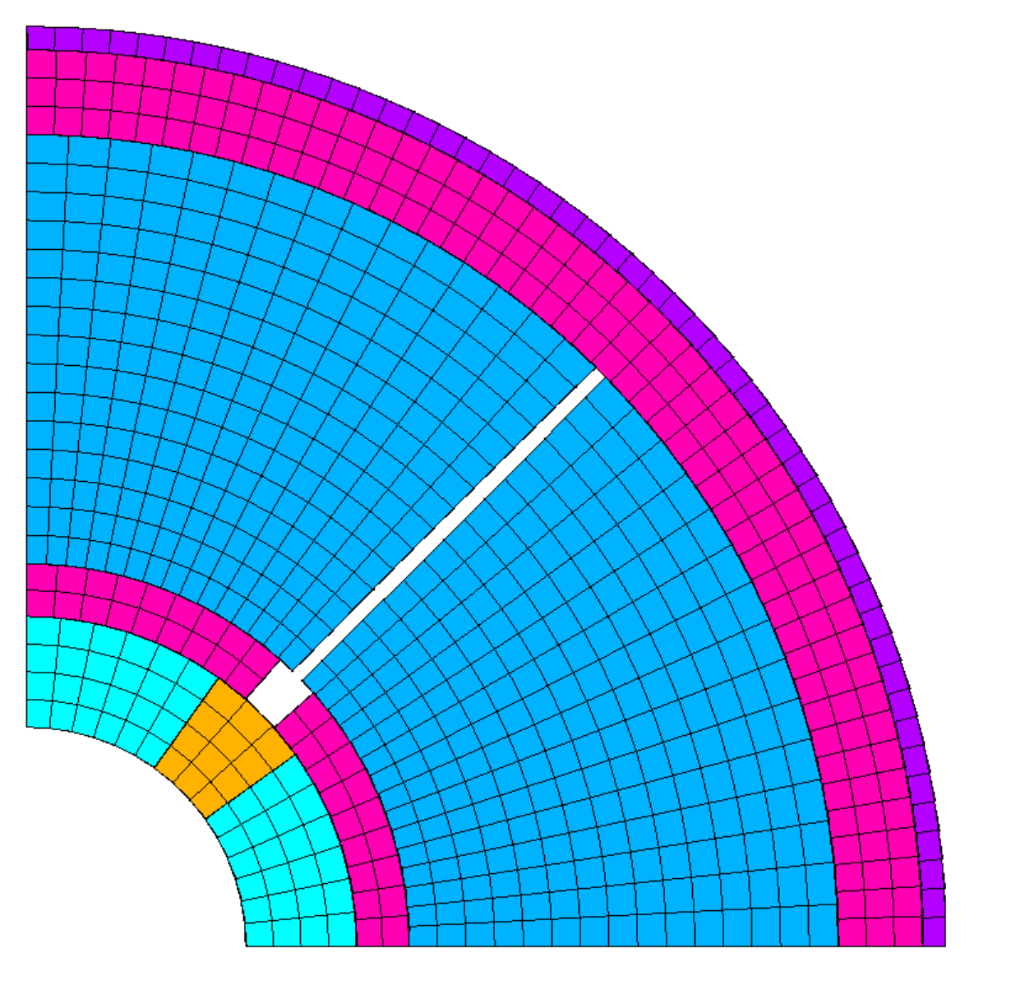
3D Model – Description and validation
Parameter | Step | Model | Value | Unit
sy avg coil | RT | Full | 30 | MPa
sy avg coil | RT | Simple | 31 | MPa
dR shell | RT | Full | 0.208 | mm
dR shell | RT | Simple | 0.172 | mm
sy avg coil | CD | Full | 67 | MPa
sy avg coil | CD | Simple | 69 | MPa
dR shell | CD | Full | -0.879 | mm
dR shell | CD | Simple | -0.877 | mm
Simplified 3D model to check effects during thermal cycles
Octant model would not be sufficient
Loading as interference between the collar and the yoke
Main results compared with the usual octant model
Average vertical pole and shell stress on the mid-plane, radius variation after loading and after cooldown
Surprisingly close, no?

Slide 10
3D Model – Results
Welding Shim
1. Loading, 2. Shim
3. Vessel, 4. CD
5. Warm-up
Standard
1. Loading, 2. CD
Checking, during a thermal cycle, the impact on:
Coil stress
Shell stress
Vessel contact force
Shell longitudinal displacement (at z=0)
Compare with no interference case

Slide 11
Additional Checks
2D model
Plots with cooldown x
Add points in the ‘acceptable’ range
Sensitivity analysis to vessel t.c. (2.8 to 3.2 mm/m)
3D model with target vessel stress
Highly simplified 3D (~cylinders) x
Check cooldown contraction and compare against ’standard’ case (shell/yoke sliding?) x
Acceptability range (spole < 5 MPa, Fz > 123 kN) x
Add step to standard model with warm up

