Slide 1
Data Management at the DOE JGI
Kjiersten Fagnan, CIO
April 8, 2022

Slide 2
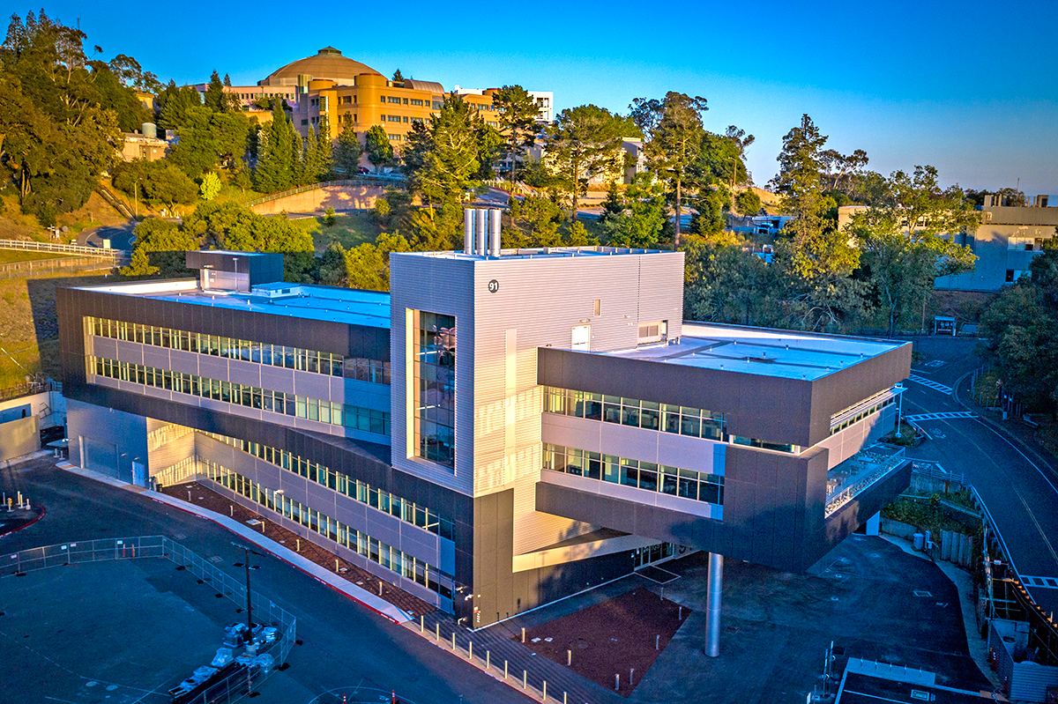
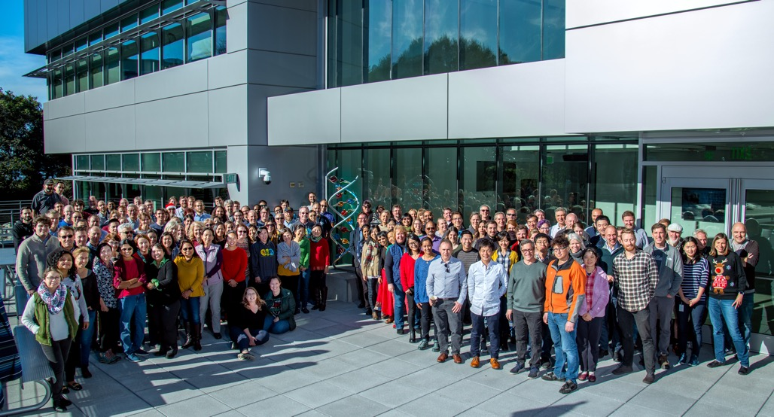








The DOE Joint Genome Institute at a glance
Integrative Genomics Building (IGB)
JGI MISSION:
To provide the global research community with free access to the most advanced integrative genome science capabilities in support of the DOE energy & environmental research mission
U.S. Department of Energy Office of Science User Facility
JGI established in 1997, User facility from 2004
Located at Lawrence Berkeley National Laboratory
~285 staff; ~$80M annual funding
2,038 Global Primary Users in FY20; >10,000 Data Users

Slide 3

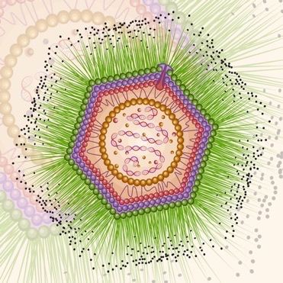
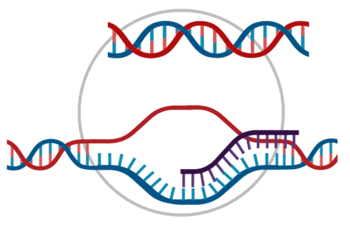
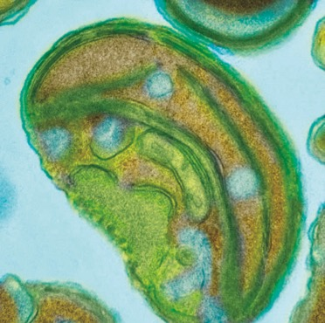
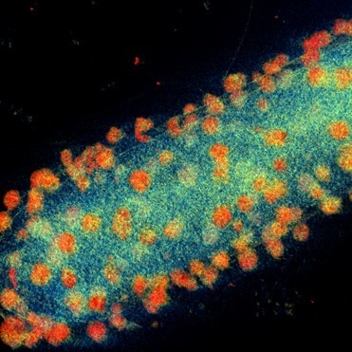

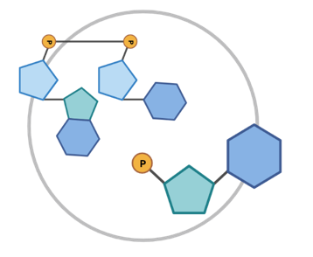
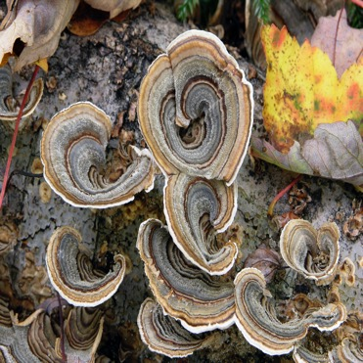
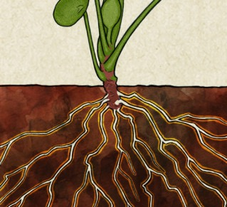
What we offer
plants
viruses
DNA/RNA sequencing
bacteria/archaea
algae
DNA synthesis
metabolomics
JGI products
fungi
microbial communities

Slide 4
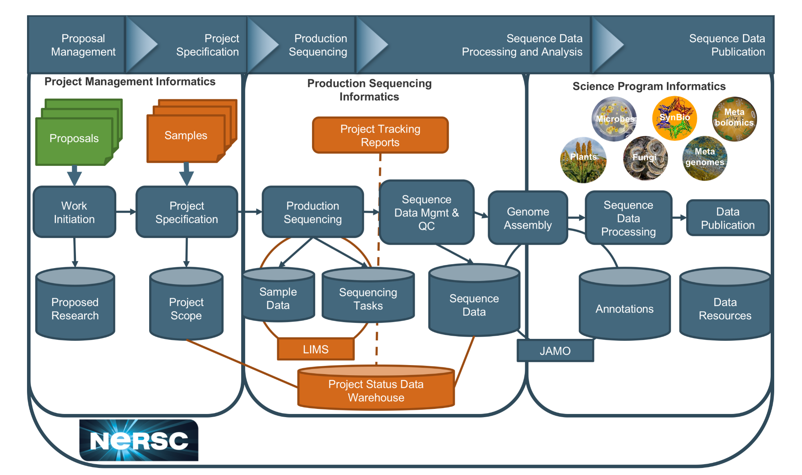





Computing and Informatics are foundational

Slide 5
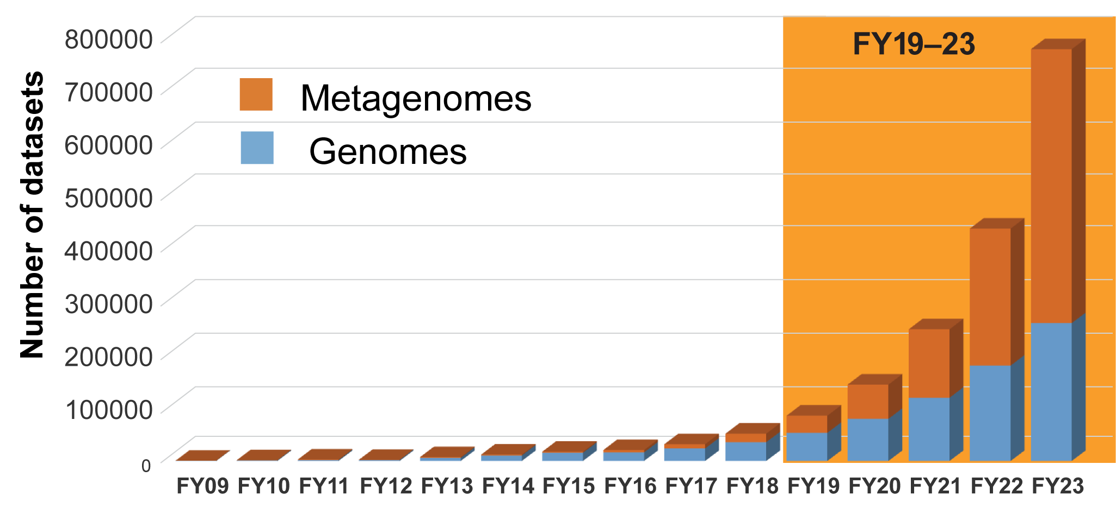
Deluge of Large, Complex Data Sets
JGI manages a 14+ PB data repository

Slide 6
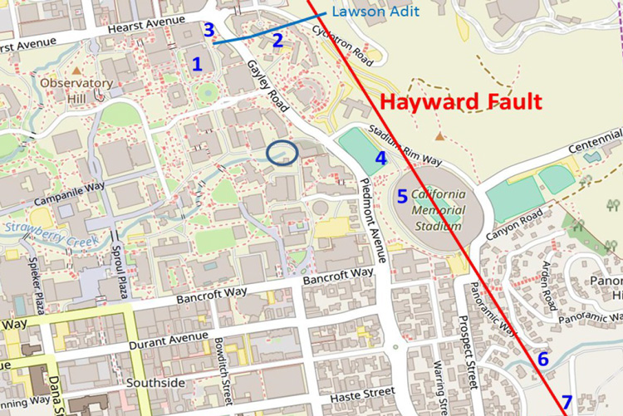
Berkeley Lab is on a Major Fault Line
NERSC is here!
Most samples used to generate data at JGI
are unique and irreplaceable

Slide 7
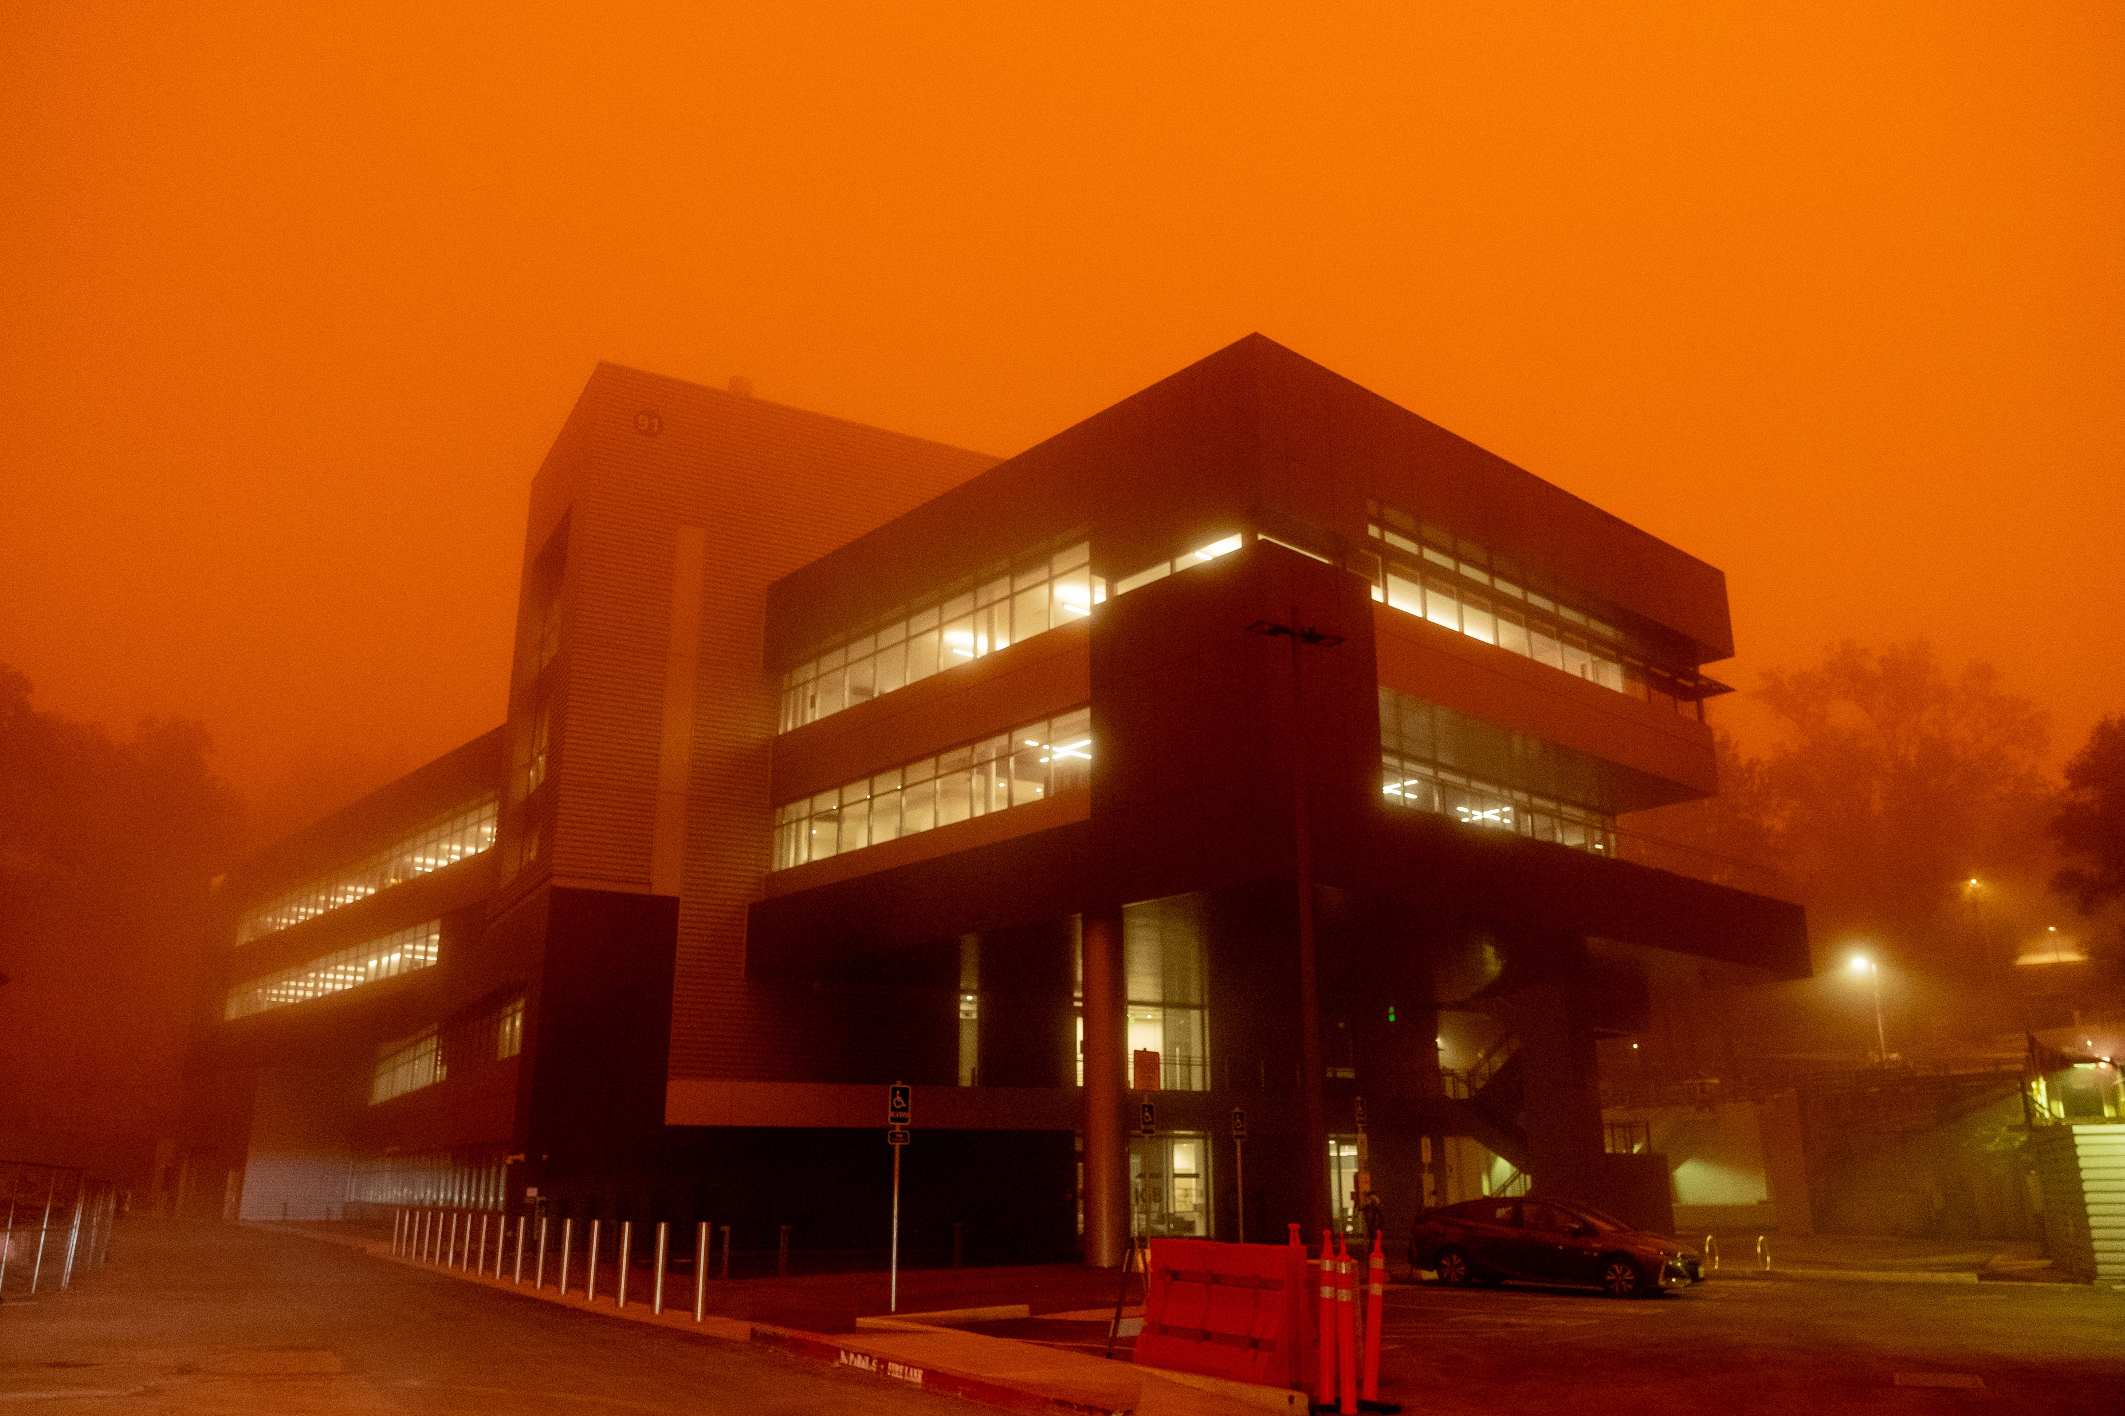


CA has Fires, too!
We need to distribute Data and Analysis to maintain scientific productivity

Slide 8
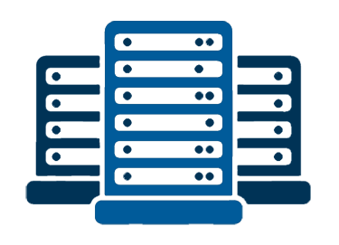


Current Infrastructure Snapshot
NERSC
LBL IT
ORNL
192 genepool nodes
20 large memory nodes
40 batch nodes
12 interactive nodes
Computing
3PB DnA file system
4PB community file system
Cori SCRATCH
14PB tape archive
Lawrencium SCRATCH
1PB tape archive
Data Storage
70 virtual machines
250TB of storage
Plus standalone DB ~ 300 TB
67 virtual machines
Services in SVM
10 Groups (Phyto, Myco, etc)
Web Servers

Slide 9




JGI’s Computing Needs are Diverse
Scale of Data
Large-scale data or compute needs - >100,000 CPU hours
Prototyping, exploratory analysis, small production work
Scale of Computing (CPU hours)
Notes:
The smaller the data and computing needs, the more options staff have available for computing.
Right now staff can use the cloud or LBL IT resources for smaller-scale computing.
JGI needs dedicated resources for mid-range computing to replace the Cori-genepool capacity and that is the focus of the current procurement

Slide 10









JGI is Running Analyses Across the West Coast
JGI Centralized Workflow System
Beta is running
Workflow Description Language
Cromwell Workflow Manager
Additional resources (cloud, ORNL, ANL, etc)
future
Common interface to access resources

Slide 11
JGI Analysis is Backed by a Centralized Resource
JGI Analysis and Metadata Organizer
  Hierarchical Data Management (file systems and tape)
  Searchable metadata (100s of keys)
Supports data distribution through API and Globus
Centralized workflow system moves the data to SCRATCH or /tmp depending on the analysis
Key databases cached on local resources

Slide 12
JGI Data Hierarchy

Slide 13
Summary
JGI’s Infrastructure needs to be resilient and stable → Distrbuted
Application performance limited by I/O, not CPU
  Analyzing O(10,000)-O(100,000) files at one time against common databases (cataloging)
  Generating O(100)-O(1,000) output files
  Outputs are used by the community for comparative analysis on small clusters or through the browser
Centralized data management has been critical for internal and external data access

Slide 14
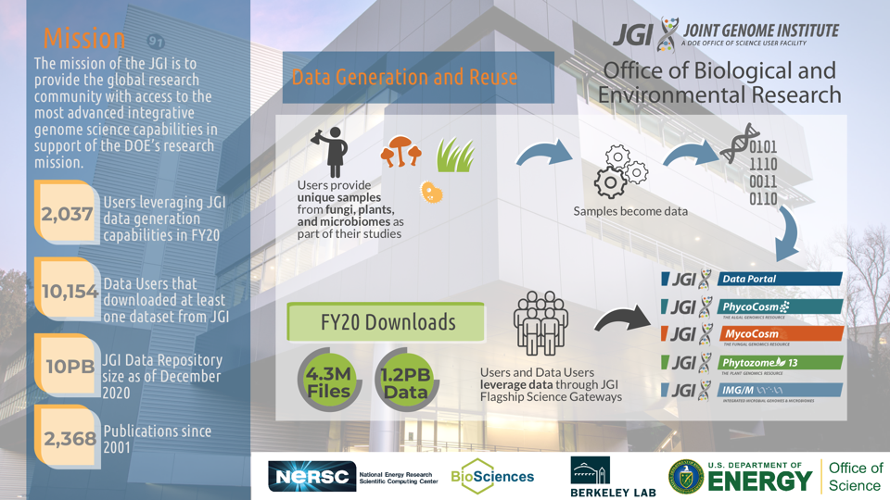
In a 2 week period data users have requested...
30,000
80,000
120,000
Notes:
Finish here by talking about the future of JGI as an SC Public Reusable Research Data Resource

