Slide 1
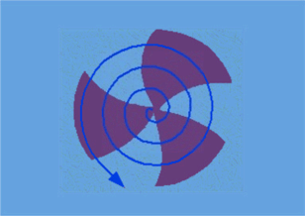

LHe vessel & Blade Tuner for
5-cell, 650 MHz, β=0.61 SRF Cavity
Sumit Som
Head, RF Division
Government of India
Department of Atomic Energy
Variable Energy Cyclotron Centre
Sector-1, Block-AF, Bidhan Nagar, Kolkata, India
Webex IIFC meeting on 29-Feb-2012

Slide 2
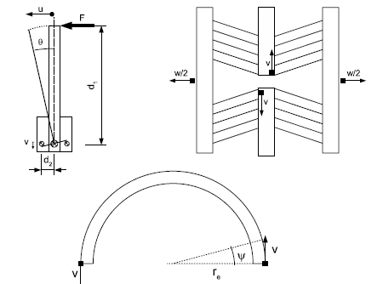
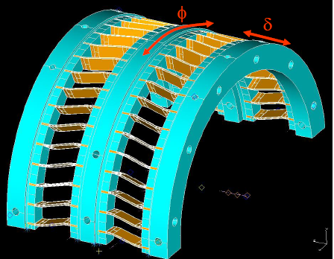
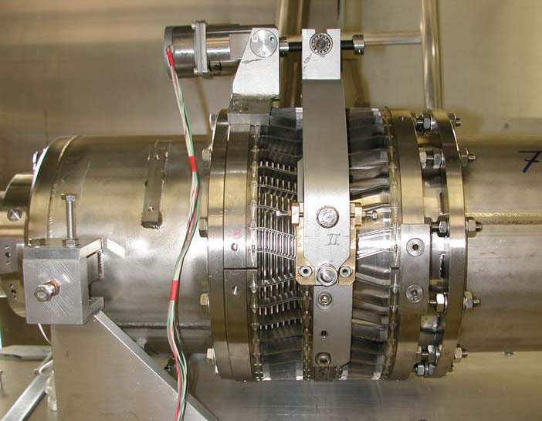
TRANSFORMATION OF
AZIMUTHAL ROTATION INTO A LONGITUDINAL MOTION
IN BLADE TUNER
Cinematic description of the fine tuning system
PICTURE OF A COMPLETELY INSTALLED BLADE TUNER AT INFN

Slide 3
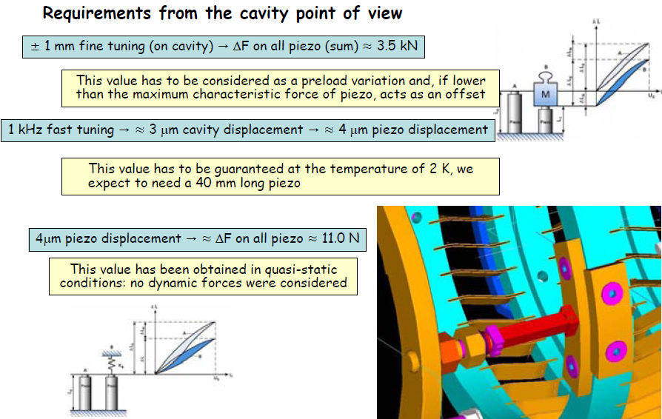
From the preliminary study, the following requirements have been noted.

Slide 4
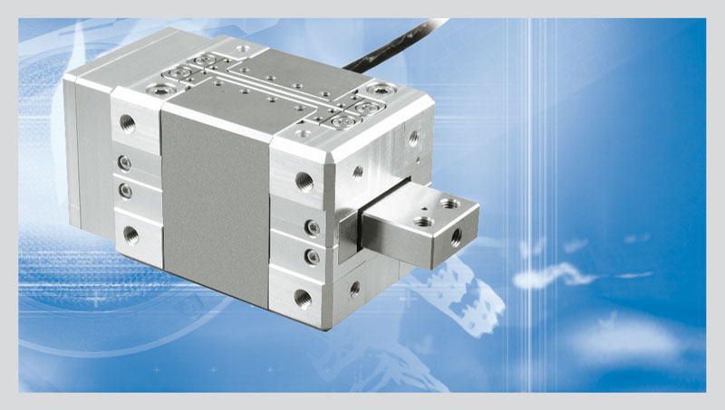
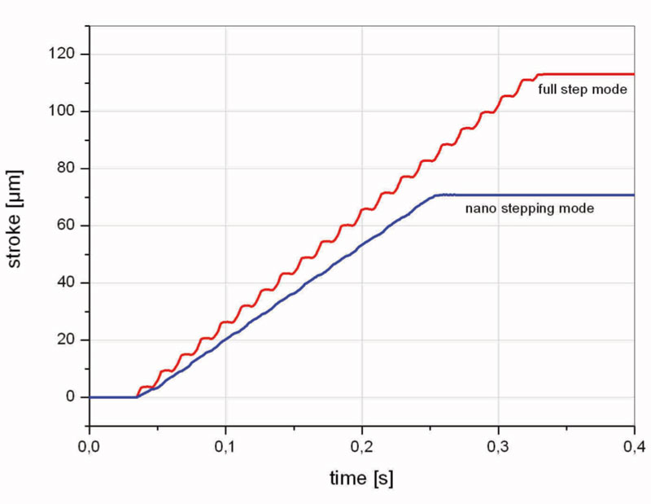
Piezo actuator (PI-make)
N-216 NEXLINE® High-Load Actuator. Feed motion is realized by piezo stepping motion which allows basically a travel ranges with nanometer accuracy
High-Force PiezoWalk® Drive for Long-Range Nanopositioning
Travel Range 20 mm
Resolutionto 0.03 nm Open-Loop, 5 nm
Closed-Loop
Up to 800 N Holding Force/600N (working)
Self Locking at Rest
Non-Magnetic and Vacuum-Compatible Working Principle
Cleanroom Compatible
Motion mode comparison of a NEXLINE® actuator: The nanostepping mode provides a very smooth motion. Full step mode allows higher speed

Slide 5
DESIGN OF TEST CRYOSTAT
Overall design has been done for Test Cryostat that can accommodate the 5-cell elliptical shape
650 MHz, β=0.61 cavity
Dimension of the Test Cryostat:
2360 mm. Height x 1762 mm. Diameter
LHe vessel dimension of the Test Cryostat:
1050 mm. Length x 512 mm. Diameter
Cryostat consists of:
  LHe vessel, LN2 shield
  Internal & external magnetic shielding
  Pump out port
  LN2/LHe in, LN2/LHe gas out, Safety port
  LN2/LHe instrumentations
  RF probe in/out --- adjustable from outside
  RF power coupler arrangement etc.

Slide 6
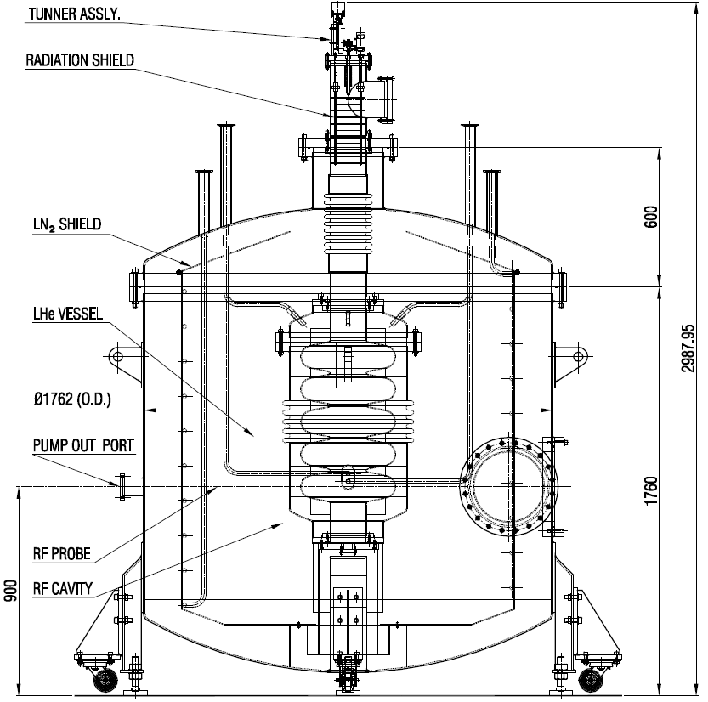
CAVITY PLACED VERTICALLY IN CRYOSTAT
SCRF cavity can be placed in the same CRYOSTAT in two possible ways
Vertically
Horizontally
Future modification: CRYOSTAT can be operated at 2K
(for cavity placed horizontally) adding components (Heat Exchanger, JT valve etc.) – provision for space

Slide 7
Mechanical Design
Volume of inner helium vessels ~ 216 lts.
Overall diameter of the cryostat has been increased to
accommodate the cavity in horizontal as well as in
vertical condition.
The cryostat has provision for operation of the cavity at
2K also.
Conductive Heat load to the liquid helium vessels from
top support is < 4 watt.
Heat load to the helium vessels due to radiation using
the10 layers of MLI on helium vessels is 0.05W.

Slide 8
Summary
Preliminary study on Blade Tuner is in progress.
Piezo actuator with 800N holding force and 600N working load and 1 nm step size with 20 mm. movement can be considered for using with blade tuner (in place of stepper motor + piezo actuator with less movement capability).
From the experience of designing the test cryostat for 650 MHz, β=0.61, 5-cell SRF cavity, we have now initiated the design activities of the LHe vessel for the said cavity.

Slide 9


