Slide 1

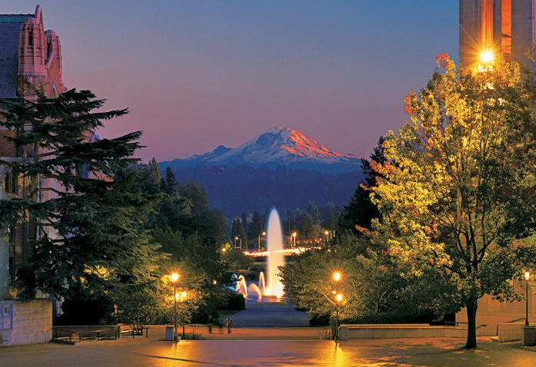
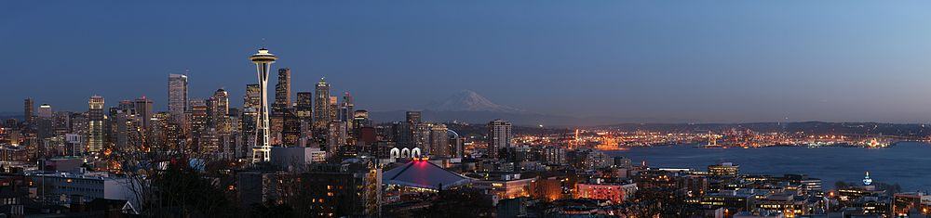
Snowmass All-Conveners Meeting
Status Report
Feb. 18, 2022
Joel Butler

Slide 2
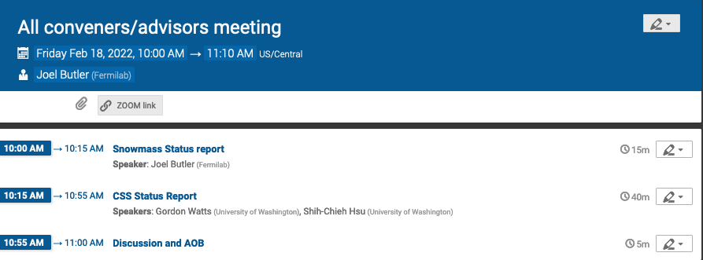
Outline
Snowmass Committees meeting times and schedule
CSS Logos
Snowmass funding status, quick overview –more detailed discussion in next talk
All-Frontier meeting schedule
Disseminating CSS plans for discussion
New Tasks for conveners
Reminder: CSS Program Committee

Slide 3
Snowmass Meeting Times and Schedules
Steering Group: Thursday 16:00 US Central, weekly
All-Conveners
  10:00 – 11:00 US/Central time every approximately every four weeks on Friday starting Feb 18
Advisory Group
  Time zone issues - Advisory Group spans from Japan to California
  08:00 – 09:00 US/Central time approximately every four weeks on Monday starting Feb. 28 (moved from Feb 21)
CSS Program Committee
  Meets once per month, typically at 1:30 US/Central at 1:30 pm
  Meeting frequency likely to increase

Slide 4
Specific Dates from now until CSS
All Conveners
  Feb 18
  Mar 18
  April 22
  May 20
  June 17
  July 8
Advisory Group
  Feb 28*
  Mar 21
  April 25
  May 23
  June 20
  July 11
Moved from Feb.21, which is US Presidents Day
These are entered into the Snowmass Calendar on the Twiki
and will be entered in Snowmass Indico (will link to calendar)

Slide 5
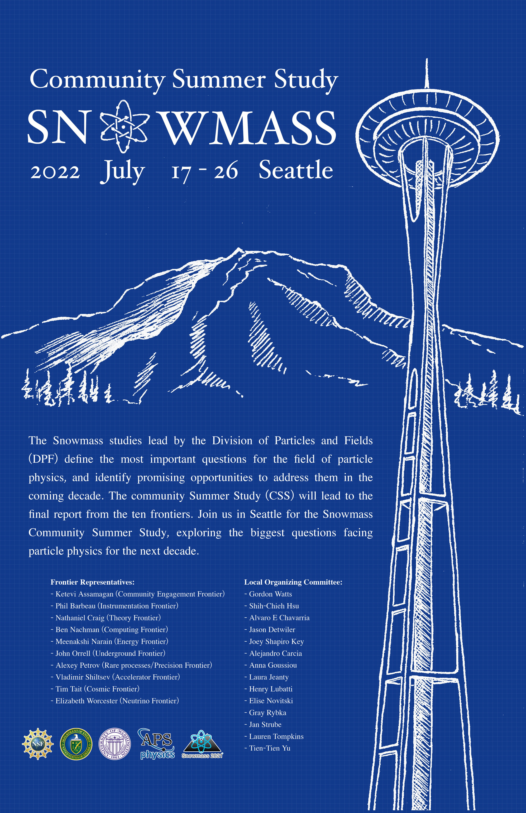
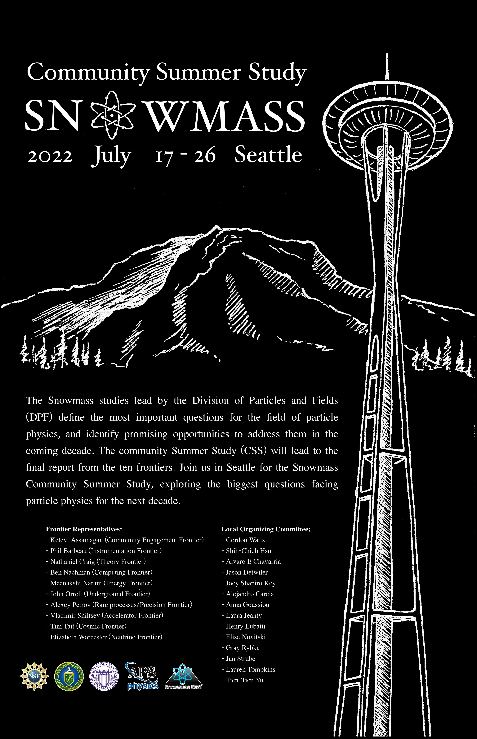
Proposed Logos
Did not get any comments yet. Please send comments to organizers.

Slide 6
Snowmass CSS Funding Status
DOE approved the proposal for the CSS for $99K (though more was requested, this was the expected amount). This is from their “central management reserve”
Funds for “preparatory (a.k.a. All-Frontier) meetings
  These funds are from the HEP Programs via the individual Program Managers.
  DOE, after great difficulty with budget problems and some internal procedures, has provided $10K for the Theory Meeting and $10K for the Energy Frontier meeting.
  DOE will struggle with the remaining requests, but the meetings are later so we do have more time for decisions to be made. Each Program has its own constraints.
    There is no Program that funds Community Engagement
    Two proposals, NF and RPF, go to the same program and they may not be able to provide $20K
      The two frontiers are revisiting their needs, but they are unlikely to change. Then, we will discuss the situation early next week and probably contact DOE
Request for support from NSF not yet submitted – Gordon/Shih-Chieh to discuss
DPF has to determine how much and what items it will contribute to Snowmass
  We have been saving money for some time to have resources for Snowmass
  Tulika and the chair line will discuss this with APS soon

Slide 7
CSS Status: Budget Status
Planning and Budget Status and Next Steps will be discussed by Gordon Watts and Shih - Chieh Hsu of UW today.
Initial round of key surveys are complete
  → information to support planning

Slide 8
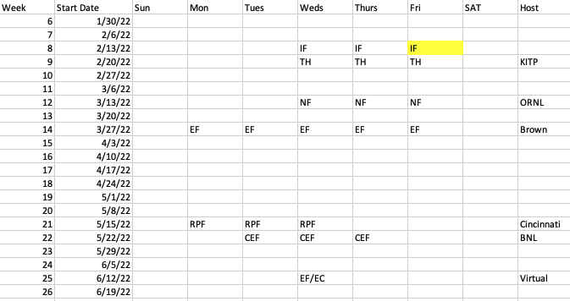
Snowmass Preparatory Meeting Schedule
No conflicts among ”All-Frontier” meetings . We should maintain this.

Slide 9
Snowmass CSS
Presentation of Plans
The broad plan has to be pinned down now that data collection is complete
  Some important decisions affecting costs at UW have to be made in next two weeks
Presentation of the plan, especially funding request
  Feb 17: Discuss with Steering Group Feb 17
  Discuss with All-conveners Feb 18
  Feb 28: Discuss with Advisory Group
  Feb 24: Discussion of options at Steering Group with UW
    →Decisions

Slide 10
New tasks for Conveners
We will resume Snowmass Newsletter next week
We will ask you to identify any key issues for your frontier
  you might want to discuss some of them with the DPF chair line (other channels?)
Make sure that you stay engaged in the CSS Program Committee through your frontier representative
  If your PC rep cannot make a meeting, which will become more frequent soon, please consider sending one of the other conveners
Provide input to CSS Local Organizing Committee though channels to be provided by UW (SLACK …)

Slide 11
CSS Program Committee
Steering group members:
  Joel Butler (PC co-chair), Tao Han, Sekhar Chivukula, Andre De Gouvea, Young-Kee Kim, Prisca Cushman
  Glennys Farrar, Yury Kolomensky, Sergei Nagaitsev, Nicolas Yunes
Frontier representatives:
  Ketevi Assamagan (Community Engagement Frontier)
  Phil Barbeau (Instrumentation Frontier)
  Nathaniel Craig (Theory Frontier)
  Ben Nachman (Computing Frontier)
  Meenakshi Narain (Energy Frontier)
  John Orrell (Underground Facilities)
  Alexey Petrov (Rare processes/Precision Frontier)
  Vladimir Shiltsev (Accelerator Frontier)
  Tim Tait (Cosmic Frontier)
  Elizabeth Worcester (Neutrino Frontier)
Early Career members:
  Garvita Agarwal (PhD student, Univ. Buffalo, CMS)
  Jacob Zettlemoyer (postdoc, FNAL, CEvNS)
  CSS Local Organizing Committee Chairs:
  Gordon Watts (PC co-chair), Shih-Chieh Hsu
As needed. Time has been
13:00 on Wednesdays

Slide 12
Today
First presentation of CSS details after the two surveys
Our goal is to convey information and to receive feedback about problems
  We do not have time to solve problems so we will limit the discussion to identifying items to be resolved outside the meeting
Please use “raise hand” feature in ZOOM

Slide 13
Backup Slides

Slide 14
CSS Local Organizing Committee
CSS Program Committee
  As needed, typically 1pm on Wednesday
    Last held on Jan 19
CSS Local Organizing Committee
  Gordon Watts
  Shih-Chieh Hsu
  Alvaro E. Chavarria
  Jason Detwiler
  Joey Shapiro Key
  Alejandro Garcia
  Anna Goussiou
  Laura Jeanty
  Henry Lubatti
  Elise Novitski
  Gary Rybka
  Jan Strube
  Lauren Tompkins
  Tien-Tien Yu

Slide 15
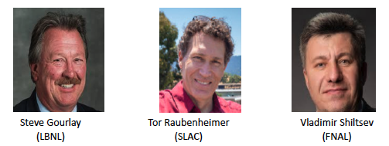
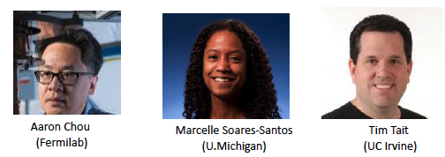
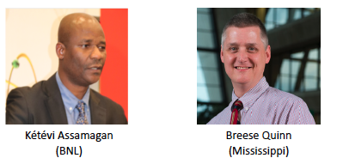
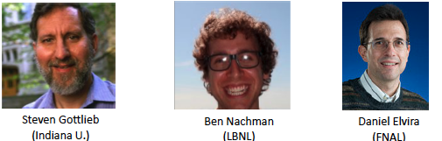
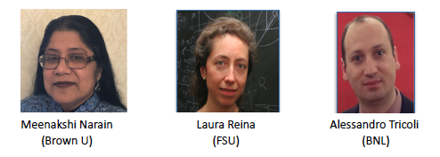
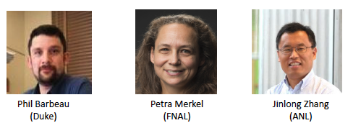
Organization in Ten “Frontiers” -I
Accelerator
Cosmic
Community Engagement
Computing
Energy
Instrumentation

Slide 16
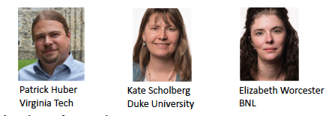
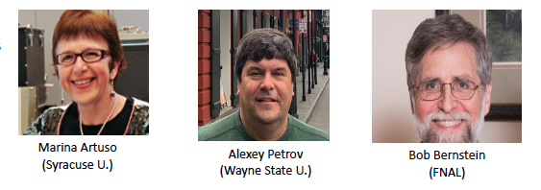
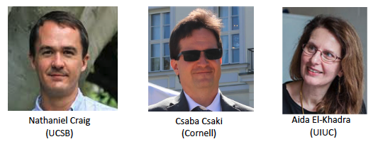
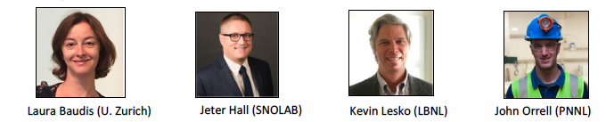
Organization in Ten “Frontiers” - II
Neutrino
Rare Processes & Precision Measurements
Theory
Underground Facilities and Infrastructure
All frontiers have topical subgroups (details on Twiki)
Accelerator: 7 Instrumentation: 10
Cosmic: 7 Neutrino: 10
Community Engagement: 7 Rare Processes: 7
Computing: 7 Theory: 11
Energy : 10 Underground: 6
More than 1500 people have signed up to participate in Snowmass!

Slide 17
10 Frontiers | 80 Topical Groups
Energy | Higgs Boson properties and couplings, Higgs Boson as a portal to new physics, Heavy flavor and top quark physics, EW Precision Phys. & constraining new phys., Precision QCD, Hadronic structure and forward QCD, Heavy Ions, Model specific explorations, More general explorations, Dark Matter at colliders
Neutrino Physics | Neutrino Oscillations, Sterile Neutrinos, Beyond the SM, Neutrinos from Natural Sources, Neutrino Properties, Neutrino Cross Sections, Nuclear Safeguards and Other Applications, Theory of Neutrino Physics, Artificial Neutrino Sources, Neutrino Detectors
Rare Processes | Weak Decays of b and c, Strange and Light Quarks, Fundamental Physics and Small Experiments. Baryon and Lepton Number Violation, Charged Lepton Flavor Violation, Dark Sector at Low Energies, Hadron spectroscopy
Cosmic | Dark Matter: Particle-like, Dark Matter: Wave-like, Dark Matter: Cosmic Probes, Dark Energy & Cosmic Acceleration: The Modern Universe, Dark Energy & Cosmic Acceleration: Cosmic Dawn & Before, Dark Energy & Cosmic Acceleration: Complementarity of Probes and New Facilities
Theory | String theory, quantum gravity, black holes, Effective field theory techniques, CFT and formal QFT, Scattering amplitudes, Lattice gauge theory, Theory techniques for precision physics, Collider phenomenology, BSM model building, Astro-particle physics and cosmology, Quantum information science, Theory of Neutrino Physics
Accelerator | Beam Physics and Accelerator Education, Accelerators for Neutrinos, Accelerators for Electroweak and Higgs Physics, Multi-TeV Colliders, Accelerators for Physics Beyond Colliders & Rare Processes, Advanced Accelerator Concepts, Accelerator Technology R&D: RF, Magnets, Targets/Sources
Instrumentation | Quantum Sensors, Photon Detectors, Solid State Detectors & Tracking, Trigger and DAQ, Micro Pattern Gas Detectors, Calorimetry, Electronics/ASICS, Noble Elements, Cross Cutting and System Integration, Radio Detection
Computational | Experimental Algorithm Parallelization, Theoretical Calculations and Simulation, Machine Learning, Storage and processing resource access (Facility and Infrastructure R&D), End user analysis
Underground Facilities | Underground Facilities for Neutrinos, Underground Facilities for Cosmic Frontier, Underground Detectors
Community Engagement | Applications & Industry, Career Pipeline & Development, Diversity & Inclusion, Physics Education, Public Education & Outreach, Public Policy & Government Engagement
Snowmass Early Career | Snowmass Early Career to represent early career members and promote

Slide 18
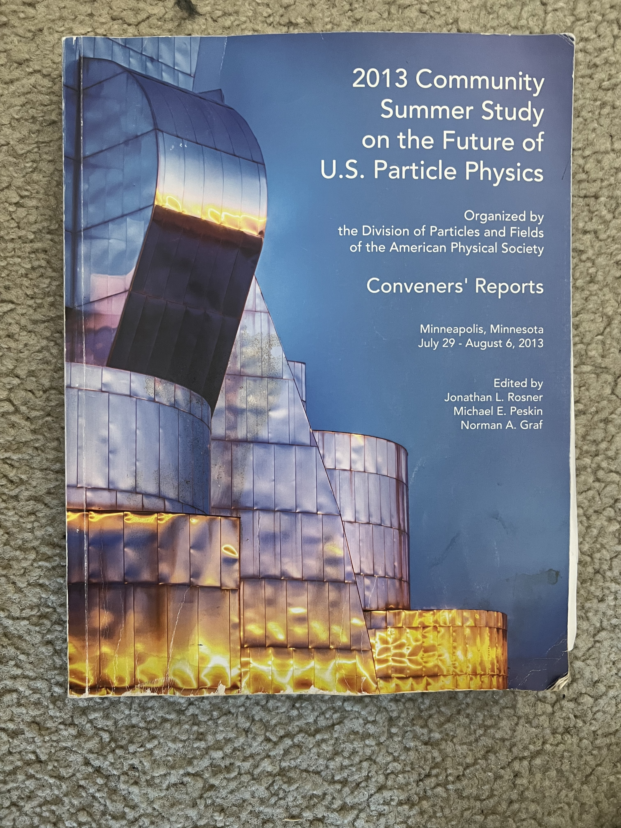
The Snowmass Book - 2021
Contributed paper 1
Topical group 1
Frontier 1
Report
Topical group N
Summary
and
Book
Contributed paper M
Topical group
reports
Frontier 10
Report
Report cover from Snowmass 2013, report is~ 350 pages
The new report is expected to be ~500 pages
Contributed papers will remain part of the permanent record of Snowmass

Slide 19
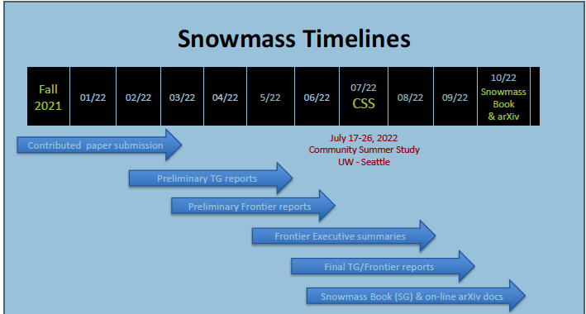
Timeline for Snowmass Book
March 15: Contributed papers (a.k.a. White Papers)
May 31: Preliminary Topical Group Reports
June 30: Preliminary Frontier Reports
July 17 – 26: Converge on reports for all the frontiers and produce executive summaries representing the views of their communities and providing the basic input needed for P5
September: draft Executive Summary and Report Summary
October- November: Snowmass Book finalized and ready for submission

Slide 20
Impact of COVID
This edition of Snowmass was planned to run from the summer of 2020 to a final get-together in July of 2021 at the University of Washington
By early 2021, it became clear that COVID would have a major impact on our ability to carry out the necessary work because of
  Lack of face-to-face meetings reduced efficiency
  Heavy burdens fell on our young physicists, who do many of the studies
    Especially young physicists with children, who now had care for them all day and school them at home
In consultation with DOE, which agreed to delay P5 by one year, to 2022/23, we decided to take a ~7month pause/slowdown with the expectation that conditions would improve because of vaccines and other mitigation measures
  The meeting at University of Washington was delayed until July of 2022
The pause/slowdown began in January of 2021
The startup dates varied among the frontiers, but by September everything was restarted and there was a “Snowmass Day” on September 24, 2021, to review the status and plans for completing the work in for the July 2022 meeting
We hope that vaccination and mitigation will enable us to function well even in the face of the Omicron variant, which has surfaced since the restart
Our study will be sufficiently complete to provide the necessary inputs to P5 and we hope to avoid further postponements

Slide 21
Selected Upcoming Activities
Preparatory ”All-frontier” meetings (which we hope will be HYBRID, i.e. will have both an in-person component and remote access) to complete and begin to synthesize the white papers:
  Instrumentation Frontier, Feb. 14-18, Stony Brook (delayed, remote?)
  Theory Frontier, Feb. 23 – 25, KITP-UCSB: hybrid meeting
  Neutrino Frontier, March 16 – 18, Oak Ridge National Lab, hybrid
  Energy Frontier, week of March 27, Brown University, hybrid
  Rare Decays and Precision Measurements: May 16 – 19, University of Cincinnati, hybrid
  Community Engagement: May 24 - 26, Brookhaven National Lab, hybrid
Special Seminar series (all virtual) on topics that will shape US accelerator activities including construction projects and R&D
  Colliders (EF and AF)
  Muon properties and decays (RPF and AF)
  Neutrinos (NF and AF)
  Accelerator Dark matter searches and other fixed target needs (RPF and AF)
Ongoing Initiative of Snowmass Early Career
  Colloquium series: “Big Questions in Particle Physics”

Slide 22
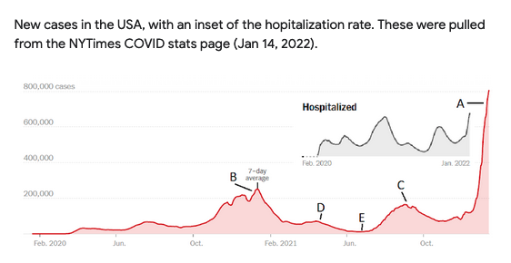
From CSS Survey

Slide 23
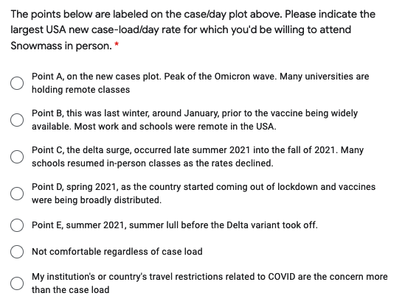
From CSS Survey

Slide 24
Captioning
Request for support of one physicist to work on a white paper in CEF/COMMF3 on accessibility
  Insists that high quality captioning necessary
  White Coat captioning is $306/h at 8 meetings
Brief Notes and Action Items from meeting with
  Discussion of need – the target is major white paper – options, quality issues
  DPF budget constraints, issue of opportunity costs and Constant sum game
  Opportunity costs are related to increased pressure to provide a variety support, especially for Early Career Scientists
  Giordan Stark: Provide a definite proposal for the rest of 2022
  Tulika to follow up with CERN on an AI-based automated captioning system that may be tested at the LHCP
  Joel will ask APS what their plans to address this problem
  We (DPF) will check with other APS units to learn if they face similar challenges and what solutions they have utilized or are considering
  We should be sure to consider all alternatives to captioning since it is unclear that the resources will be available for all future needs.
  We, collectively, should explore other sources of funding, including a specific addition to conference fees, private funds, some form of crowd-sourcing …
If any your Divisions have good solutions or want to work with us to find them, let us know
We sent an email approving the captioning request for finishing the contributed paper Giordan is working on. He has to apply for support for captioning at all-frontier meetings and the CSS and it is not guaranteed at the quality level he seeks. It can be included in the registration fee. We have applied to the FAs for funds.

