Slide 1
LBNL Respooling Machine Procurement Review
February 17, 2022
Elizabeth Lee (emlee@lbl.gov)
Manufacturing Engineer
Lawrence Berkeley National Laboratory

Slide 2
Overview
Background
Procurement Objectives
Target Specifications (Constraints)
Procurement Options
Front Runners
Additional Concerns
Conclusion and Future Work
Questions?

Slide 3
Background: What’s a respooling machine?
Charge: 2
What is a respooling machine?
Respooling machines (respoolers) are used to subdivide bulk lots of wire into smaller unit lengths.
Where is the respooler located?
LBNL Cabling Facility (B77A-103)
Who uses this respooler/facility?
Cabling team technicians, but any project relying on cabling work at LBNL is a direct stakeholder
Which respooler does LBNL currently use?
Meteor ME-301 linear solenoid winding machine (~1950’s era), with additional QC subsystems
Why is it important?
Respooling machine is used to prepare all wire lengths used for LBNL cabling activities (Rutherford cabling, wire annealing spool prep., etc.)
First step in most processes at LBNL cabling facility - initial QC for all wire

Slide 4
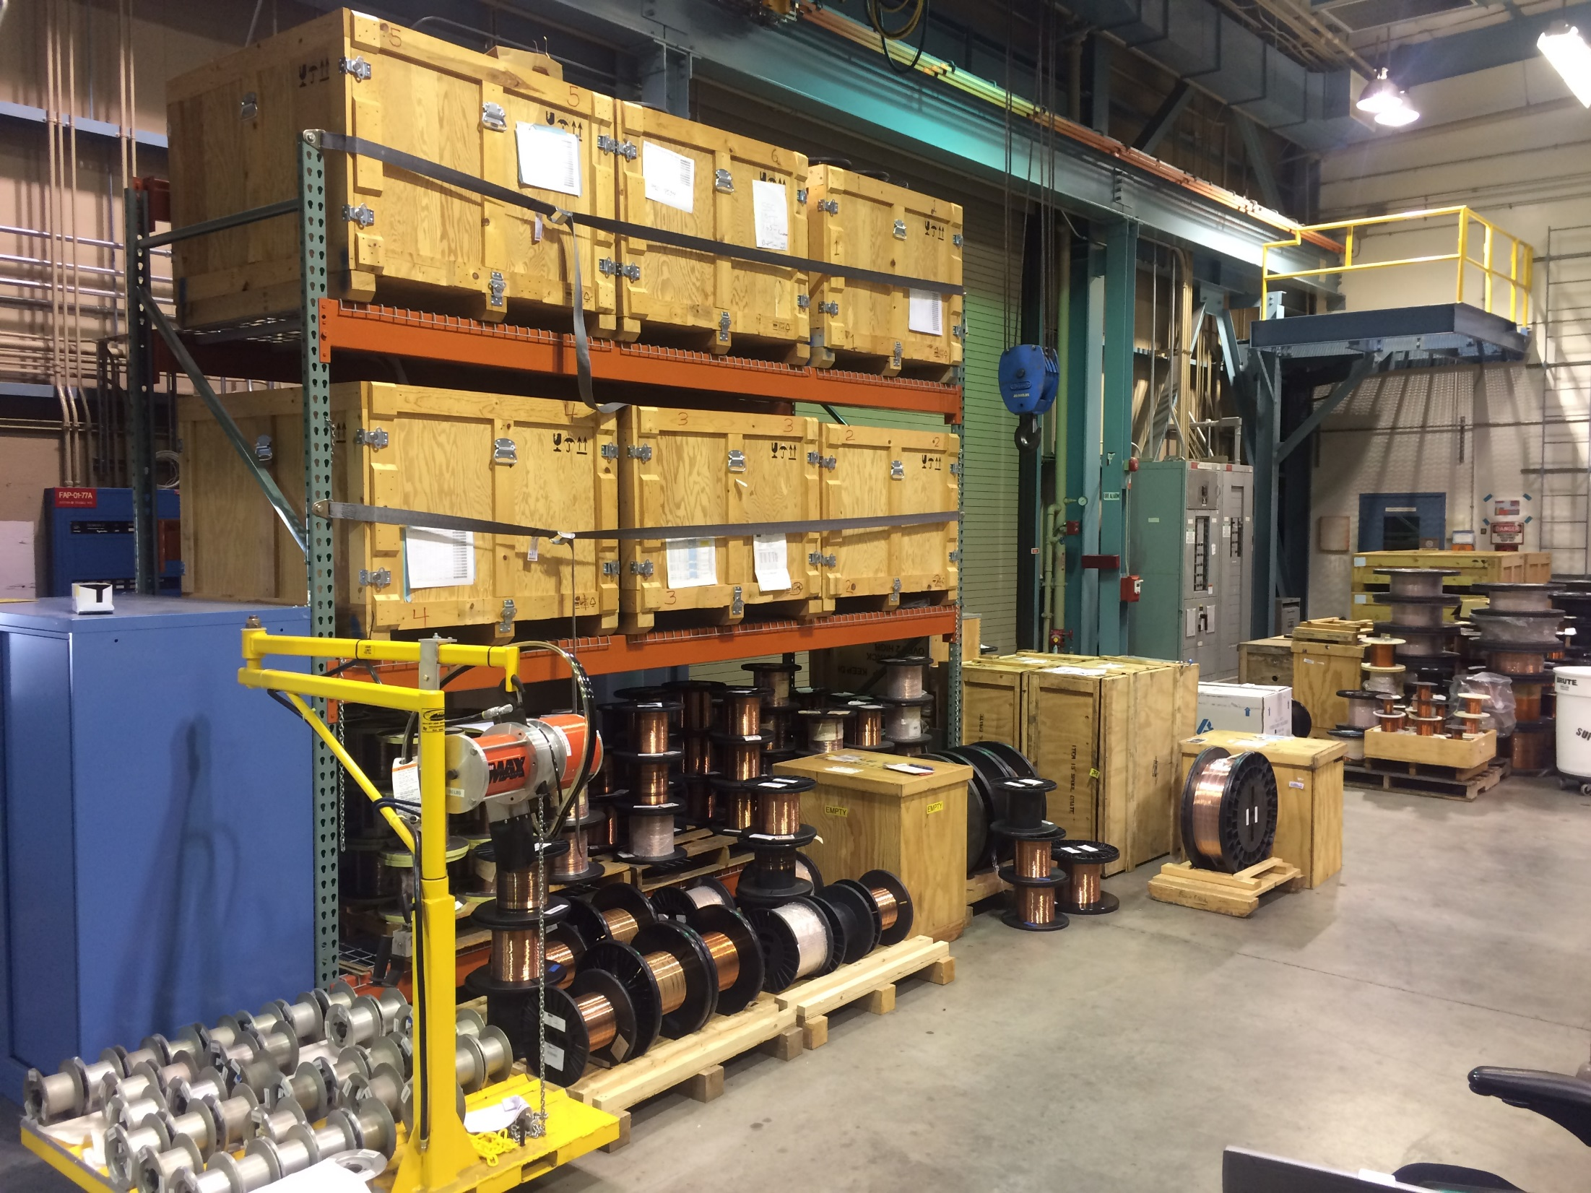
Background: Spool Types in use at LBNL
Photo credits: Hugh Higley

Slide 5
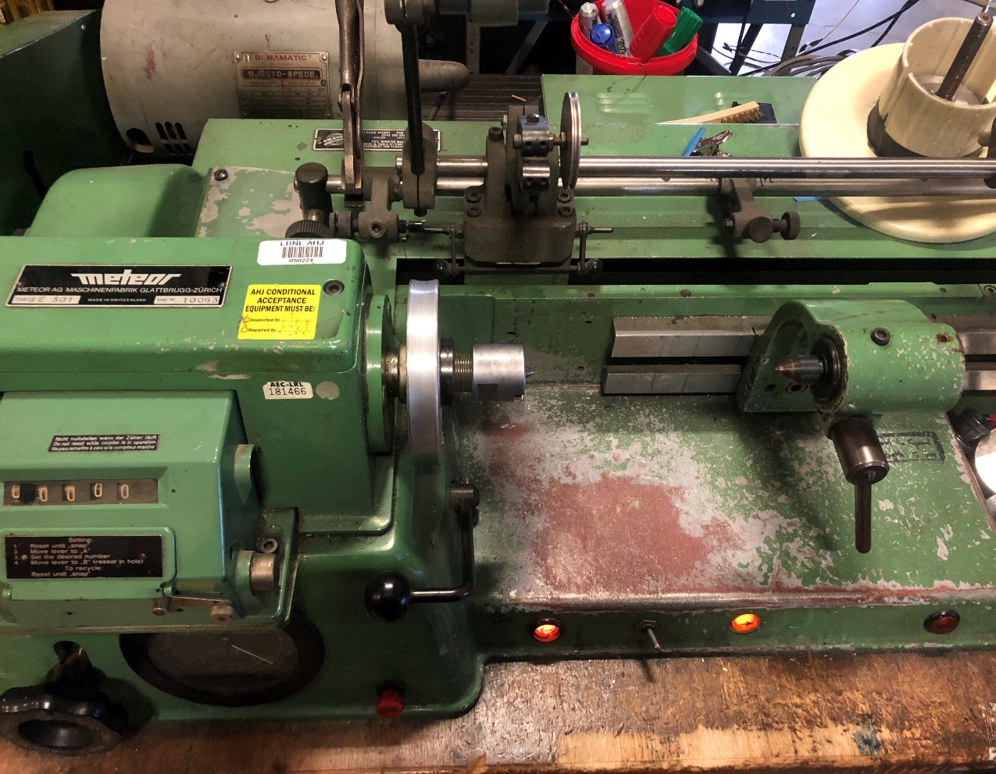
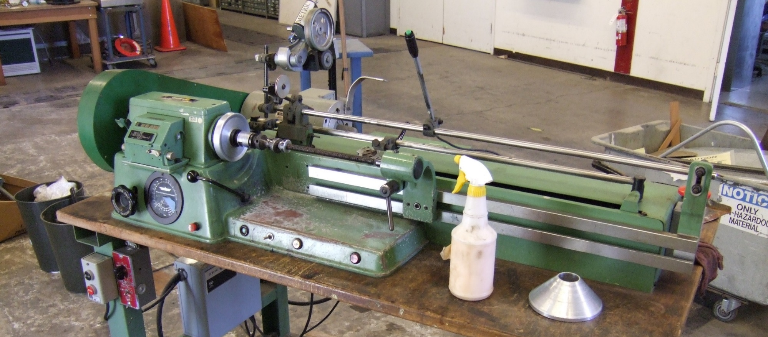
Background: How does the ME-301 work?
Charge: 1,2
Basic function
Motor drives spindle (i.e., rotates spool) to take up wire
Traversing pulley geared to motor – moves from side to side to level-wind, controlling the number of wire turns/layer
Lengths recorded by attached footage counter assembly
Not a stock feature – added by LBNL
Important Features
Level winding
Layers are wound flat
No bunching of wire
Automatic-traverse
Transmission prevents technicians from having to watch wire, respool and move the traverse to level wind
Traversing guide pulley
Al Spool mount
Footage counter assembly

Slide 6
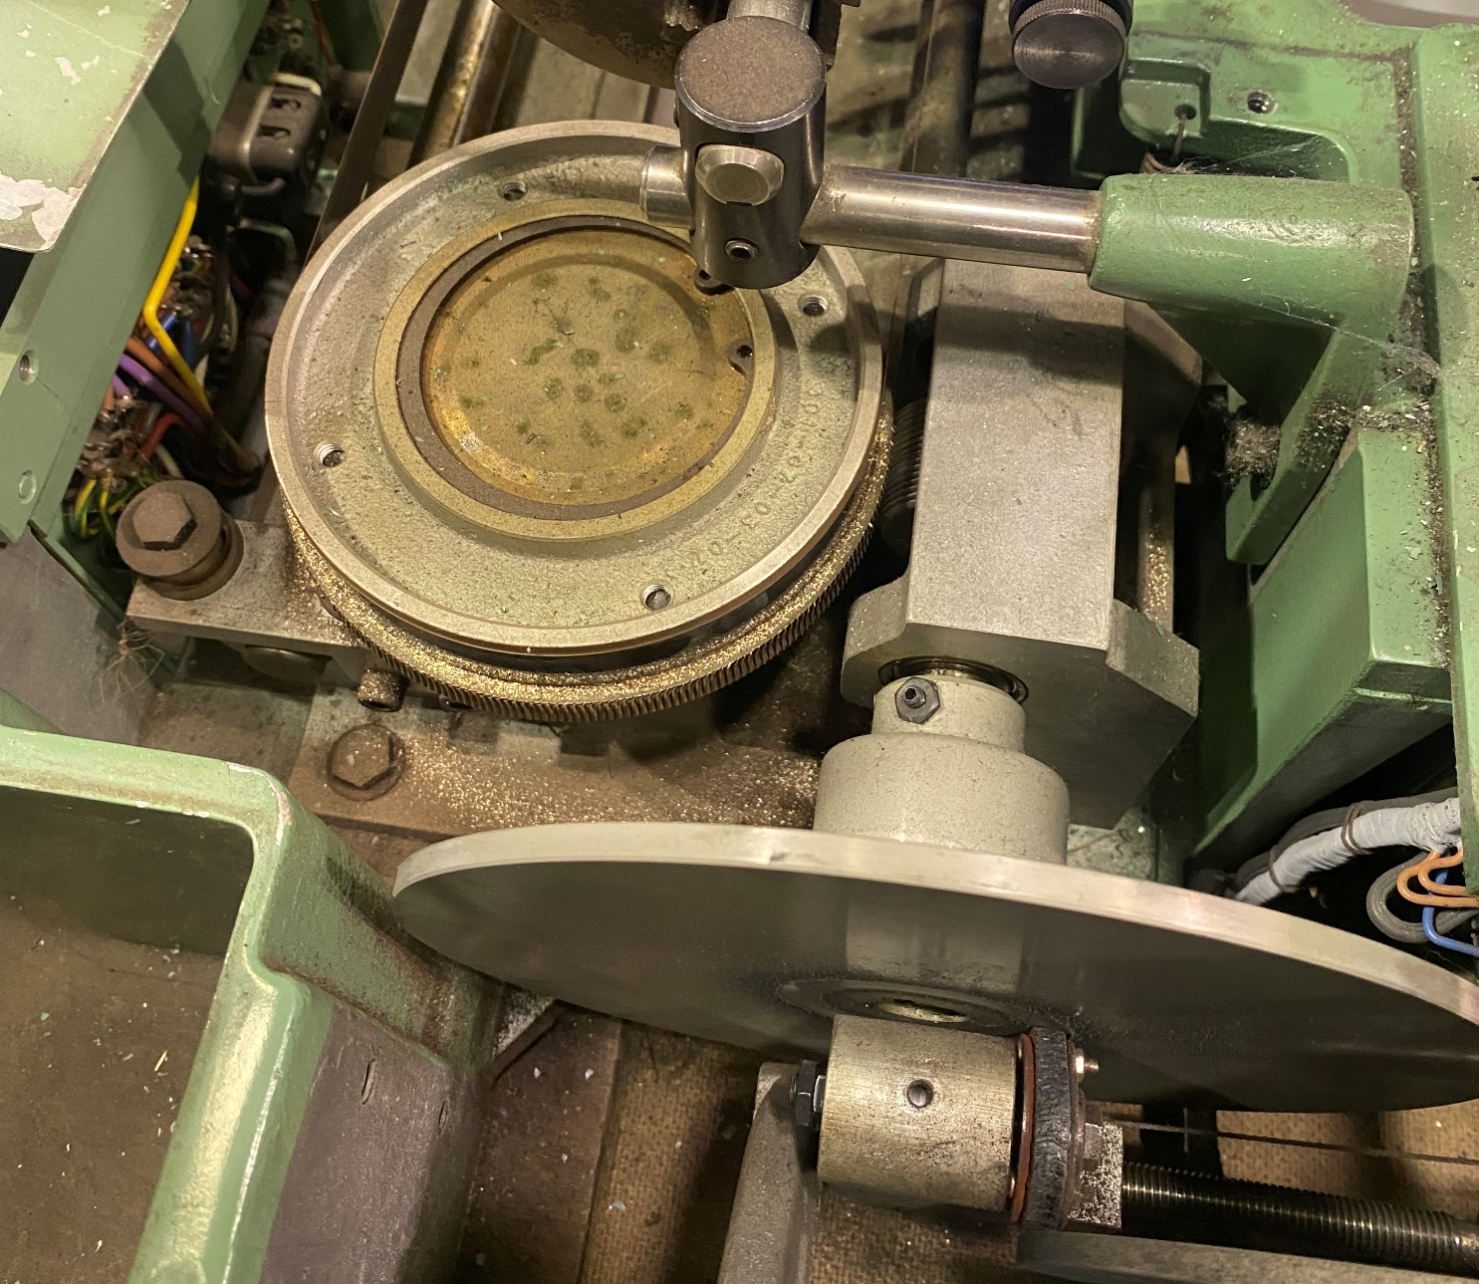
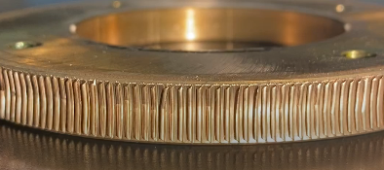
Background: Recent Issues and Impact
Charge: 2
Main transmission broke down in November 2021 due to accelerated wear & tear from large project work
Pre-LARP/AUP, average length respooled was ~60 km/yr
During LARP/AUP, respooling rate increased to ~600 km/yr (10x increase)
Support availability extremely poor
Meteor AG is a Swiss company – sole U.S. distributor provided poor support and had extremely long part lead times
Machine assemblies poorly documented due to machine age
Gear and mating worm drive had to be sent to a specialty machine shop in Milwaukee, WI for reverse-engineering and fabrication
Breakdown caused 2.5 month delay for cable production at LBNL; entire facility “dead in the water”
Brass worm gear had worn through original set of teeth (almost no engagement with worm drive)
Friction transfer roller worn down, poor contact/power transmission
Detail: worm gear damage from where mating worm had cut past gear’s original set of teeth

Slide 7
Procurement Objectives
Charge: 1,2,3
System reliability
Increase level of vendor support/maintenance
Decrease maintenance frequency
Define safe operating state/limits for machine to prevent early failure
Operational consistency
Improve consistency of level winding operation (smoother layers)
Enable faster respooling operation
Improve wire tensioning consistency
System performance
Respool a wider range of wire types/diameters
Hold and wind larger take up spools (transfer/storage, annealing)
Increase weight capacity of machine

Slide 8
Target Specifications
Charge: 2
Electrical Input: 208 V three phase or 115/120 VAC preferred
Footprint: 72” x 35” max. area
Min. Take-up spool flange diameter: 12” (preferably up to 18”)
Weight capacity: 200 lbs
Max. Traverse: 20”
Features:
Level-winding
Automatic traverse
Wire tensioning system
On/off button operation

Slide 9
Vendor Preferences for New Machine
Charge: 3
Warranty for any device purchased
Existing and active parts department
Existing and active service department
Willing to provide mounting footprint and center of gravity (CG) information at time of quote so that we can assess installation costs/feasibility
Note that LBNL is subject to the Buy American Act for purchases beyond a certain threshold

Slide 10
Vendor Survey
Charge: 3
Tried to identify as many manufacturers of linear solenoid winding machines as possible
Limited total number of potential suppliers substantially; winding machines of this type are not common
Primarily tried to find manufacturers online
One manufacturer (Broomfield) was referred to our attention because another team had LBNL had visited a local winding factory with many Broomfield machines
One manufacturer (Gorman) provided a list of other legacy U.S. manufacturers as part of their “History” page
Attempted to contact manufacturers on this list, if still in business
Only got responses after request for quote (RFQ) from four companies – these are the manufacturers of the options presented here

Slide 11
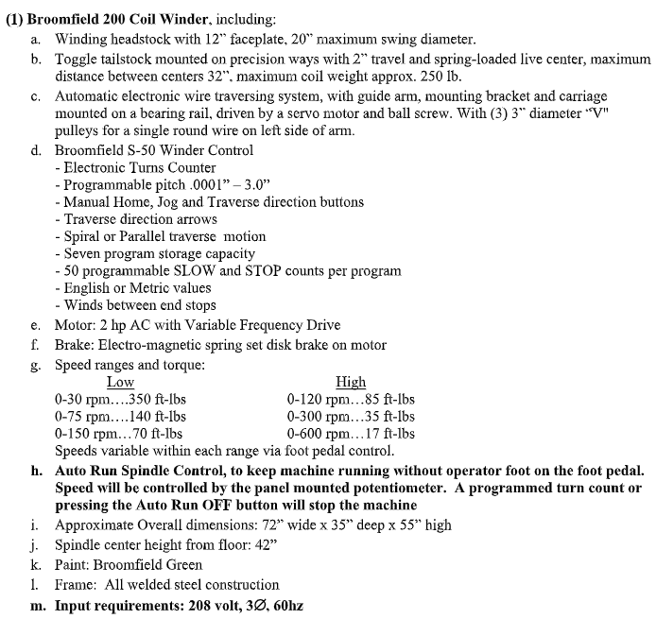
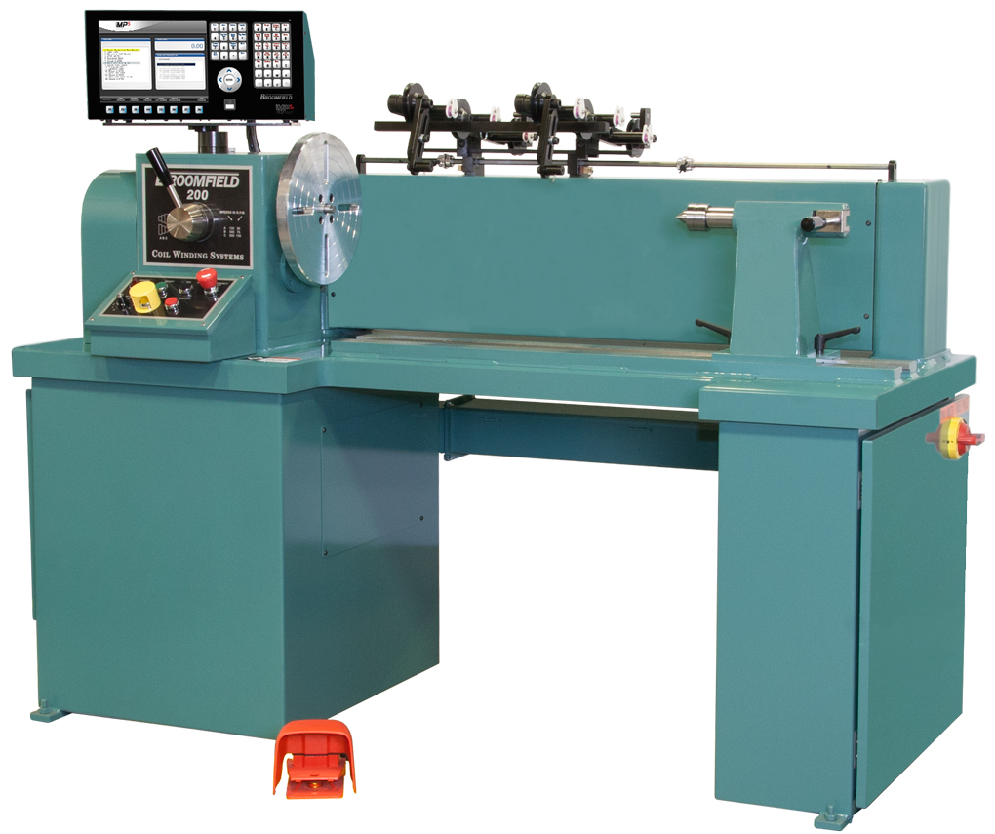
Option 1
Charge: 1, 2
Broomfield 200 Series Winder

Slide 12
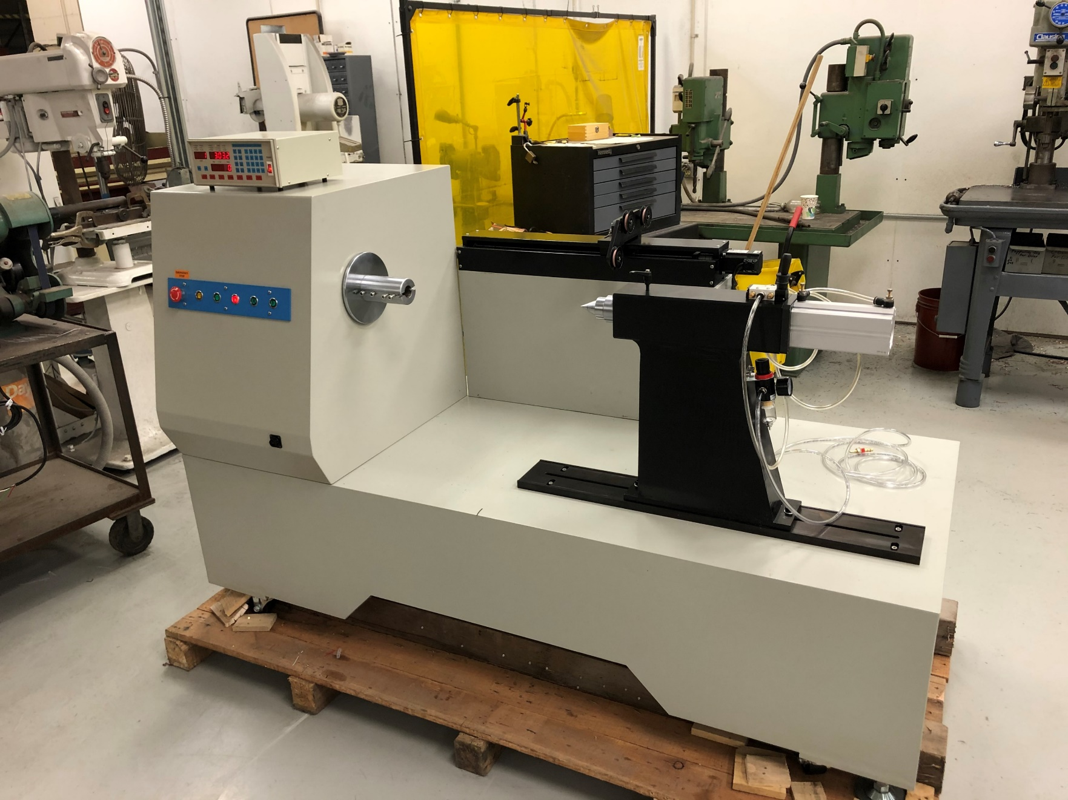
Option 2
Charge: 1, 2
George Stevens GS-F100CXLB

Slide 13
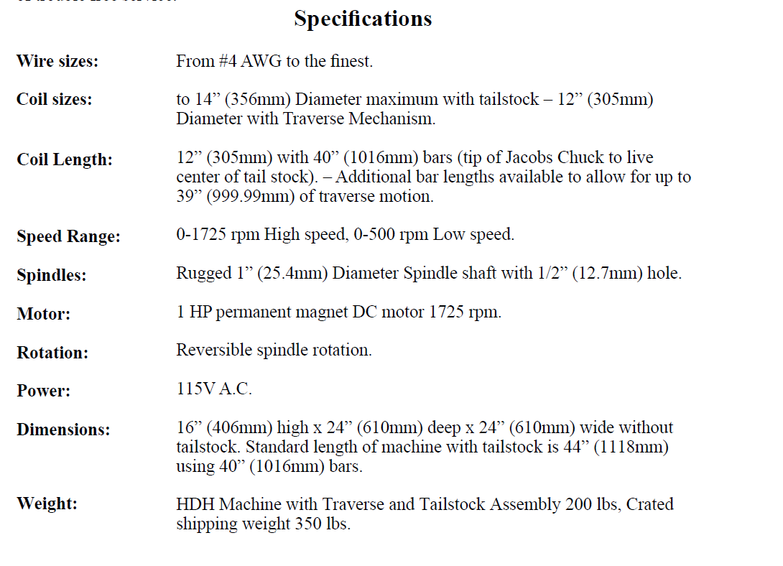
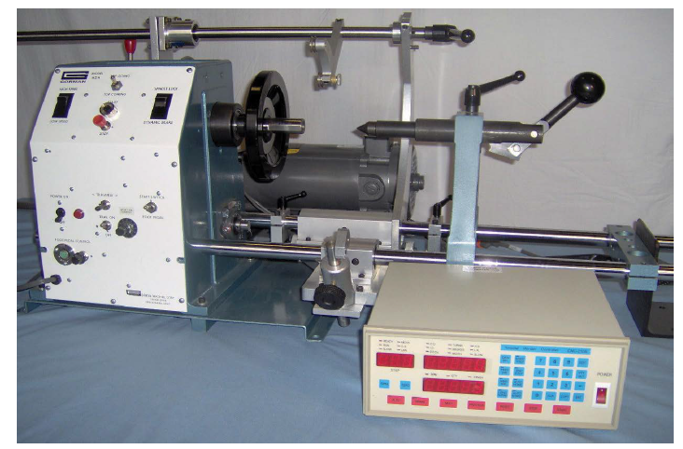
Option 3
Charge: 1, 2
Gorman HDH Winder

Slide 14
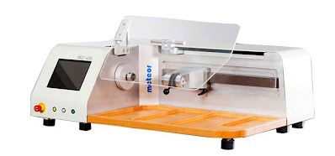
Option 4
Charge: 1, 2
Meteor M22-400

Slide 15
Options Summary
Charge: 2, 3
Manufacturer | Model | Options | Max. Travel | Max. Diameter of Take-up Spool | Min. Wire Diameter | Max. Wire Diameter | Device Weight | Footprint (L x W x H) | Elec. Requirement | Lead Time | Warranty
Broomfield | 200 Series | DT-124 Dereeling + tensioning stand, auto-run spindle control, 3 free days of training at Broomfield site | 32" | 20" | No limit given | No limit given | 1600 lbs | 72" x 35" x 56" | 208 V, three phase | 5-6 months | Not listed
Gorman | HDH | Bar extension for automatic traverse | 39" | 12" | No limit given | 5.189 mm | 200 lbs | 44" x 24" x 24" | 115 VAC | Not listed | Not listed
Meteor | M22-400 | Mechanical tensioner, dual roller wire guide, 2 days set up and training | 15.7" | 7.87" | 0.01 mm | 2 mm | 120 kg | 71" x 20" x 20" | 220 VAC, 10 A | Not given until receipt of order, per quote description | 1 year or 2000 hours
George Stevens | GS-F100CXLB | Custom | 20" | 20" | 1.29 mm | 3.66 mm | Not given | Not given | 208 V, three phase | 3.5-4 months | Not listed

Slide 16
Ranking by Feature
Charge: 3, 4
Arbitrary scoring system: use international track and field meet scoring to see which device gets the most “points”
1st through 4th place: 5, 3, 2, and 1 points for each parameter, respectively
First place criteria
Largest maximum take-up spool diameter
Smallest minimum wire diameter
Lowest weight
Smallest footprint
Minimal electrical work (existing access: 208 VAC three phase, 115/120 VAC)

Slide 17
Ranking by Feature: Results
Charge: 3, 4
 | 1st | 2nd | 3rd | 4th
Maximum Travel | Gorman | Broomfield | George Stevens | Meteor
Max. Diameter of Take-up Spool | Broomfield / George Stevens | Gorman | Meteor
Min. Wire Diameter | Broomfield / Gorman | Meteor | George Stevens
Max. Wire Diameter | Broomfield | Gorman | George Stevens | Meteor
Device Weight | Meteor | Gorman | Broomfield | George Stevens
Approximate Footprint (L x W x H) | Gorman | Meteor | Broomfield | George Stevens
Elec. Requirement | Broomfield | George Stevens | Gorman | Meteor
Broomfield | Gorman | Meteor | George Stevens
29 | 31 | 17 | 18
In arbitrary scoring system, Gorman and Broomfield score the highest – can eliminate Meteor and George Stevens, which we do not believe will have adequate performance

Slide 18
Broomfield 200 vs. Gorman HDH
Charge: 3, 4
Broomfield 200
(72” x 36” x 55”)
Gorman HDH
(44” x 24” x 16”)

Slide 19
Broomfield 200 vs. Gorman HDH
Charge: 4, 5
What makes the Broomfield 200 different from the Gorman HDH? It is 4X more expensive than the HDH – why?
Additional features
Auto Run spindle control
Programmable controller
3 days of free training for up to three people to ensure the transition goes smoothly and machine works for our application
Wire payoff stand with pneumatic braking
General performance increases
2 hp motor with variable speed drive vs 1 hp DC motor
20” max. coil diameter (vs 14” on Gorman)
250 lb coil weight capacity
Gorman HDH is a reasonable direct replacement for the ME-301, but the Broomfield machine would help “future-proof” the cabling facility

Slide 20
Additional Considerations
Charge: 4, 5
Broomfield is a larger supplier – they sell to coil manufacturers and solenoid winding facilities/subsidiaries
Have time/energy invested into services and parts departments because their core customers need industrial reliability
Customers include Eaton, GE, Philips Medical, Schneider Electrical, and Siemens, among others
Gorman was the most responsive vendor in initial communications, but it is a very small company
Family owned business
If firm were to go out of business, LBNL would be back at square one (unsupported machine)
Operator preference
LBNL head cabling technician has assessed these options and indicated his preference for the Broomfield 200 due to perceived build quality and reliability

Slide 21
Team Preference: Broomfield 200
Charge: 4, 5
System reliability
Vendor should be capable of providing prompt technical support
Operational limits and maintenance recommendations for new machine are both well-defined and documented
Operational consistency
Supplier included de-reeling stand should help stabilize feed spool and improve respooling speed/consistency
System performance
System will be able to respool a wider range of wire types/diameters
System can hold larger/heavier take up spools than the current respooler

Slide 22
Conclusion
Charge: 4, 5
The LBNL cabling team wants to replace the current respooler to ensure operational continuity and adequate support for ongoing scientific projects
The LBNL cabling team would like to improve facility respooling capabilities to support a wider variety of wire and cable types
The Broomfield 200 machine is very strong candidate for a “future-proofing” LBNL’s respooling capabilities
If wire cannot be prepared for Rutherford cabling, cables cannot be produced – the LBNL cabling team hopes that the facility respooler can become an enabling technology, and not a limiting one

