Slide 1
Notes on work in February 14-25, 2022
A. Shemyakin, A. Romanov
Meeting on Undulator Light Interferometry Setup
25 February 2022

Slide 2
Summary
Used an alignment fixture
Installed a CCD camera; took images
Unsuccessfully tried to identify sources of jitter

Slide 3
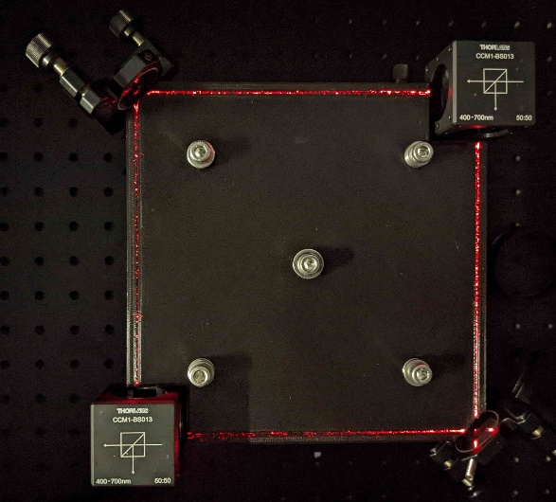
Alignment fixture
Sasha R. 3D printed a plate with two pairs of parallel grooves
  Used eyes to align the mirrors and splitters to direct the light beam along the grooves to form a square MZI
    Accuracy is likely <1 mm
IM1
BS1
M2
S1
BS2
IM2
160 mm
S2
HeNe
M1
Left – Aligning with the fixture. Right- the corresponding schematic. HeNe is HeNe laser. M1 and M2 are mirrors outside of MZI. IM1 and IM2 are mirrors inside of MZI. BS1 and BS2 are cubic beam splitters of the MZI. S1 and S2 are screens.

Slide 4
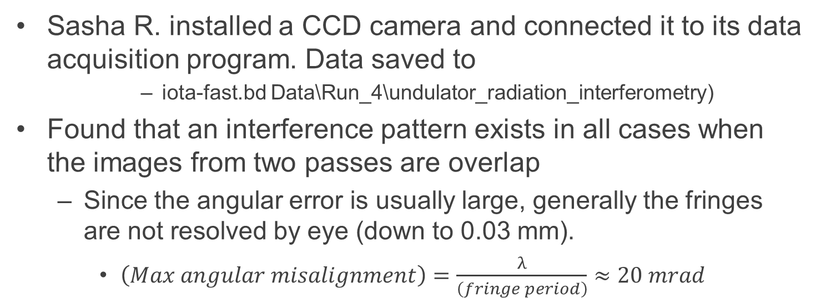
Camera
Sasha R. installed a CCD camera and connected it to its data acquisition program. Data saved to
      iota-fast.bd Data\Run_4\undulator_radiation_interferometry)
Found that an interference pattern exists in all cases when the images from two passes are overlap
  Since the angular error is usually large, generally the fringes are not resolved by eye (down to 0.03 mm).
    $\left(Max angular misalignment\right)=\frac{λ}{\left(fringe period\right)}≈20 mrad$
IM1
BS1
M2
NF
Test setup with the camera. HeNe is HeNe laser. M1 and M2 are mirrors outside of MZI. IM1 and IM2 are mirrors inside of MZI. BS1 and BS2 are cubic beam splitters of the MZI. L1 is a defocusing lens (expander). S1 is a screen. NF is the neutral filter. CCD is a CCD camera.
S1
BS2
IM2
L1
HeNe
M1
CCD

Slide 5
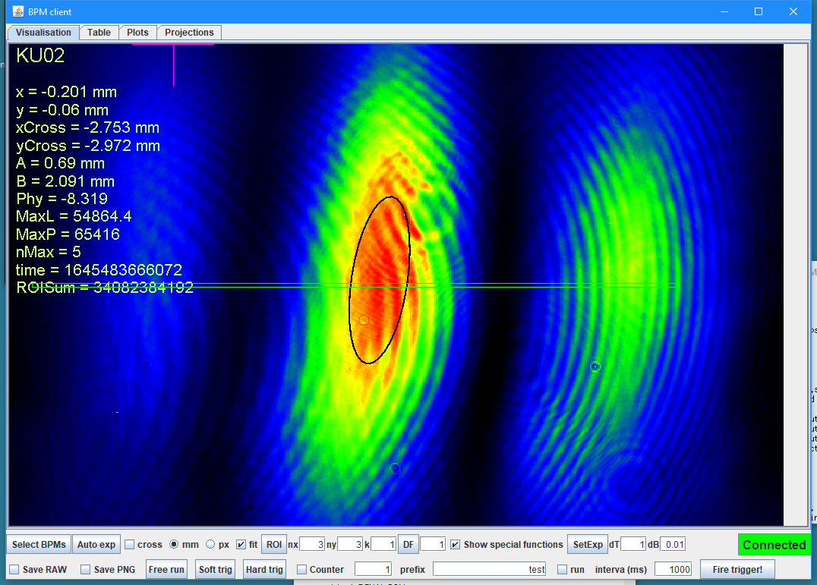
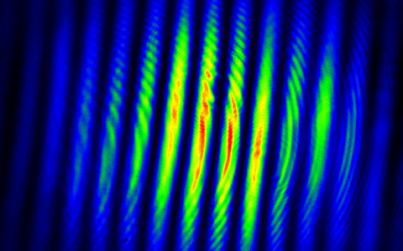
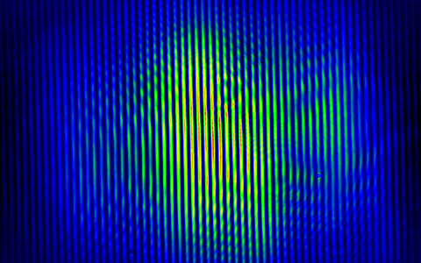
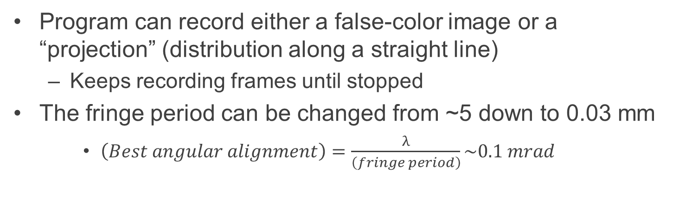
Images
Program can record either a false-color image or a “projection” (distribution along a straight line)
  Keeps recording frames until stopped
The fringe period can be changed from ~5 down to 0.03 mm
    $\left(Best angular alignment\right)=\frac{λ}{\left(fringe period\right)}\sim 0.1 mrad$
Three camera images at different misalignments. The red rectangle shows an approximate location of the projection used in the following plots.

Slide 6
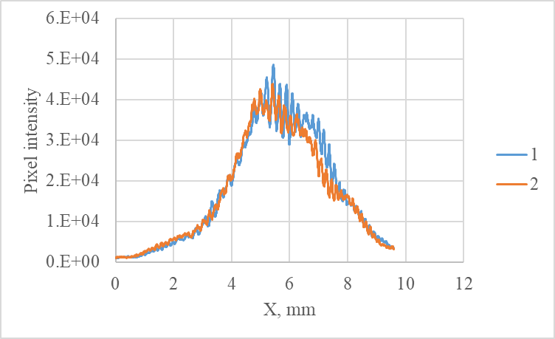
Stability, no interference
The images without interference pattern are stable
  When one of paths is blocked
Spots from two paths are aligned quite well
  There is an asymmetry in the brightness distribution, some difference on right side, and a different interference pattern
Typical relative difference in pixel intensity between two different frames (the same projection) when one of paths is blocked.
Comparison of profiles from two separate paths. Each image is modulated with ~0.2 mm period.

Slide 7
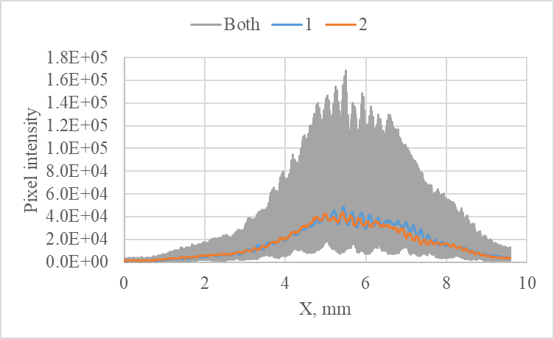
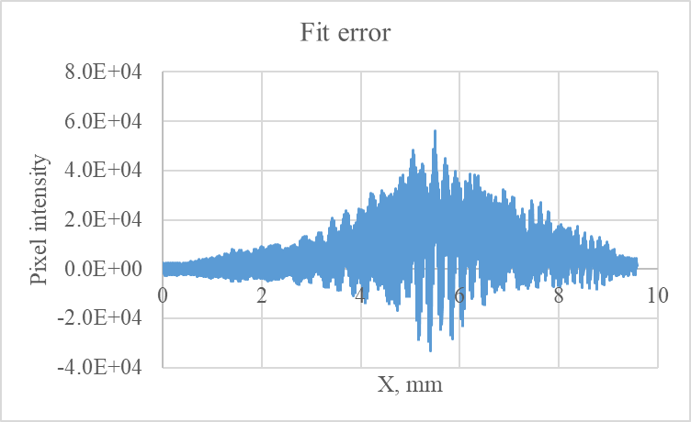
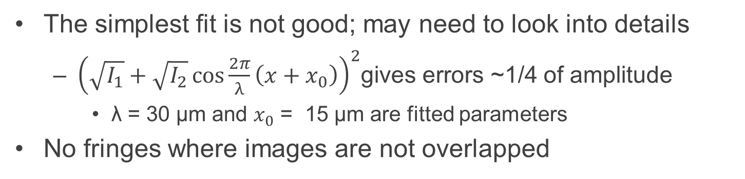
Interference pattern
The simplest fit is not good; may need to look into details
  ${\left(\sqrt{I_{1}}+\sqrt{I_{2}}\cos{\frac{2π}{λ}\left(x+x_{0}\right)}\right)}^{2}$gives errors ~1/4 of amplitude
    λ = 30 µm and $x_{0}$ = 15 µm are fitted parameters
No fringes where images are not overlapped
Interference pattern (gray) compared with profiles from individual paths.
Errors of a simple fit.

Slide 8
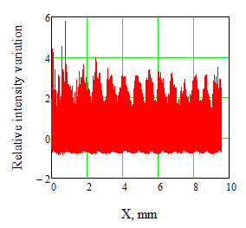
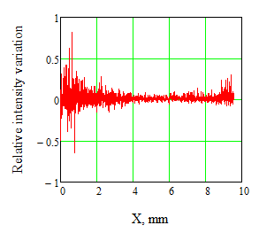
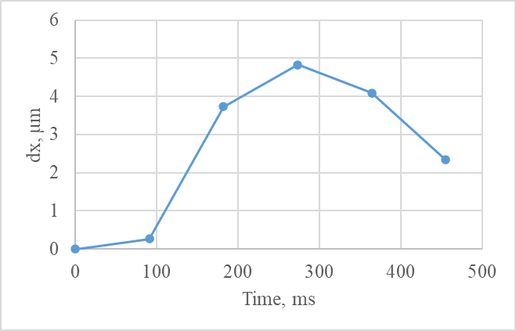
Stability of the interference pattern
The interference pattern moves in sub-second scale
  When the projection is shifted as a whole, stability is similar to the one without the pattern
  For 6 recorded frames, the maximum shift is 0.16 of period
Typical relative difference in pixel intensity between two different frames of the same projection.
Same relative difference as on the left but with an optimum shift of one of the frames.
Optimum shift with respect to the first frame.

Slide 9
Stability of the interference pattern – cont.
Tried to close the lid of the optical table; to move the table to the floor, with or without a support
  Looking by eye, improvements are insignificant
Might consider assembling the MZI on a small table installed inside the main table

