Slide 1
CEF4: TG Discussion 5.Apr.22 S. de Jong, S. Malik, R. Ruchti
Posted on Indico:
Minutes of the 22.Mar.22 CEF4 Meeting
Notes from 29.Mar.22 CEF4 TG Conveners Discussion on TG Report Development and Preparation.
Thanks to Daria.
Final status of CPs (table and arXiv links on slide 2).
CEF4 TG Report
Drafting in progress. Once a first draft is in place (~two weeks) comments will be welcome from CEF4 group to polish it up.
Notes from CEF TG Conveners Meeting 1.Apr.22 (see slide 3)
Timeline ahead for Snowmass Documentation Preparations
Website to register for CEF Workshop (now fully online) 24-26.May.22
https://indico.fnal.gov/event/52461/
Request for ideas for Community Engagement at the Snowmass CSS Meeting in Seattle, July.22
CEF4 Contributions to the meeting:
Potential template for TG Reports in Overleaf
https://www.overleaf.com/project/623f4646a6bd6458eb0c0095
APS Innovation Fund preproposal submission and community-wide opportunity it represents
Snowmass Accessibility Survey (see slide 4)
Developing Ideas for Community Engagement at the Snowmass CSS in Seattle, 17-27.Jul.22 (see slides 5-n)

Slide 2
CEF4 - Physics Education – CP Status Table
CEF4 has four Contributed Papers | arXiv Status
CP1/4: Broadening the scope of Education, Career and Open Science in HEP | https://arxiv.org/abs/2203.08809
CP2: Opportunities for Particle Physics Engagement in K-12 Schools and Undergraduate Education | https://arxiv.org/abs/2203.10953
CP5: International Connections | https://arxiv.org/abs/2203.09336
CP3: Particle Physics Specific Education https://www.overleaf.com/read/ygvznnnnjdvh | CP in preparation

Slide 3
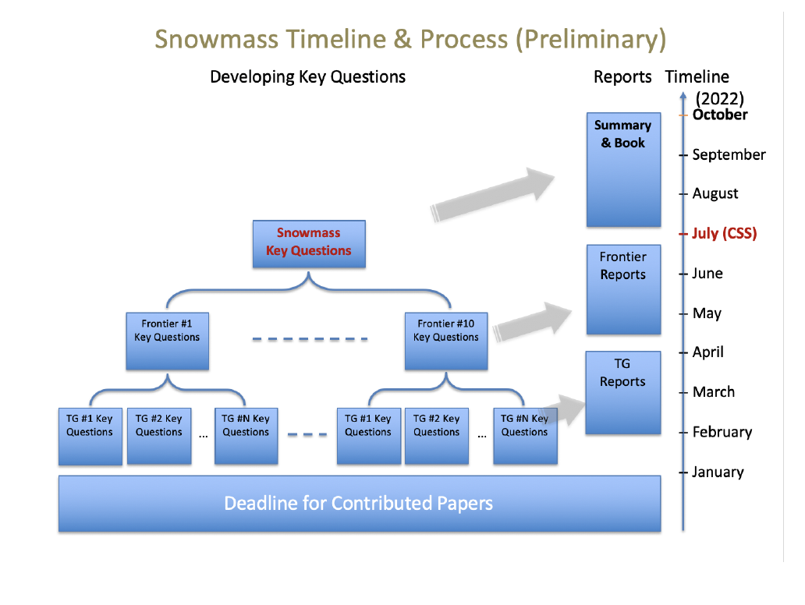
From Ketevi and Breese, 1.Apr.22

Slide 4
From Snowmass Organization
Dear Snowmass Enthusiasts!
We are extending the deadline for the updated Accessibility Survey an additional two weeks. If you haven’t done so already, please fill out the short survey below by April 15th. This anonymous survey is vitally important to the high energy community and its aggregated results will be included in the final version of Accessibility in High Energy Physics: Lessons from the Snowmass Process. The current version of the paper can be found on arXiv: https://arxiv.org/abs/2203.08748.
https://forms.gle/xBhtfxB4ye8rPuBi6

Slide 5
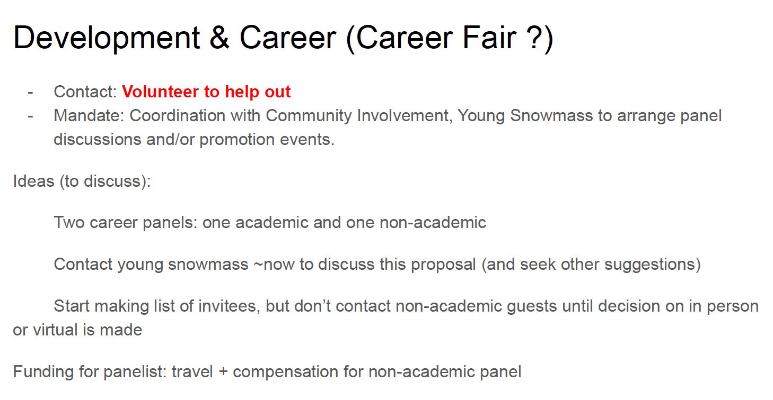
Following Slides from the Snowmass CSS Organizers – for Consideration

Slide 7
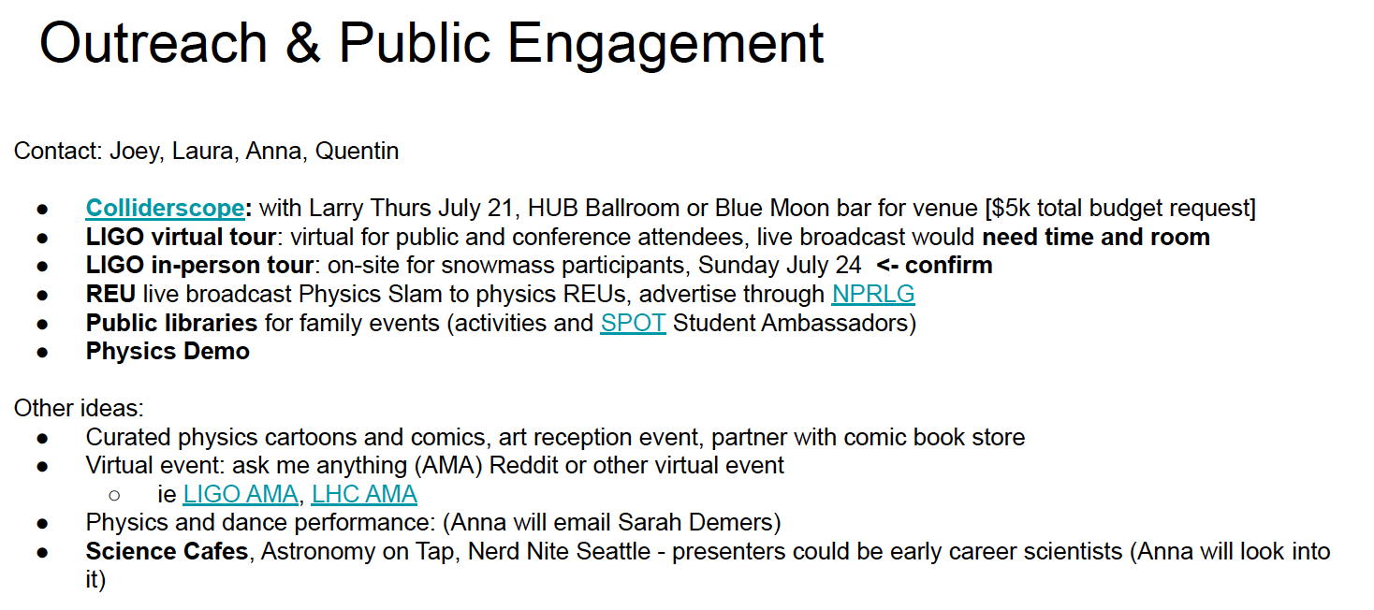

Slide 8
