Slide 1
Lab 6 Polystyrene Polymer Tests

Slide 2
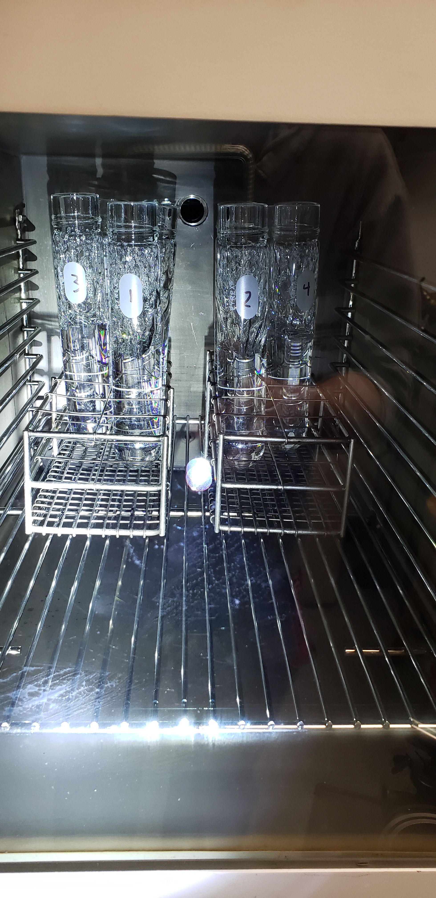
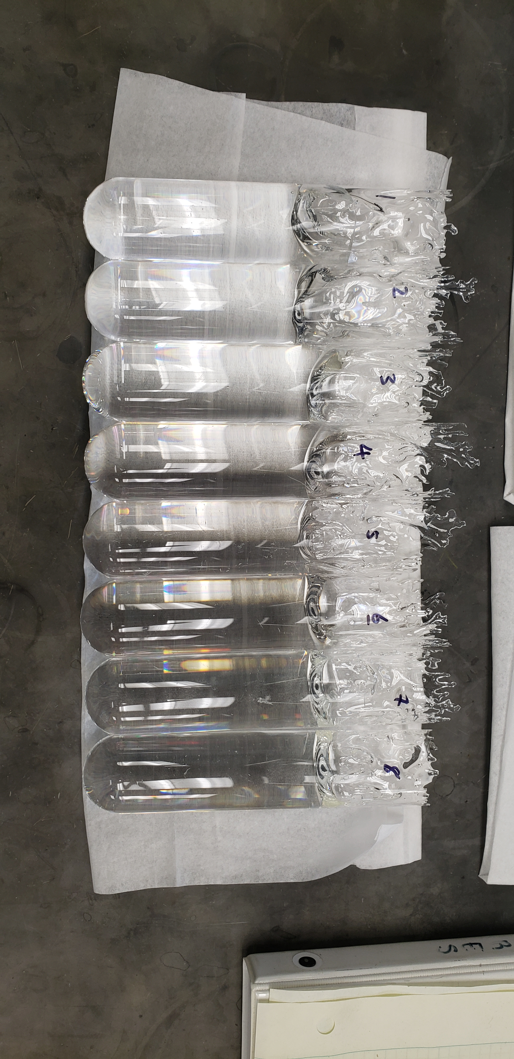
Oven Run PS Pellet Casting

Slide 3
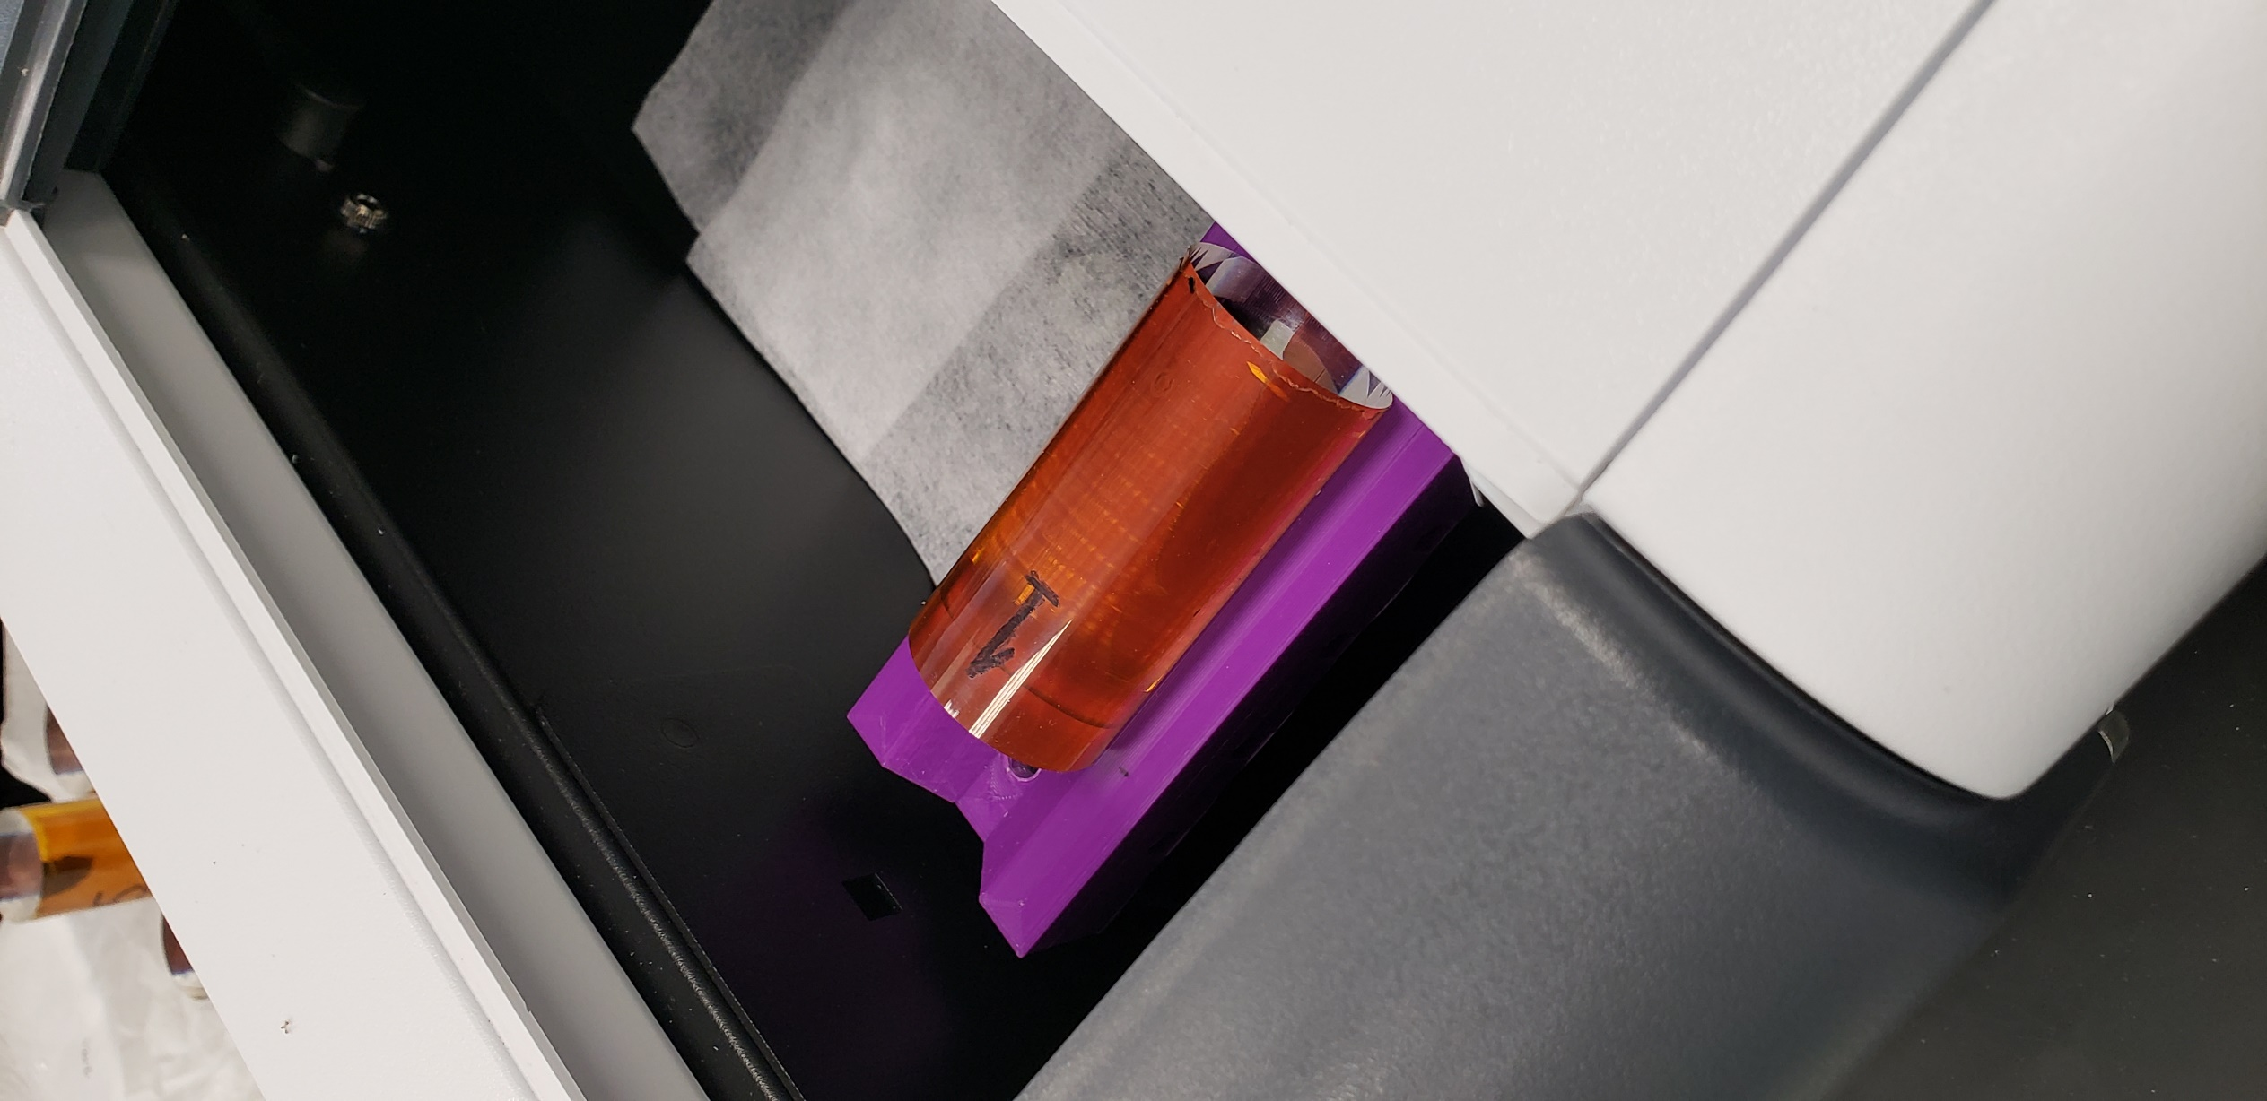
Oven Run Sample Measurements
Measurements performed using: Agilent Cary 60 UV-Vis Spectrophotometer

Slide 4
Sample Identification:
Sample #: Year (Month) - Gaylord Number/Total Gaylords in Purchase
Oven Run 2/22 |  |  |  |  | Batch/Lot #:
OR2-22_1 = 1: 2002 (Aug.) - Box 98 |  |  |  |  | QE13020522
OR2-22_2 = 2: 2003 (Mar.) - Box 48 |  |  |  |  | QE13020522
OR2-22_3 = 3: 2022 (Jan.) - Sample Drum |  |  |  |  | K1101HR101
OR2-22_4 = 4: 2022 (Jan.) - Sample Drum |  |  |  |  | K1101HR101
OR2-22_5 = 5: 2002 (Aug.) - Box 98 |  |  |  |  | QE13020522
OR2-22_6 = 6: 2003 (Mar.) - Box 48 |  |  |  |  | QE13020522
Oven Run 1/22 |  |  |  |  | Batch/Lot #:
OR1-22_4 = 4: 2008 (Sep.) - Gaylord 8/26 |  |  |  |  | WH19048L12
OR1-22_5 = 5: 2010 (Jun.) - Gaylord 10/27 |  |  |  |  | XG19048L11
OR1-22_6 = 6: 2013 (Aug.) - Gaylord 18/26 |  |  |  |  | 724809600
OR1-22_8 = 8: 2016 (Nov.) - Gaylord 7/26 |  |  |  |  | E1029HR101
OR1-22_11 = 11: 2018 (Nov.) - Gaylord 2/26 |  |  |  |  | G1014HR101
OR1-22_12 = 12: 2021 (Sept.) - Gaylord 1/25 |  |  |  |  | K0811HR101
*All samples made of pure PS pellets and cut/polished into 7cm lengths

Slide 6
Polystyrene %T over Time
 | %Transmittance
Wavelength: | 390nm | 405nm | 420nm | 450nm | 500nm
2002 | 61.76795 | 71.93742153 | 78.13495 | 85.35968 | 91.69676
2003 | 60.525 | 70.49690937 | 76.42775 | 83.55524 | 90.4177
2008 | 54.23589 | 70.17348616 | 80.58712 | 89.44572 | 94.48749
2010 | 63.27138 | 74.04961484 | 80.39898 | 87.02418 | 92.02607
2013 | 65.41401 | 78.00700388 | 84.8095 | 90.80903 | 94.82824
2016 | 63.65202 | 77.45036239 | 85.10389 | 91.4707 | 95.31595
2018 | 65.13605 | 76.32921728 | 82.9106 | 89.1824 | 93.57134
2021 | 52.94145 | 67.08357431 | 75.12062 | 82.70656 | 88.20972
2022 | 50.40762 | 64.77253229 | 73.84831 | 82.05732 | 87.74345

Slide 9
Polystyrene %T for Various Lots (“Greying”)

Slide 10
Upcoming Testing:
Polystyrene Reference from Monomer (Polymerization Run)
INEOS PS Pellets (PS 1200 & PS 153F)

