Slide 1
Accelerator Frontier Outlook on Dark Sector Searches
Jeffrey Eldred
Accelerator-based Dark Sector Searches Agora
April 22nd 2021

Slide 2
2
Talk Structure
Intense Proton Rings
- LANL PSR
- ORNL SNS
- FNAL Proposed PAR
- FNAL Proposed RCS
- ESS Proposed ESSnuSB AR
Proton Slow-spill
- FNAL Main Injector, PIP-II Linac
Colliders
- CERN LHC
- KEK Belle II
Electron Searches
- SLAC LCLS-II
- JLAB CEBAF HPS
2
Jeffrey Eldred | Accelerator Frontier & Dark Sector Searches
Notes:
2
2
2

Slide 3
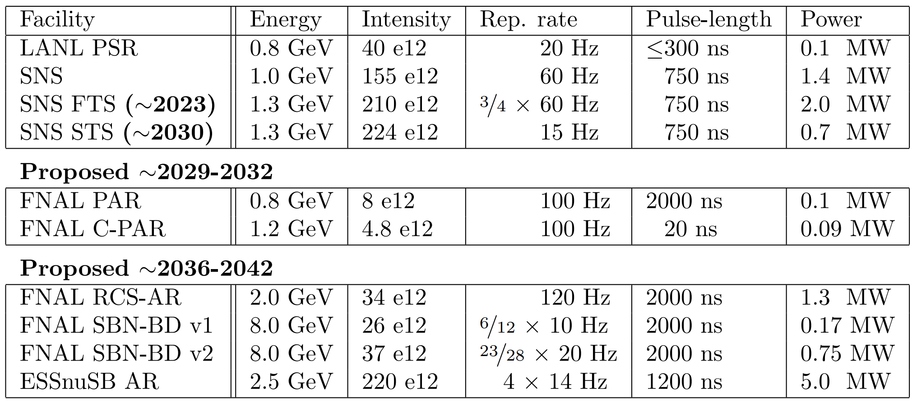
3
Proton Source Comparison
3
Jeffrey Eldred | Accelerator Frontier & Dark Sector Searches
Notes:
3
3
3

Slide 4
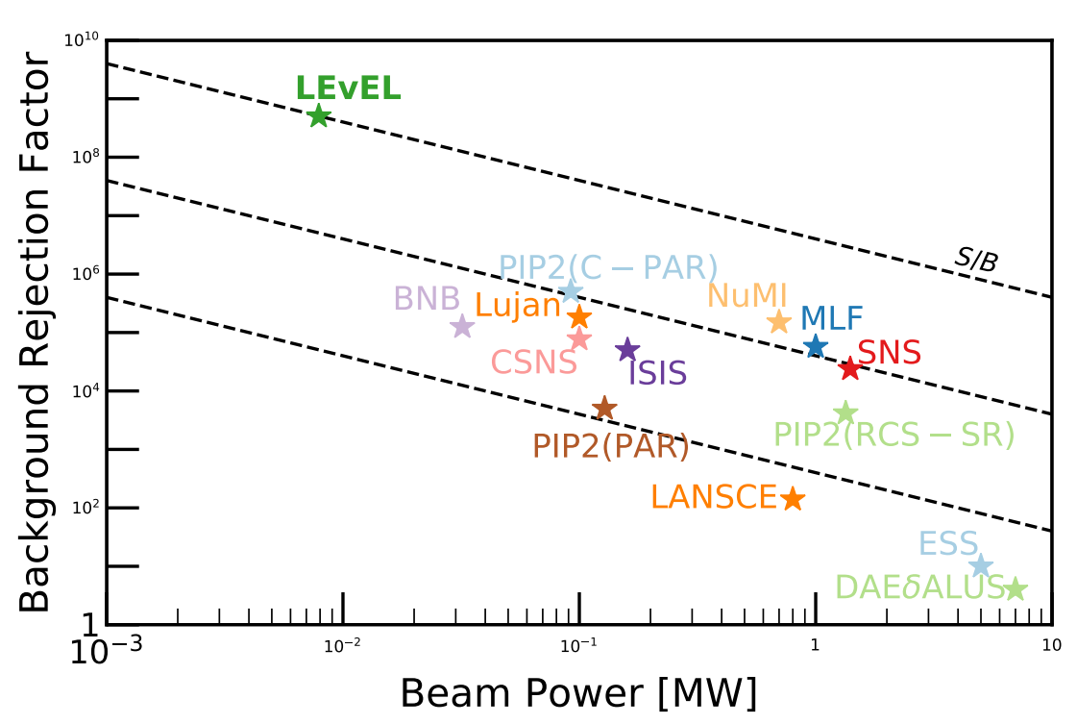
4
Proton Source Quality Chart
4
Jeffrey Eldred | Accelerator Frontier & Dark Sector Searches
Notes:
4
4
4

Slide 5
5
Proton Source Quality Chart
5
Jeffrey Eldred | Accelerator Frontier & Dark Sector Searches
Notes:
5
5
5

Slide 6
6
LANL PSR
Upgrade of PSR Snowmass white paper,
for Coherent CAPTAIN Mills (CCM) experiment.
LANL PSR Capabilities
- 40e12 protons in 300ns pulses every 20Hz (100kW at 0.8 GeV).
PSR with Short-Pulse Upgrade
- Aims for sub-100ns pulses, possible 30ns pulses.
- Synergy with PSR neutron resonance experiments.
- Pulse stacking with 2nd harmonic cavities to flatten RF-wave.
- Manage impedances and electron-cloud instabilities with ferrites, transverse and longitudinal feedback systems.
6
Jeffrey Eldred | Accelerator Frontier & Dark Sector Searches
Notes:
6
6
6

Slide 7
7
ORNL SNS
SNS Proton Power Upgrade (PPU) CDR.
COHERENT Snowmass white paper.
SNS Capabilities
- 155e12 protons in 750ns pulses every 60Hz (1.4 MW at 0.97 GeV).
SNS with Proton Power Upgrade (PPU) ~2023
- First Target Station (FTS) ~2023: thermal n from liquid-Hg target
210e12 protons in 750ns pulses every 3/4x60Hz (2.0 MW at 1.3 GeV).
- Second Target Station (STS) ~2030: cold n from rotating-W target
224e12 protons in 750ns pulses every 15Hz (0.7 MW at 1.3 GeV).
7
Jeffrey Eldred | Accelerator Frontier & Dark Sector Searches
Notes:
7
7
7

Slide 8
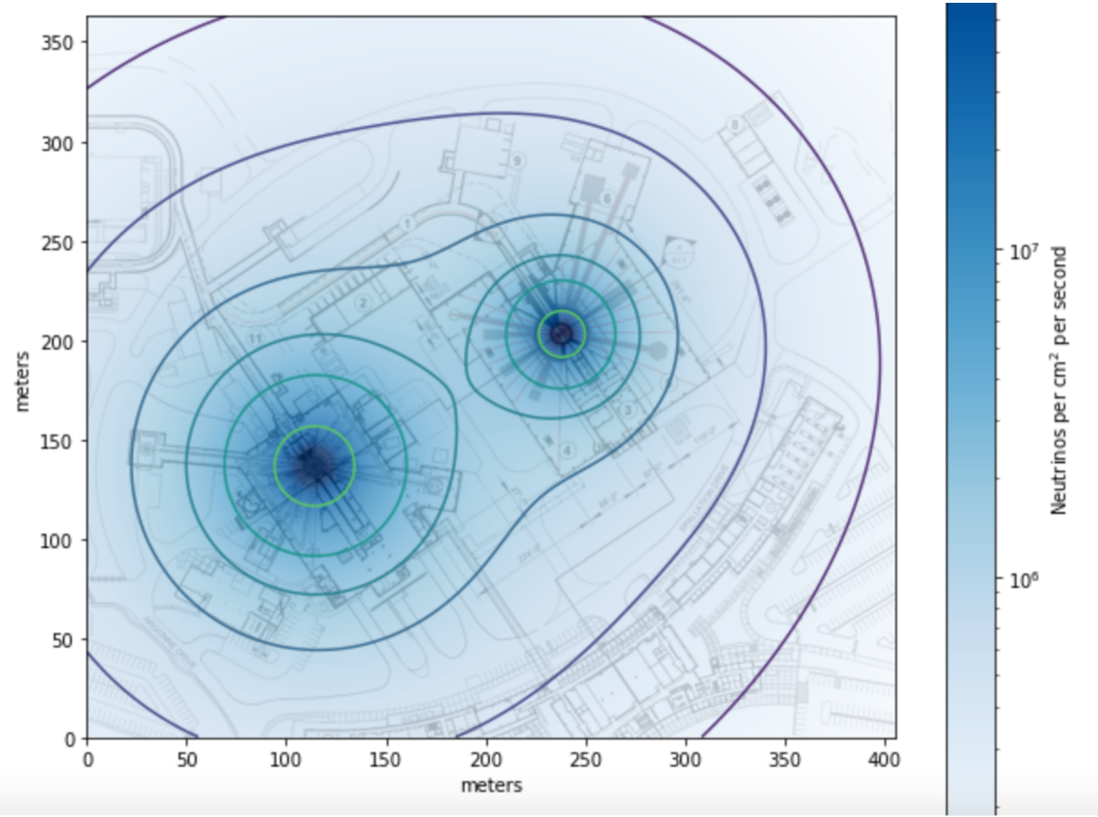
8
FTS vs STS Locations (neutrinos)
8
Jeffrey Eldred | Accelerator Frontier & Dark Sector Searches
Notes:
8
8
8

Slide 9
9
Fermilab PIP-II Outlook
Fermilab Proton Improvement Plan II (PIP-II) Upgrade CDR.
PIP2 Beam Dump (PIP2BD) Snowmass white paper.
PIP-II Linac Capabilities ~2029
- 2mA CW-capable at 0.8 GeV (94-99% of 1.6MW unsubscribed)
(Proposed) PIP-II Accumulator Ring (PAR)
- - 0.8 GeV, 474m ring to facilitate injection into the Booster and to host PIP2-BD experimental program.
- PIP2-BD: 8e12 protons in 2000ns pulses every 100Hz
(0.1 MW at 0.8 GeV).
- With pulse compression: ~4e12 protons in 500ns pulses every 100Hz
(0.05 MW at 0.8 GeV).
- see Pellico et al. Snowmass white paper for preliminary ring design.
9
Jeffrey Eldred | Accelerator Frontier & Dark Sector Searches
Notes:
9
9
9

Slide 10
10
Fermilab PIP-II Outlook
PIP2 Beam Dump (PIP2BD) Snowmass white paper.
… or (Proposed) Compact PAR (C-PAR)
- 100m ring, better optimized for experimental program.
- Would (likely) not help with Booster injection.
- Sited to be compatible with a 1.2 GeV injection.
- Compact ring capable of high rep. rate compatible with requirements for a proposed PRISM-like CFLV. See Prebys et al. and Aoki et al..
- PIP2-BD mode: 4.8e12 protons in 20ns pulses every 100Hz
(0.09 MW at 1.2 GeV).
- CLFV mode: 0.9e12 protons in 20ns pulses every 800Hz
(0.14 MW at 1.2 GeV).
10
Jeffrey Eldred | Accelerator Frontier & Dark Sector Searches
Notes:
10
10
10

Slide 11
11
C-PAR Pulse Schemes
PIP2-BD mode:
4-bunch merge and
100 Hz extraction
Four 1.2e12 bunches
consecutive RF buckets
100 Hz fill
CLFV mode:
800 Hz single-bunch extraction
Eight 0.9e12 bunches
every other RF bucket
100 Hz fill
11
Jeffrey Eldred | Accelerator Frontier & Dark Sector Searches
Notes:
11
11
11

Slide 12
12
Fermilab RCS (Proposed)
2.4 MW RCS upgrade white papers, summary of two versions 1 2.
(Proposed) 2.4 MW RCS Upgrade for DUNE/LBNF ~2038
- A ~2 GeV upgrade of PIP-II Linac.
- New ~550m rapid-cycling synchrotron (RCS) to replace Booster ring and provide 26-37e12 protons every 10-20 Hz at 8 GeV.
Possible Accumulator Ring & Experimental Program
- A 2 GeV ~550m AR is required by some RCS upgrade scenarios and may be beneficial for other RCS scenarios.
- If H- laser-stripping technology can be developed, this AR could operate a high-power experimental program simultaneously.
- DM mode: ~34e12 protons in 2000ns pulses every ~120Hz (1.3 MW).
8-GeV Dark Sector Searches
- The 2.4 MW RCS upgrade would provide 170-750 kW at 8 GeV.
- The dominant factor in beam power is the RCS ramp rate.
- SBN-BD white paper Toups et al.
12
Jeffrey Eldred | Accelerator Frontier & Dark Sector Searches
Notes:
12
12
12

Slide 13
13
ESS nuSB Accumulator Ring (Proposed)
ESSnuSB Snowmass white paper.
ESS Status & Comissioning paper N. Milas et al.
ESS Linac ~2026:
62.5 mA for 2.86ms every 14Hz (2.0 MW at 0.8 GeV).
ESS Linac at Full Power:
62.5 mA for 2.86ms every 14Hz (5.0 MW at 2.0 GeV).
(Proposed) ESSnuSB Accumulator Ring ~2037
- Upgrade to 2.5 GeV & 10MW, with 14 Hz H- interleaved with 14 Hz p+.
- ESSnuSB AR is 380m ring which extracts four 1.2us pulses separated by 0.9ms every 72ms, dividing the pulses across four neutrino targets/horns.
- ESSnuSB: 220e12 protons in 1.2us pulses every 4x14Hz
(5.0 MW at 2.5 GeV).
ESSnuSB white paper discusses subsequent a 2ns proton compressor ring, to serve as a proton driver for a future muon collider program.
13
Jeffrey Eldred | Accelerator Frontier & Dark Sector Searches
Notes:
13
13
13

Slide 14
14
Proton Dark Matter Searches
Common Themes in Intense Proton Facilities
- High power H- injection, foils -> lasers.
- Intense space-charge - compact, GeV-scale, large aperture rings.
- Pulse compression schemes, longitudinal manipulation.
- Kickers with high rep. rate extraction, fast rise time.
- Service to multiple experimental programs.
FNAL is deciding on it’s future experimental program
14
Jeffrey Eldred | Accelerator Frontier & Dark Sector Searches
Notes:
14
14
14

Slide 15
15
FNAL Slow Spill Protons
DarkQuest Snowmass white paper.
Main Injector Slow Spill
- 8e12 protons at 120 GeV, over six seconds, once a minute.
- Limited by particle loss rates during 2nd-order resonant extraction.
REDTOP paper Gatto et al.
PIP-II Linac Capabilities ~2029
- 2mA CW-capable at 0.8 GeV
- REDTOP Run-II, tagged η
Upgraded PIP-II Linac Capabilities ~2038
- 2mA CW-capable at 2.0 GeV
- REDTOP Run-III, tagged η’
15
Jeffrey Eldred | Accelerator Frontier & Dark Sector Searches
Notes:
15
15
15

Slide 16
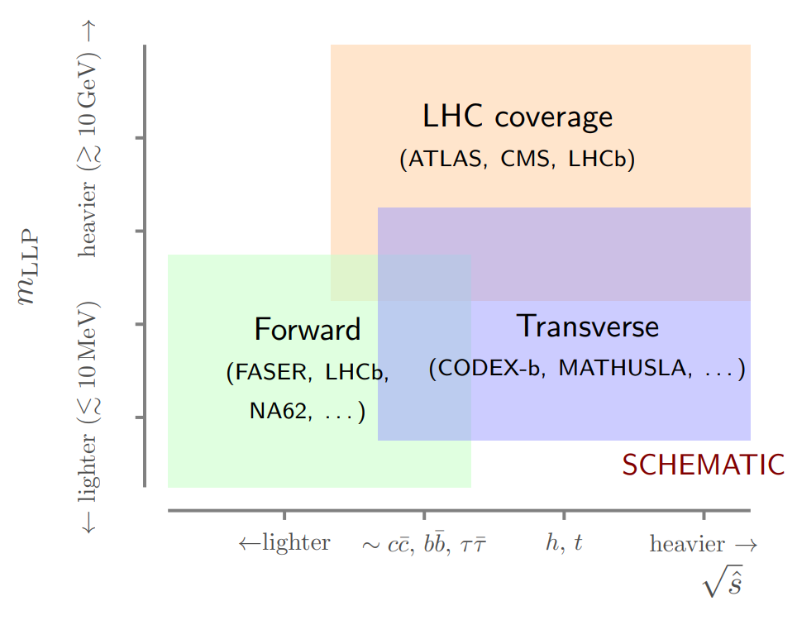
16
CERN LHC
Forward Facility at HL-LHC Snowmass white paper.
CODEX-b Snowmass white paper.
LHC-b Dark Sector Snowmass white paper.
LEvEL at LHC Beam Dump, K. Kelly et al.
16
Jeffrey Eldred | Accelerator Frontier & Dark Sector Searches
Notes:
16
16
16

Slide 17
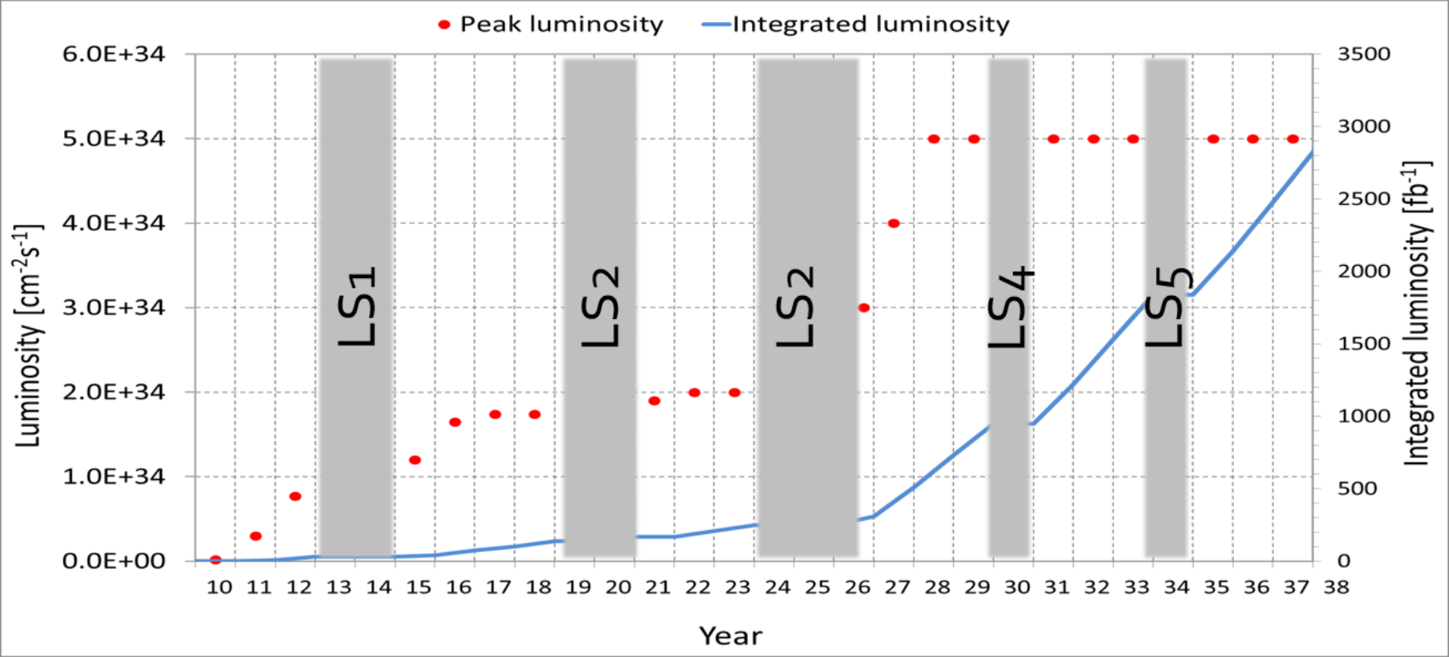
17
CERN LHC
Forward Facility at HL-LHC Snowmass white paper.
CODEX-b Snowmass white paper.
LHC-b Dark Sector Snowmass white paper.
LHC capabilities
- 2.06e34 cm⁻²s⁻¹ instantaneous luminosity circular p⁺ p⁺ collider.
- 13 TeV center of mass energy (6.5+6.5 Gev) symmetric collision.
- also supports ion-ion collisions.
HL-LHC:
- crab cavities
- Nb3Sn quads
- bunch spacing
- detector upgrades
- B. Schmidt
FCC Snowmass white paper
17
Jeffrey Eldred | Accelerator Frontier & Dark Sector Searches
Notes:
17
17
17

Slide 18
18
KEK Belle II
Belle-II GAZELLE Snowmass white paper.
Belle II Capabilities
- 2.4e34 cm⁻²s⁻¹ instantaneous luminosity circular e⁺ e⁻ collider.
- 10.58 GeV center of mass energy (4+7 Gev) asymmetric collision.
Proposed Polarization Upgrade Snowmass white paper.
18
Jeffrey Eldred | Accelerator Frontier & Dark Sector Searches
Notes:
18
18
18

Slide 19
19
JLAB CEBAF HPS & APEX
HPS Snowmass white paper.
Physics with CEBAF paper J. Arrington et al.
LERF Capabilities
- Up to 135pC at 74.85 MHz CW, 0.17 GeV electrons, up to ~1.7 MW.
DarkLight experiment
CEBAF Capabilities
- Up to 1.3pC at 249.5 MHz CW, 1-11 GeV electrons, up to 1 MW.
- up to 85% polarization.
- APEX experiment in Hall A.
- HPS experiment in Hall B.
Experiments need runtime, looking at target & detector improvements.
HPS:
19
Jeffrey Eldred | Accelerator Frontier & Dark Sector Searches
Notes:
19
19
19

Slide 20
20
SLAC LCLS-II
LDMX Snowmass white paper.
LCLS-II capabilities
Cu Linac (now): 180pC at 120 Hz, 15 GeV electrons.
SC Linac (comissioning): 100pC at 1 MHz, 4 GeV electrons.
- LDMX at SLAC LCLS-II SC Linac or JLAB CEBAF.
LCLS-II-HE
- Extend SC Linac to provide 8 GeV electrons
(PEP-II / BaBar no longer operational.)
20
Jeffrey Eldred | Accelerator Frontier & Dark Sector Searches
Notes:
20
20
20

Slide 21
21
Final Thoughts
Common Themes in Proton Facilities
- High power H- injection, foils -> lasers.
- Intense space-charge - compact, GeV-scale, large aperture rings.
- Pulse compression schemes, longitudinal manipulation.
- Kickers with high rep. rate extraction, fast rise time.
- Service to multiple experimental programs.
Slow-extraction, Electron Machines & Colliders
- Experiment beamtime and real estate.
- Accelerator performance. Rep. rate, luminosity, energy, polarization.
- Design of Dark Sector targets and detectors.
Consider also future colliders such as FCC and ILC.
21
Jeffrey Eldred | Accelerator Frontier & Dark Sector Searches
Notes:
21
21
21

