Slide 1
Engineering at Fermilab
Paul C. Czarapata
July 26, 2022

Slide 2
A little about me -
Electronic Engineer
I have been at the laboratory for almost 50 years!
I have two jobs;
  Associate Division Head in the Accelerator Division
  Deputy Chief Engineer for Fermilab.
A Very Important Definition for you:
  An Engineer is a person who solves problems you didn’t know you had in ways you can’t understand!
I hope you are up to date with your prefixes. Micro, nano, etc.

Slide 3
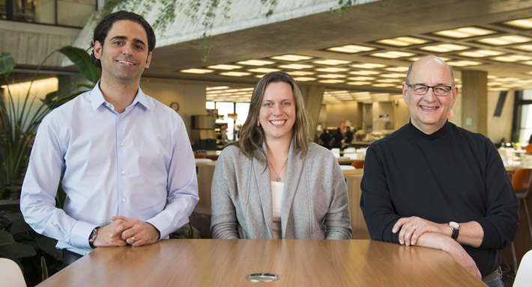
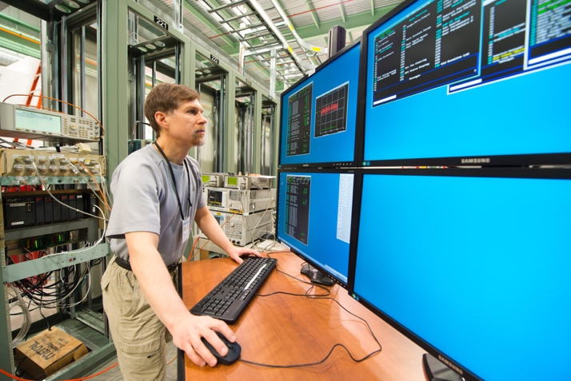
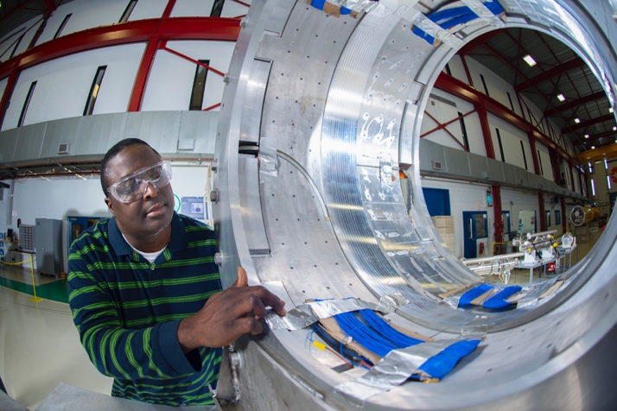
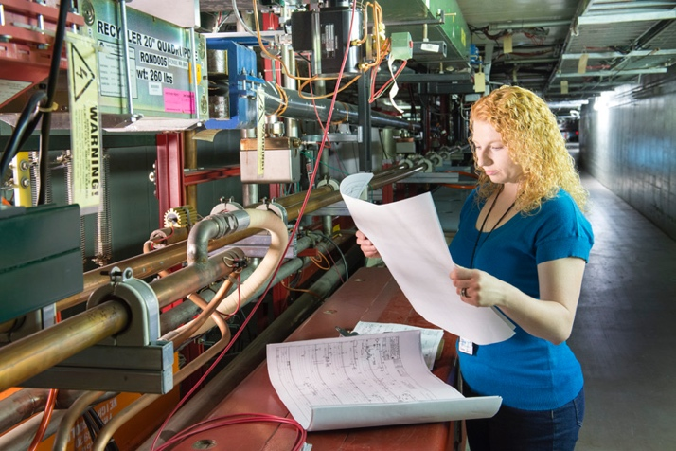
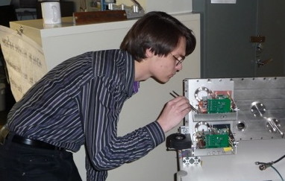
Who are the engineers?
Part of a team that also includes scientists, technicians, drafters, contractors
~ 270 engineers (~15% of lab employees)
  Civil Engineers
  Electrical Engineers
  Mechanical Engineers
  Quality Engineers
  Computer engineers / professionals

Slide 4
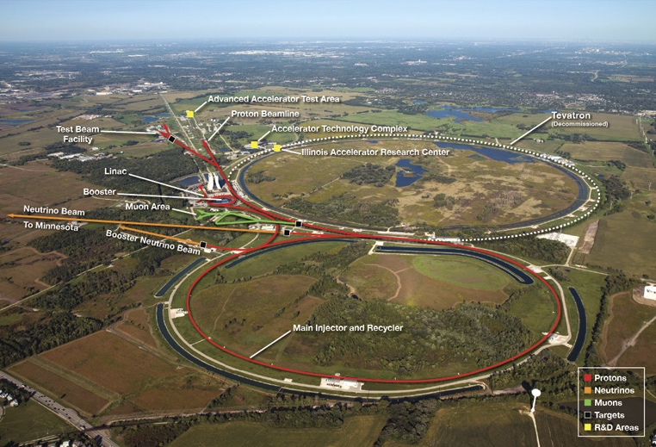
Where do we work? Main Campus – Batavia, IL

Slide 5
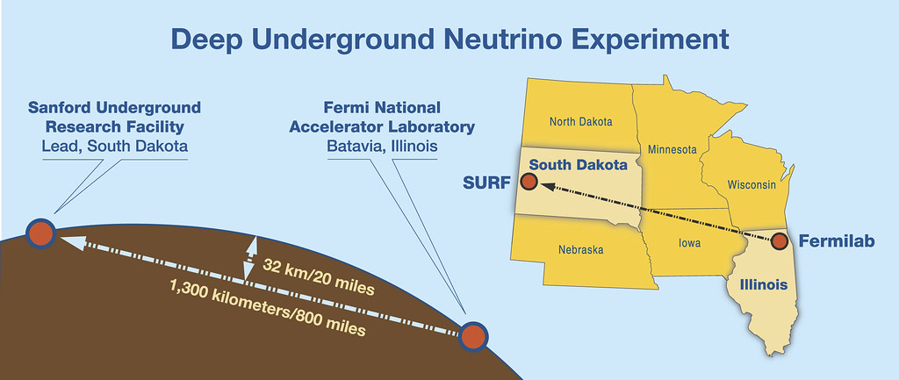
DUNE at LBNF

Slide 6
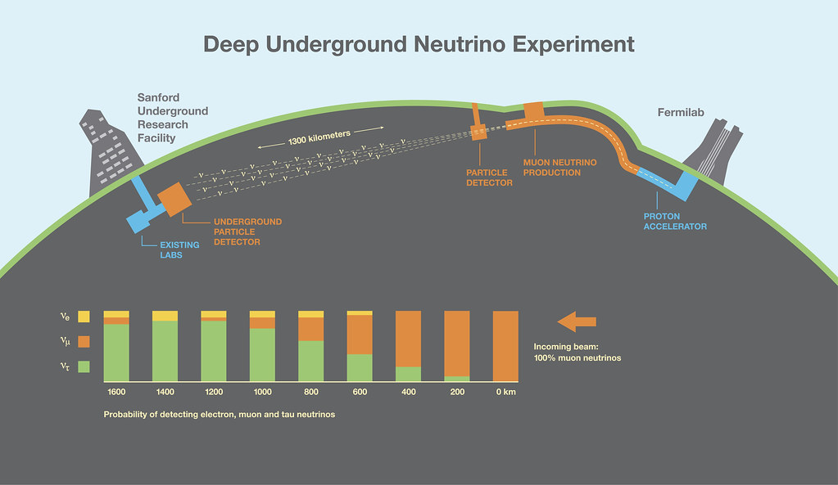
Flagship Experiment

Slide 7
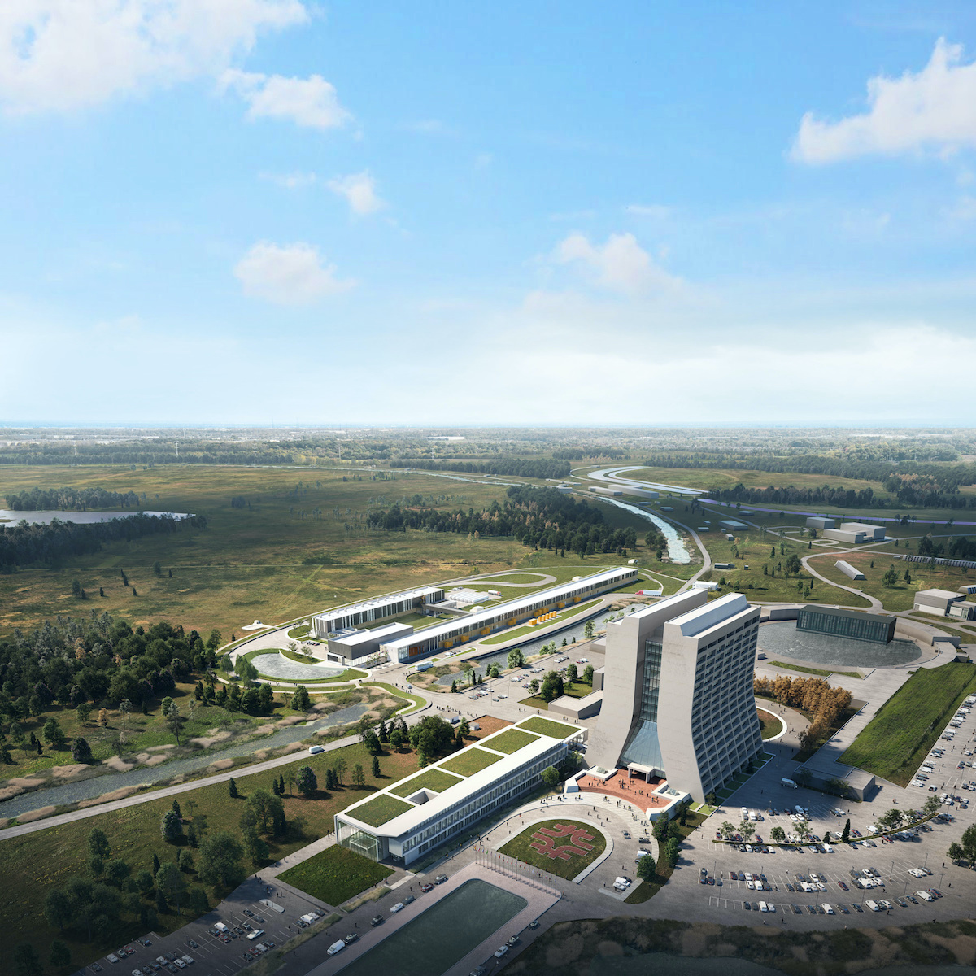
PIP-II Accelerator complex

Slide 8
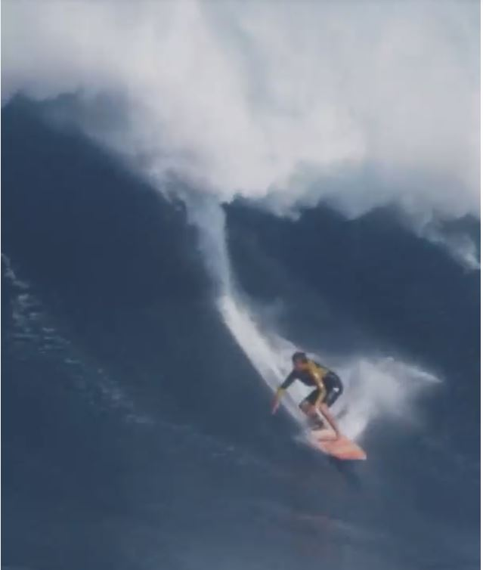
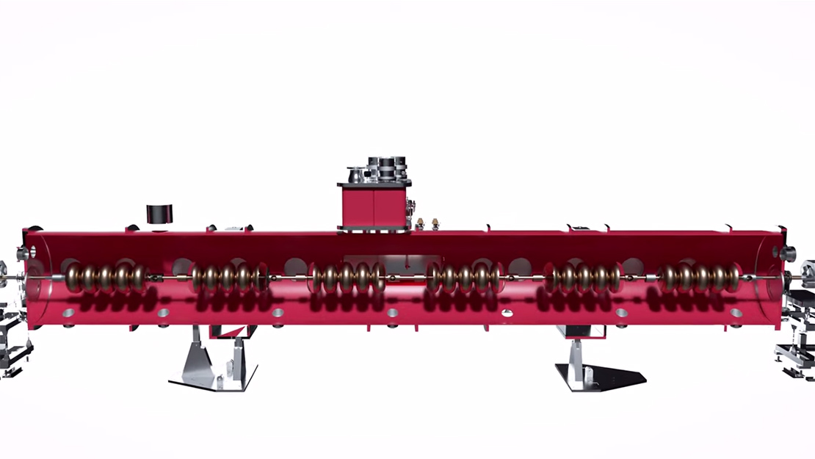
PIP-II Cryogenics Module
Magnets DO NOT accelerate the beam; RF waves do the acceleration.
Need precise frequency and phase control.

Slide 9
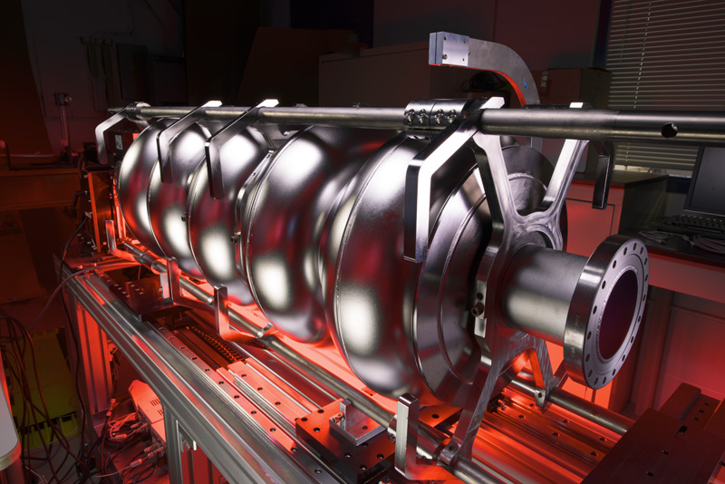
PIP-II Cavities
Cooled to liquid Helium temperatures

Slide 10
Up Next – A sampling of our work
Power electronics
  Designed to power the magnets that steer the beams
Instrumentation
  Allows us to see the beams. Location and profiles.
Target Systems
  Allows us to produce particles to study

Slide 11
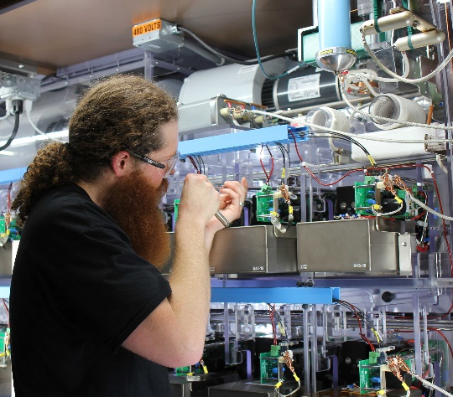
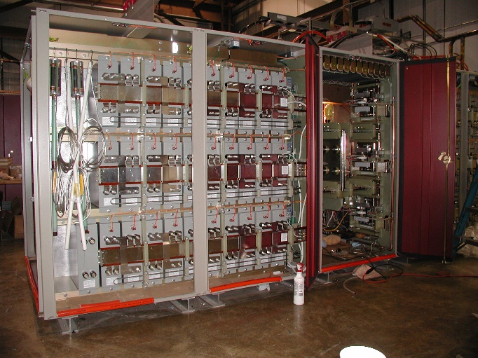
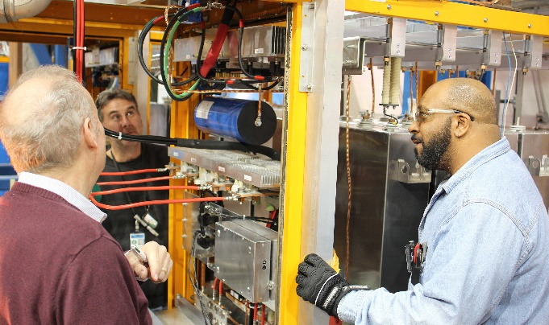
AD/EE Support – Power Supplies from DC to ns, W to MW
Marx Modulator provides a 30 kV, 300 A,
200 us wide pulse 15 times a second to the RF amplifier tube to accelerate beam
PIP II Chopper provides 500 V, 2 ns rise and fall time arbitrary pulse pattern at 38 MHz repetition rate to deflect beam
NuMI horn ps provides 700 V, 200 kA, 2 ms wide pulse every 1.33 seconds to focus beam
Pbar lens provided 1 kV, 25 kA, 400 us wide pulse 8 times in 80 ms to drive focusing and collecting lens after target

Slide 12
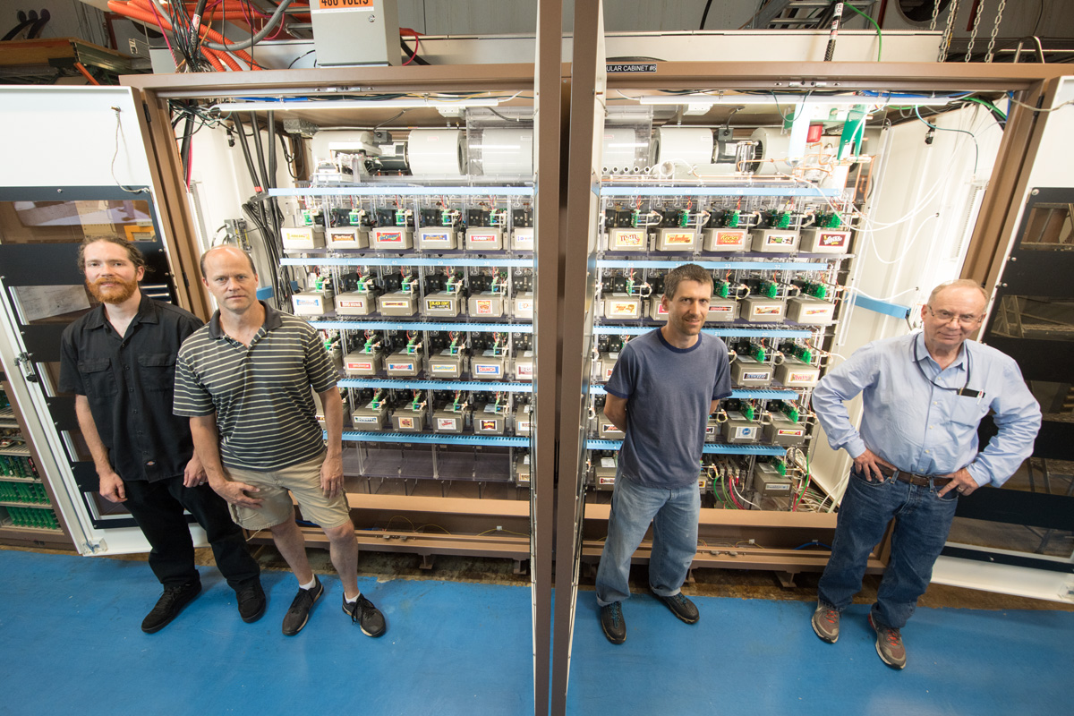
Marx Modulator

Slide 13
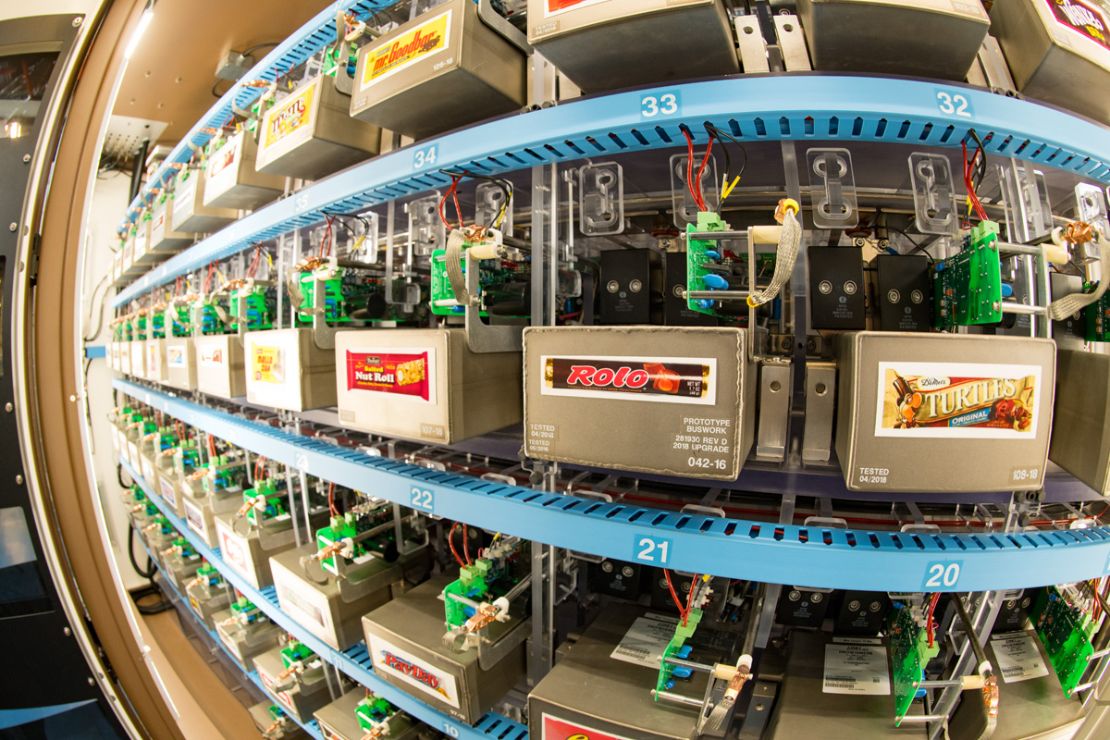
A little humor – the “vending machine”

Slide 14
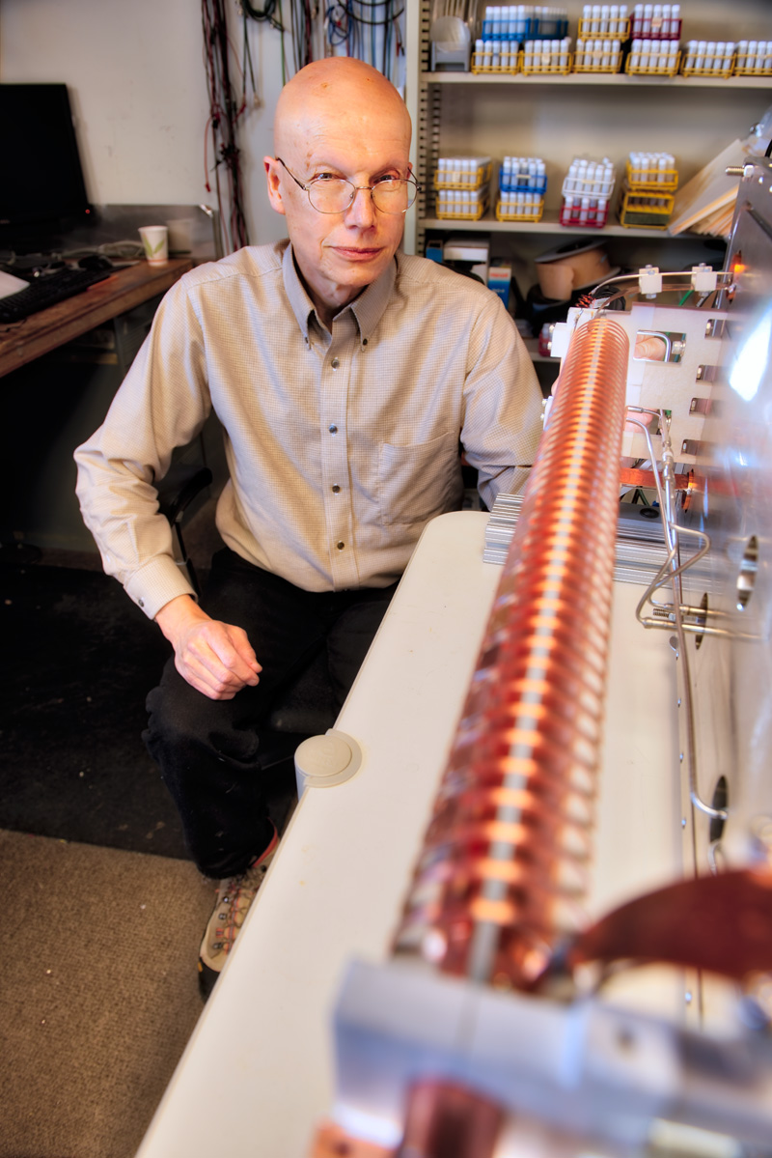
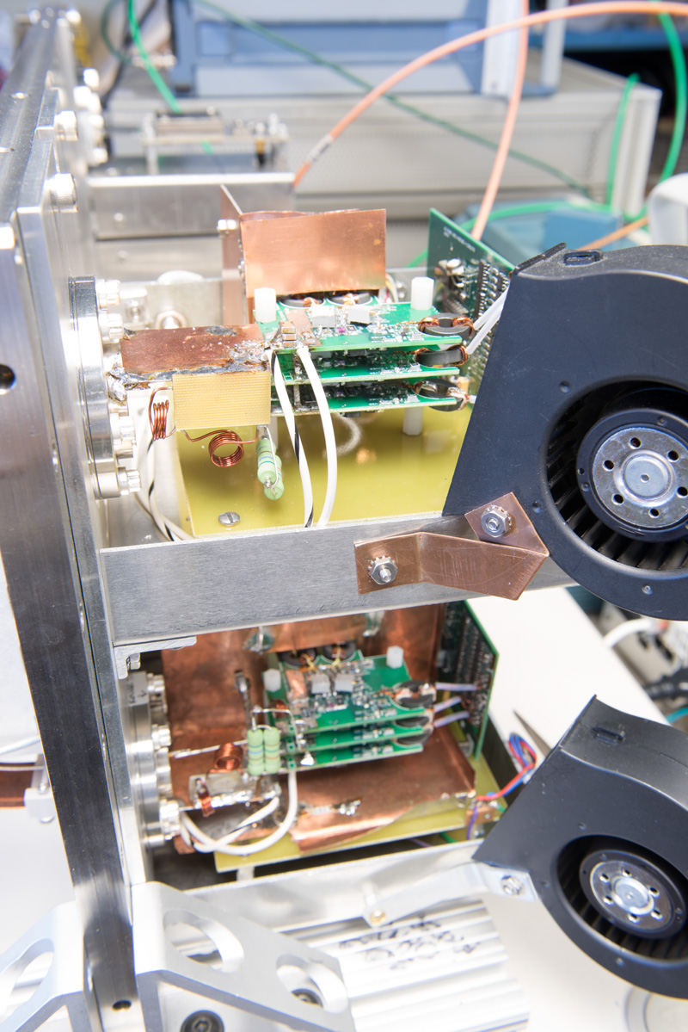
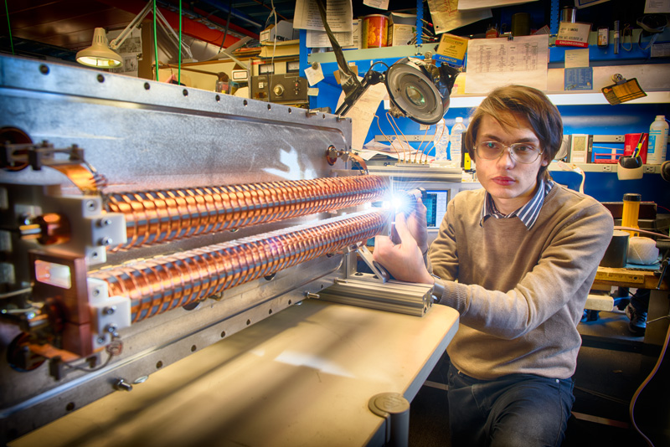
PIPII Beam Chopper
Provides 500 V, 2 ns rise and fall time arbitrary pulse pattern at 38 MHz repetition rate to deflect beam

Slide 15
NuMI Horn Power Supply
700 V, 200 kA, 2 ms wide pulse every 1.33 seconds to focus beam

Slide 16
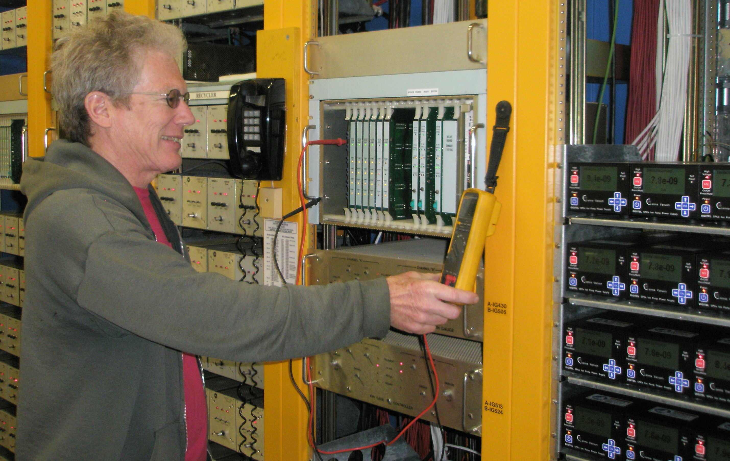
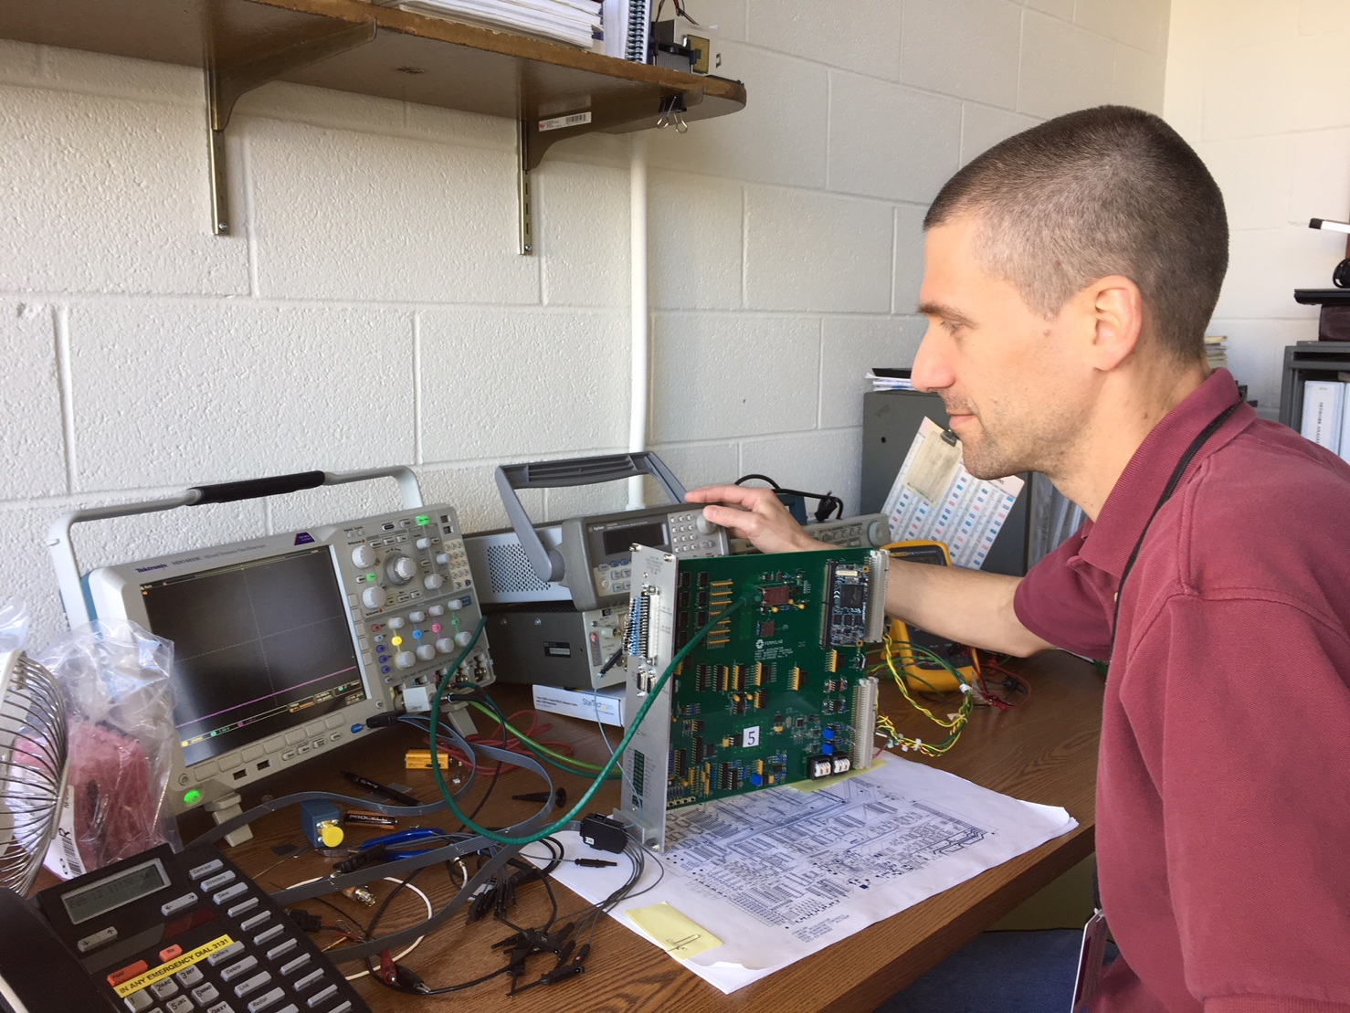
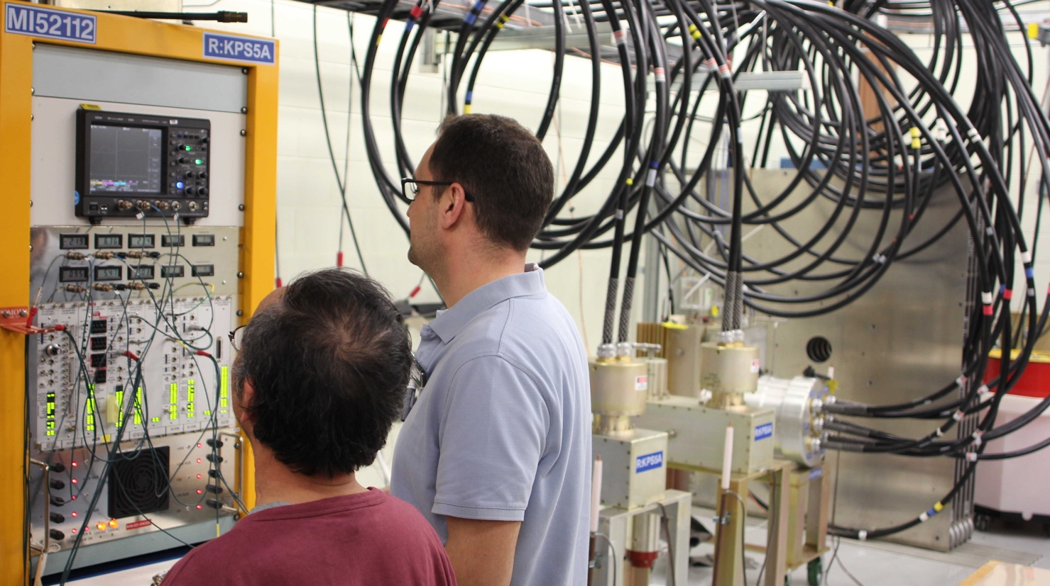
Power Supply Control
Control of large number of power supplies for vacuum systems
Control of 52 switches in a Marx modulator providing a precision pulse amplitude
Control of fast high voltage switches with 1 ns stability

Slide 17
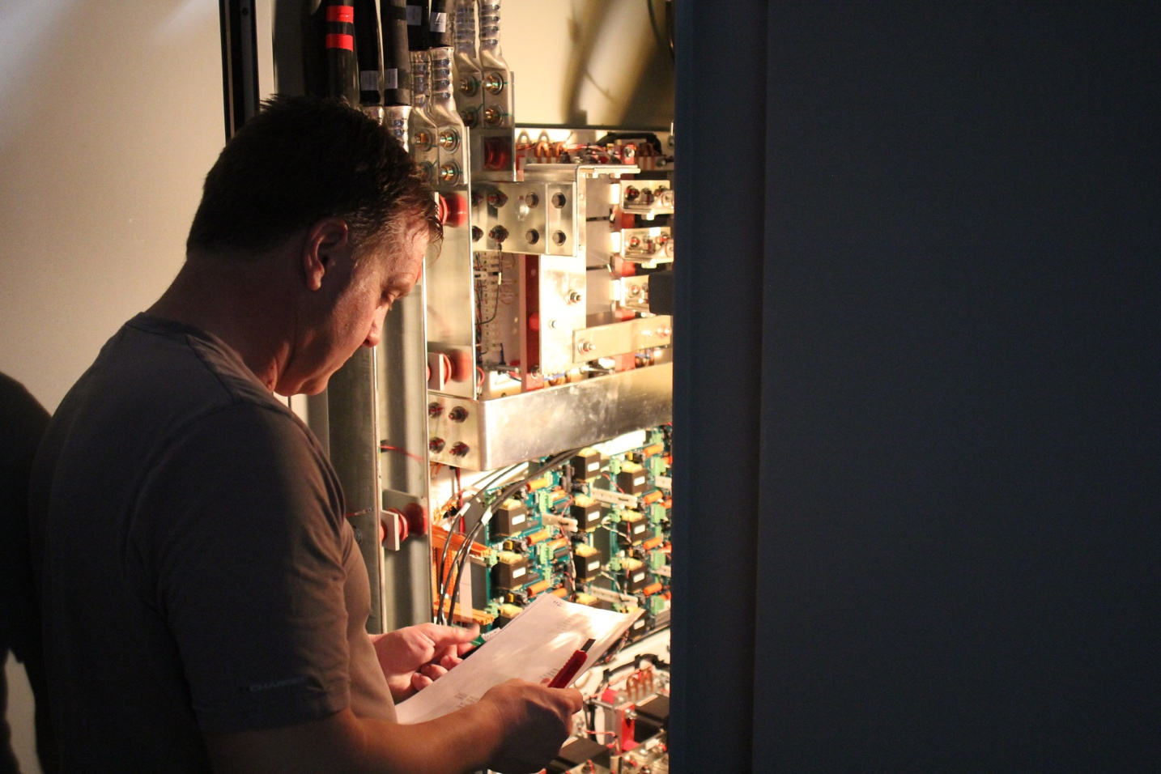
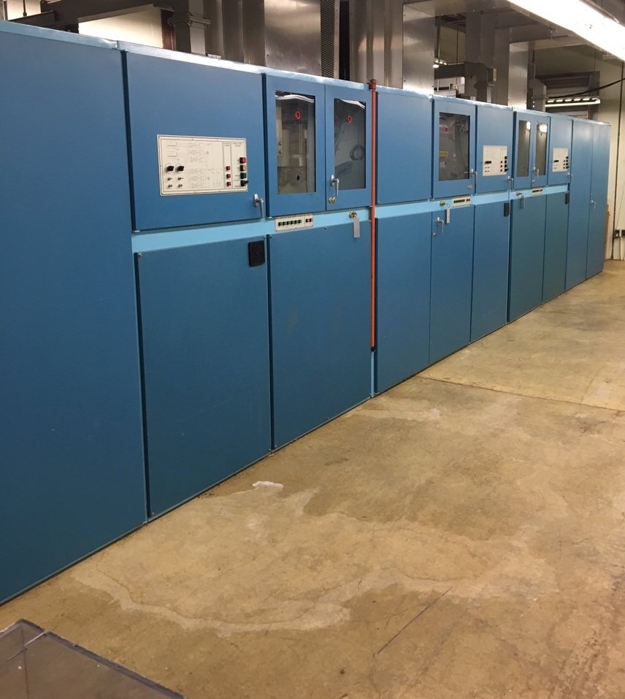
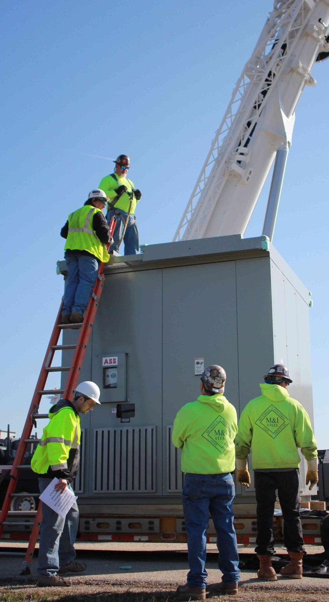
High Power Ramped Supplies
Design and specify power supplies from Watts to MegaWatts to bend and focus particle beams.
140 V, 1000 A supply (above), a 1000 V, 10000A supply (center) and a high-power transformer
Regulation of these power supplies at the 100 ppm level over different operating conditions including changes in loads, tracking a ramped reference and a changing power line.

Slide 18
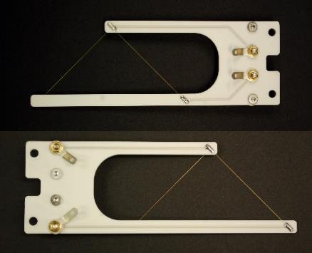
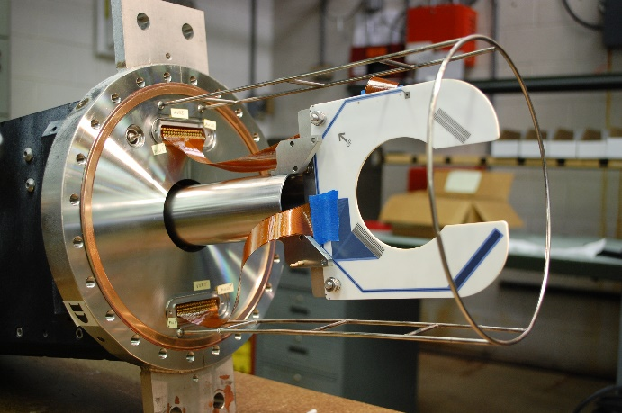
Instrumentation - Multiwire SEM Profile Monitors
UT/Austin Multiwire Rebuild
Retired multiwire detectors outfitted with new ceramic wireplanes, motors and controls for use in Mu2e beamlines.
At a small fraction of the cost of construction for new detectors saving more than $150K in detector costs.
New Design Crawling Wire for PIP2-IT
Ceramic wireplane frame design and assembly for crawling wire
Additional Projects
Ceramic wireplanes custom designed for JPARK in Japan.
Custom designs for Finland laboratory.

Slide 19
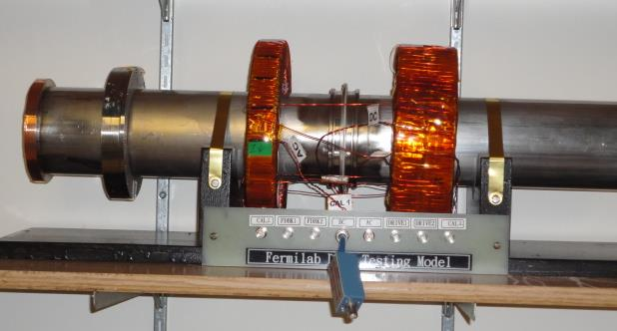
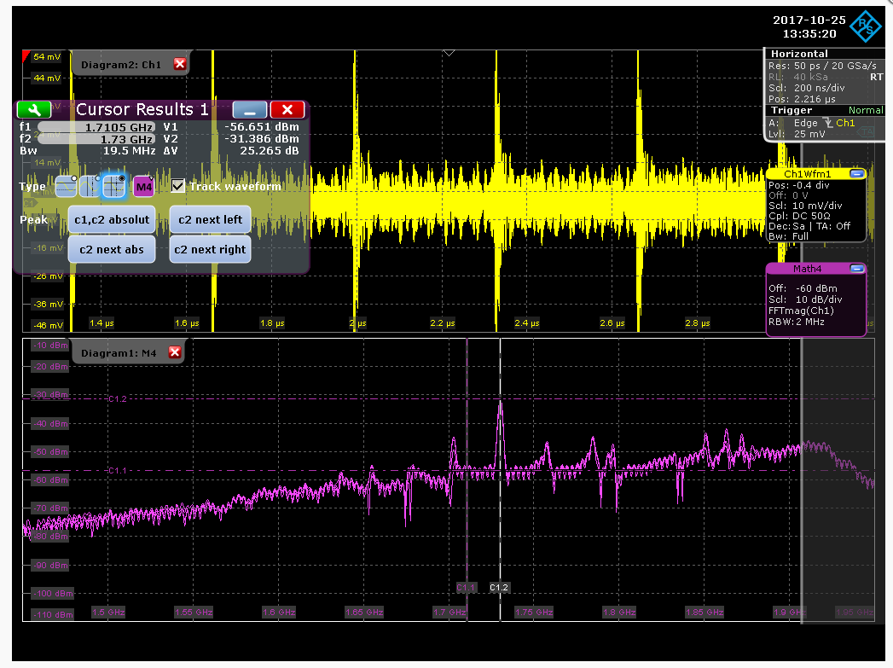
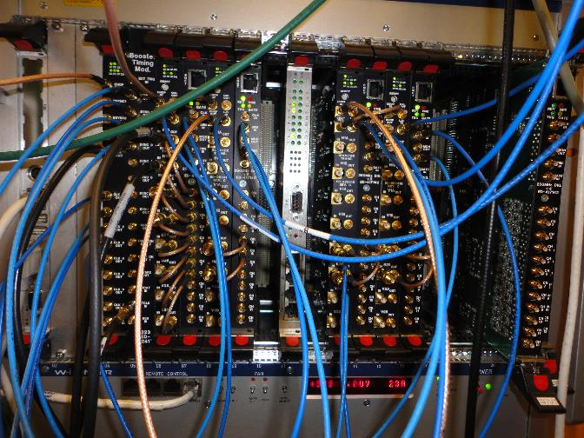
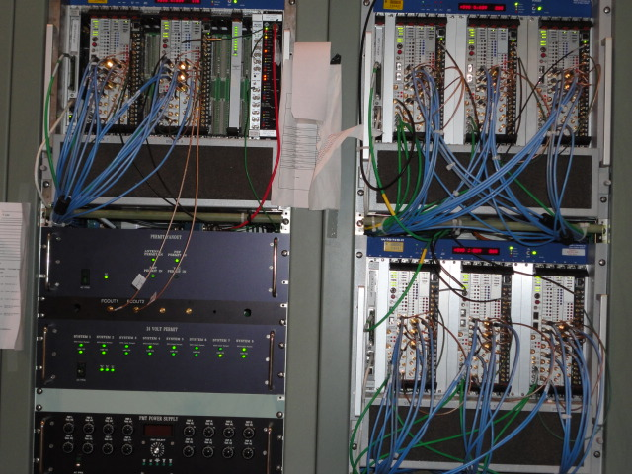
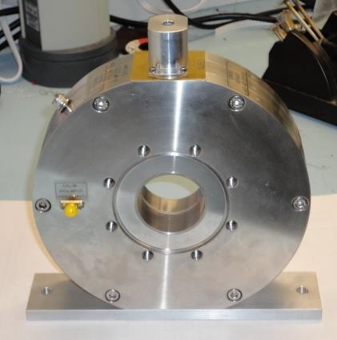
Measurement of Beam for precise control.
DCCT Test setup to implement Digital Feedback DCCT in RR
HOM Coupler Measurements at FAST resolved 1.71 GHz Mode
New Booster BPM timing and digitizers installed
RF Interlocks at LCLS-II
Beam Pickup for FAST Beam

Slide 20
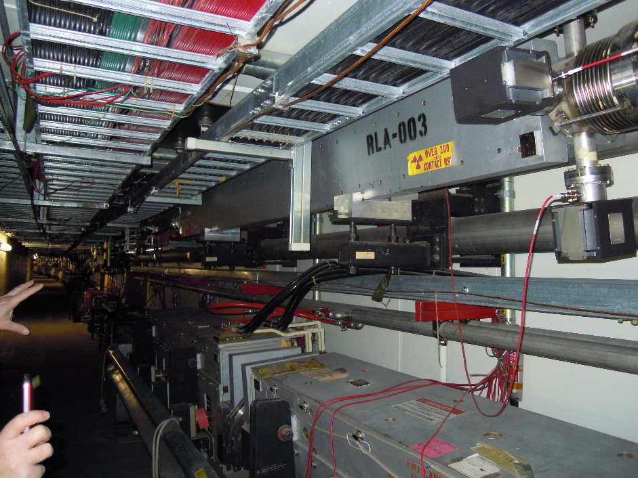
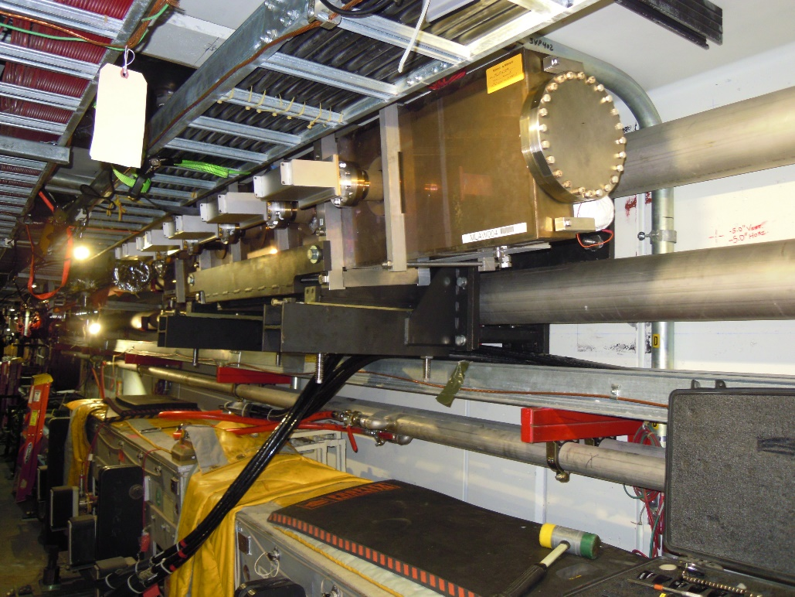
Accelerator Complex - Mech Support Dept.
Old Lambertson: removal planning,
taking into account tight space and
heavy load (5000-lb); stand design
planning (6 degrees of freedom,
+/- 1° rotation, +/-1-inch lateral, built
around LCW piping)
New Lambertson: installed
Safely involving AD and PPD Engineers and technicians

Slide 21
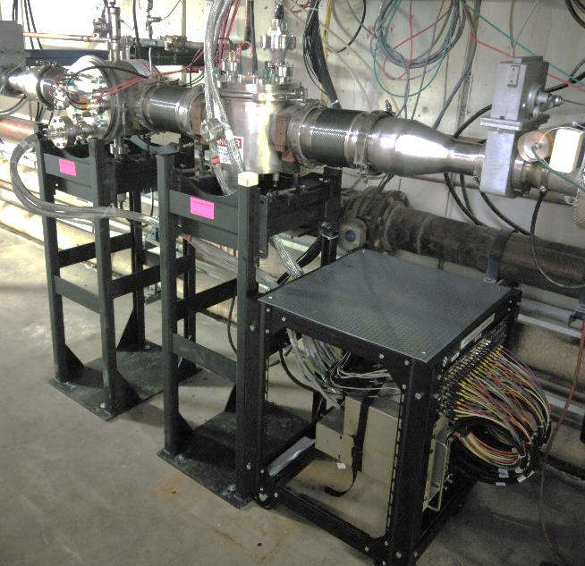
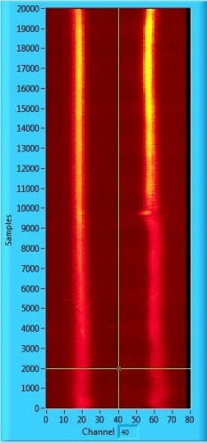
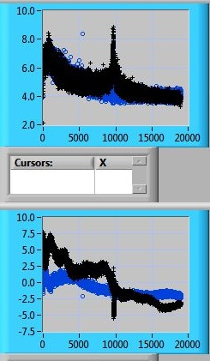
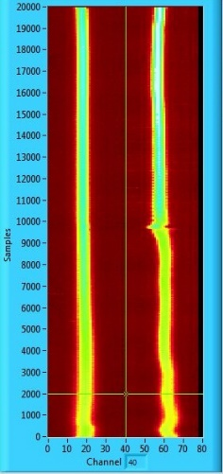
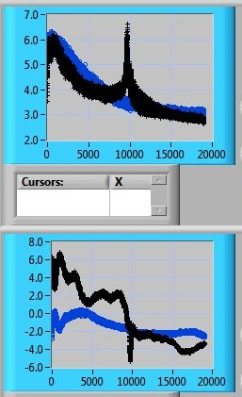
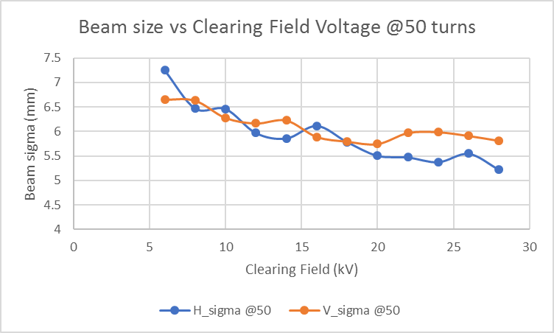
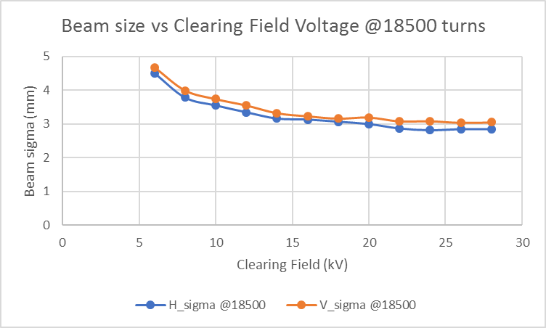
Booster L-4 Ion Profile Monitor Installation
Beam profile, sigma, and position
measurement with 8 kV clearing field
Beam profile, sigma, and position
measurement with 24 kV clearing field
Installation of vertical and horizontal IPMs at Long 4
-30 kV electrostatic IPMs have been installed and commissioned in the Booster
-40 channels per plane
-Increased accuracy of measurement at higher beam energy compared to 8 kV IPM, due to noticeable effect of space charge with lower clearing field voltage

Slide 22
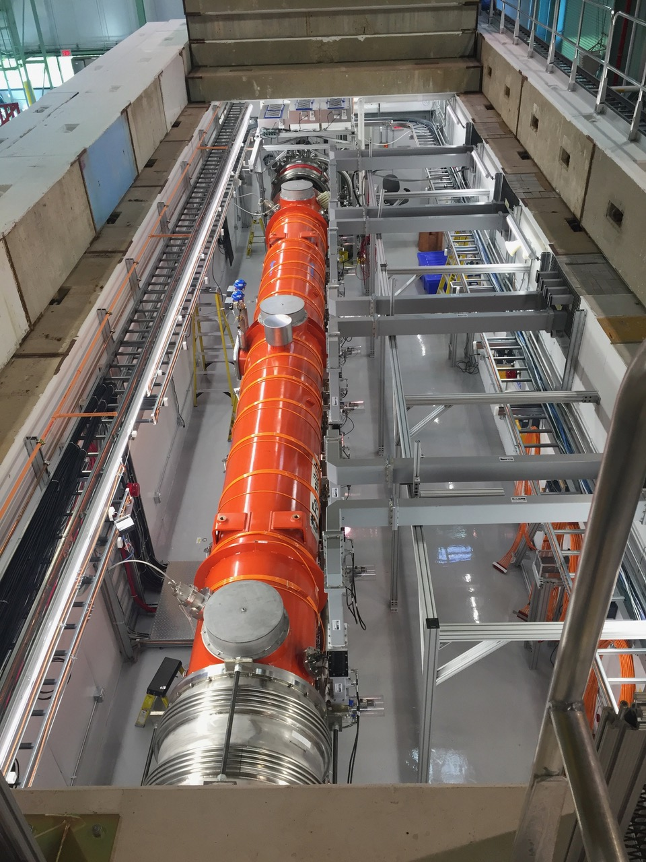
Test Facilities
CMTS: Completed testing of 8
LCLS-II cryomodules

Slide 23
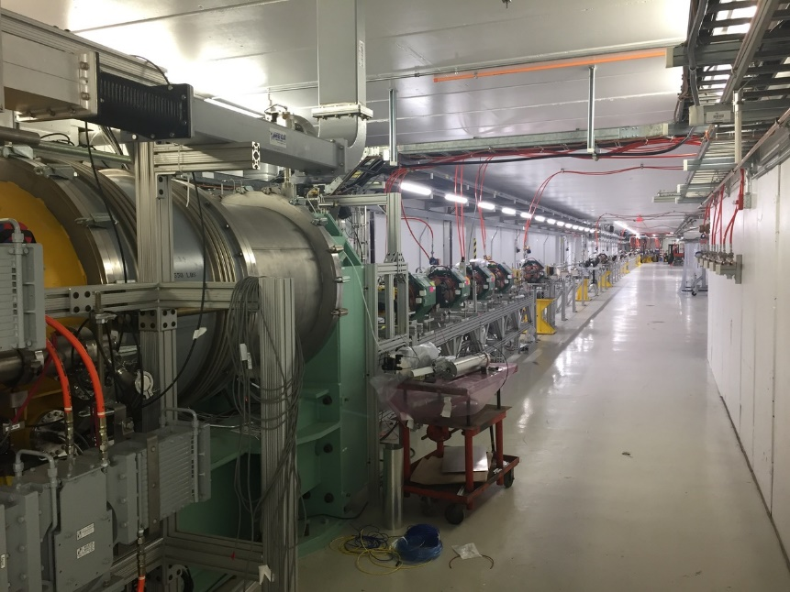
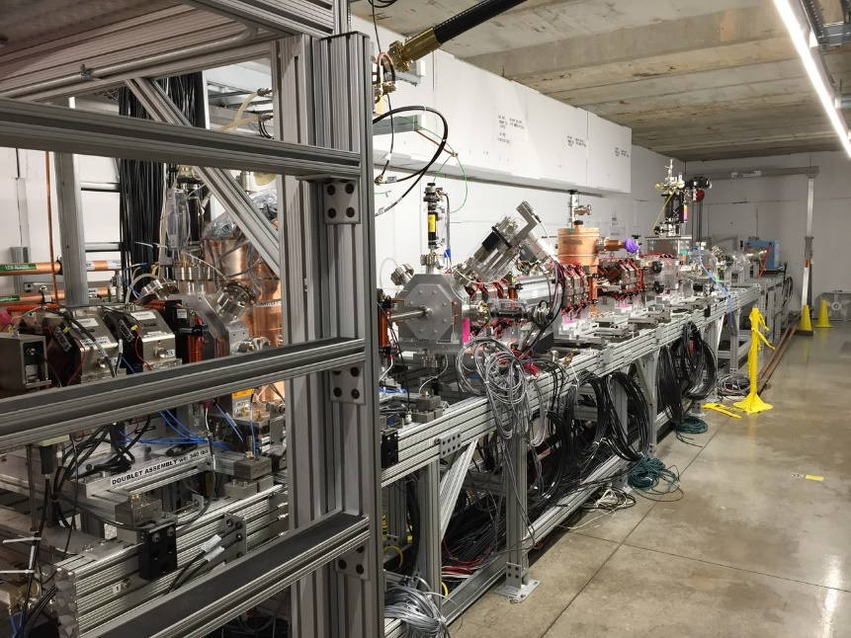
Test Facilities (cont’d)
New FAST beamline extended
beyond cryomodule
PIP2IT’s Medium Energy Beam Transfer

Slide 24
Long Baseline Neutrino Facility
The Target Hall Shield Pile of the Long Baseline Neutrino Facility is being designed to have a uniform slope. This will allow for greater reconfigurability and more effective shielding while using 100 tons less steel

Slide 25
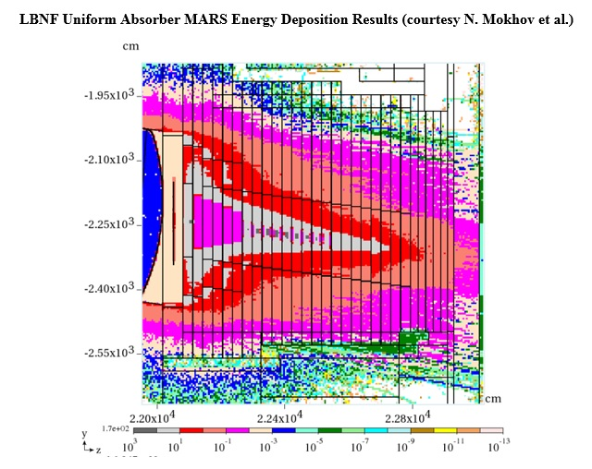
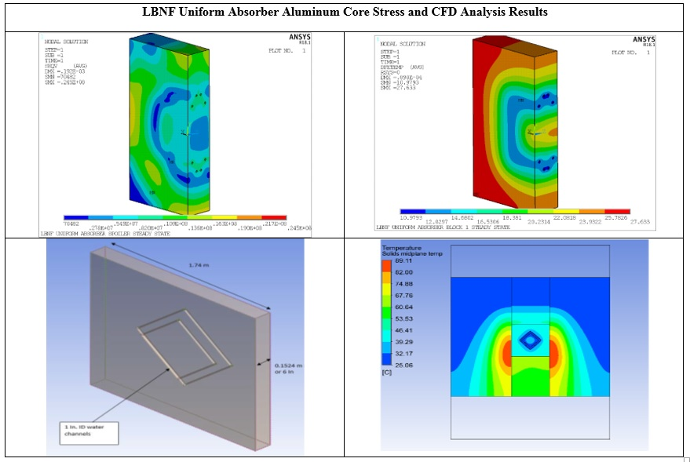
LBNF (cont’d)
Uniform Hadron Absorber: Analyze aluminum core stress and CFD, based on MARS energy deposition simulation results. CFD is Computational Fluid Dynamics!

Slide 26
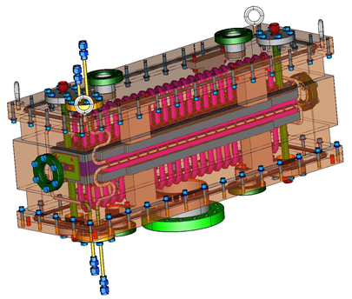
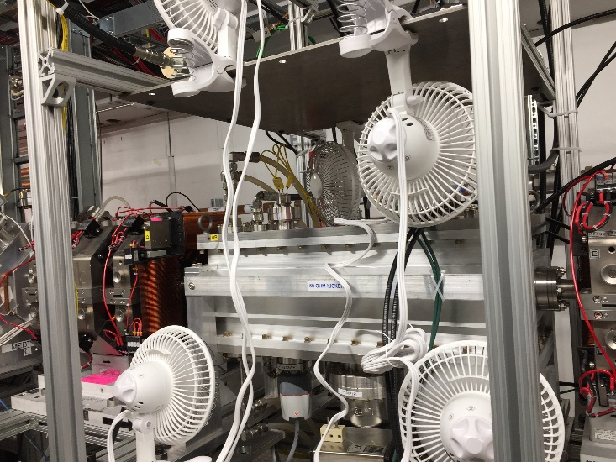
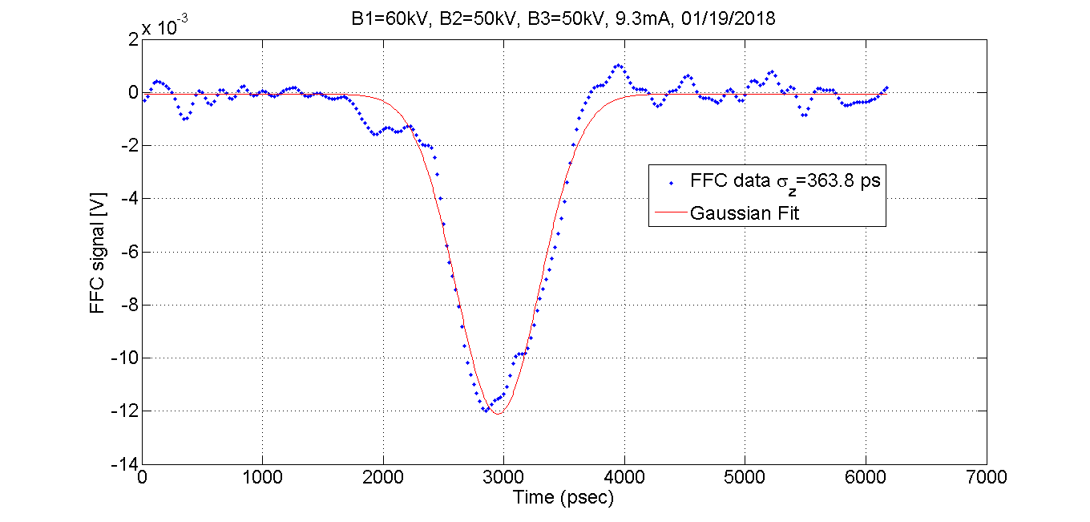


RF Department
PIP-II 50 Ohm Fast kicker – Installed at CMTF
Features:
Shielded 50 Ohm delay lines
Minimized coupling between delay lines
Reduce dispersion > bandwidth
Fast rise time & less distortion
470 pSec rise time
Uses commercial amplifiers
PIP-II Fast Faraday Cup (FFC)
Gaussian Fit from FFC &
estimate of RMS bunch length

Slide 27




RF Department
Creating Four 2.5 MHz Bunches from
One Booster Batch in the Recycler
Six 2.5 MHz Recycler Cavities at MI-30
Adiabatic 2.5 MHz
Recycler
53 MHz
Six 2.5 MHz Solid-State
Amplifiers at MI-31
Recycler Beam

Slide 28




RF Department
PIP-II
SigmaPhi 162.5 MHz, 75 kW amplifiers for RFQ have been operational at PIP2IT since 2014.
Comark/Technalogix 162.5 MHz, 3 kW amplifiers
    Buncher 1, 2 & 3 operational
    All five amplifiers at Fermilab
RF Distribution in place for RFQ and Buncher 1, 2 & 3.
Four McManus 162.5 MHz, 7 kW circulators. Two are in use for Buncher 2 and Buncher 3.
First 162.5 MHz, 7 kW CW amplifier.

Slide 29





RF Department – Low Level RF
PIP-II Kickers
PIP-II RF Hardware
LCLS-II LLRF collaboration and cryomodule testing

Slide 30



Pre-Target Window - Design
High Power Limitation
Identified as likely weak point past 700kW: Poor braze quality, marginal window strength.
Required end cap redesign and increase in beam spot size for 1MW operation.
Work to Date
Original window remodeled in ANSYS and analyzed for temperature and stress at 1MW (failed on fatigue life).
Revision to existing design is an increase in beryllium thickness from a nominal .010” to .015”.
Has negligible effect on neutrino flux.
Thermal and stress analysis completed; provides a 57% stress reduction with minimal increase in steady state temperature.
Analysis Credit: Raul Campos

Slide 31


Pre-Target Window – Fabrication
Production Window
Window design has been presented to Vacuum Window Committee and passed requirements set forth.
Engineering note is formalized and will be available after final review.
Drawing package is being prepared and available for bid submittal.
Fabrication Improvements
Recent work with lab vendor has markedly improved braze alloy coverage; nearly 100% on recent scans.
  Best defense against corrosive atmosphere.
  Eliminates stress concentrations at interface.

Slide 32



Target Baffle - Design
Target Baffle
Thermal and structural analysis of existing design at 1MW completed.
Graphite internal diameter scaled with beam spot size to reach 15mm diameter.
No unforeseen issues with temperature / stress / fatigue life on both graphite collimation slugs, as well as external aluminum cooling shroud.
Air cooling still sufficient.

Slide 33

Horn 1 - Design
Inner & Outer Conductors
Thermal analysis of conductors is complete.
Assumes new water based cooling convection coefficients from planned RAW system upgrades.
Structural analysis underway and expected to be complete within 4-6 weeks.
Increase in neck or weld diameter not believed to be required at this time.
Analysis of existing design peer reviewed.
Stripline analysis completed.
Analysis Credit: Yun He

Slide 34


NuMI focusing horn
New Horn 1 (left) and
Used Horn 2 (right)

Slide 35



Target Chase Shielding - Design
Chase Shielding
Cover plates over Horn 2.
Additional shield wall envisioned for separating D.S. end of Horn 1 from Horn 2; vice-versa for upstream end of Horn 2 to Horn 1.
Design Credit: Joe Angelo

Slide 36



Decay Pipe Window - Design
U.S. Decay Pipe Window
NuMI AIP included provision for production of spare decay pipe window, as well as remote controlled robot or tooling capable of repair / replacement.
Current design work has focused on the prospect of repairing window as opposed to full fledged replacement.
Accurate chase model created for repair mechanism design.
Repair mechanism investigation / prototyping completed.
Thermal & structural analysis of window complete.

Slide 37


High Power RF
Pulsed and CW RF from kW to MW
Modulator providing a precision pulse amplitude
Two Tetrode amplifiers on top of a 53 MHz cavity
Prototyping a Cavity

Slide 38

Some past projects
CDF Detector

Slide 39

Future LBNF Detectors

Slide 40

MicroBooNe Electronics
Kirsty Duffy with MicroBooNE electronics
Be sure to watch Kirsty’s “Even Banana’s” on YouTube.

Slide 41

Boards for CMS and FTBF
Detector Boards designed by Particle Physics Division

Slide 42


ANNIE experiment
Preparing a photomultiplier for the ANNIE experiment.

Slide 43


Muon Campus Mu2e Construction
Muon Campus construction in full swing.
Soon we will be commissioning beam to Mu2e.
New Recycler RF cavities for rebunching beam for g-2 and Mu2e assembled, tested, and now installed
Technical Division building magnets for Delivery Ring injection/extraction:
C-magnet at test facility
Pulsed power supply for Delivery Ring injection septum
43

Slide 44


Quantum Computing
Dilution Refrigerator (above) NEXUS quantum board (right)

Slide 45

Work in other areas – SDSS in New Mexico

Slide 46



Every Engineering Design has challenges!
Moths could ruin the telescope drive!

Slide 47
Difficulties faced
Legacy technology not taught in schools any longer.
  In some of our systems only legacy equipment will work.
All National Labs are looking for high power RF engineers
  On a recent trip I was told their plan was to raid talent from other labs.
Analog design for real world is not taught in depth.
  While you can do many things in the digital domain, there are some places that need analog skills.
Hard to use co-op students in some areas.
  High current and high voltage can hurt you (or worse!)
A big concern is finding electronic techs.
  Industry doesn’t want them repairing boards… swap and discard is the current culture.

Slide 48
Above all else, remember
It is not the 6800 acres or buildings that make Fermilab but rather the people who work here and are dedicated to turning out great science!

