Slide 1
Mechanical Design of the OSCURA vessel
Kodjo Akouedjinoude
Date: 06/15/2022
kakoued1@fnal.gov
Mentor: Nathan Saffold

Slide 2
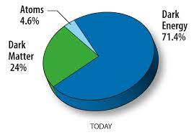
What is Dark Matter?
Dark Matter (DM) are invisible particles that exist but do not interact with electromagnetic waves
Current measurements indicate that 80% of the matter in our universe is Dark Matter
There has not been any direct observation of Dark Matter yet

Slide 3
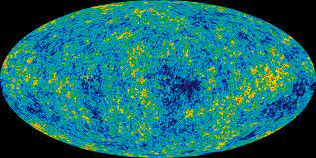
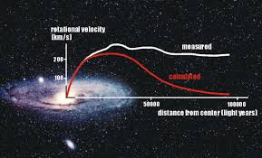
How do we know DM exists?
Rotation curves of galaxies and the cosmic microwave background
For some references on DM observations:
What is dark matter?
(in French) La matière noire

Slide 4
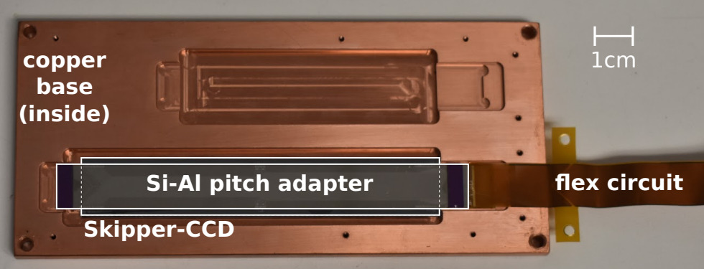
History of the DM searches
There are many experiments for DM using different detector technologies
One of the most recent DM particle research is the SENSEI experiment
The SENSEI experiment developed highly sensitive sensors (skipper-CCDs) with ultra-low readout noise for the detection of low-mass DM particles

Slide 5
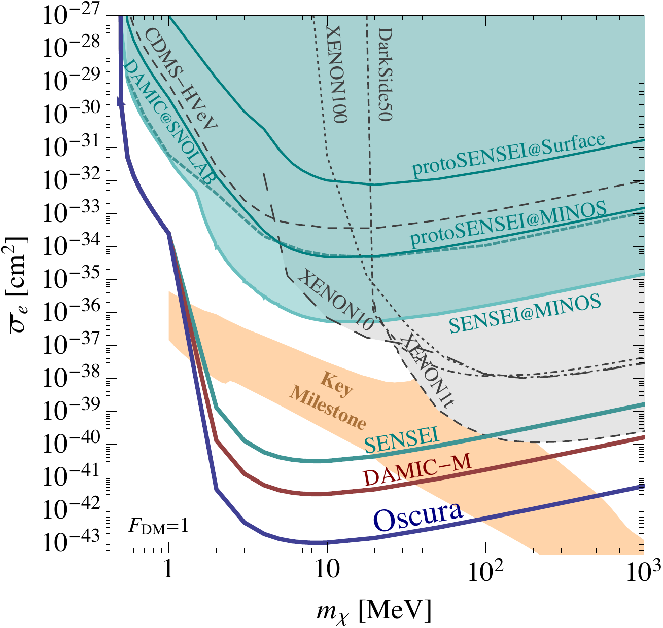
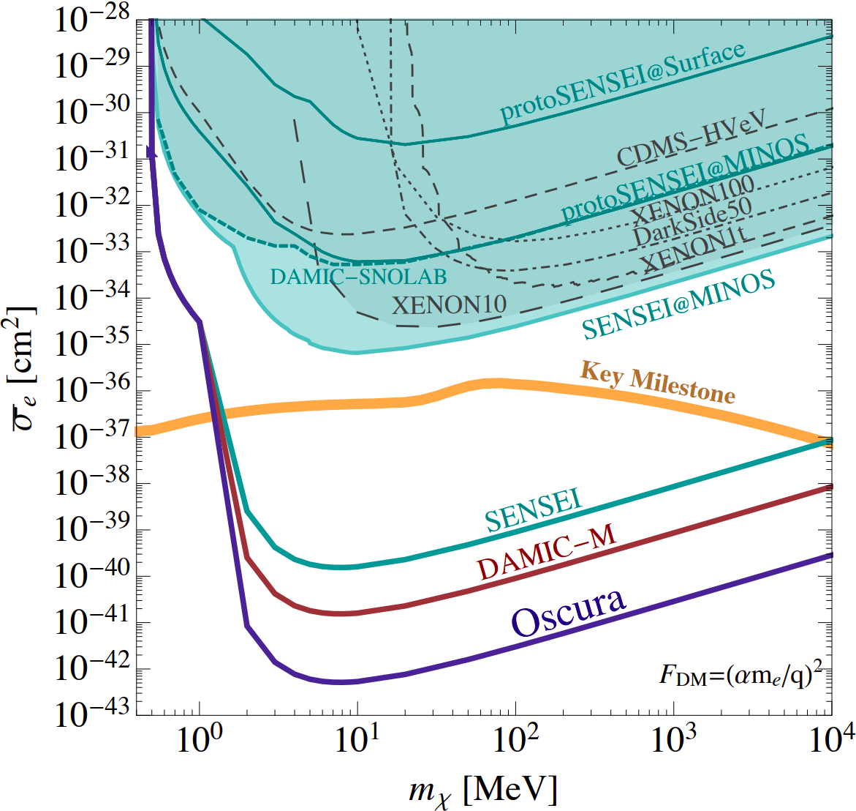
CCD searches for dark matter
DAMIC (40 g, ongoing): first CCD DM experiment
SENSEI (O(100) g started in 2021): first DM experiment using skipper-CCDs
Several physics results (most recent 2020) from prototypes and test runs; full-scale experiment being commissioned at SNOLAB
Active mass and radiopurity similar to DAMIC
DAMIC-M (O(1) kg starting 2023): next-generation Skipper experiment
Scaling up in mass, with corresponding improvement in radiopurity
Oscura (O(10) kg, in development): next-generation Skipper experiment
Major R&D for readout, cooling, integration

Slide 6
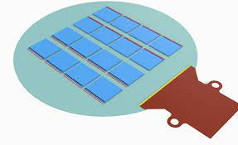
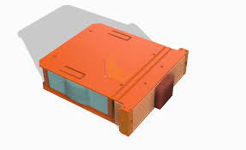
The Oscura Project
The OSCURA will be using a larger array of DM particle detectors, the skipper-CCDs (~10kg)
The goal of this study is to assess the feasibility of scaling up the existing SENSEI vessel to house 10 kg of CCDs for the Oscura experiment
Multi Chip Module (MCM):
16 CCDs mounted on one silicon wafer
Super Module (SM):
16 MCMs housed in electroformed copper
Main challenges
Size and weight constraints
Temperature uniformity across the detector array

Slide 7
The existing SENSEI Vessel

Slide 9
Backup

Slide 10
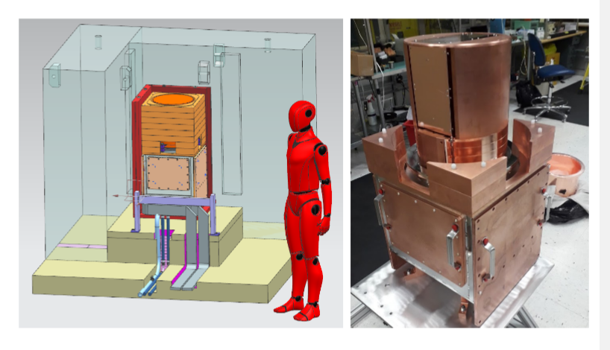
Scaling up the SENSEI Vessel
Scaling up the vessel requires an understanding of its different components:
Lower vessel assembly
Under vessel services (cables)
Upper vessel to house the CCD super modules

Slide 11
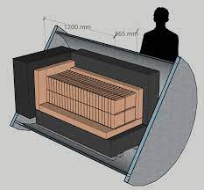
Comparing the scaled-up vessel to the cylindrical OSCURA vessel

Slide 12
Educated decision of a vessel
This magnitude of detectors requires a different cooling system, in this case, pressurized liquid nitrogen (LN2)

Slide 13
Portions of the scaled-up vessel
Bell Jar
Bell Jar External Shield
Cable junctions
Copper box
Lower vessel box
Modules
Services
VIBs

Slide 14
Overview
Introduction
What is Dark Matter?
History of the DM searches
The Oscura Project
The existing SENSEI Vessel
Scaling up the SENSEI Vessel
Advantages & Inconveniences
Comparing the scaled-up vessel
to the cylindrical OSCURA vessel
Educated decision of a vessel

