Slide 1
Anomaly Onset in the Fermilab LINAC using L-CAPE
Davion Washington
SIST/GEM 5 Minute-5 Slides
North Carolina A & T
6/10/22
Primary Mentor: Jason St. John
Alternative Mentor: Brian Schupbach

Slide 2
Objective
Use Anomaly Detection to predict beam outages, and clustering to identify classes of outages in the LINAC (Linear Accelerator). Beam outages mean less beam for research, and lost time, while identifying outage classes is a necessary first step to automating mitigation or prevention measures.

Slide 3
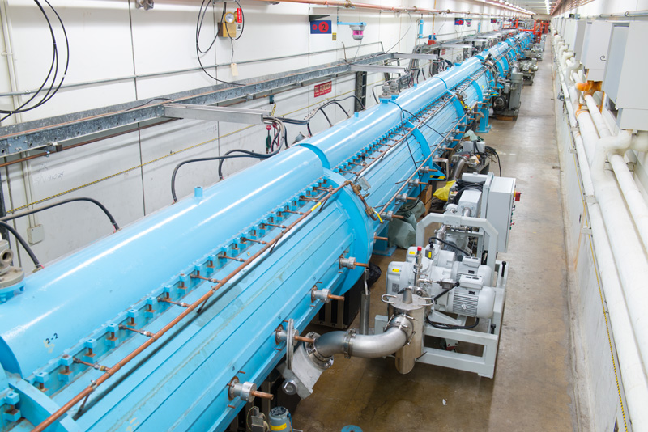
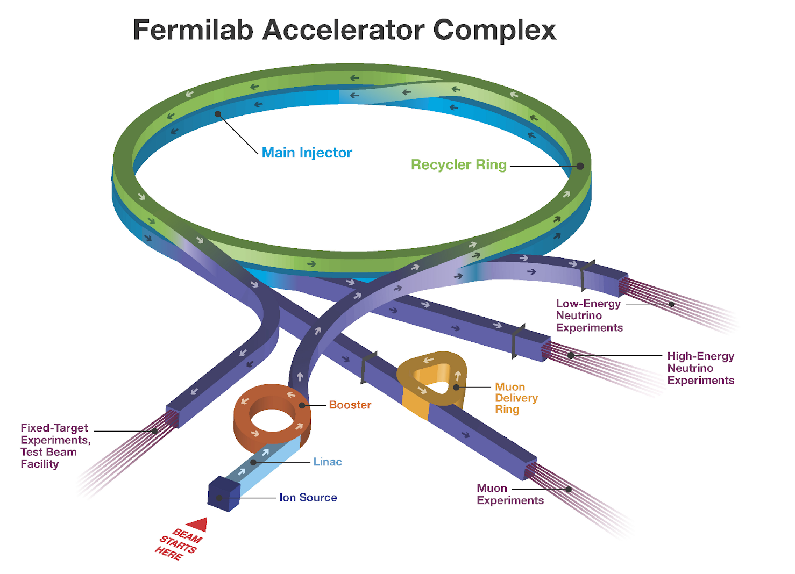
Linac
Beginning of accelerator complex
500-foot straight accelerator
Brings proton beams up to energies of 400 MeV (~ 70% of the speed of light)
Provides a proton beam for the Booster accelerator and the rest of the chain of accelerators
Uses radiofrequency(RF) power
2500+ control system devices including RF system devices

Slide 4
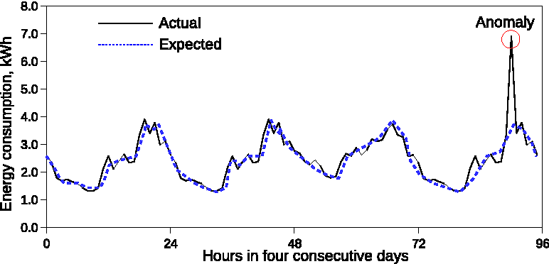
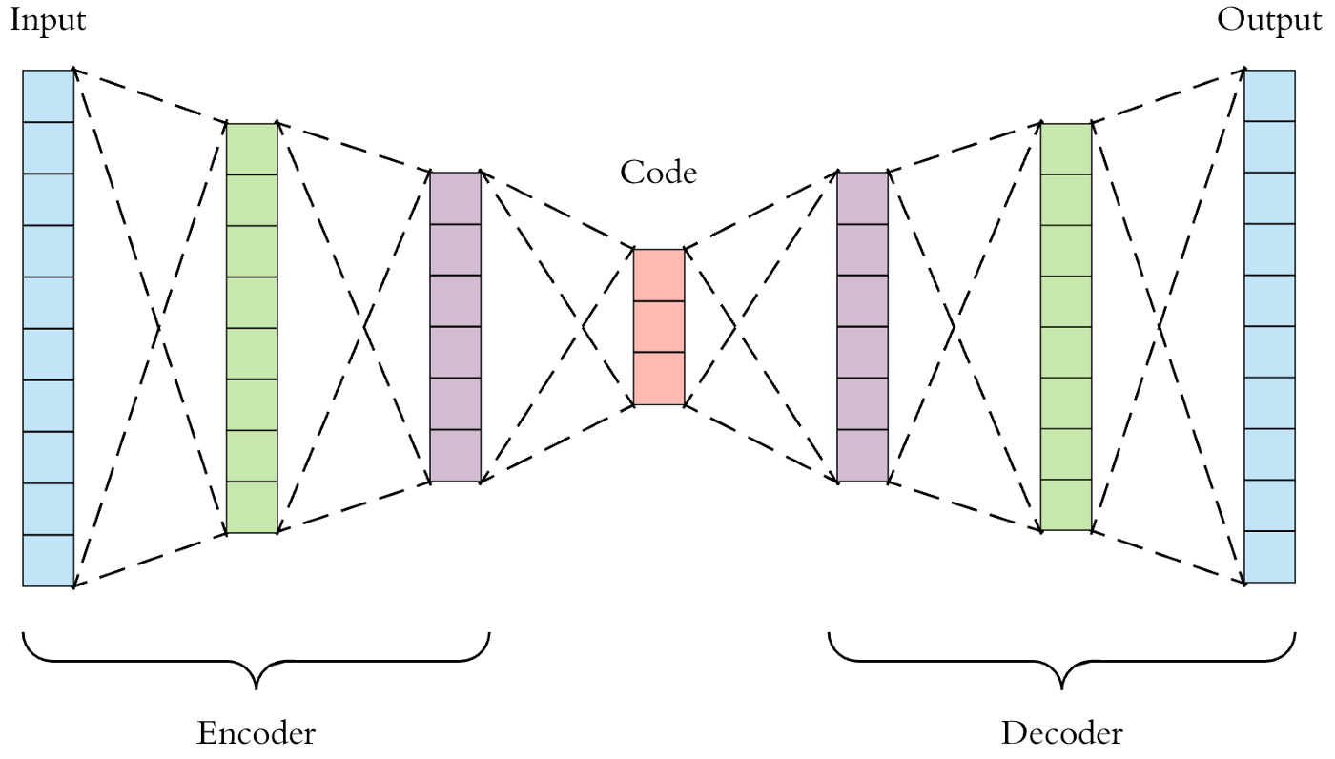
Anomaly Detection
Machine learning tool/Handles large datasets
Used here to predict beam outages
Trained an autoencoder on each device so increasing reconstruction errors will suggest anomalies
Difference between expected data and actual data is the reconstruction error for one device
Identifying data points in data that are outliers

Slide 5
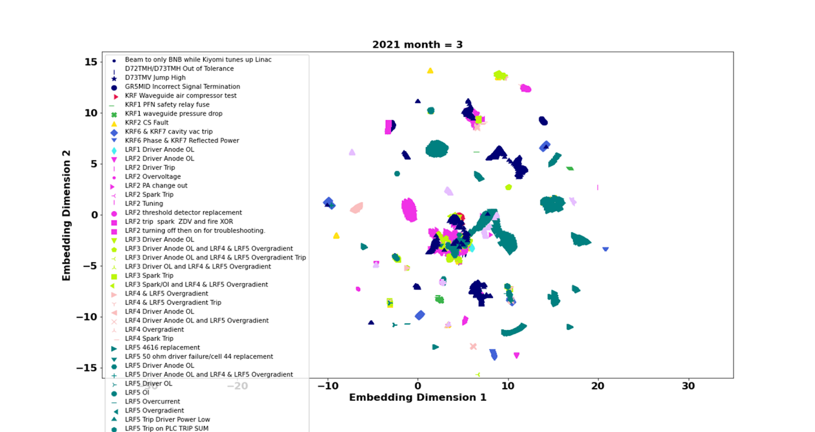
Characterizing Outages
Dimensionality reduction by UMAP(Uniform Manifold Approximation and Projection) projecting 250 dimensions (reconstruction error) to two
One entry for every 10secs of outage
Color-coded by group and RF Station
Shape-coded by fault type (cluster characterization)
Where is normal operation on this plot?
How do we transition to anomalies? Quickly? Slowly?
Can we predict an upcoming anomaly?

Slide 6
Reference
Fermilab | Science | Particle Accelerators | Fermilab's Accelerator Complex (fnal.gov)
05.11-K-Means.ipynb - Colaboratory (google.com)
Firing on all cylinders (fnal.gov)
How to do Anomaly Detection using Machine Learning in Python? (projectpro.io)
How Machine Learning Can Enable Anomaly Detection | by Countants | DataDrivenInvestor
Scalable prediction-based online anomaly detection for smart meter data – ScienceDirect
Applied Deep Learning - Part 3: Autoencoders | by Arden Dertat | Towards Data Science

Slide 7
Thank you!!

