Slide 1
Low Energy Neutron Background – LDMX @ Fermilab
Param Upadhyay – Tufts/Oxford
Supervisor: Dr. Cristina Mantilla Suarez
5 Minutes 5 Slides
15 June 2022

Slide 2
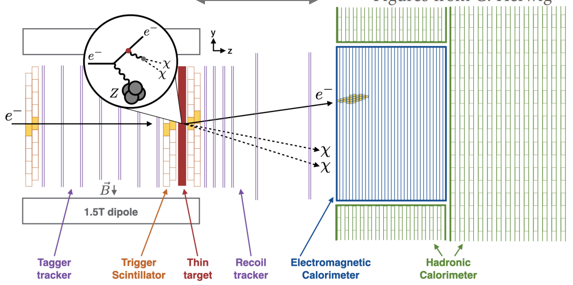
What is LDMX?
Using Missing Momentum Methods to Detect Light Thermal DM

Slide 3
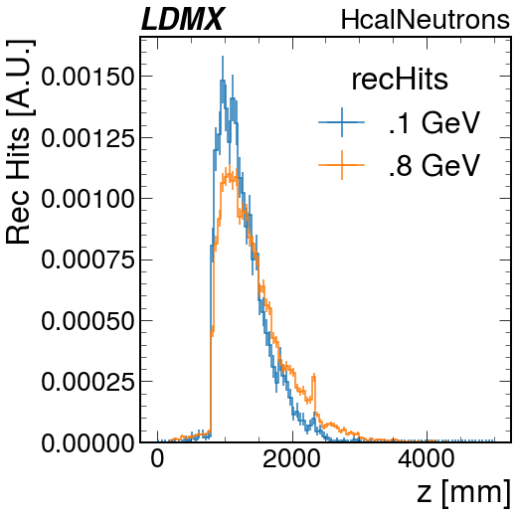
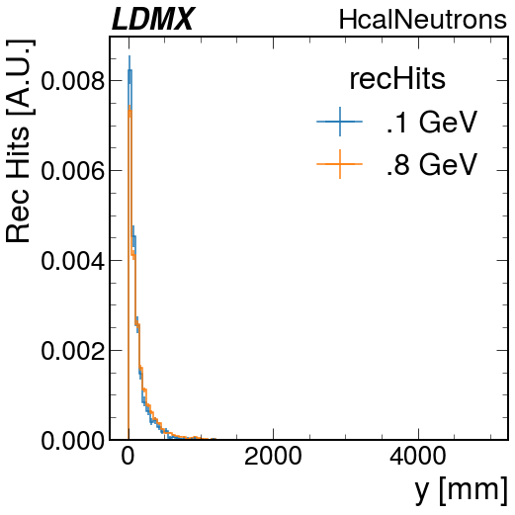
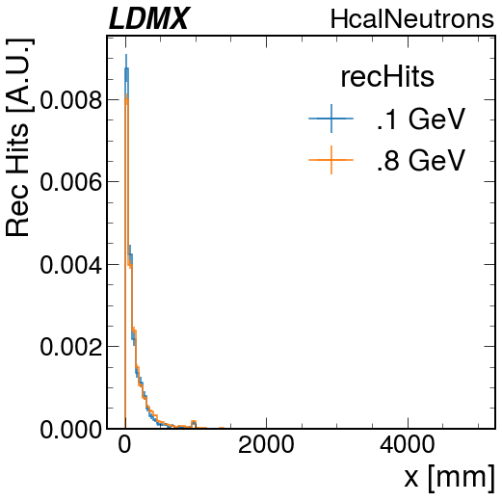
Preliminary Plots
Standard RecHit distribution observed along the detector z axis.

Slide 4
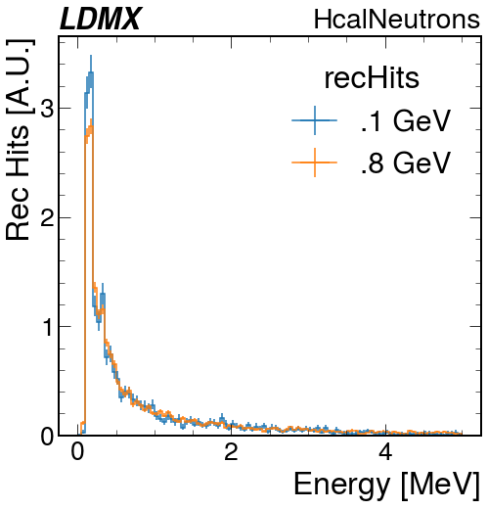
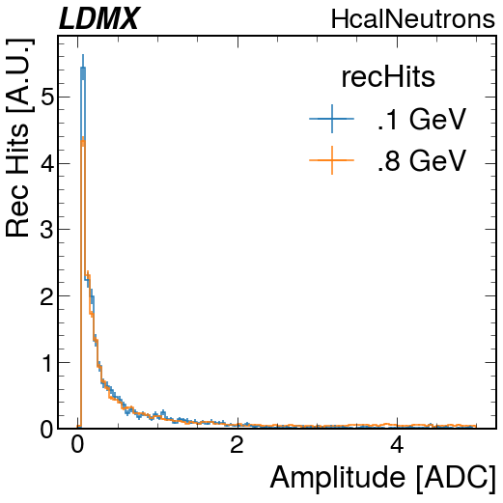
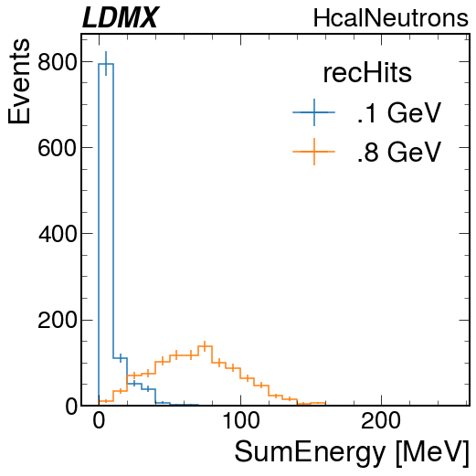
Preliminary Plots
The energy blips up at .1 and .8, as seen on the first and third graphs. We observe regular distribution tails. Sum Energy should be about 10% of gun.

Slide 5
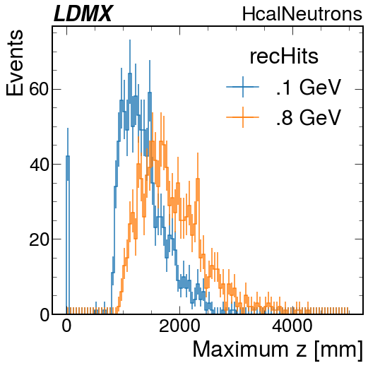
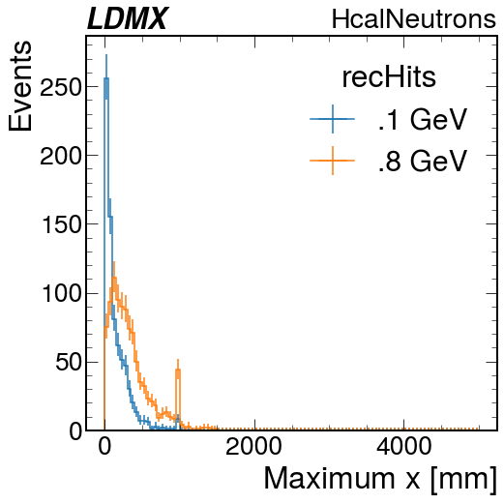
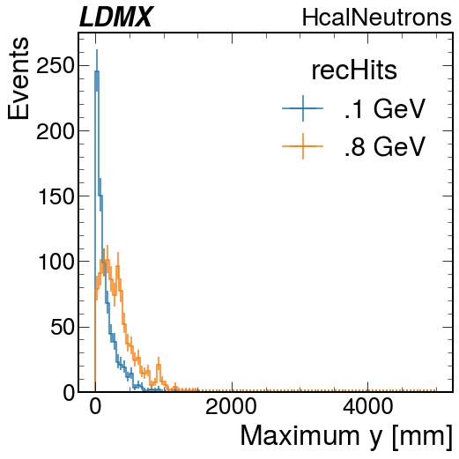
Preliminary Plots
Null events are binned to zero, we want to explore the threshold of detection.

Slide 6
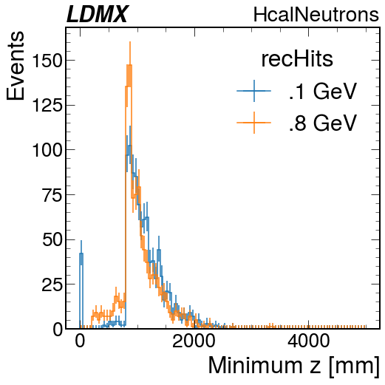
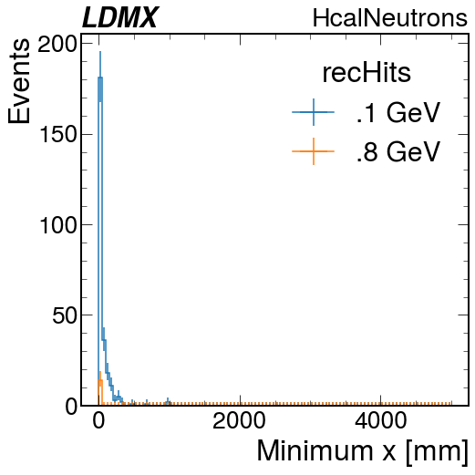
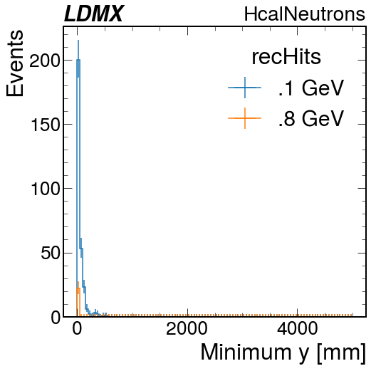
Preliminary Plots
Null events are binned to zero, we want to explore the threshold of detection.

Slide 7
Next Steps?
Now we’ll do some more processing in our analysis.
- Find which layers and scintillator bars are hit
- Process hit location on bar
- Group hits into events
- Probe low energy boundaries of detection

