Slide 1
Energy Reconstruction of Low Energy Events in LArTPC
LeRayah Neely-Brown
GEM Fellow: Purdue University
Supervisors: Joseph Zennamo + Fernanda Psihas
SIST/GEM 5 Minutes 5 Slides
06.15.2022

Slide 2
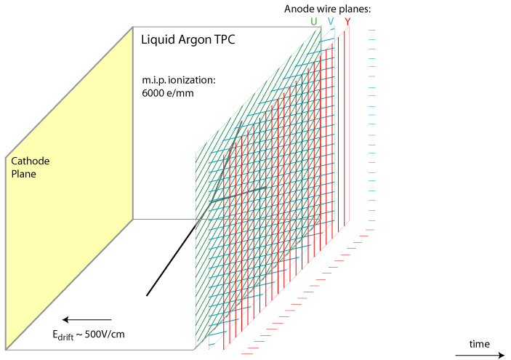
LArTPC
Liquid Argon Time Projection Chamber
Detectors where interactions between neutrinos and Argon atoms are observed
The energy & trajectory from these interactions are measured via the charge and light emitted
LAr @ BNL Animation: https://lar.bnl.gov/home/img/signal.gif

Slide 3
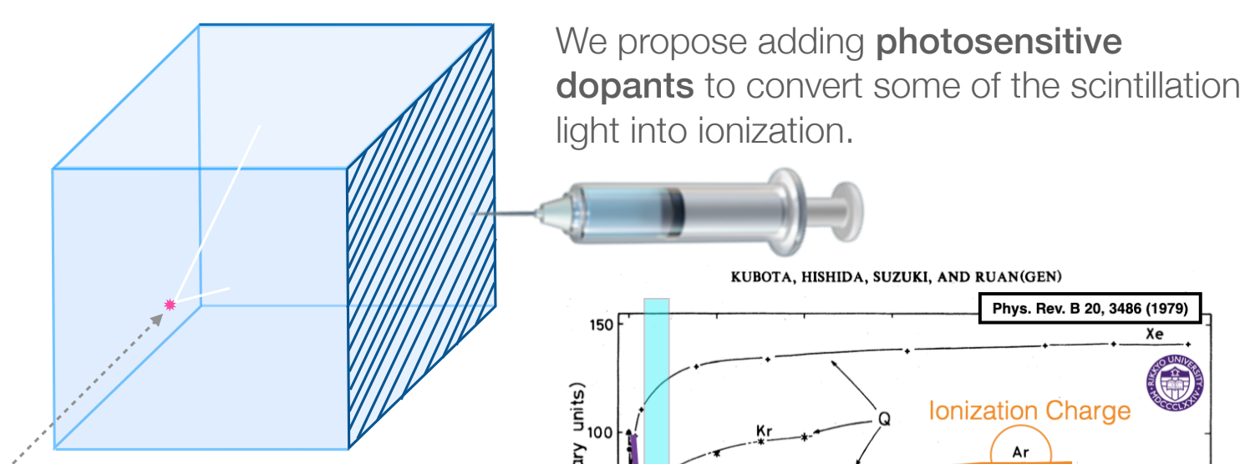
LArTPC + Dopants
This summer project’s aim is to observe how low energies are detected when photosensitive doping is added to the LArTPC.
The dopants’ purpose are to convert the scintillation light emitted into ionization charge
We want to discover how doping will improve the energy resolution and measurement at low energies
Fernanda Psihas, 2022
Notes:
proposed dopants are hydrocarbons

Slide 4
Summer Research Goals & Objectives
Main Objective: Take low energy simulations from the LArTPC and view how well the energy of the particles can be reconstructed with and without photosensitive doping
Goals To Meet Objective:
Analyze simulated electrons at 2.5 MeV & make energy distribution plots to understand energy reconstruction & resolution
Steps for this process include using stored data products from the interactions in the LArTPC to create ROOT Ttrees to make plots depicting the interactions and true deposited energy
Ultimately, these plots will help determine the ideal reconstructed energy and help improve resolution at low energies
Notes:
Photosensitive doping (via Hydrocarbons) is proposed to be used to convert the measured light into ionization charge
Instead of focusing on detecting and reconstructing the high energies that are found in the LArTPC, the main goal is to observe at the low energies
simulated e- 2.5 MeV

Slide 5
Current Progress + Near Future Steps
Recently created energy distribution plots using LArSoft files without doping

Slide 6
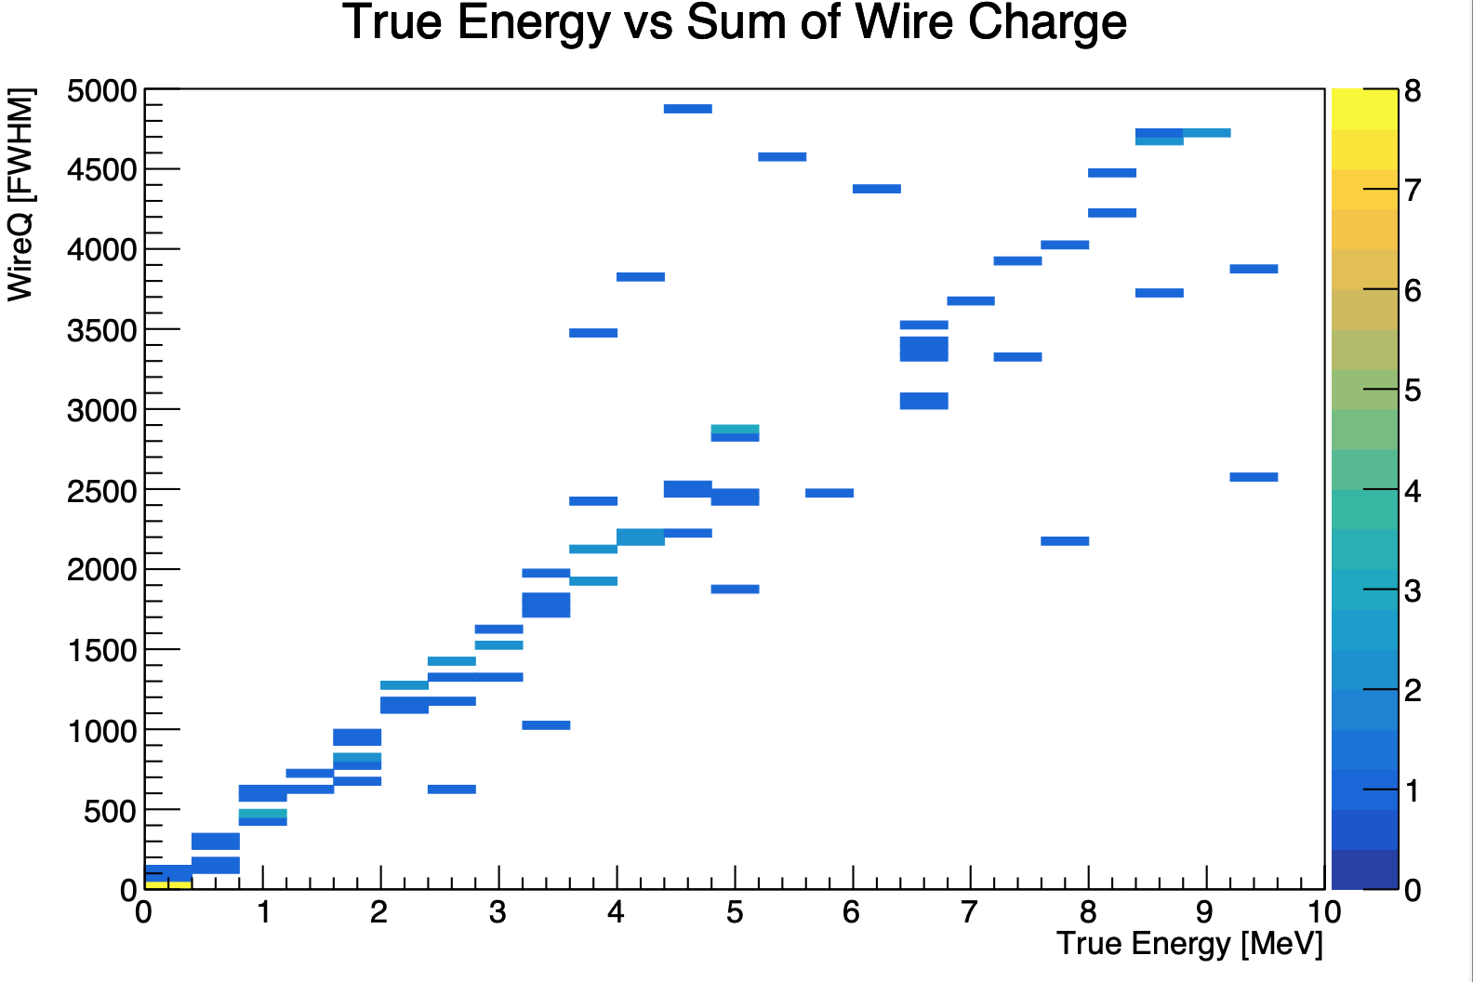
Current Progress: Example #1
Notes:
There’s a linear trend here w/ true energy and sum of charge on the wires….this shows that the the true energy variable can be used in reconstructing and the low energies

Slide 7
Current Progress + Near Future Steps
Recently created energy distribution plots using LArSoft files without doping
For the upcoming weeks, creating more energy distribution plots for low energy reconstruction with the 5000+ LArSoft simulation files with doping is the main goal

Slide 8
Current Progress + Near Future Steps
Recently created energy distribution plots using LArSoft files without doping
For the upcoming weeks, creating more energy distribution plots for low energy reconstruction with the 5000+ LArSoft simulation files with doping is the main goal

