Slide 1
5 Minutes 5 Slides
Carrie Cox
Seattle Pacific University

Slide 2
Project Outline
“Studying NuMI beamline BPMs and Multi-wire data to understand the correlations and device performances. Planning to develop a ML technique to understand the performance of the components and to detect anomalies.”
Will learn about:
Data preparation
Correlation studies with measurements
ML algorithm development
Model validation and testing
Model testing with spill-by-spill data

Slide 4
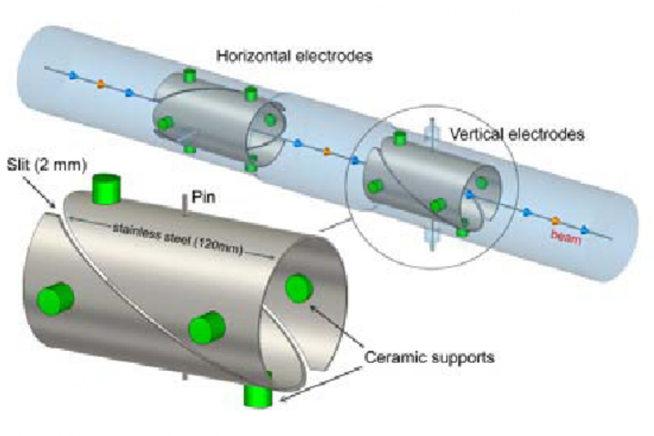
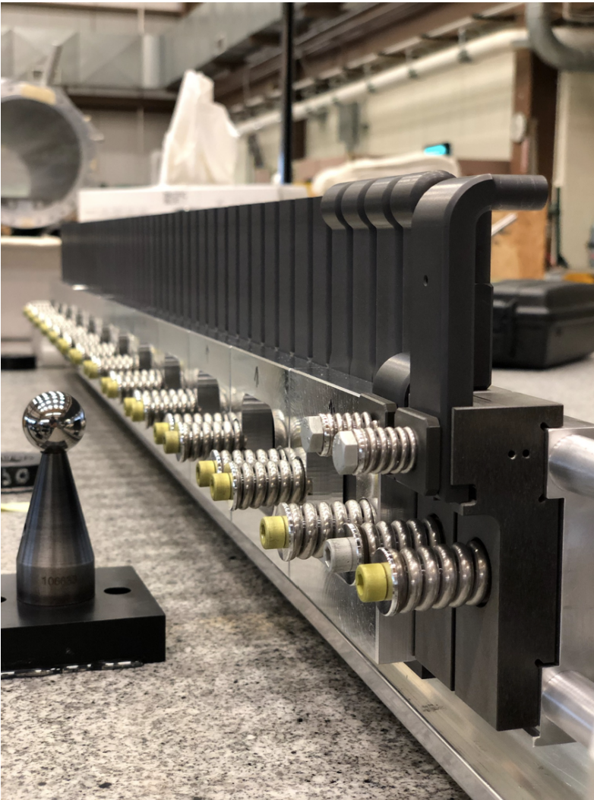

Slide 5
Why?
Having a machine learning model will help us…
Better understand the patterns and correlations of the beam’s performance
Predict beam performance under different conditions
Optimize the NuMI beam performance

Slide 6
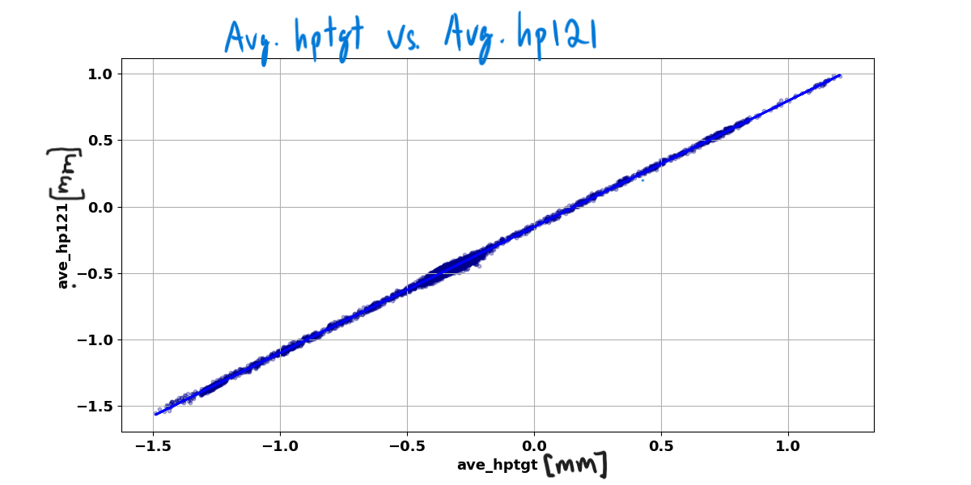
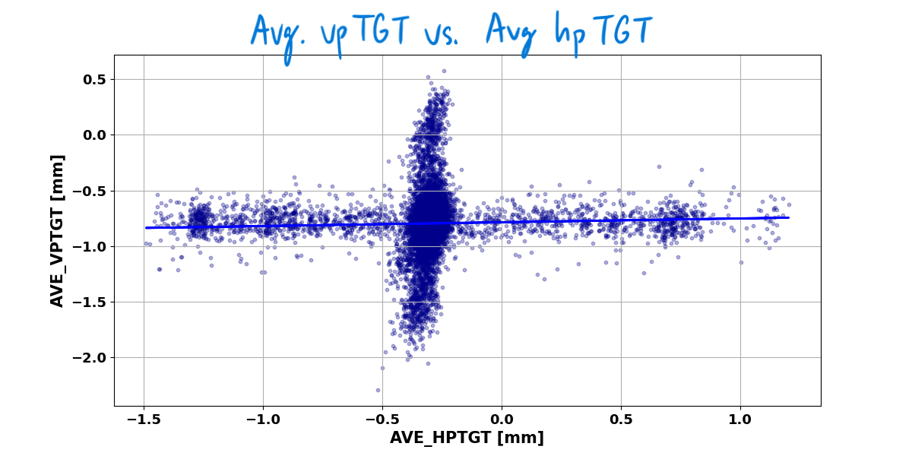
Progress So Far…

