Slide 1
Cryomodule Coupler Test Stand
Brayden Bahnke
Mechanical Engineering, University of Alaska--Fairbanks
Supervisor: Josh Helsper
5 minutes, 5 slides meeting
June 15, 2022

Slide 2
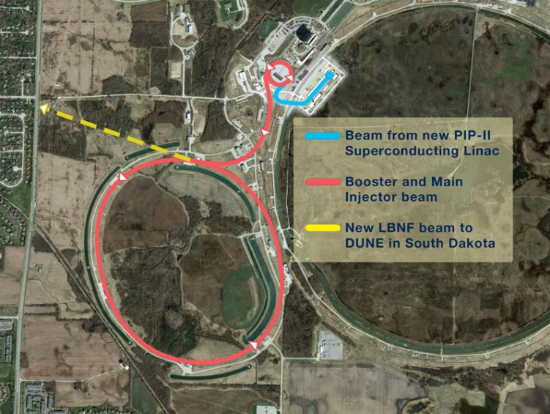
Proton-Improvement-Plan II (PIP-II)
Uses
Power Muon Experiments
Fermilab test beam facility
Neutrinos for DUNE
Linear accelerator
1 MW proton beam
superconducting radio-frequency
Temperatures down to 2 Kelvin!
PIP-II

Slide 3
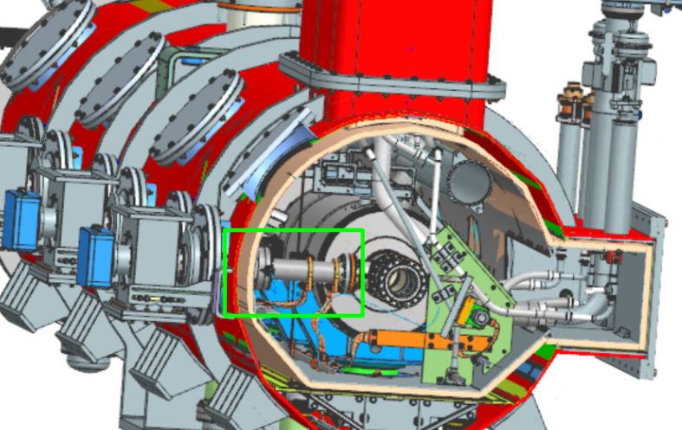
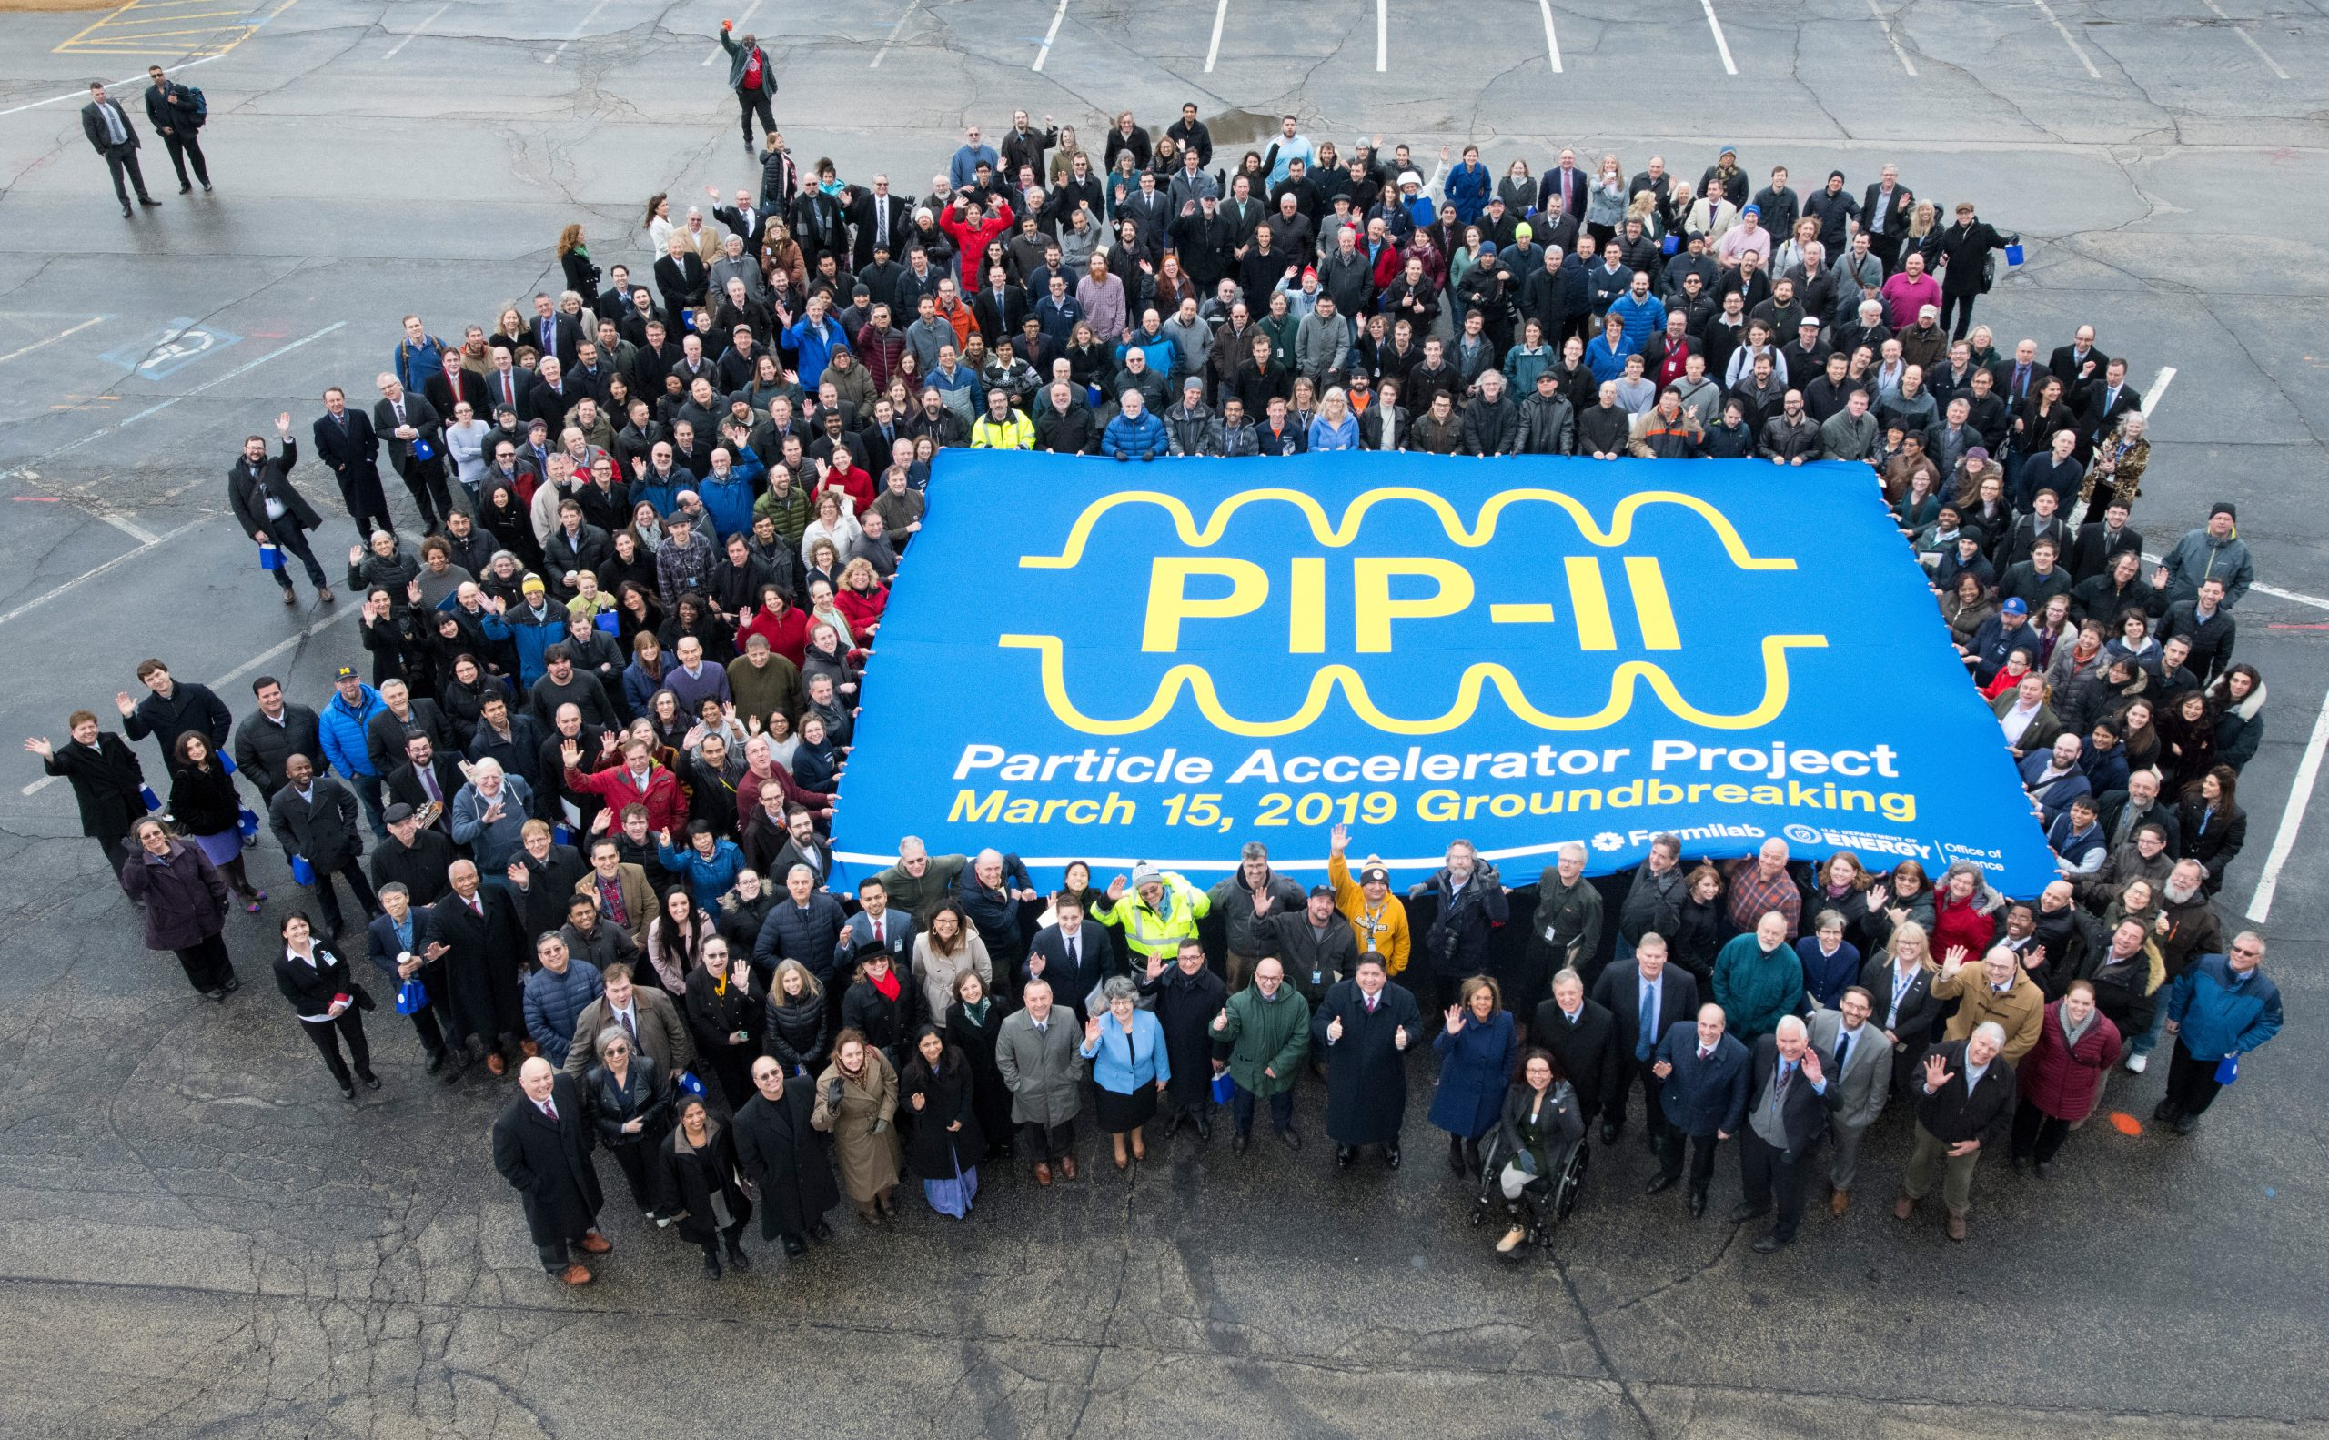
Couplers
Provide energy to the accelerators in the cryomodules
Subject to extreme cold and vacuum
Delicate internal components
Sourced out of UK
How can we make sure they work?
Fermilab employees, public office holders, and international collaborators meet for the groundbreaking of PIP-II.
Coupler attached to cryomodule

Slide 4
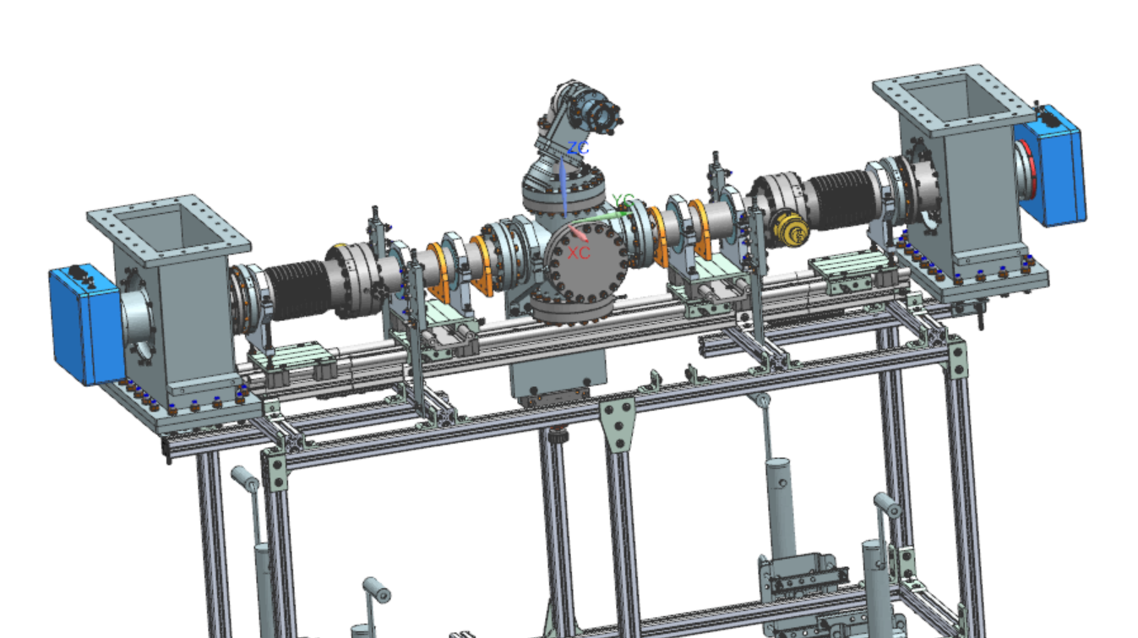
Vacuum Coupler Test Stand
NX Master model of the test stand with coupler highlighted
Why
$$$
Quality control
How
Clean room
Place coupler under a vacuum
Cool it
Test power
So what is the project?

Slide 5
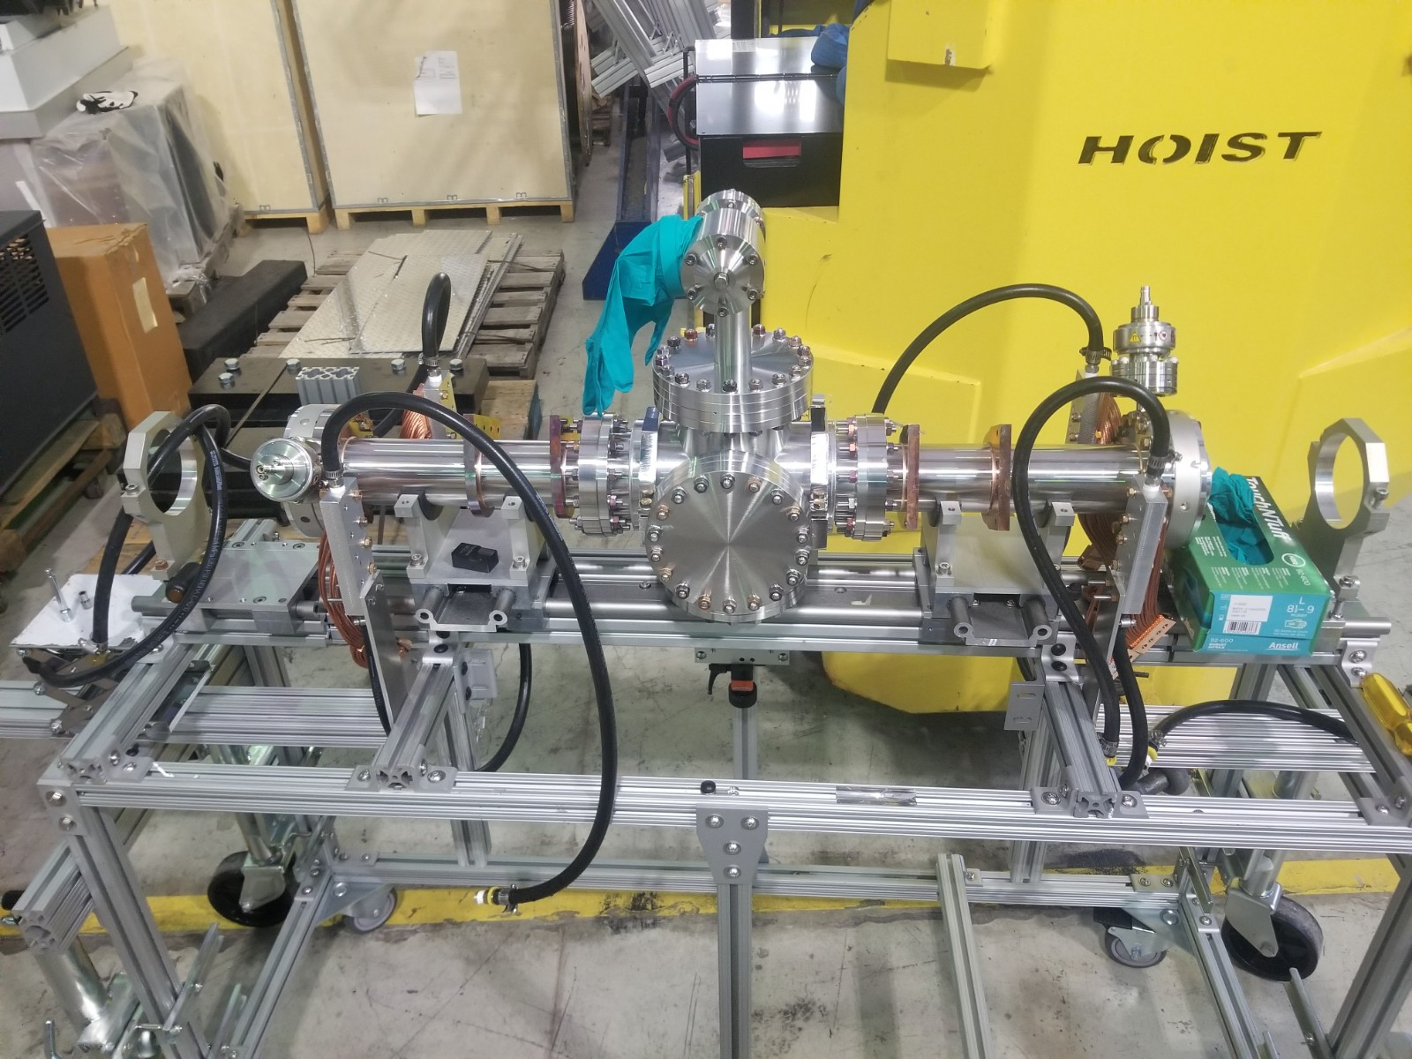
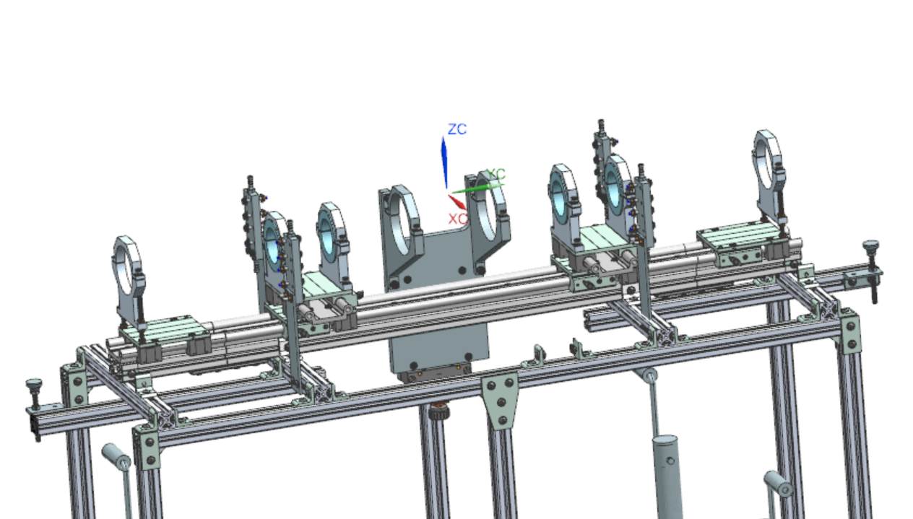
So, what’s the issue?
Test stand shortcomings
Difficult to assemble
Labor intensive
No way to compensate for axial deviation
Additional components necessary post-completion
Photo of test stand with vacuum assembly installed (above)
CAD model of test stand (left)

Slide 6
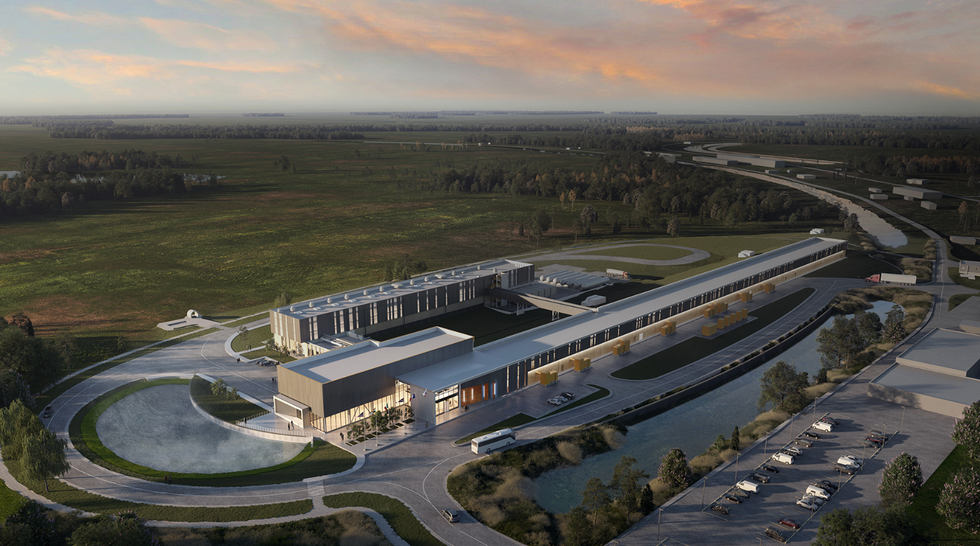
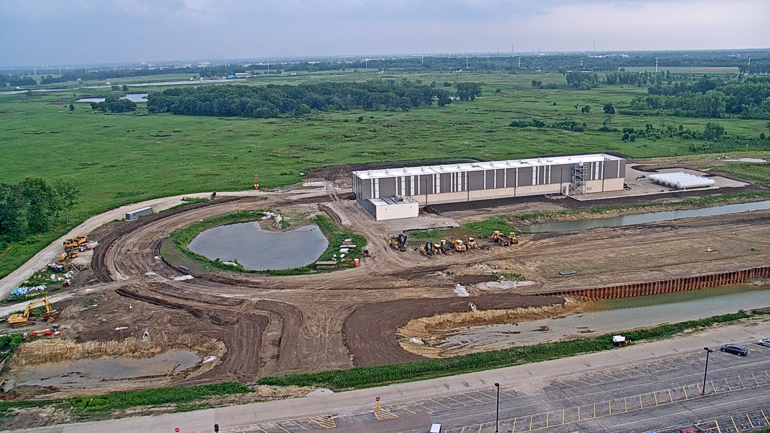
The End Goal
New test stand
Proper component support
Efficient to set up
Tolerant of misalignment
Learning outcomes
Familiarity with NX CAD program
Understand Fermilab Design Process
Large scale-CAD document management
Digital rendering of PIP-II facility (above)
PIP-II facility under construction with the cryomodule building framed up. June 13, 2022.

