Slide 1
Mapping the Radial Magnetic Field of Muon g-2
Fatima Rodriguez, GEM Intern
Supervisors: Saskia Charity and Brendan Kiburg
SIST/GEM 5 Mins/5 Slides, Summer 2022
June 15, 2022

Slide 2
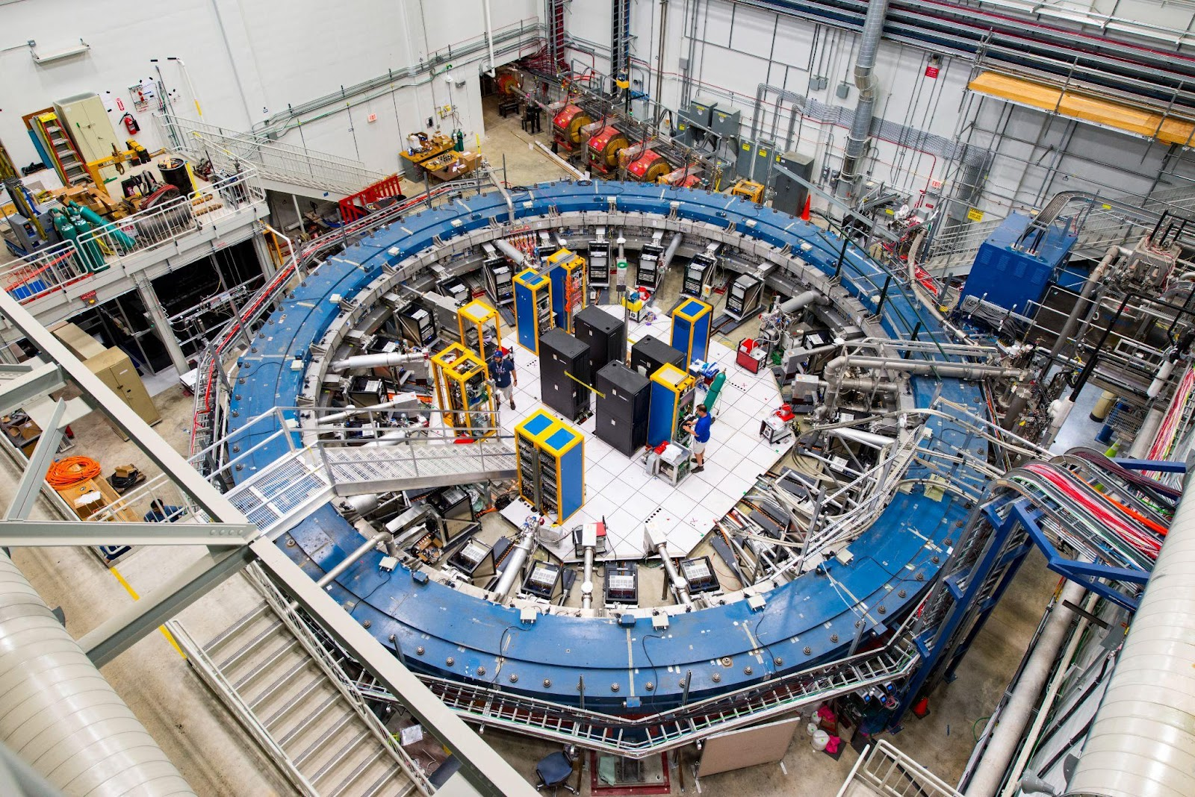
Muon g-2
The goal of Muon g-2 is to measure the anomalous magnetic moment of a muon.
Magnetic dipole moment (MDM): $\vec{μ}=g\left(\frac{q}{2m_{μ}}\right)\vec{s}$
g-factor: $g_{μ}=2(1+a_{μ})$
Muon g-2 directs a beam of protons into a fixed target to create pions, which then decay into muons. This beam of muons is then directed into a 50-foot-diameter superconducting storage ring, where calorimeters are used to detect its decay positrons.
We can determine how the muon’s internal magnet precesses by the number of positrons detected as a function of time and their energy levels.
Fig 1: Muon g-2 at Fermilab. Photo: Reider Hahn, Fermilab (2017).

Slide 3
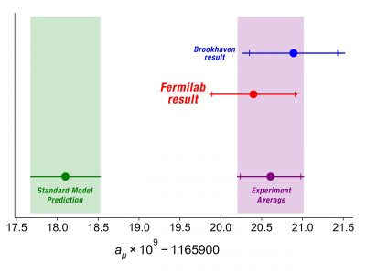
Muon g-2 motivation
In measuring g-2 with high precision, we can compare its value to the theoretical prediction from the standard model (SM).
At first order of Dirac’s theory for s=1/2 particles, g=2.
$g_{μ}=2\left(1+a_{μ}\right)⇒$ $a_{μ}=\frac{g−2}{2}$
$$a_{μ}^{BNL}=116592080\left(63\right)×{10}^{−11}$$
$$a_{μ}^{FNAL}=116592040\left(59\right)×{10}^{−11}$$
This experimental avg. with >$4σ$ discrepancy suggests new underlying physics that diverge from the SM!!
Fig 2: Muon g-2 2021 results. Ryan Postal, Fermilab/Muon g-2 collaboration (2021).

Slide 4
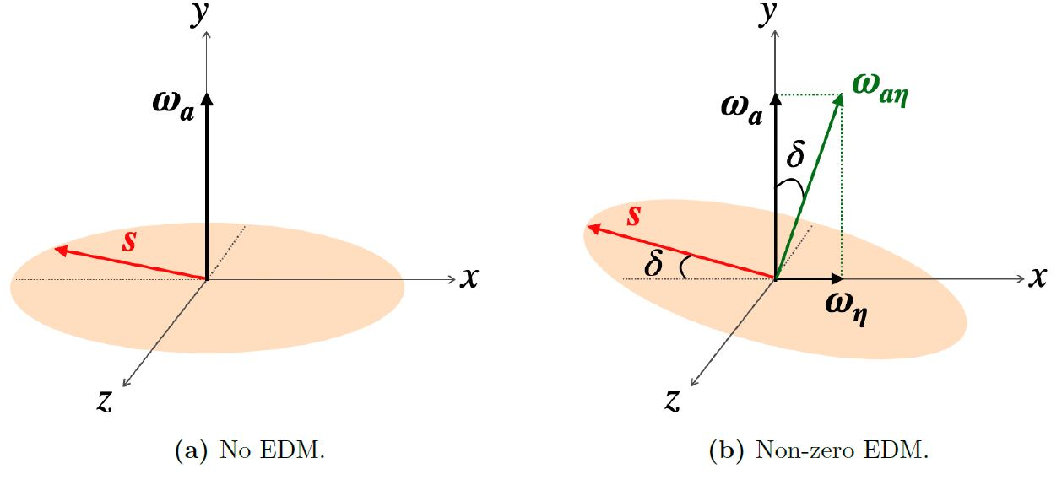
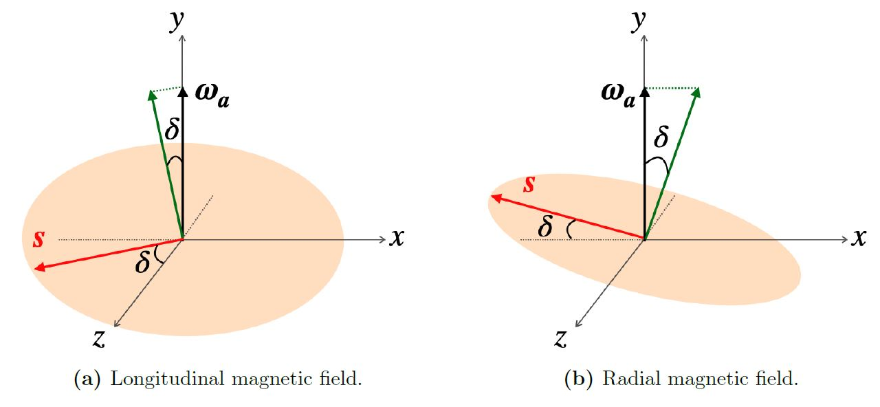
Uncertainty in the electric dipole moment (EDM)
A non-zero muon EDM would be a sign of physics beyond the SM. A radial field has the same effect on the data as an EDM would → fake signal!
EDM: $\vec{d}=η\left(\frac{Qe}{2mc}\right)\vec{s}$
Fig 3: The muon spin precession plane with no EDM (a) and non-zero EDM (b).
Fig 4: The muon spin precession plane with non-vertical magnetic field components.
Diagrams by Samuel Grant, University College London (2022).

Slide 5
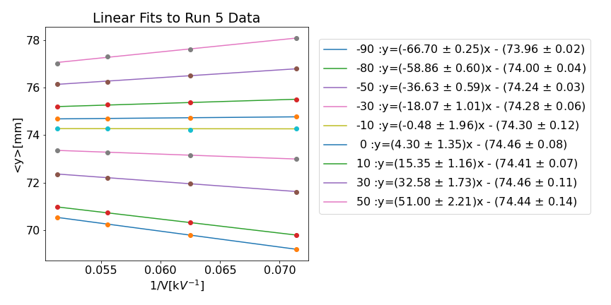
Beam Method
We can measure how the ring average vertical beam position, <y>, changes over a range of applied fields by the surface correction coils (SCCs).
$$<y> ∝ \frac{<B_{r}>}{V}$$
$$where <B_{r}> = <B_{r}^{a}>+<B_{r}^{b}>$$
Fig 5: Linear fits of the ESQ/SCC scans. Data was obtained by Dominika Vasilkova.

Slide 6
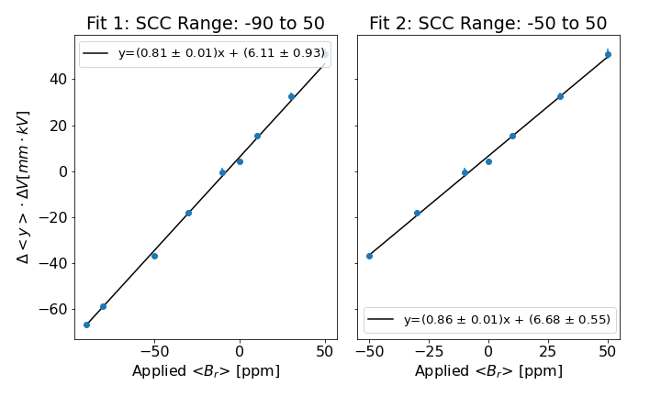
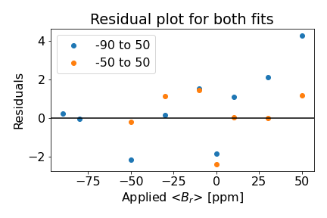
Beam Method
The applied radial field that returns a gradient of zero on the linear fit, is equivalent to the averaged background radial field, $<B_{r}^{b}>$.
$$<y> ∝ \frac{<B_{r}>}{V}$$
$$where <B_{r}> = <B_{r}^{a}>+<B_{r}^{b}>$$
Fig 6: Gradient vs. applied radial field. Optimal applied radial field for zero gradient is $7.53 ±1.15$ ppm and $7.74 ±0.65$ ppm, for Fit 1 and Fit 2 respectively.
Fig 7: Residual plot for fits in Fig 6. Fit 1 shows that we are losing muons at scans < -50 ppm.
Notes:
Divide this into two slides: 1: gradient plots 2: linear fits

Slide 7
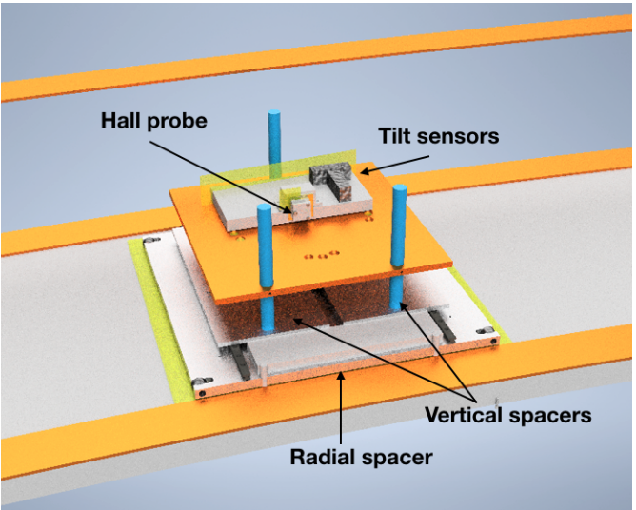
Next Steps
By using a Hall probe and building a platform, we can directly measure the radial magnetic field in the storage ring and cross-check the measurements with the predicted analysis done with the beam method.
The Hall probe will detect the magnitude of the magnetic field using the Hall effect, such that the output voltage of the Hall probe will be directly proportional to the strength of the field.
Steps:
Build Hall probe and use Inventor to document the model.
Minimize the voltage offset and planar Hall effect.
Measure the radial and longitudinal components at different azimuthal locations.
Analyze data using Python to find average radial and longitudinal magnetic fields.
Fig 8: The hall probe that we will replicate from Rachel Osofsky’s analysis in Run 1 (Osofsky, 2019).

