Slide 1
Cluster Cosmology
Ebtihal M. Abdelaziz
Supervisor: Jim Annis
SIST 5 minutes, 5 slides
6/15/2022

Slide 2
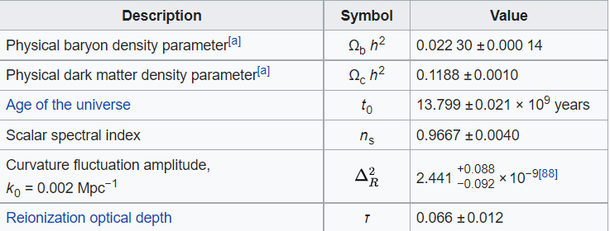
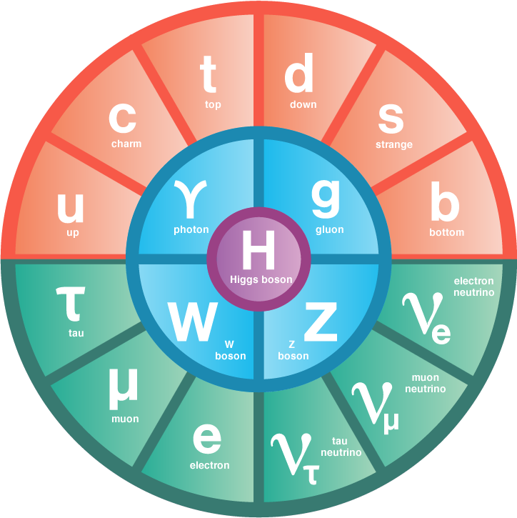
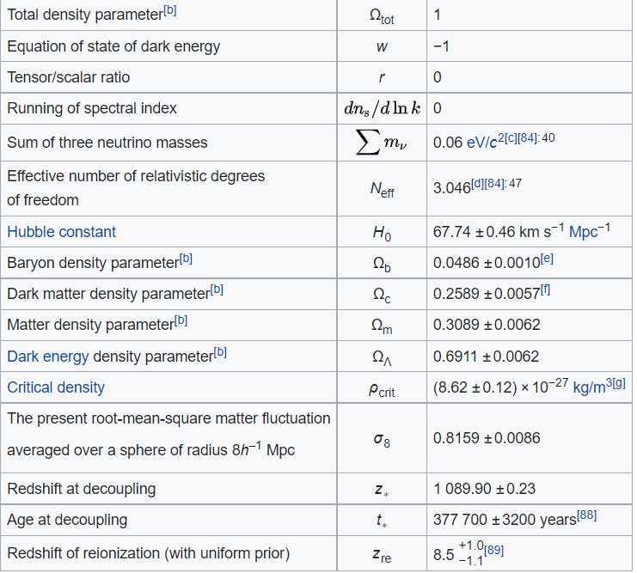
ΛCDM
Standard model of cosmology

Slide 3
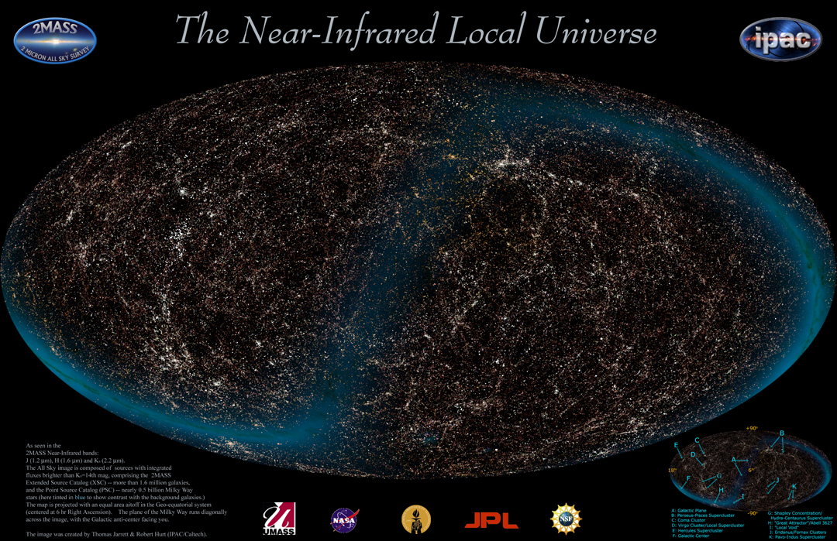
CMB
(Picture 2MASS Large Scale Survey)
(Picture from Planck collaboration)

Slide 4
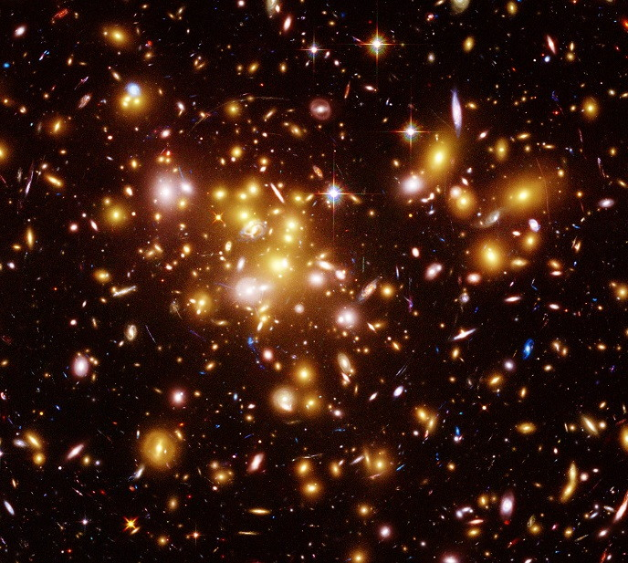
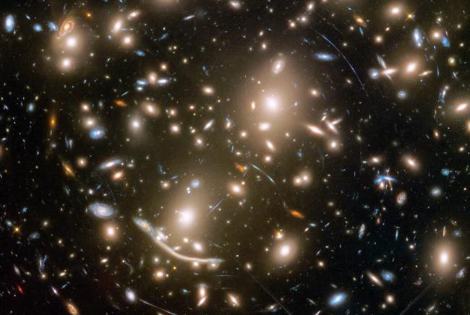
Galaxy clusters and weak lensing
Structures with the largest scale in the Universe
Their mass can be found using weak lensing

Slide 5
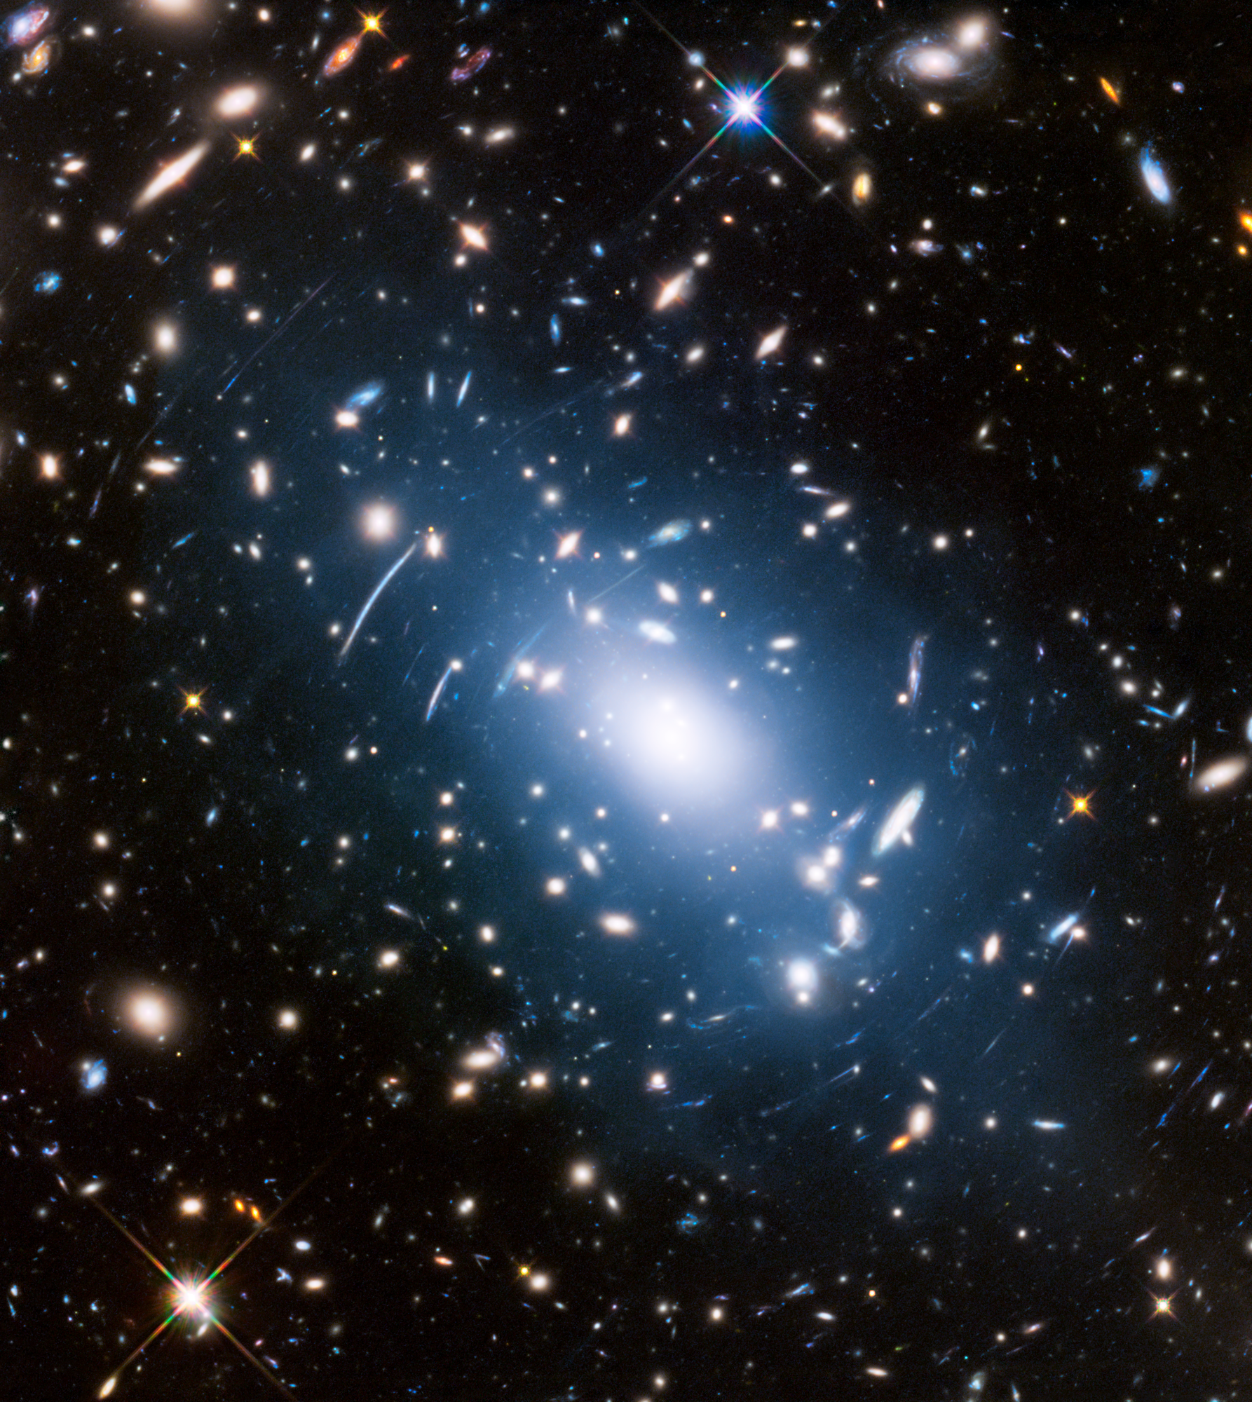
Cluster Cosmology
In 2020, the DES cluster group measured $Ω_{m}=0.2.$
References
Abbott, T. M. C., and others. "Dark Energy Survey Year 1 Results: Cosmological constraints from cluster abundances and weak lensing".Phys. Rev. D 102, no.2 (2020): 023509.
Frieman, Joshua, Michael, Turner, and Dragan, Huterer. "Dark Energy and the Accelerating Universe".Ann. Rev. Astron. Astrophys. 46 (2008): 385–432.
Costanzi, Matteo, Francisco, Villaescusa-Navarro, Matteo, Viel, Jun-Qing, Xia, Stefano, Borgani, Emanuele, Castorina, and Emiliano, Sefusatti. "Cosmology with massive neutrinos III: the halo mass function and an application to galaxy clusters".JCAP 12 (2013): 012.

