Slide 1
DUNE workflows on the EAF for analyzing data from ProtoDUNE-II
Lewhat Aylay
SIST 5 Minutes/5 Slides
Supervisor: Mike Kirby, Kenneth Herner, Andrew Norman
15 June 2022

Slide 2
DUNE
The Deep Underground Neutrino Experiment (DUNE)
Science goals:
Search for the origin of matter
Learn more about neutron stars and black holes
Shed light on the unification of nature’s forces
DUNE Computing
Global and Collaborative
15 Storage sites
36 Computing sites
https://lbnf-dune.fnal.gov
https://computing-wiki.dunescience.org/wiki/Main_Page

Slide 3
Objectives and Goals
Identifying a DUNE workflow to serve as a representative candidate for workflows that are expected to be run by individuals analyzing data from ProtoDUNE-II.
Adapt the workflow to run on the Elastic Analysis Facility.
Port the current code to the new platform(C++ to Python).
Develop metrics to evaluate the performance of the workflow on the EAF.
Test and characterize the performance of the workflow.
Metrics: Resource consumptions, ease of use, etc.
Document the results.

Slide 4
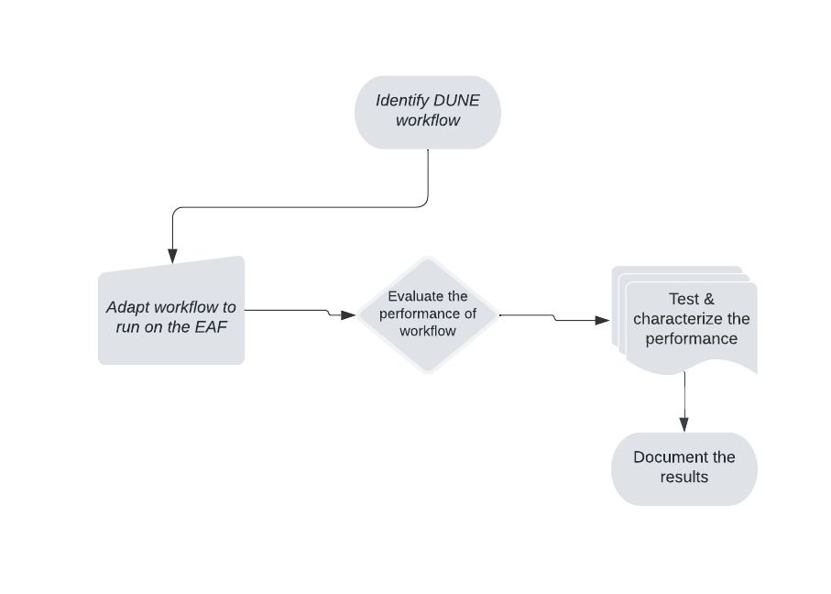
Objectives and Goals continued
Create relevant documentation
For users analyzing data
Distribute the new environment
Testing and feedback within DUNE

Slide 5
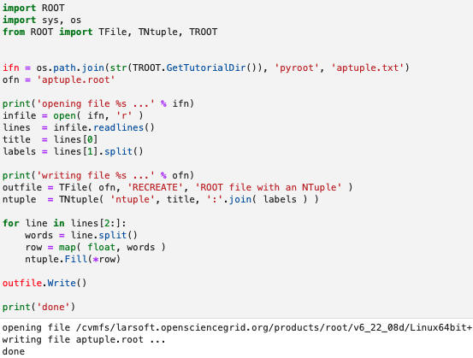
Project Progress
Setting up the Python environment
Verifying everything works correctly
Command line Python
Notebook
Using PyROOT
Allows the creation of bindings between Python and C++
Dynamic and automatic way
Proving that the building works on the environment

Slide 6
Thank You

