Slide 1
Gravity Offload Fixture for PIP-II 5 Min 5 Slides
Lilly Herbst
Supervisor: Curtis Baffes
AD Mechanical Support Department
SIST Internship 2022

Slide 2
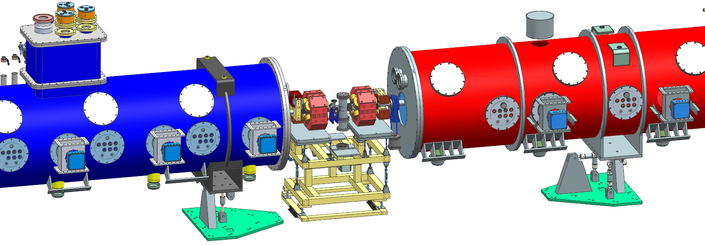
PIP-II Project
PIP-II will enable the world’s most intense beam of neutrinos to the international LBNF/DUNE project, and a broad physics research program, powering new discoveries for decades to come.
Notes:
Superconductor accelerator cavities (0 electrical resistance) –very cold temperatures- 22 cryomodules

Slide 3
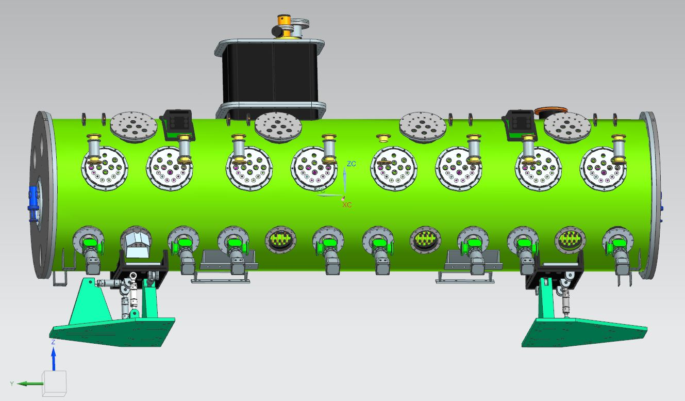
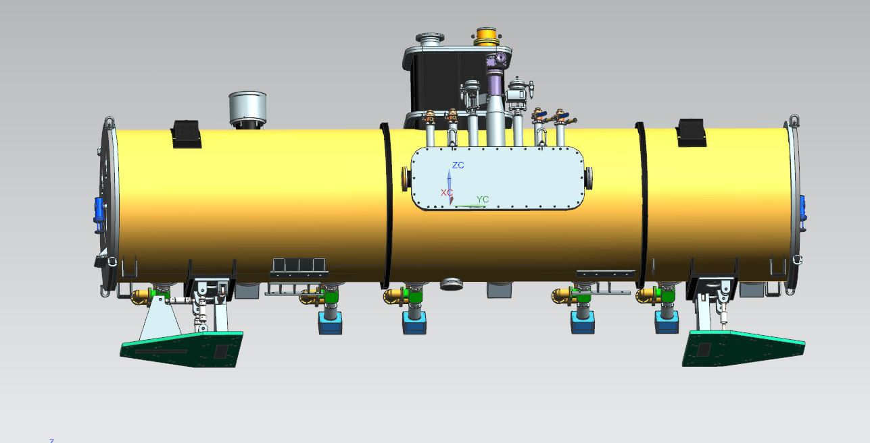
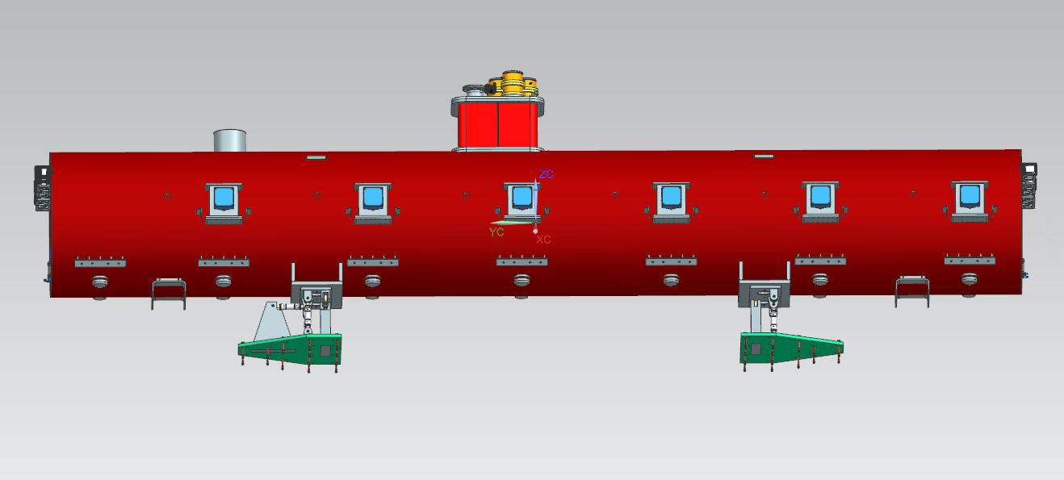
Purpose and Placement
Carries some of the vertical load on each cryomodule making the struts easier to adjust for final alignment.
SSR1
SSR2
LB650
HB650
Notes:
22 cryomodules will be installed manually by rolling the cryomodule down the linac aisle. They will be transversely shifted into their assigned spot. My project is to design a gravity offload tool that will carry some of the vertical load while the vertical struts are being adjusted for final alignment. As shown, each cryomodule has 2 stands, one upstream which has 2 vertical struts and the downstream stand has one.

Slide 4
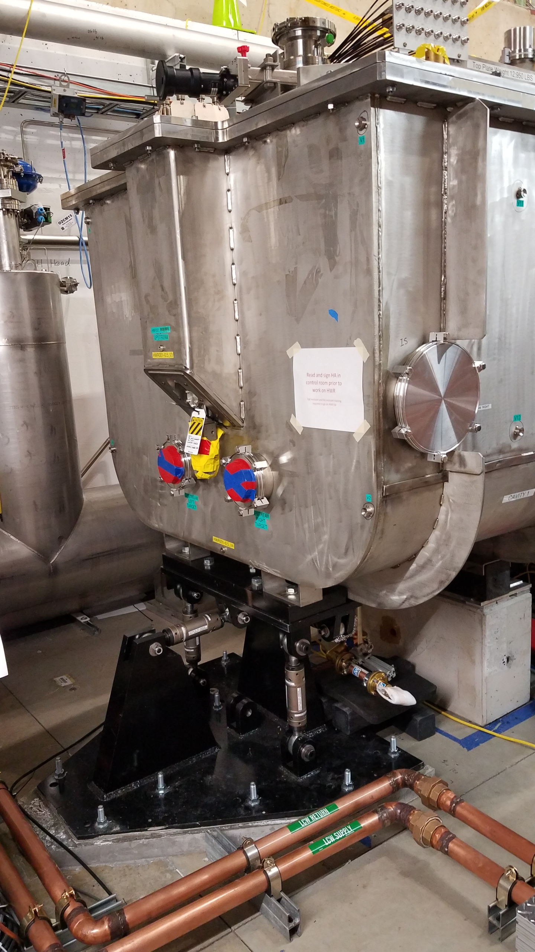
Requirements
Must adjust vertically
Ability to be removed after use
Material capable of carrying a load before 60% plastic deformation
Corrosion & water resistant
Ability to be used in each cryomodule type
Notes:
Pictured on the right is an example of the cryomodule stands previously used at PIP-II IT. The team gained experience to develop offloader requirements –list in prioritized order-

Slide 5
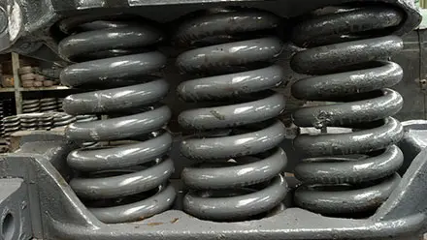
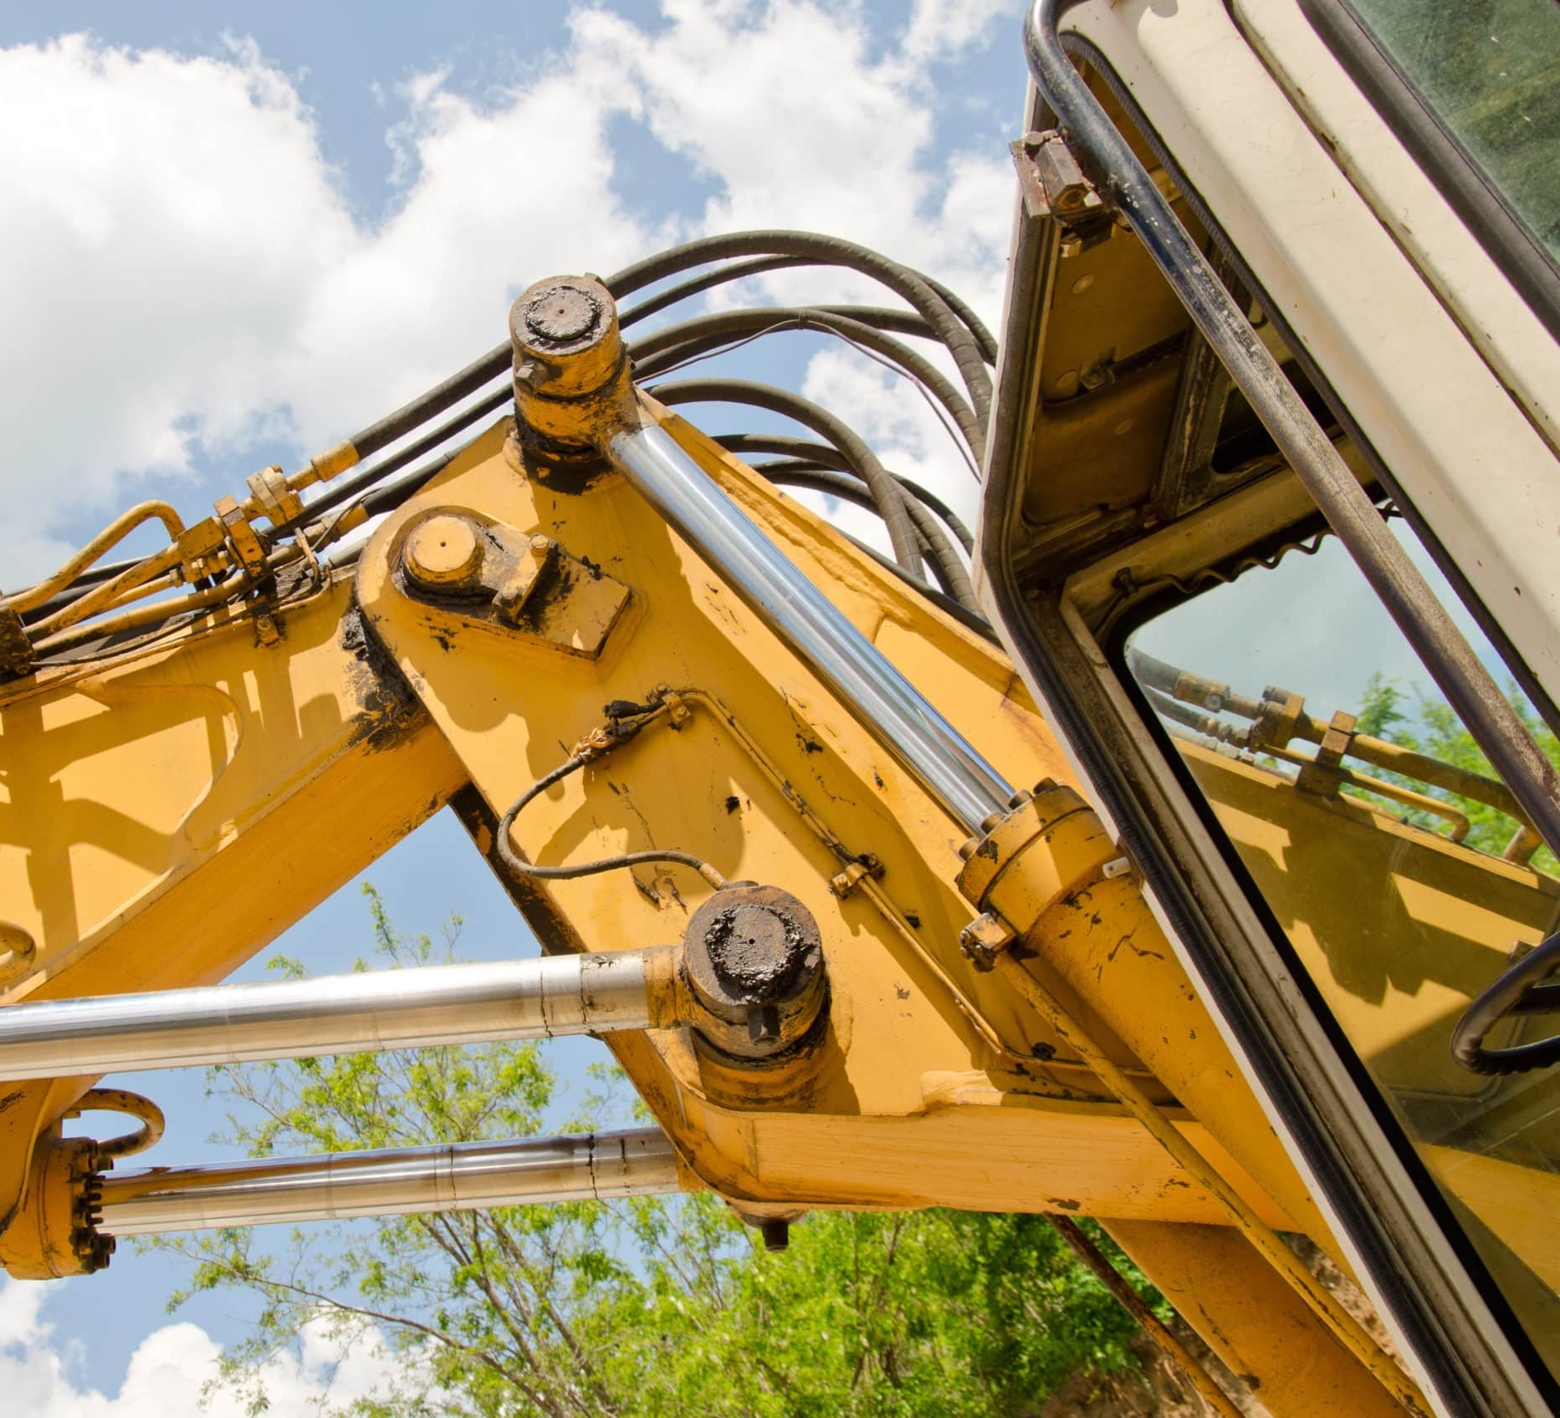
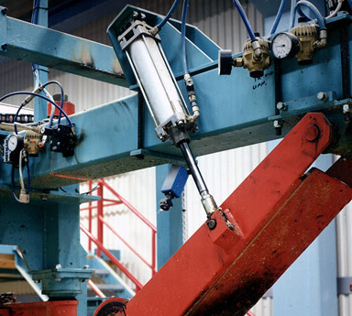
Potential Solutions
System with springs
Hydraulic cylinders
Pneumatic cylinders

