Slide 1
SPT-SLIM Electronics Rack & Detector Forecasting
Achintya Krishnan
Supervisor: Adam Anderson
SIST 2022: 5 minutes/5 slides Talk
June 17th, 2022

Slide 2
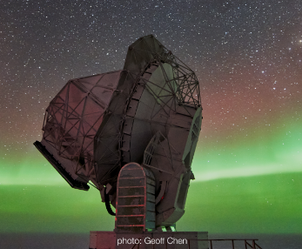
SPT Background
10-meter diameter telescope
Previous & Current Experimental History
SPT-SZ (2007-2011)
SPTpol (2012-2016)
SPT-3G (2017-present)
Key Upcoming Experiments
SPT-SLIM (planned to deploy around 2023-2024 austral summer)
SPT-3G+ (planned to deploy around 2025)
Predominantly makes observations in mm & sub-mm wavelength regions of EM spectrum (Far-IR & Microwave)
Focuses primarily on CMB measurements
e.g. Angular power spectrum (in polarization & temperature), Sunyaev-Zel’dovich effect, etc.
Exception: SPT-SLIM
South Pole Telescope (SPT)
Amundsen-Scott South Pole Station, Antarctica

Slide 3
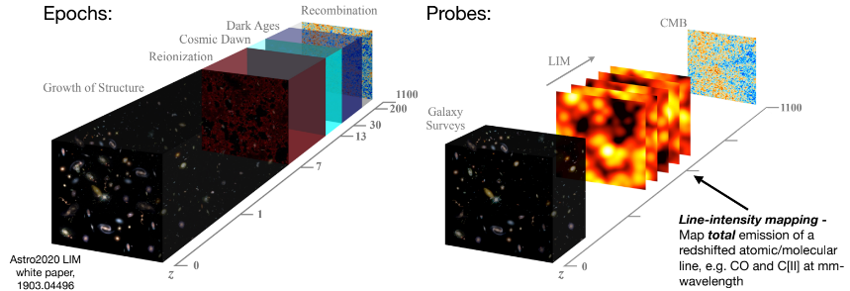
Line Intensity Mapping (LIM)
Measures redshifts of particular atomic or molecular emission line(s) from various sources
Can create 3-D map of source locations (i.e. large-scale structure of universe)
More efficient in making high-redshift observations (over large cosmological volumes) than galaxy surveys
Significant redshift range (z > 3) relatively unexplored due to inefficiencies of surveys in this exercise
Typically, surveys that can detect high-redshift galaxies restricted to small survey areas
Should further understanding of multiple cosmological parameters in $ΛCDM$ model
Sum of neutrino mass states, parameters governing expansion history of universe, etc.

Slide 4
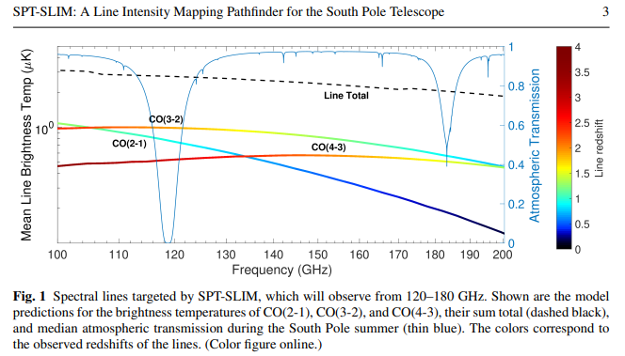
SPT-SLIM Background
South Pole Telescope Summertime Line Intensity Mapper
Will target CO J→J-1 rotational transitions redshifted to between 120-180 GHz
Commonly found in dense molecular clouds and therefore serve as useful “tracer” of matter
Similar frequencies to current CMB observations made by SPT-3G camera
Serve as proof of concept for future LIM experiments (i.e. when technology better equipped to measure greater redshifts)
Relatively new: many different experiments with different emission lines!!
Useful to determine advantages & disadvantages of each experimental “choice”

Slide 5
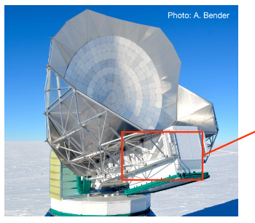
SPT-SLIM Electronics Rack: Purpose, Location, & Constraints
Purpose
Houses various electronics components necessary for SPT-SLIM experiment
Examples:
Uninterruptable power supply (UPS)
Pulse tube cooler (PTC) linear driver
Adiabatic demagnetization refrigerator (ADR) magnet’s power supply
Location
Mounted to interior walls of SPT Cabin
Constraints
Cabin ROTATES with telescope
Rack needs to be firmly secured via custom-machined “mounting structures”
Interior of cabin cramped
Weight (of components + rack itself)
External view of SPT & cabin
SPT Cabin

Slide 6
SPT-SLIM Electronics Rack: Orientation Within SPT Cabin
Cross-section view of SPT cabin (in SolidWorks) showing where SPT-SLIM electronics rack will be mounted

Slide 7
SPT-SLIM Electronics Rack: Rough Geometry
SolidWorks model of SPT-SLIM electronics rack without connecting components (e.g. fasteners, screws, etc.) & mounting structures

Slide 8
What’s Next?
Previous signal-to-noise prediction made using limited model of SPT-SLIM experimental setup
*Note: Wavenumber (h/Mpc) given on horizontal axis
SPT-SLIM Electronics Rack
Incorporate connecting components & mounting structures into SPT-SLIM electronics rack SolidWorks assembly file
Test design’s rigidity under various load conditions
Devise installation scheme
How to “lift” rack into SPT cabin
Order necessary parts & construct IRL
Next Project
Revise signal-to-noise forecasts of CO emission lines given updated SPT-SLIM experimental configuration

