Slide 1
Comparison of Electron and Neutrino Scattering Properties under GENIE Neutrino Event Generator’s Models
Yuqian “Lily” Li
Supervisor: Minerba Betancourt
5 min 5 slides
Jun 17th 2022

Slide 2
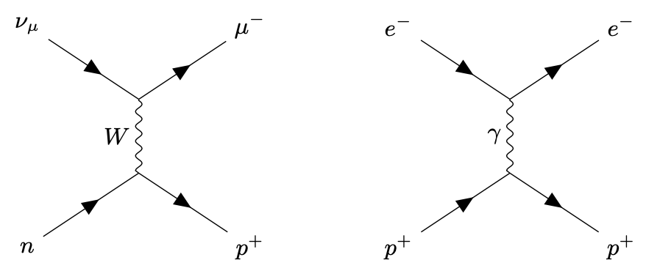
Neutrino Cross-section Measurements with Electron Scattering Data Constrain
Accurate neutrino cross-section measurements and modeling of nuclear effects are required for precise measurements of neutrino oscillation physics.
However, interaction uncertainty will limit future oscillation experiment.
Since neutrino beams are hard to form and measure, we propose using electrons to verify these models.
  e & 𝜈 interact similarly
  Many nuclear effects are identical
  e beam energy is known, can test energy reconstruction.
FIG. 1. The Feynman diagram for an idealized CCQE(Quasi-elastic scattering on nucleons) scattering event for a muon neutrino (left) and electron (right).
Notes:
We want to study neutrino properties by examine how they behave while colliding with element protons. However, since accurate neutrino cross-section measurements and modeling of nuclear effects requires precise measurements of neutrino oscillation physics, we encounter

Slide 3
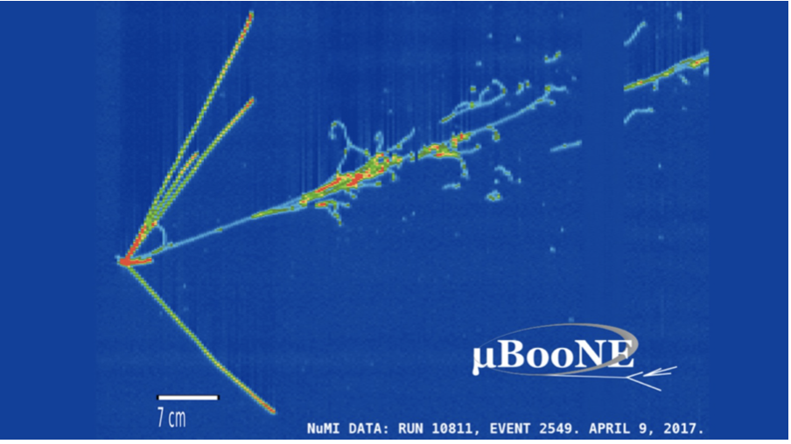
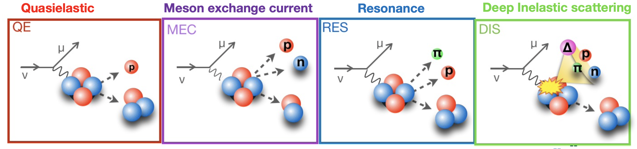
Neutrino-proton scattering is complicated
We tried to make cuts to separate the inelastic scattering using The GENIE Neutrino Monte Carlo Generator.
We will be able to compare the electron model and neutrino model of the inelastic scattering and find sequence and shared characteristics.

Slide 4
Methodology- Electron and Neutrino Scattering Channels Comparisons of Carbon12
QEL cut (C12)
ROOT is very flexible and provides both a programming interface to use in own applications and a graphical user interface for interactive data analysis.
By remodifying the code, we are able to generate histograms of different properties of the electron and neutrino scattering.
  Primary Lepton Momentum
  Proton Momentum
  Proton Angle
  Primary Proton Transverse Momentum
  …….
Entries
Primary Lepton Momentum [GeV]
Comparison of Electron and Neutrino Scattering Properties under GENIE Neutrino Event Generator’s Models

Slide 5
Neutrino scattering interacting with different target material protons
Comparison of Electron and Neutrino Scattering Properties under GENIE Neutrino Event Generator’s Models

Slide 6
Thank you for listening!
Comparison of Electron and Neutrino Scattering Properties under GENIE Neutrino Event Generator’s Models

