Slide 1
GEM 5 min 5 slide: High Pressure Rinsing of Accelerator Cavities
Trey Brown
Supervisors: Cristian Boffo and Vijay Chouhan

Slide 2
PIP-II
Linac energy increased from 0.4 GeV to 0.8 GeV
Energy of Neutrinos delivered to DUNE increased from 0.75 MW to 1.2 MW

Slide 3
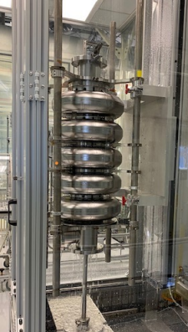
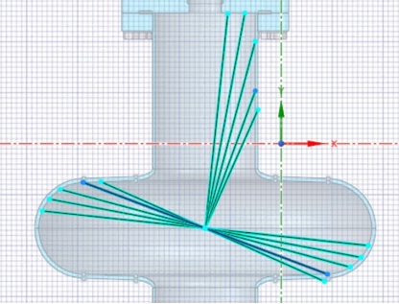
The Problem
Particle contaminants in the cavity act as electron field emitters, limiting performance
Use High Pressure Water Rinse (HPR) to remove particle contaminants
What is the most effective nozzle for cleaning the cavities?

Slide 4
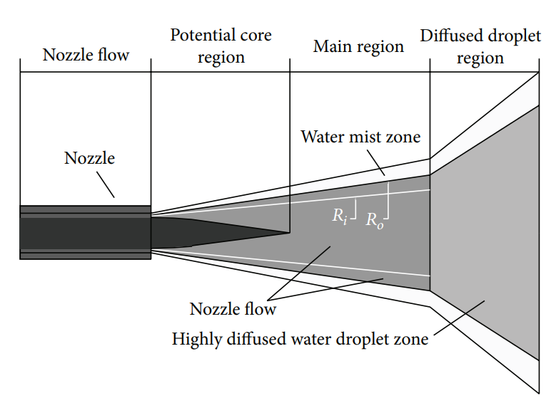
High Pressure Nozzles
[1] Shuce Zhang, "Structure Optimization and Numerical Simulation of Nozzle for High Pressure Water Jetting"
[2] M. C. Leu, “Mathematical modeling and experimental verification of stationary waterjet cleaning process,”

Slide 5
Preliminary Results
Operating pressure is 1250 psi.

Slide 6
Next Steps
Evaluate pressure on cavity wall
Find trends in relationship between orifice design and spot size
Evaluate static pressure and wall shear profiles on the impinging wall with different nozzles at different spray-wall angles

