Slide 1
Resonance Control at FAST using NNs
Silvia Peiro
Supervisors: Jinhao Ruan and Auralee Edelen
SIST/GEM 5 Mins/5 Slides
6/12/2022

Slide 2
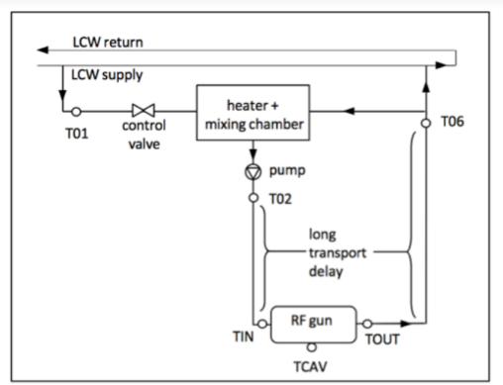
Background
A NN consists of a collection of functions with weighted connections between them.
System used to regulate the resonant frequency of the electron gun at the Fermilab Accelerator Science and Technology
How does it work?
Controllable variables:
Flow control valve setting (FVC)
Heater power setting (HP)
Figure 1: Water System with Indicated Controllable Variables

Slide 3
Why should we apply NN-based control methods?
Large thermal and transport time constants produce long variable time delays
Figure 2: Large time constants locations

Slide 4
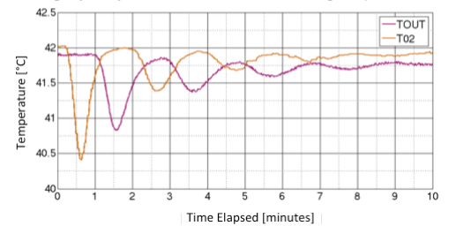
Why should we apply NN-based control methods?
Large thermal and transport time constants produce long variable time delays
Recursive behavior in the cooling system
Figure 3: Oscillatory loop in response of recursive behavior
Figure 4: Recursive Behavior

Slide 5
Why should we apply NN-based control methods?
Large thermal and transport time constants produce long variable time delays
Recursive behavior in the cooling system
Fluctuations in the low conductivity water (LCW) supply temperature
+-0.5ºC

Slide 6
Why should we apply NN-based control methods?
Large thermal and transport time constants produce long variable time delays
Recursive behavior in the cooling system
Fluctuations in the low conductivity water (LCW) supply temperature
Changes between TIN and T02 without a registered change in the ambient temperature
Figure 5: T02 and TIN indicated in water system

Slide 7
Why should we apply NN-based control methods?
Large thermal and transport time constants produce long variable time delays
Recursive behavior in the cooling system
Fluctuations in the low conductivity water (LCW) supply temperature
Changes between TIN and T02 without a registered change in the ambient temperature
Temperature recorded at TCAV will be higher than the real bulk cavity temperature under RF power
Figure 6: RF and TCAV indicated in water system

Slide 8
Goals
Accurately identify the transport delays
Figure 7: Large time constants locations

Slide 9
Goals
Accurately identify the transport delays
Quantify the combined effects of TOUT, T01, FCV setting, and HP setting on T02 (and subsequently on TIN and TCAV)
Figure 8: Water system with indication of temperature readings affected (red) by temperature and HP values (blue)

Slide 10
Goals
Accurately identify the transport delays
Quantify the combined effects of TOUT, T01, FCV setting, and HP setting on T02 (and subsequently on TIN and TCAV)
Quantify the combined effects of TIN and RF power on TCAV. Also, a model that uses T02 instead of TIN
Figure 9: Water system with indication of temperature readings affected (red) by temperature and RF values (blue)

Slide 11
Goals
Accurately identify the transport delays
Quantify the combined effects of TOUT, T01, FCV setting, and HP setting on T02 (and subsequently on TIN and TCAV)
Quantify the combined effects of TIN and RF power on TCAV
Quantify the impact of ambient temperature on the temperature differences seen within the water system and the cavity
Figure 10: Water system with major areas affected by ambient temperature

Slide 12
Process
Gather Data for the RF gun
Train a model on the new data through
Supervised learning
Auto differentiation
Put model into model predictive control loop to be tested offline
Run model on the gun
✓
Figure 11: Water System

Slide 13
References
Edelen, A. L., Biedron, S. G., Chase, B. E., Edstrom, D., Milton, S. V., & Stabile, P. (2016). Neural Networks for modeling and control of particle accelerators. IEEE Transactions on Nuclear Science, 63(2), 878–897. https://doi.org/10.1109/tns.2016.2543203

